Slide 1

Notes:
L

Slide 2




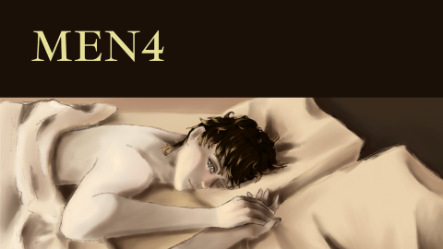
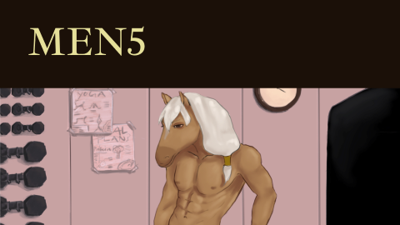
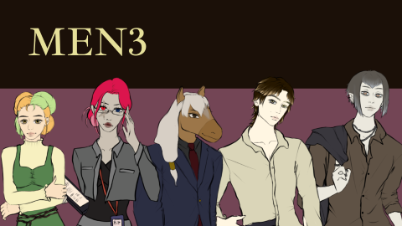
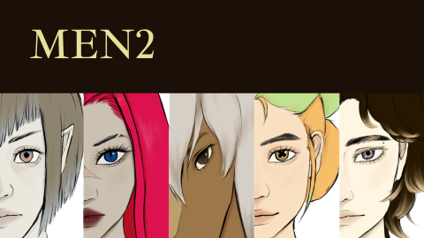
Hearts across Dimensions | DI Mentoring 5. Semester | Angelika Gort & Lukas Bucher | Mentored by Zoe Röllin

Slide 3
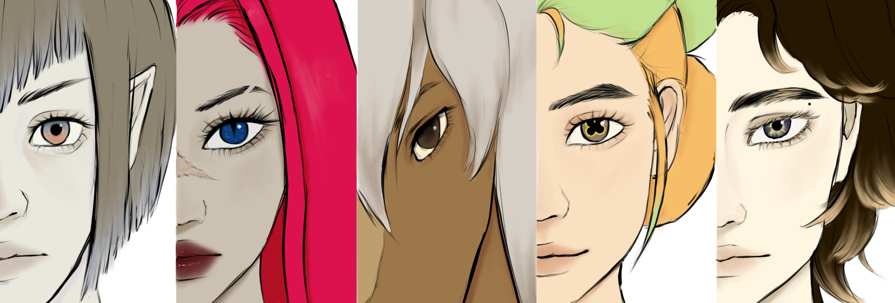
MEN2

Slide 4
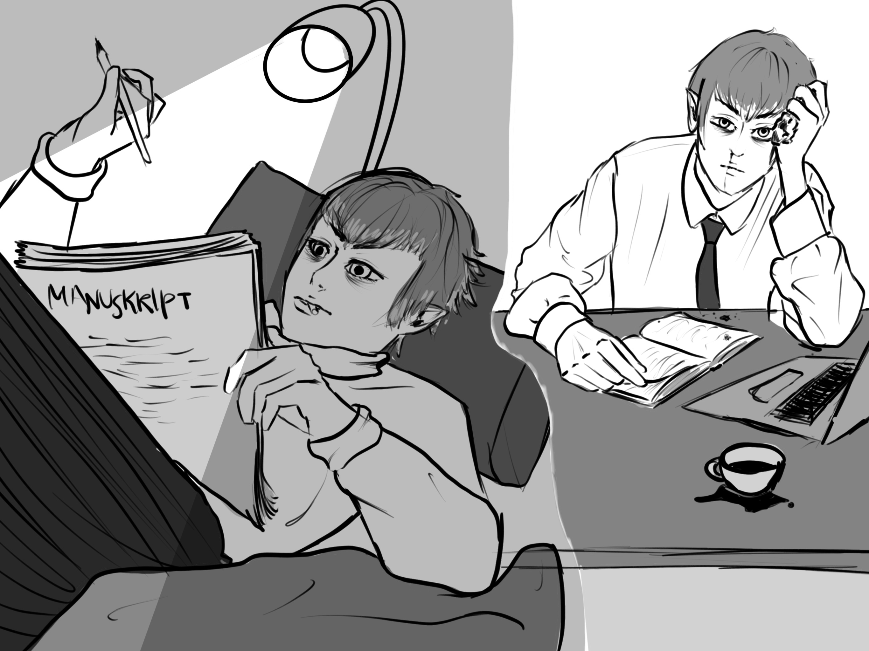
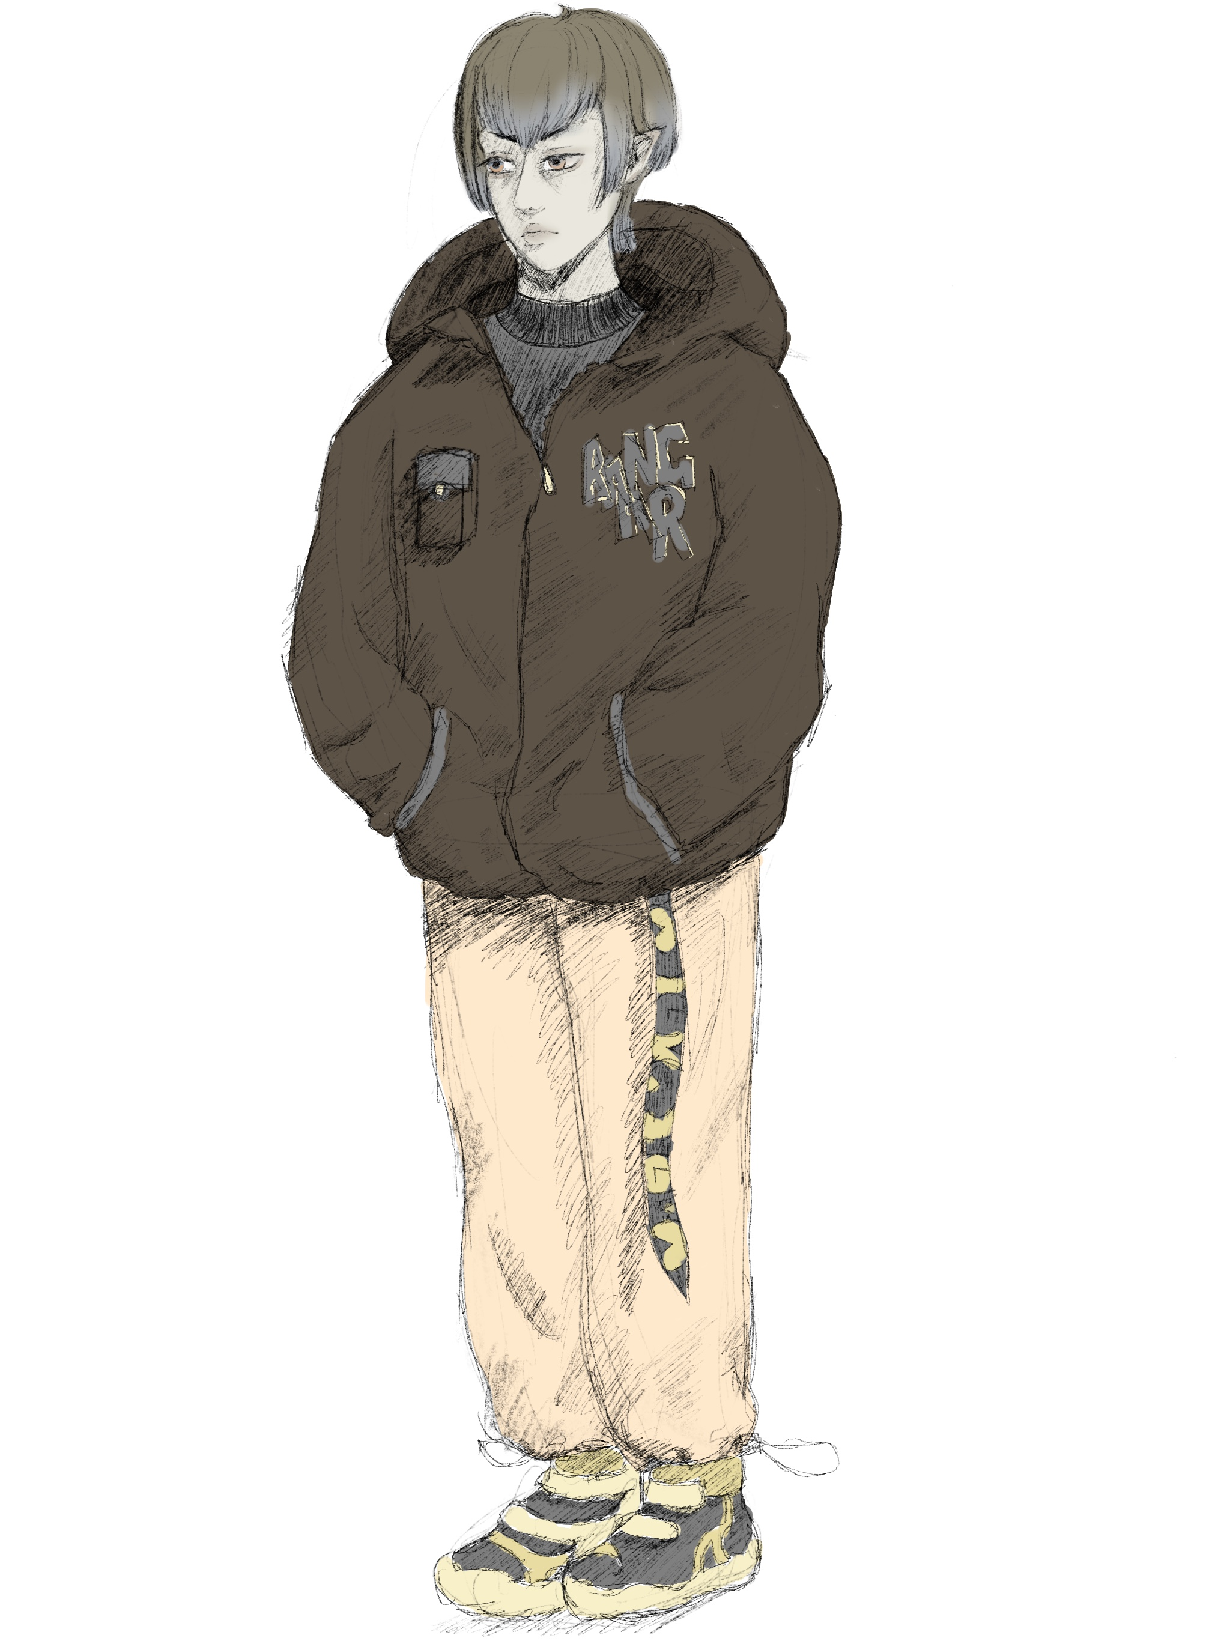
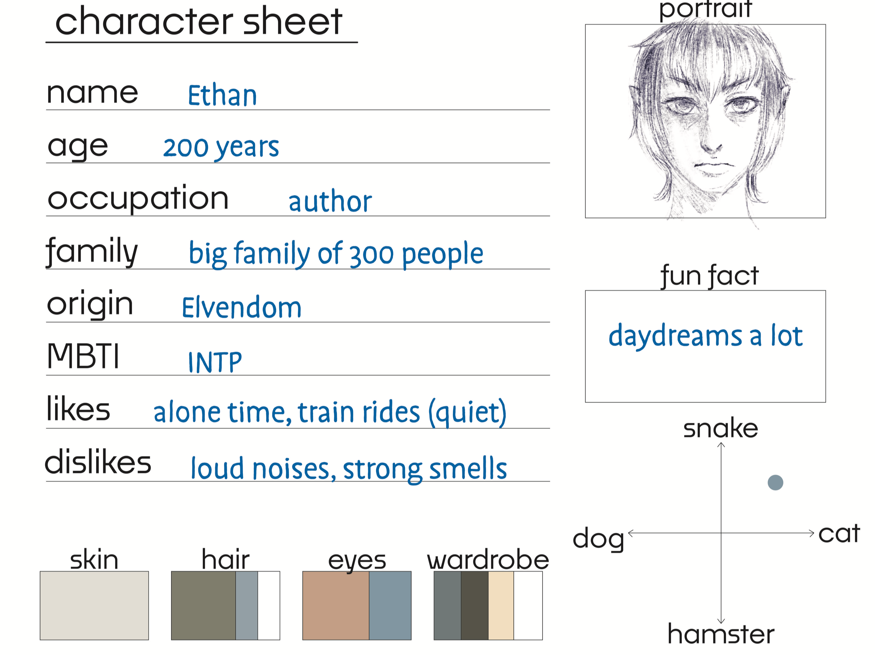
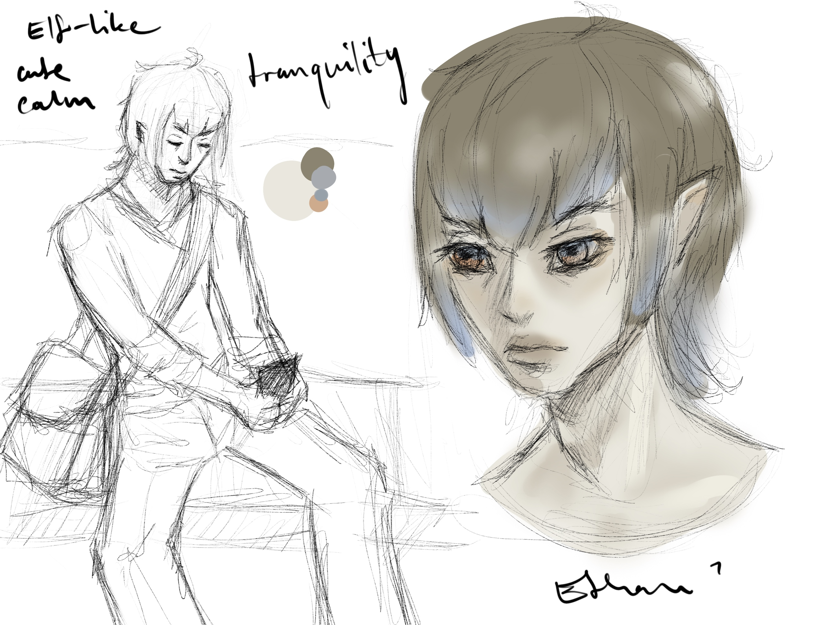
Notes:
A

Slide 5
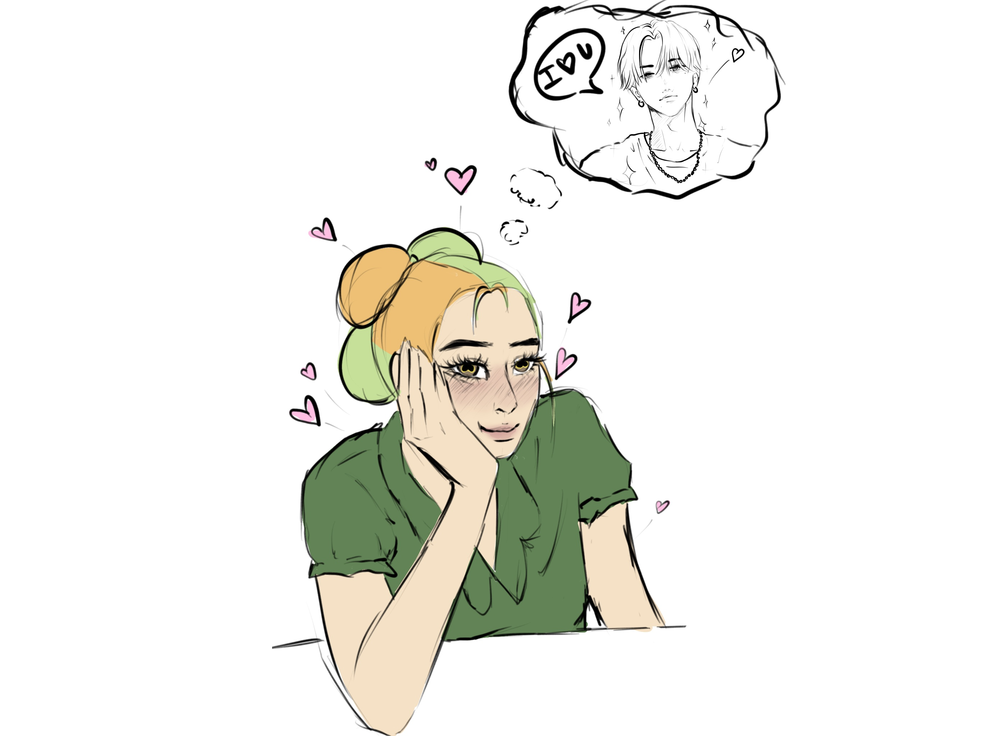
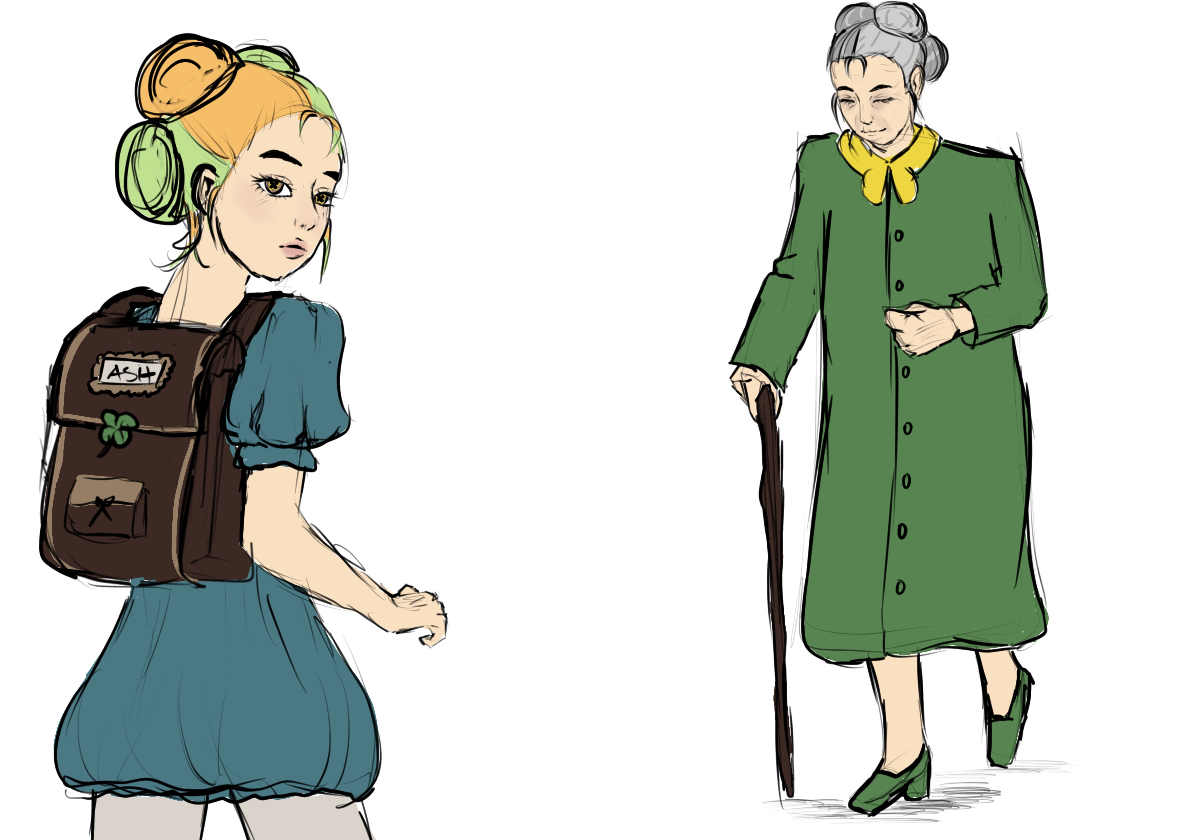
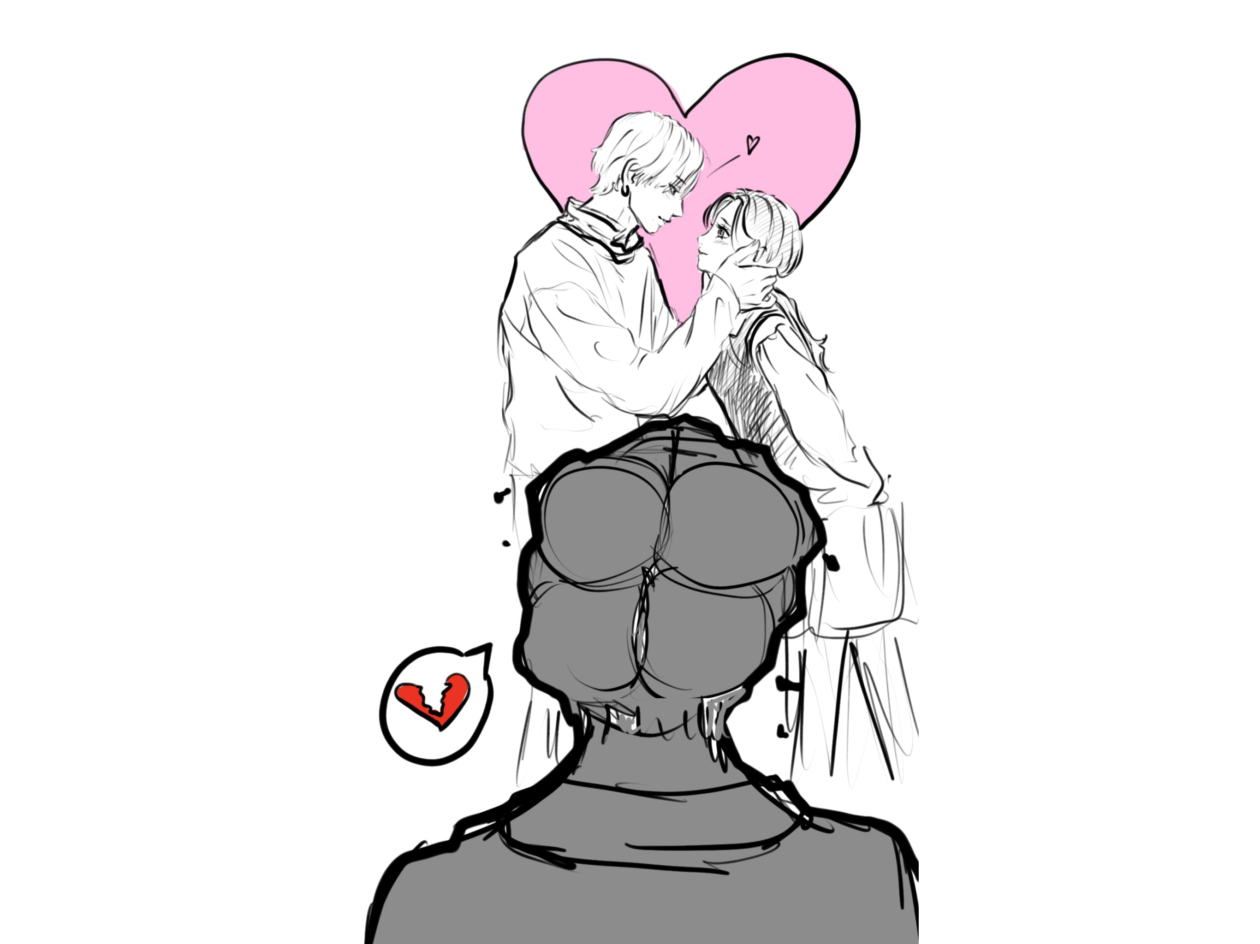
Notes:
A

Slide 6
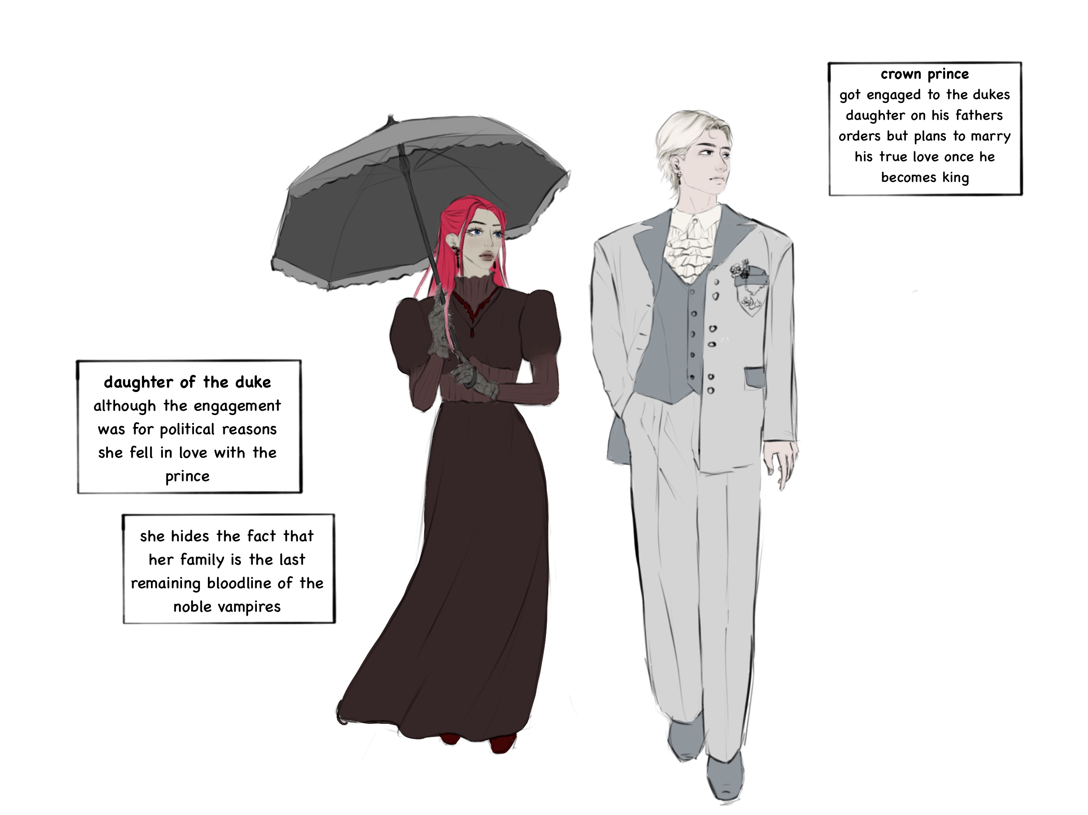
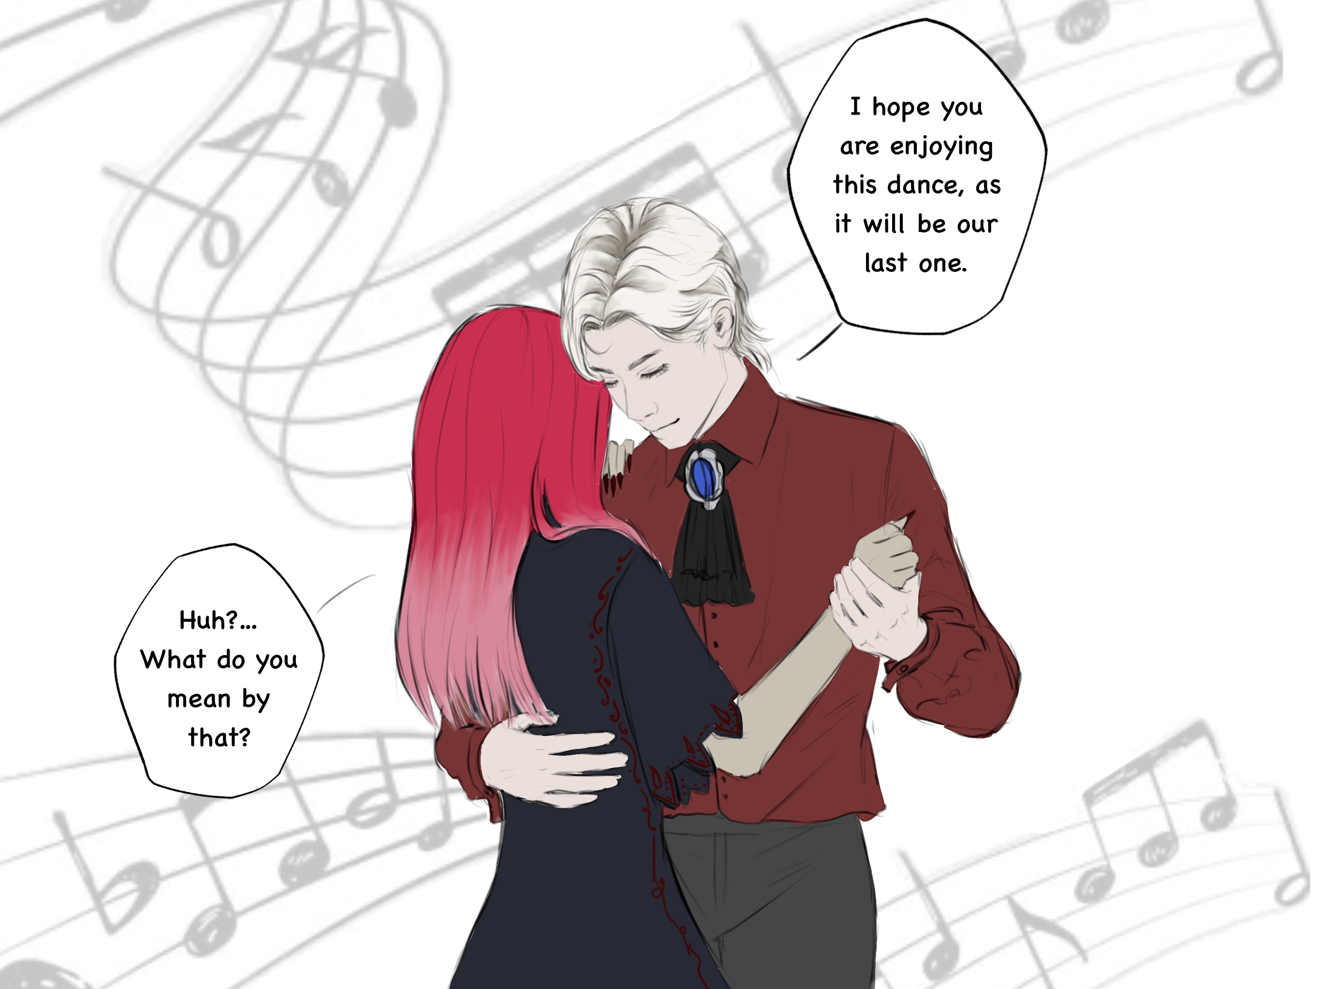
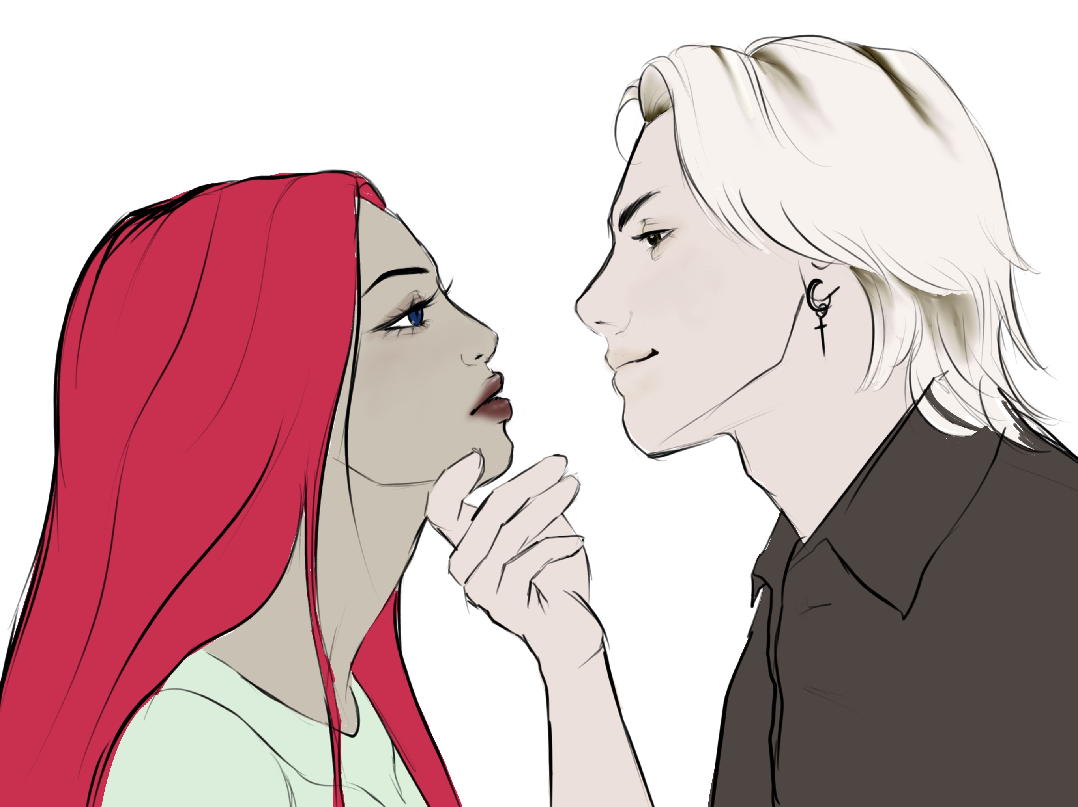
Notes:
A

Slide 7
Hearts across Dimensions | DI Mentoring 5. Semester | Angelika Gort & Lukas Bucher | Mentored by Zoe Röllin

Slide 8
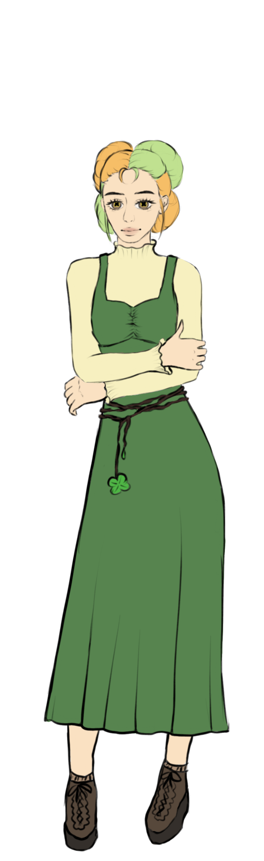
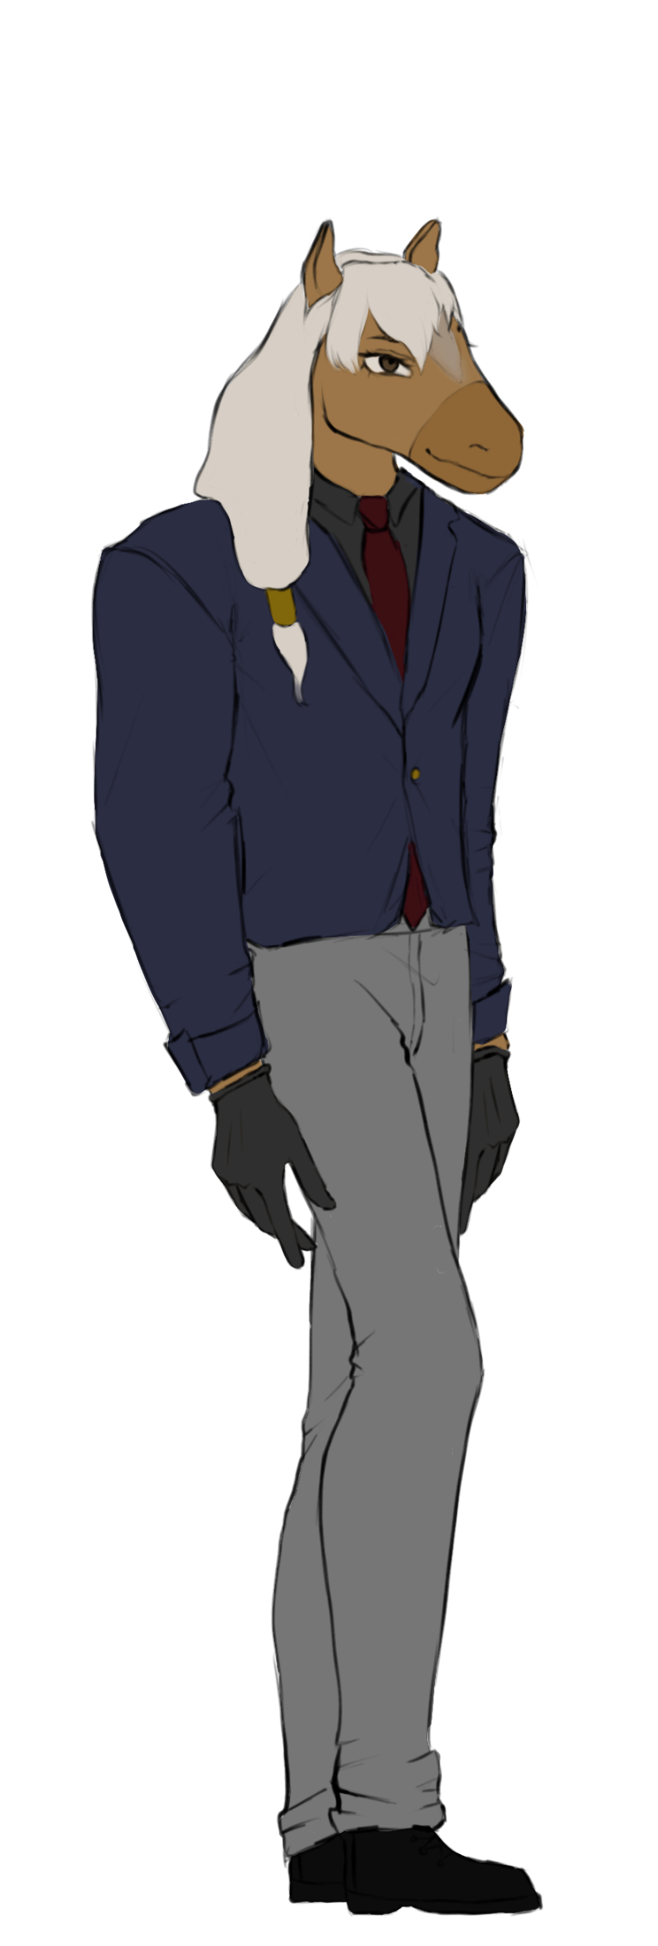
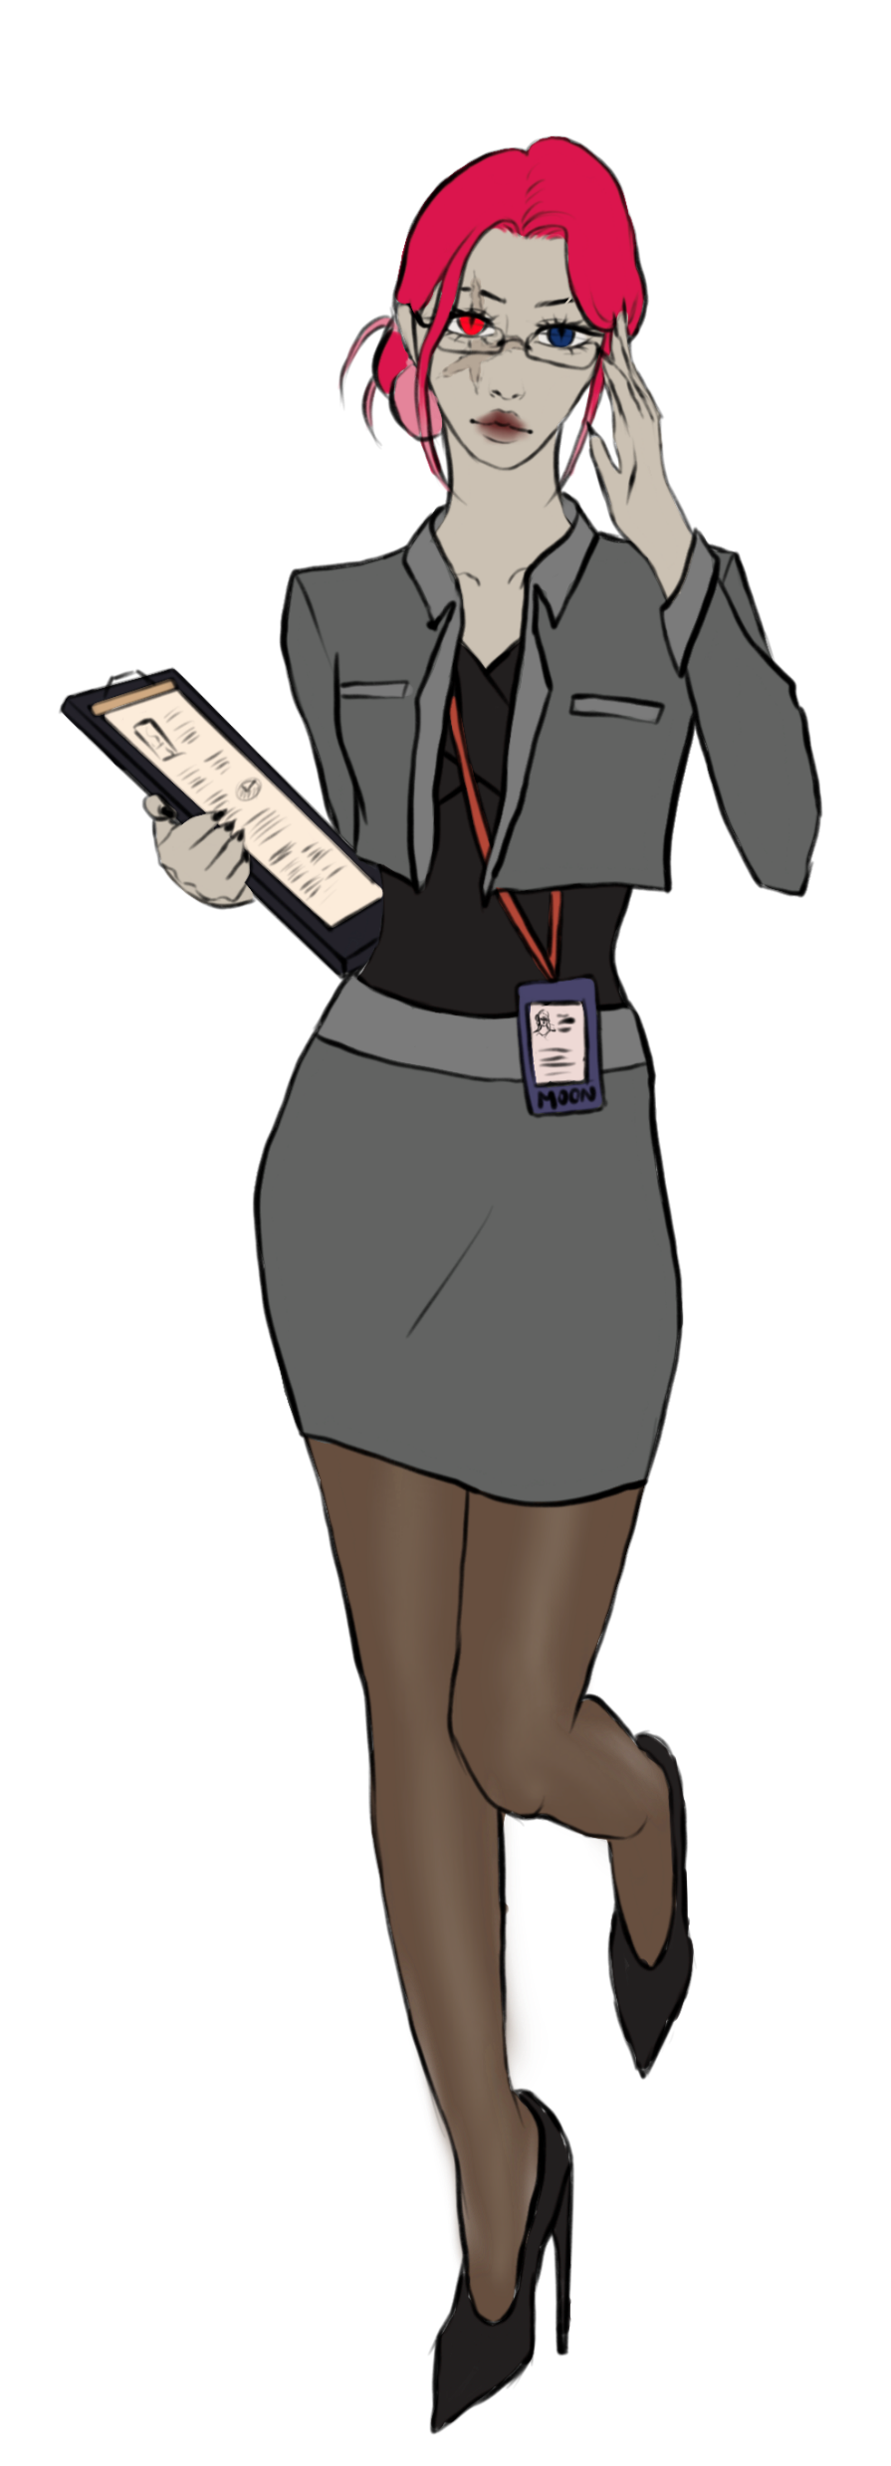
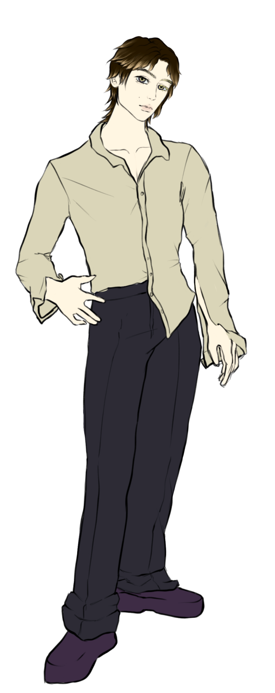
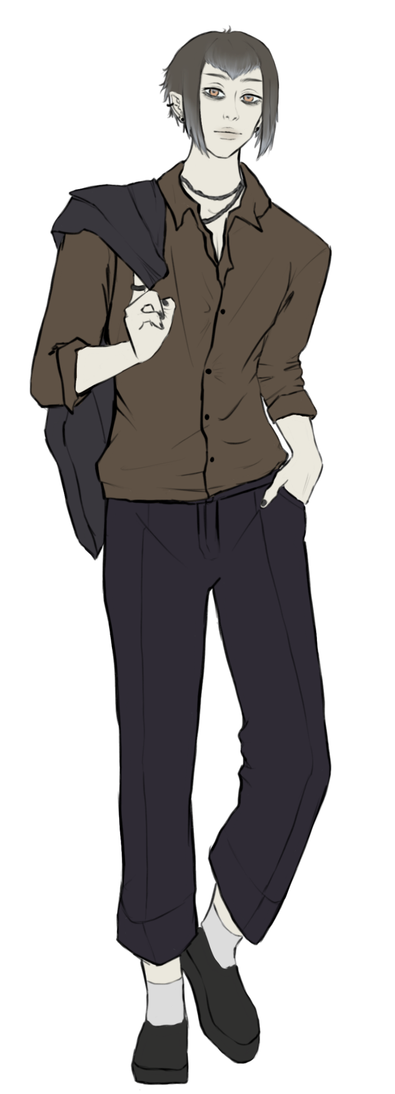
MEN3
Scarlet Moon
Aleph Rei
Ethan
Ash Clover
Mr. Horse

Slide 9
Present
Scarlet Moon
Aleph Rei
Ethan
Ash Clover
Mr. Horse
Notes:
A

Slide 10
Notes:
A

Slide 11
Notes:
A

Slide 12
Notes:
A

Slide 13

#1B1008
#734555
#E1A6B6
#E6E09A
Ibarra Real Nova
#E95487
#E16DA0
#6f4895
Ibarra Real Nova
Notes:
A

Slide 14
Hearts across Dimensions | DI Mentoring 5. Semester | Angelika Gort & Lukas Bucher | Mentored by Zoe Röllin

Slide 15
MEN4

Slide 16
Story structure
Notes:
L

Slide 17
Minigame
Notes:
L

Slide 18
Illustrations
Notes:
L

Slide 19
Illustrations
Notes:
L

Slide 20
Illustrations
Notes:
L

Slide 21
Illustrations
Notes:
L

Slide 22
Illustrations
Notes:
L

Slide 23
Character sprites
Notes:
L

Slide 24
Hearts across Dimensions | DI Mentoring 5. Semester | Angelika Gort & Lukas Bucher | Mentored by Zoe Röllin

Slide 25
MEN5

Slide 26
Plans for MEN5
✦ Backgrounds
✦ All character sprites
✦ All illustrations
✦ Full story?
✦ Polishing based on user feedback
}
Notes:
L

Slide 27
Backgrounds
Notes:
A

Slide 28
Backgrounds
Notes:
A

Slide 29
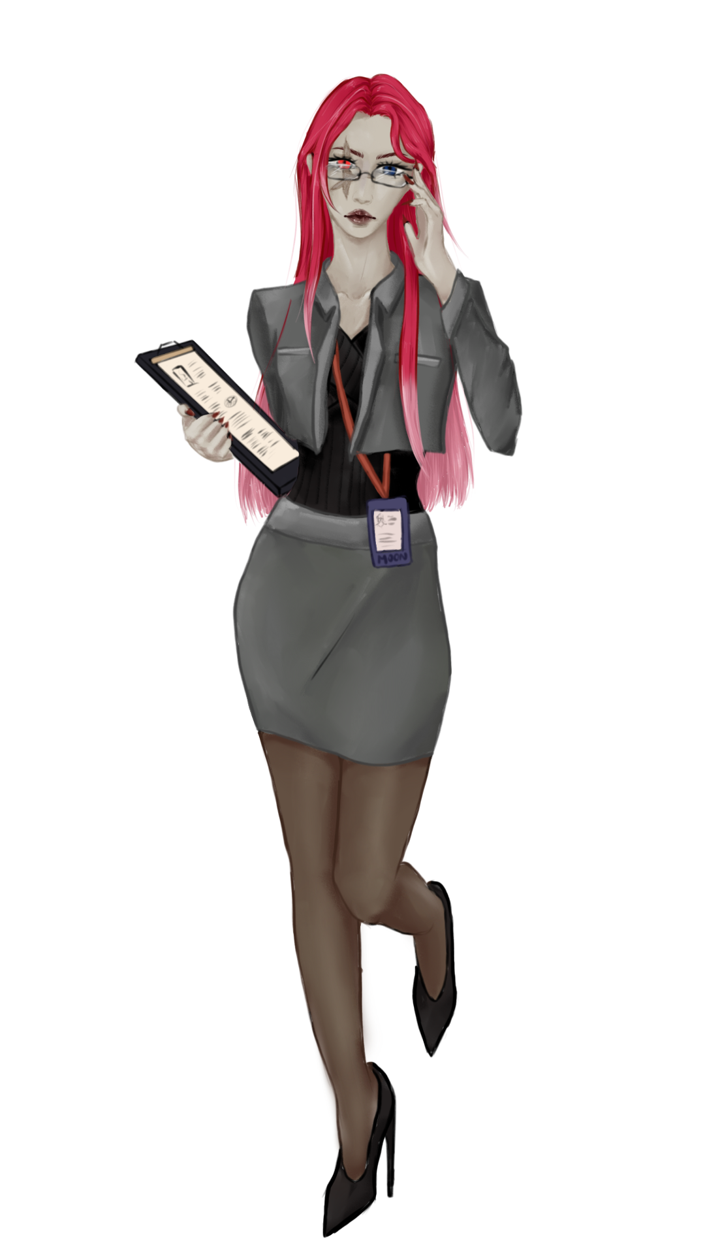
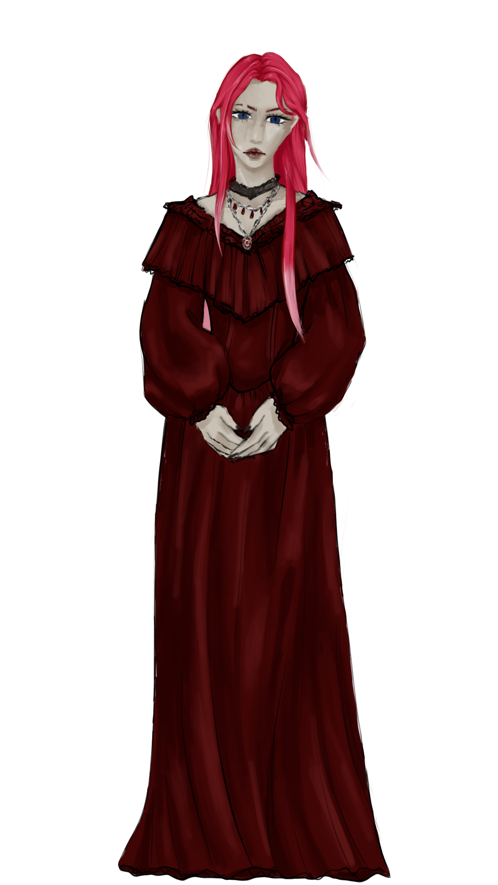
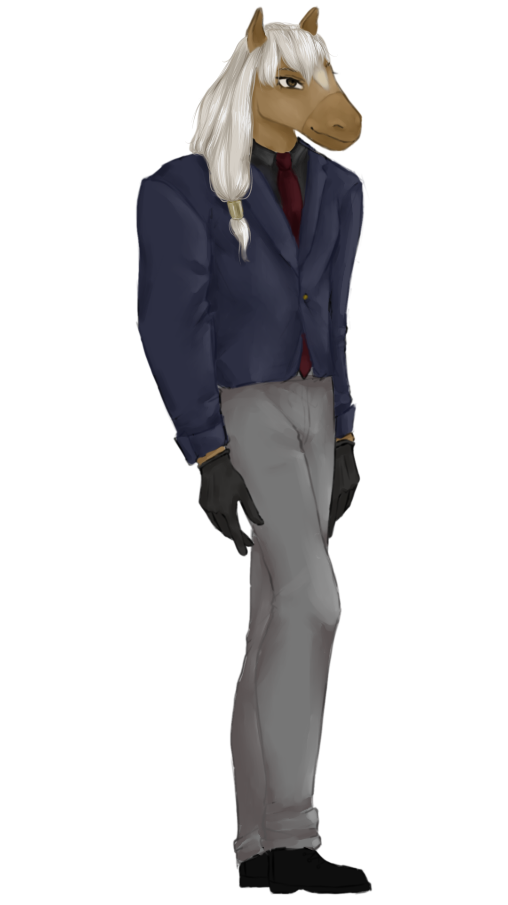
Sprites
Notes:
A

Slide 30
Sprites
neutral
Notes:
A

Slide 31


Sprites
sad
Notes:
A

Slide 32


Sprites
laugh
Notes:
A

Slide 33


Sprites
closed eyes
Notes:
A

Slide 34


Sprites
angry
Notes:
A

Slide 35


Sprites
blush
Notes:
A

Slide 36


Sprites
cheeky
Notes:
A

Slide 37


Sprites
smile
Notes:
A

Slide 38


Sprites
surprised
Notes:
A

Slide 39
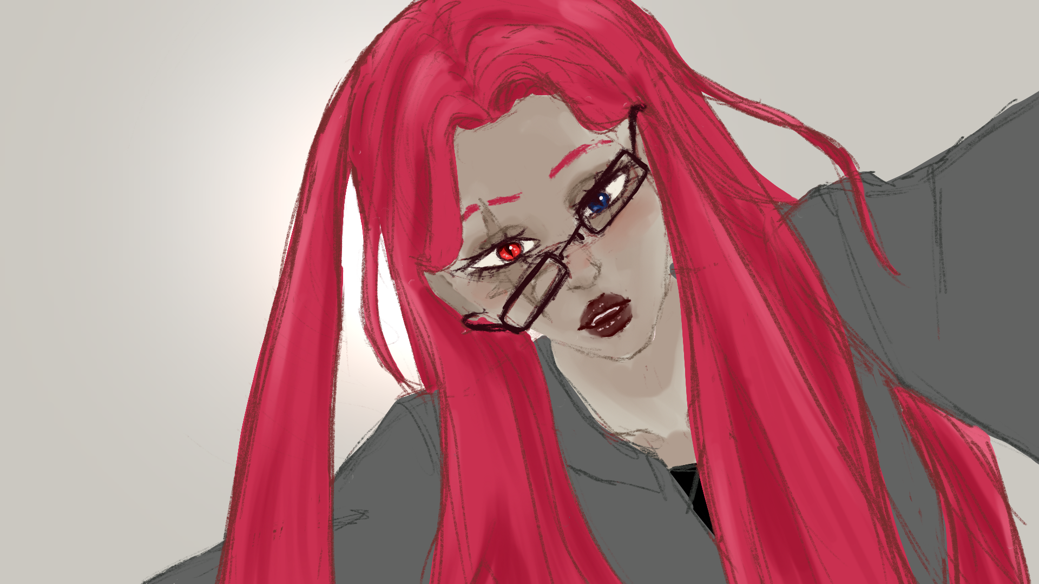
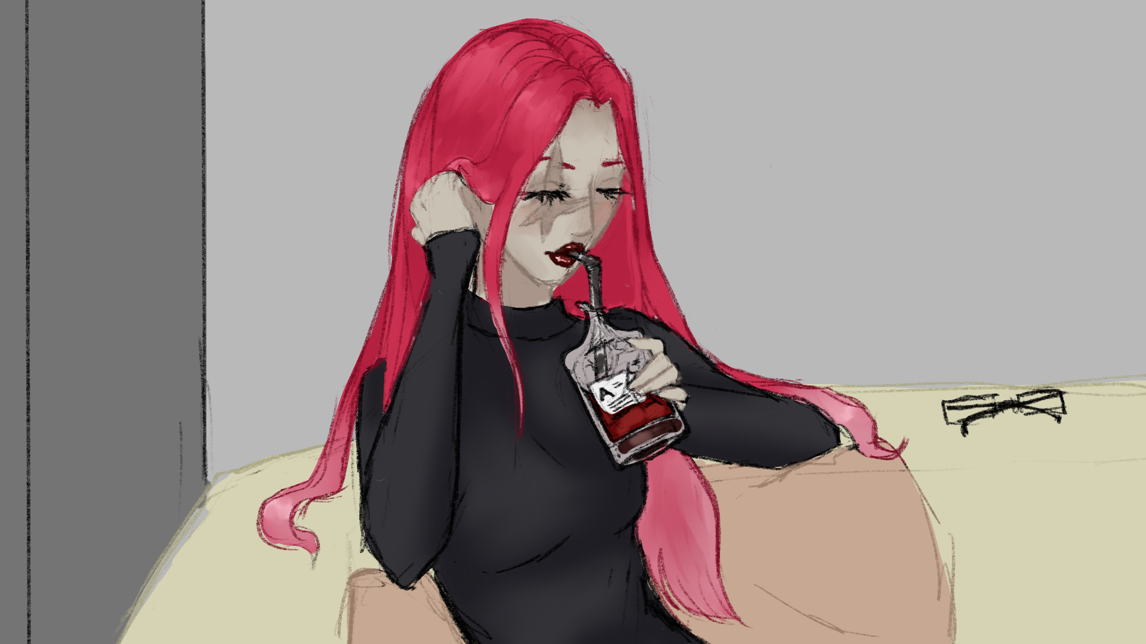
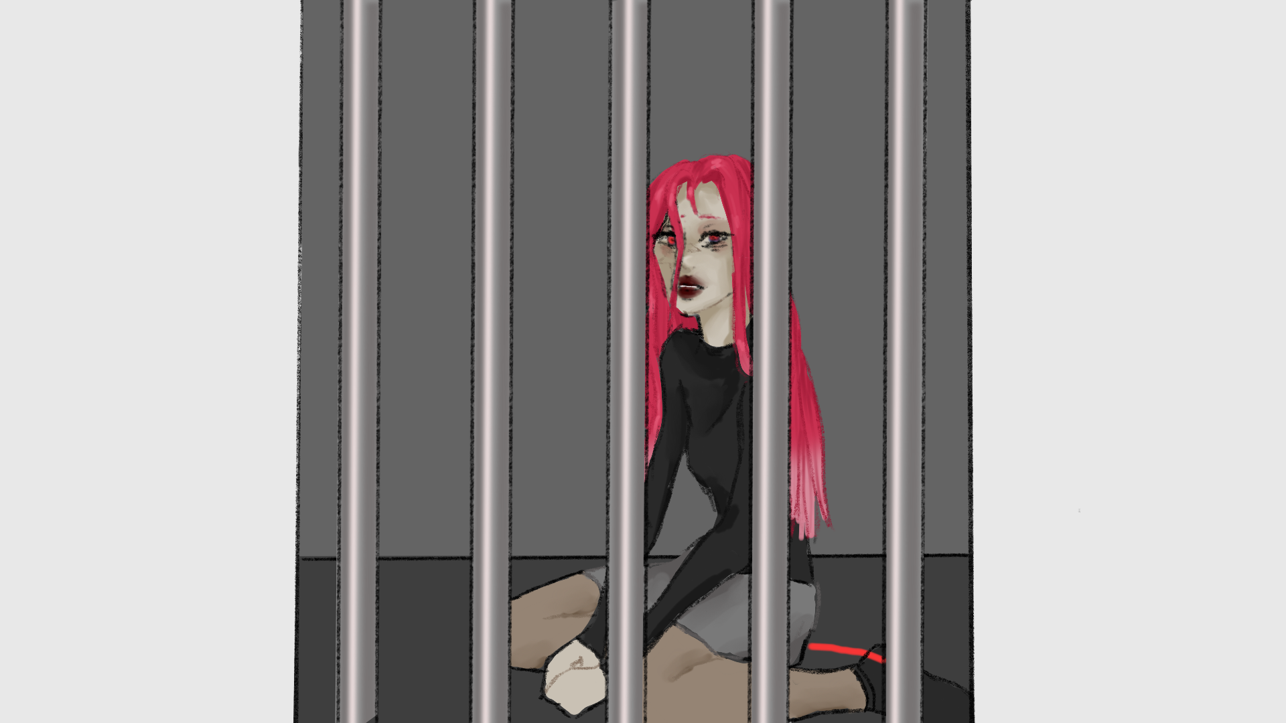
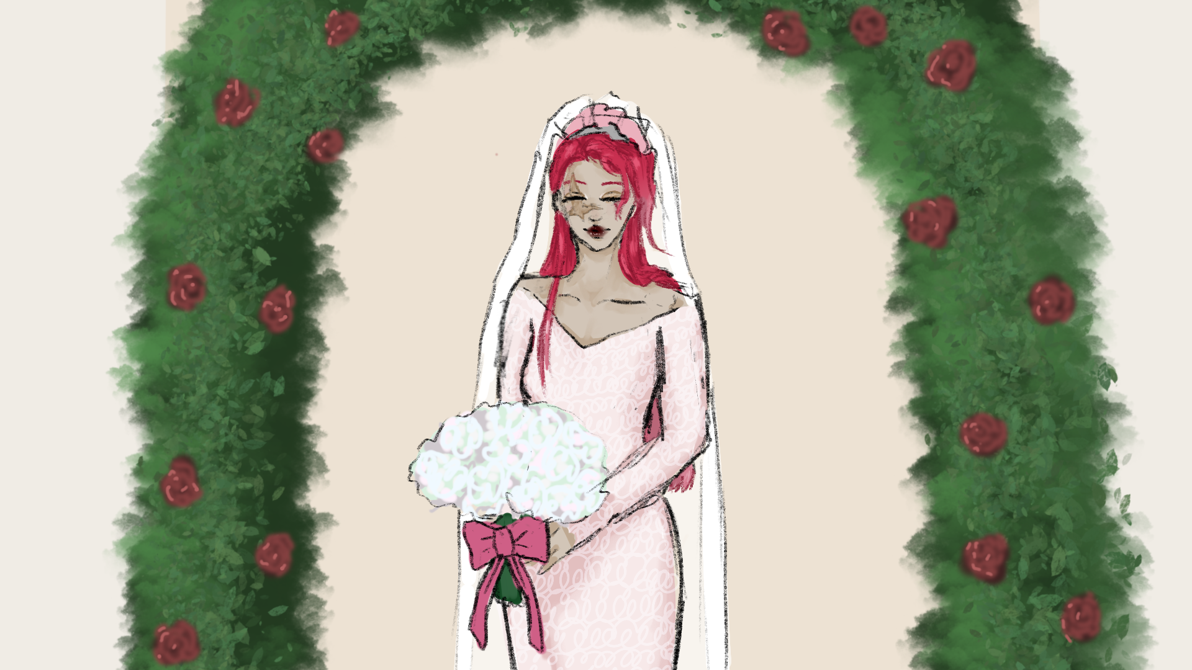
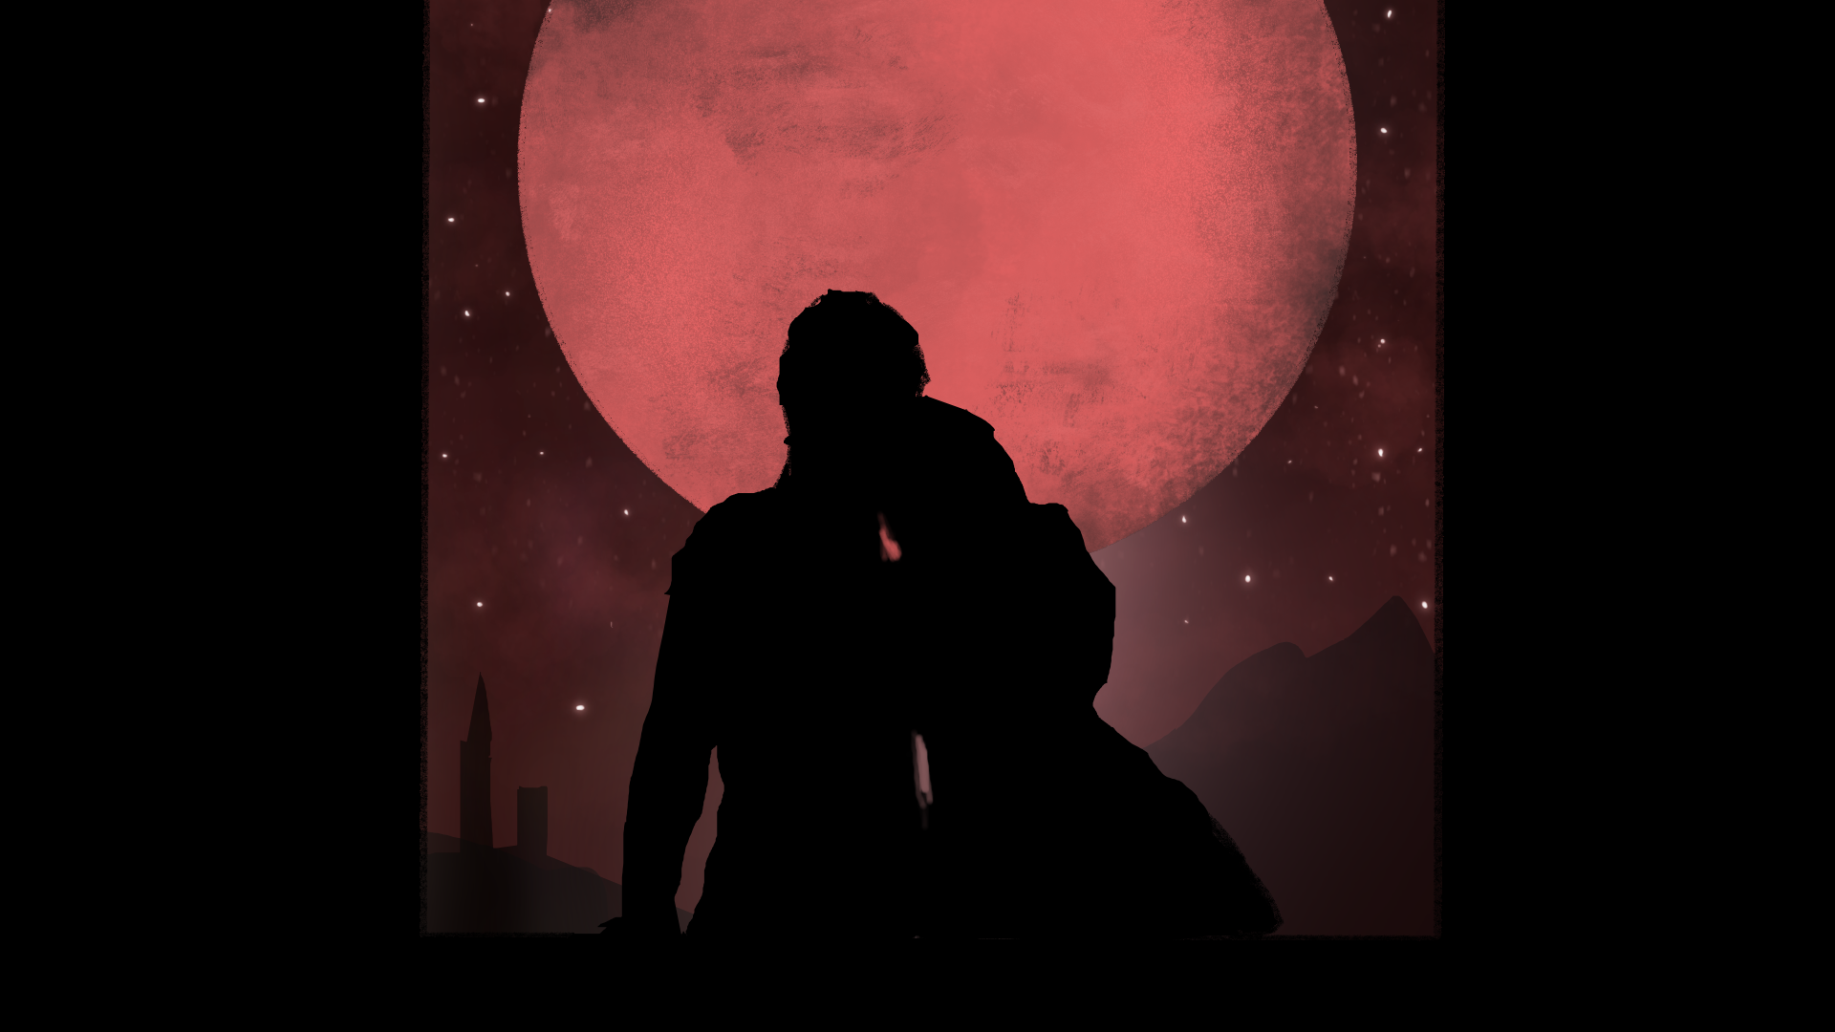
Illustrations
Scarlet
Notes:
A

Slide 40
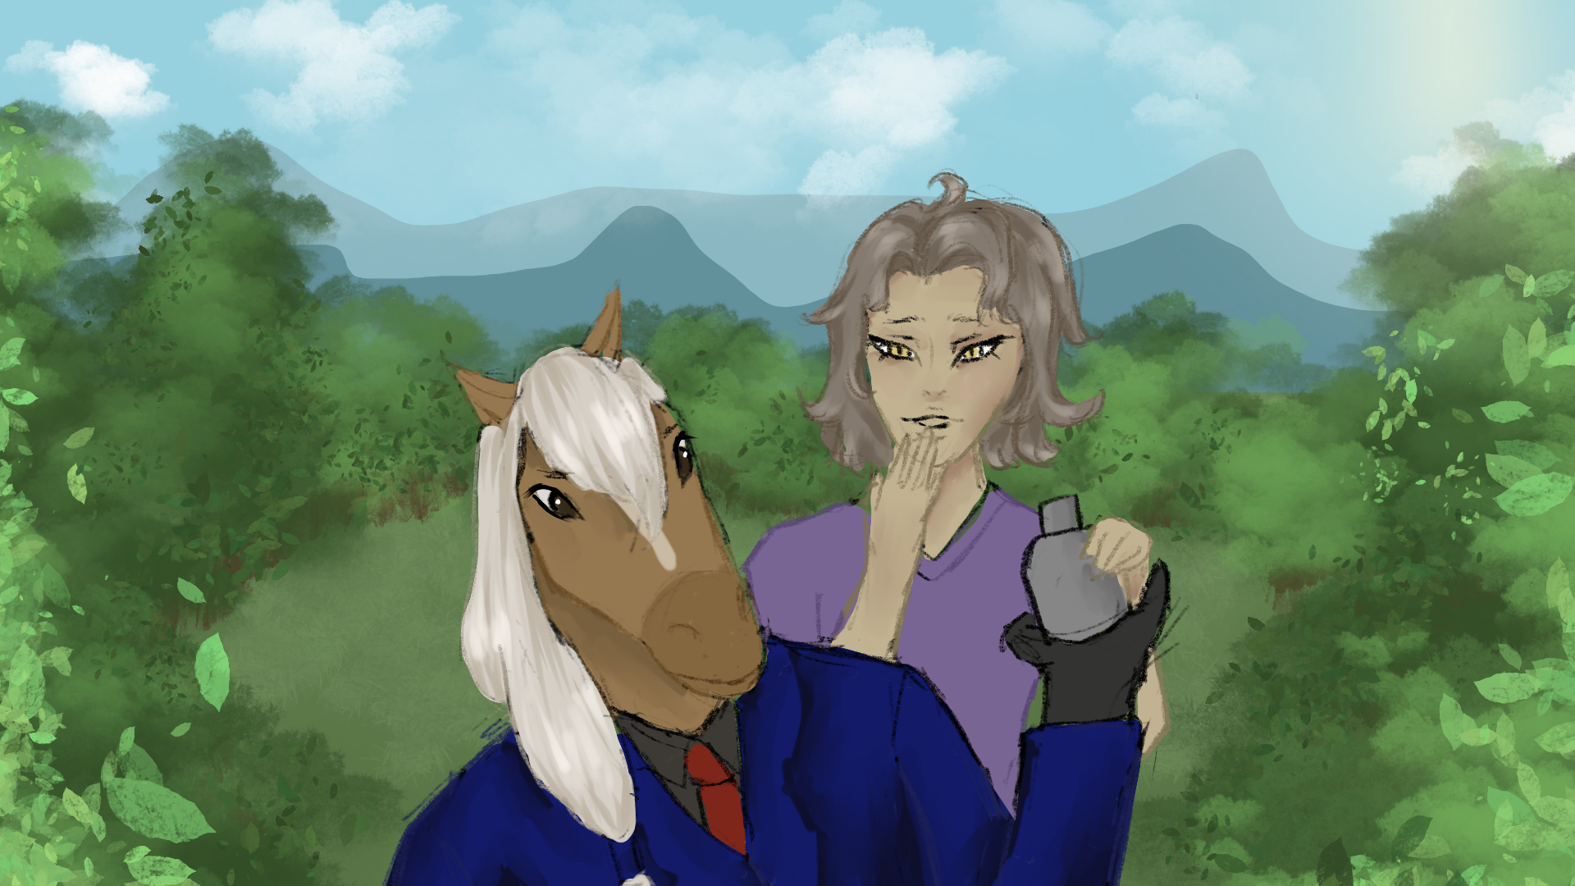
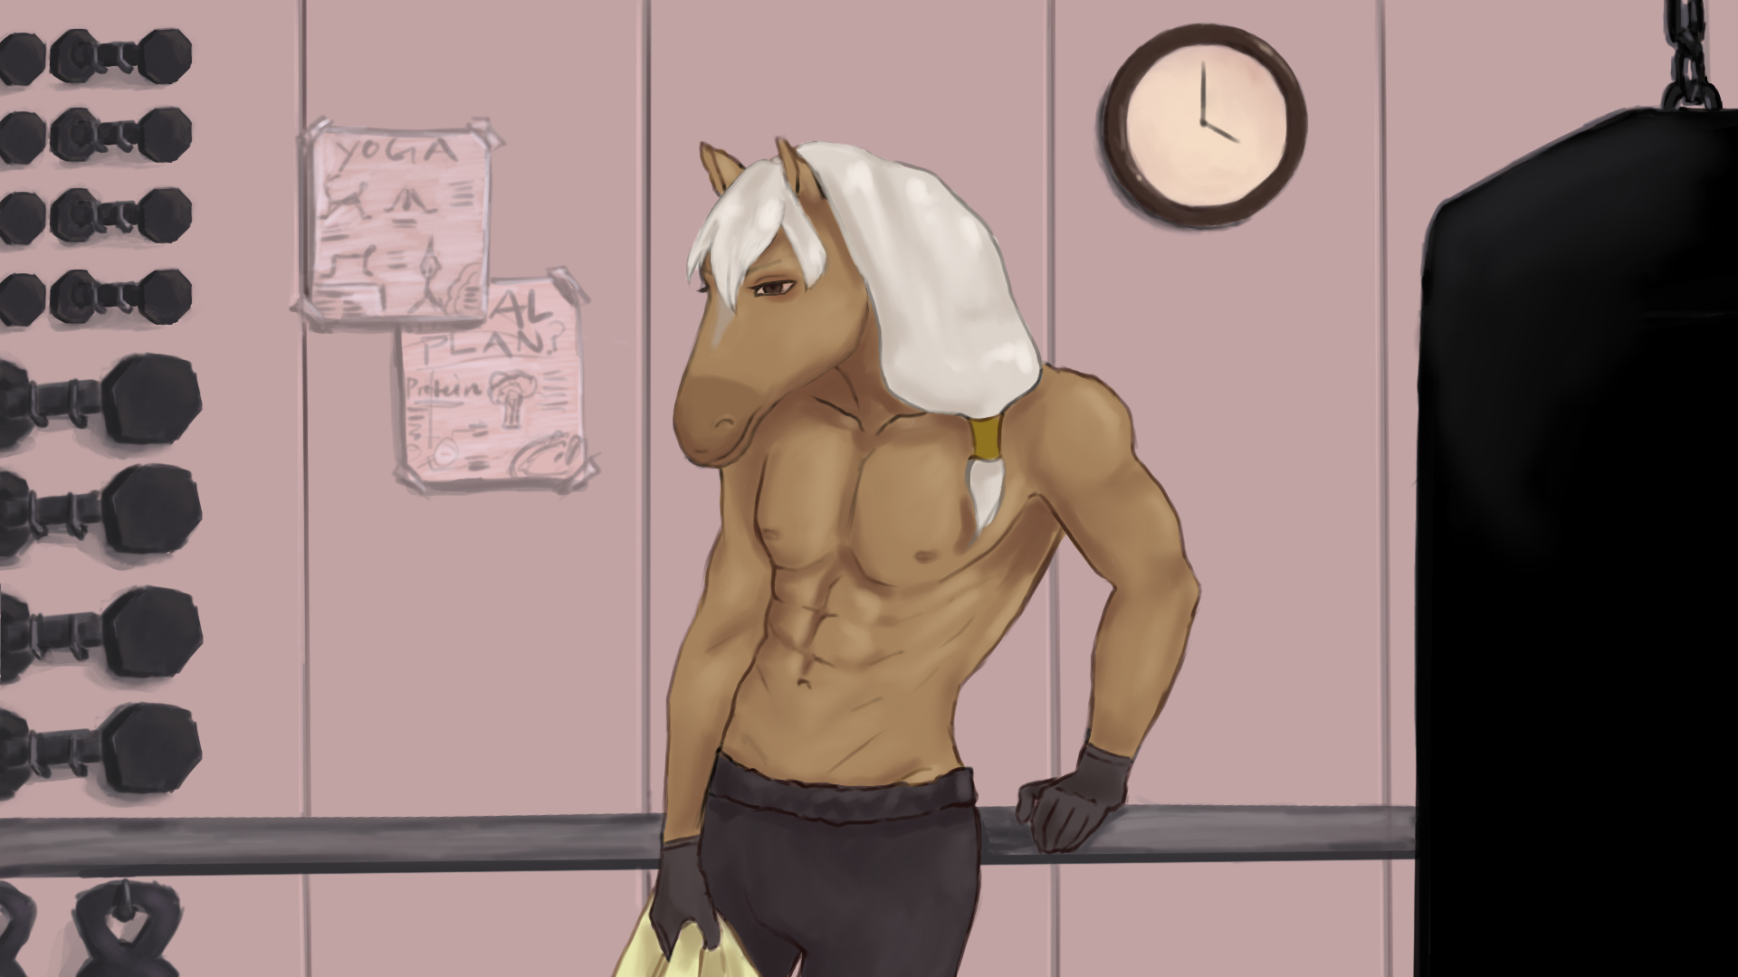
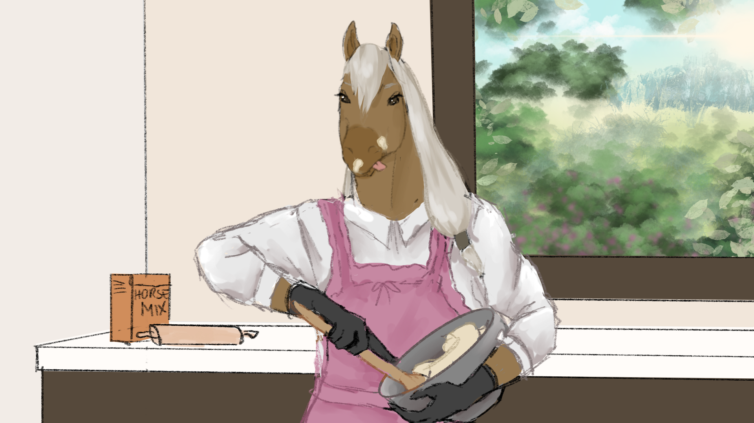

Illustrations
Mr. Horse
Notes:
L

Slide 41
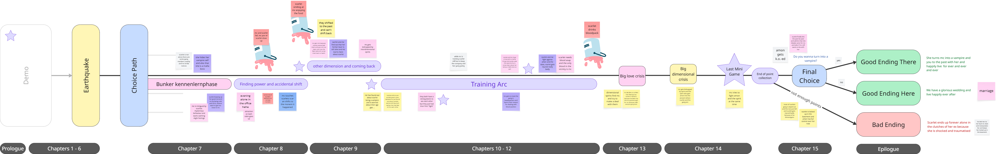
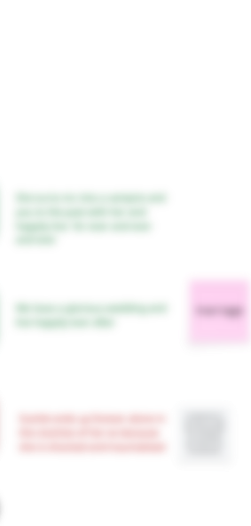

Story
Scarlet
Notes:
A

Slide 42
Story
Scarlet
Notes:
A

Slide 43
Story
Scarlet
Notes:
A

Slide 44
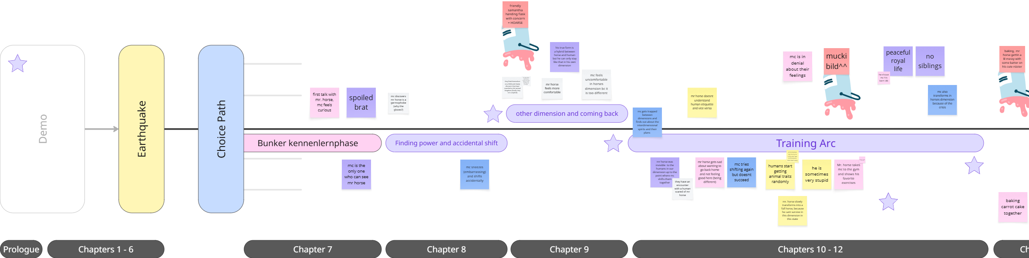
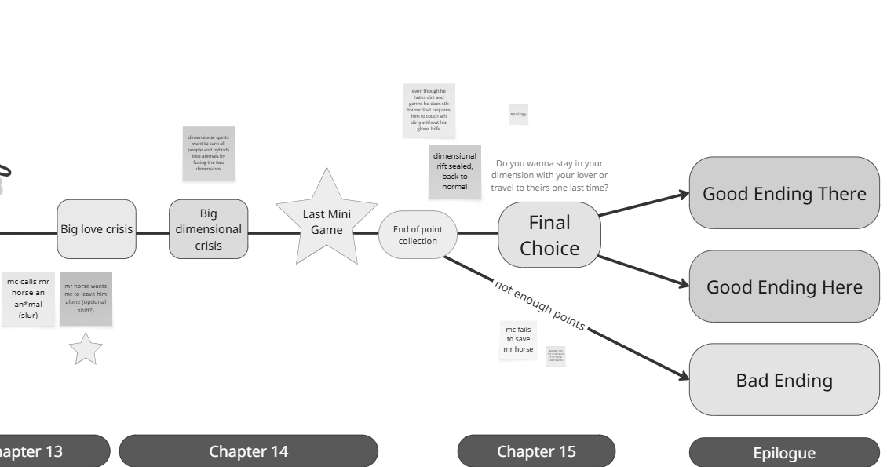
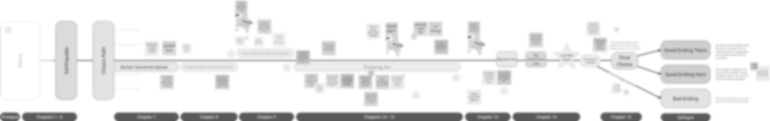
Story
Mr. Horse
Notes:
L

Slide 45
Story
Mr. Horse
Notes:
L

Slide 46
Story
Mr. Horse
Notes:
L

Slide 47
✦
Demo
Notes:
L

Slide 48

itch.io
Scan me!
Notes:
L

Slide 49
Reflexion
✦ Motivation & fun
✦ Biweekly meetings
✦ Not all goals achieved
✦ Finished Scarlet story!
✦ Struggling with Mr. Horse
✦ Continue working on it?
Notes:
L

Slide 50
Thank you!
Goodbye!
Notes:
L

