Slide 1
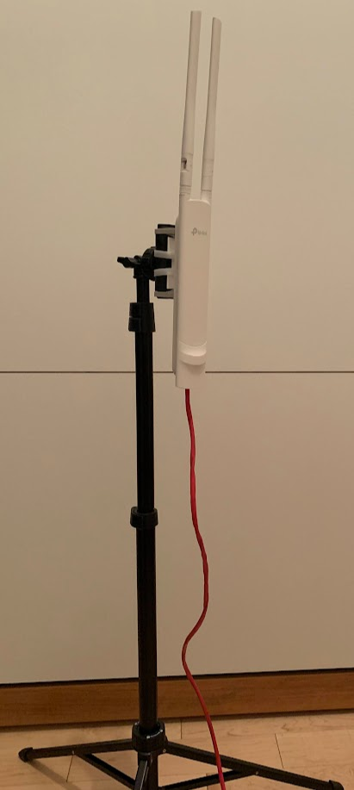
Access Points
Use a video-capable (gaming) router
Small-business Power-over-Ethernet (PoE) switches
  For example tp-link TL-SG1008P has 4 PoE ports, 4 normal ports, handles 1Gbps.
  Use one per platform
  PoE switches allow connecting WiFi access points without having to bring electrical wiring
Redundant WiFi access points
  For example, tp-link AC1200 EAP225 Outdoor
    can be mounted on a phone tripod, correct wave shape
    disk-shaped antennas are meant for upside-down ceiling mount
  Use one (or more) access point for the main platform area, one for warm-up area
  Use the vendor’s management software to create a single unified WiFi network with redundancy and roaming (e.g. tp-link Omada)
  Use proper length Ethernet cables, avoid needlessly long cables, check connectors

