Slide 1
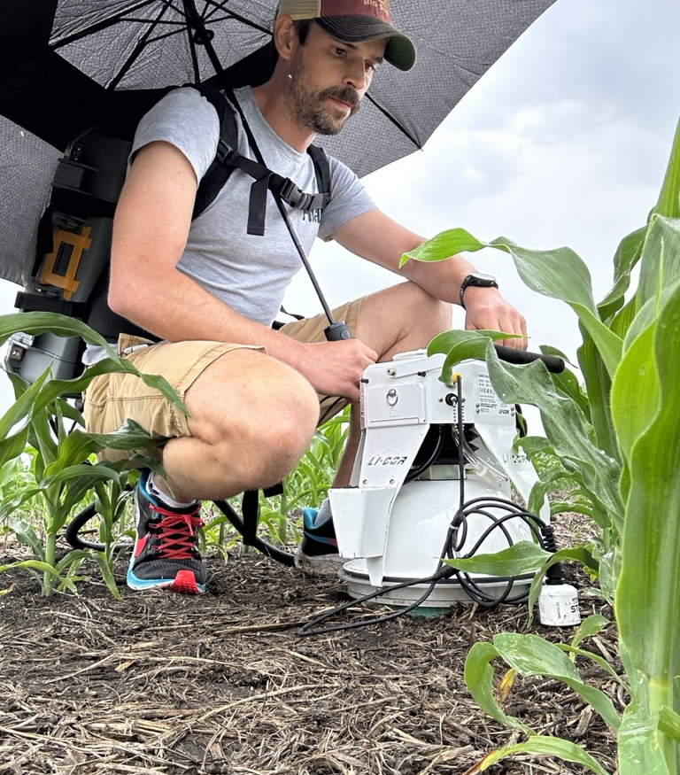
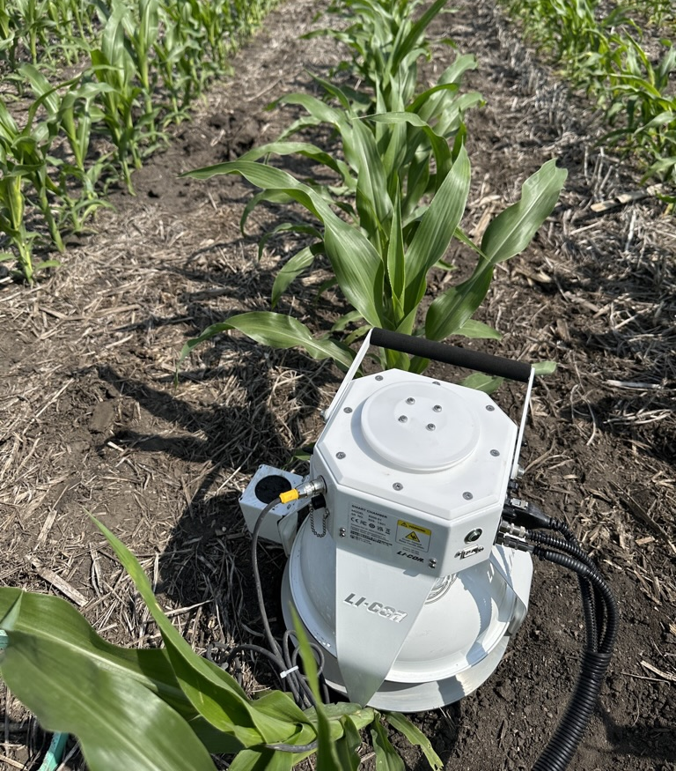
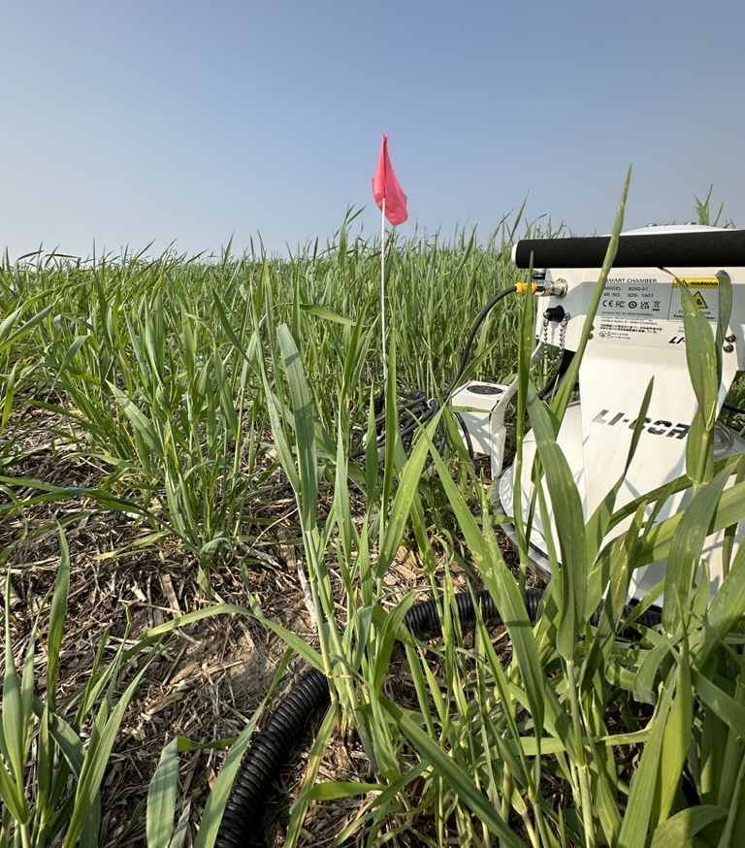
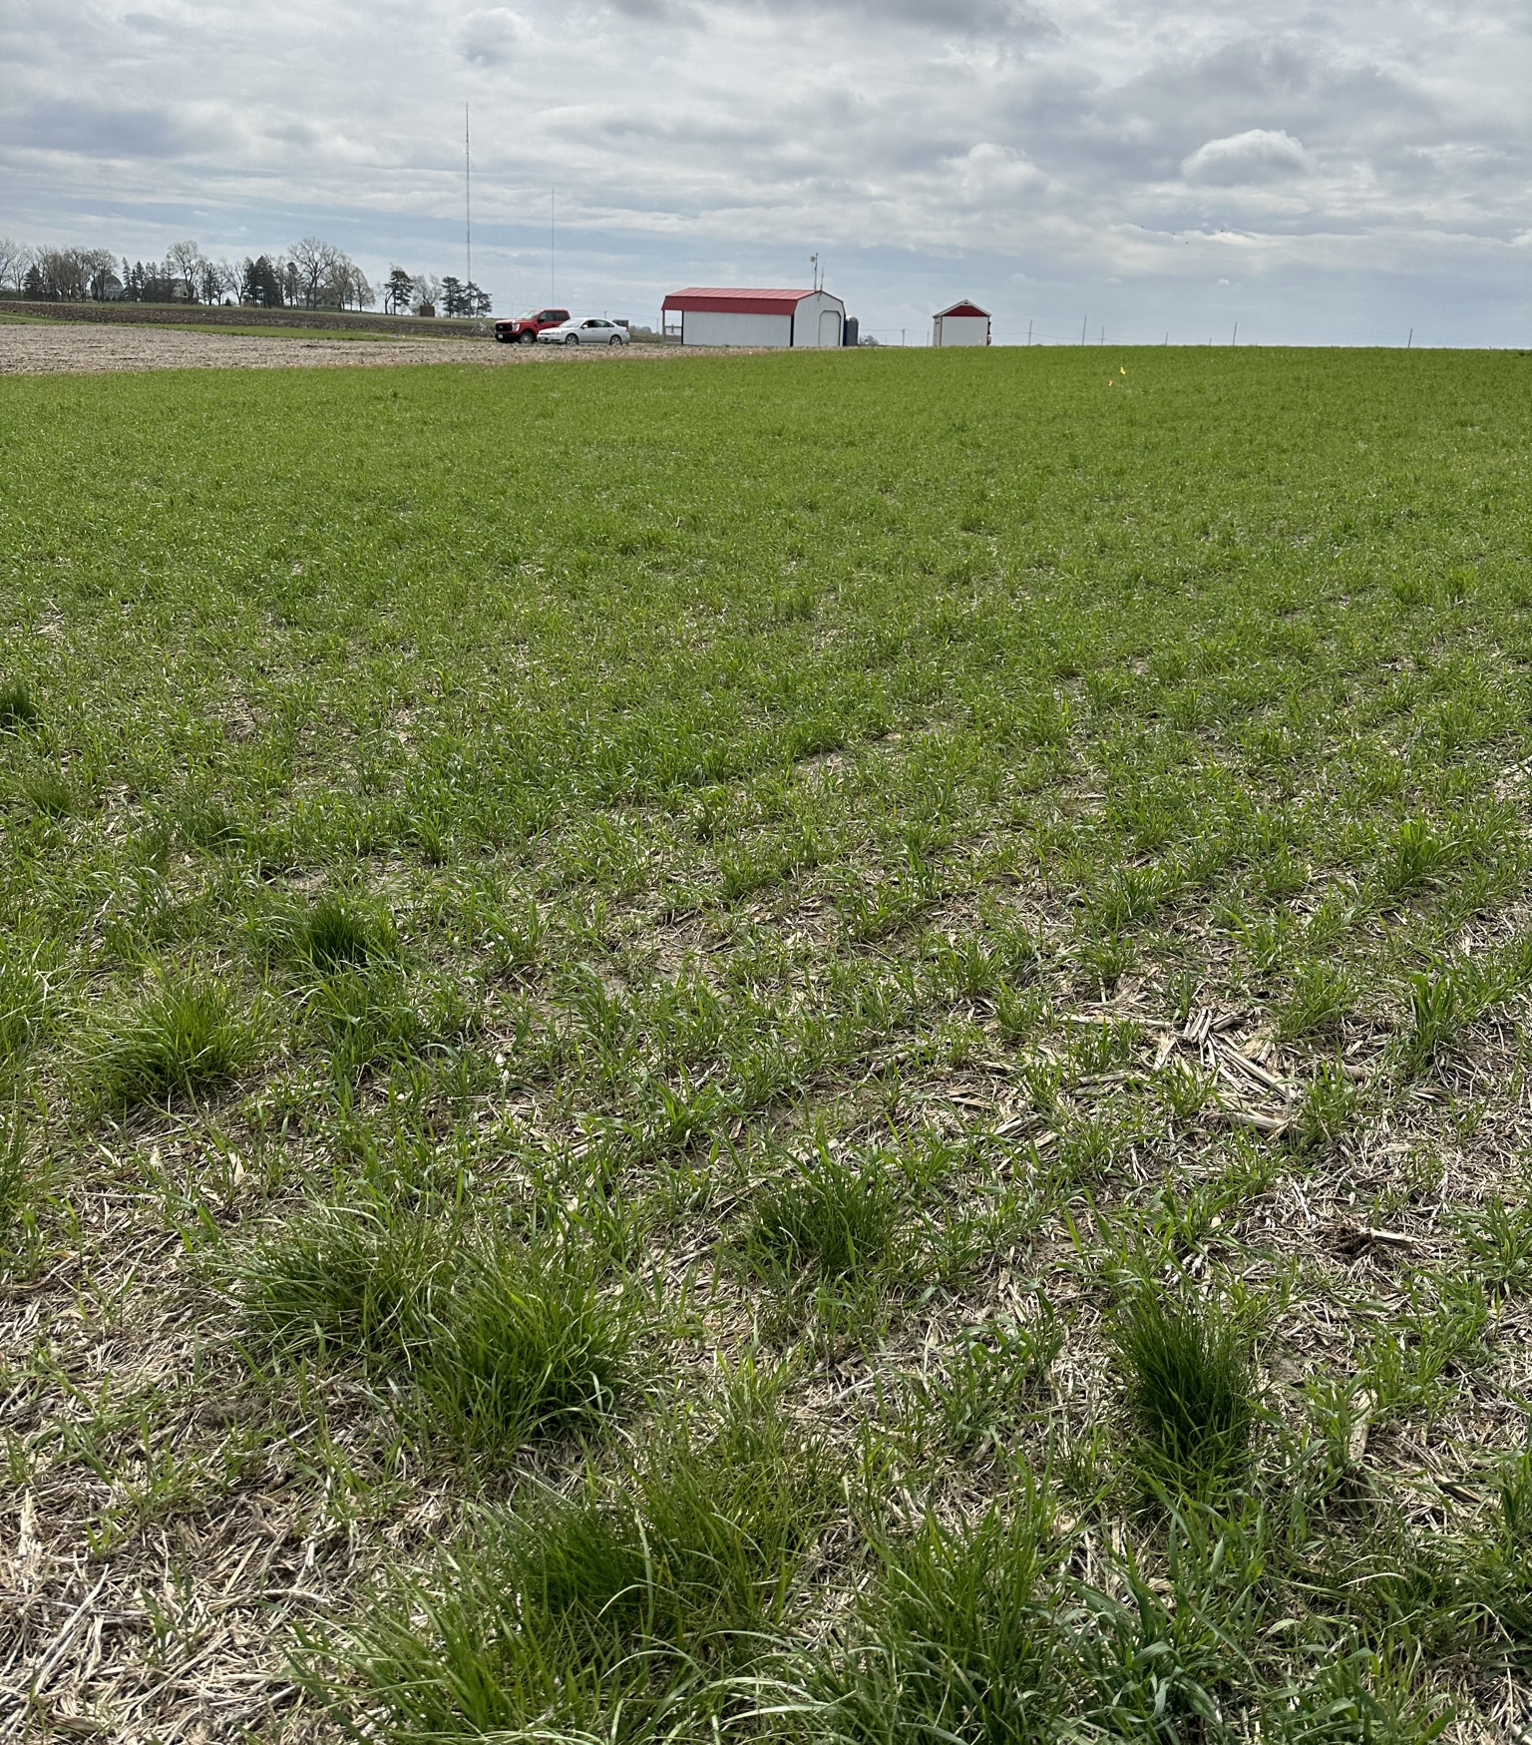
Impact of Cereal Rye on Nitrogen Loss Dynamics in Sorghum-Based Biofuel Production Systems Jared Flater, Summer Bjorn, Marshall McDaniel, Andy VanLoocke

Slide 2
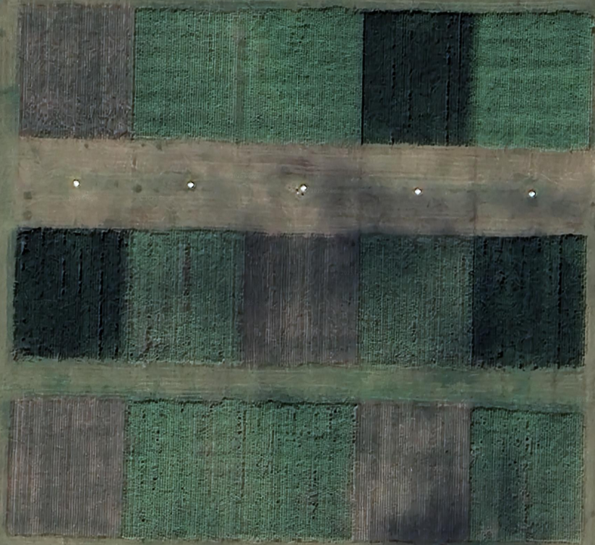

Slide 3
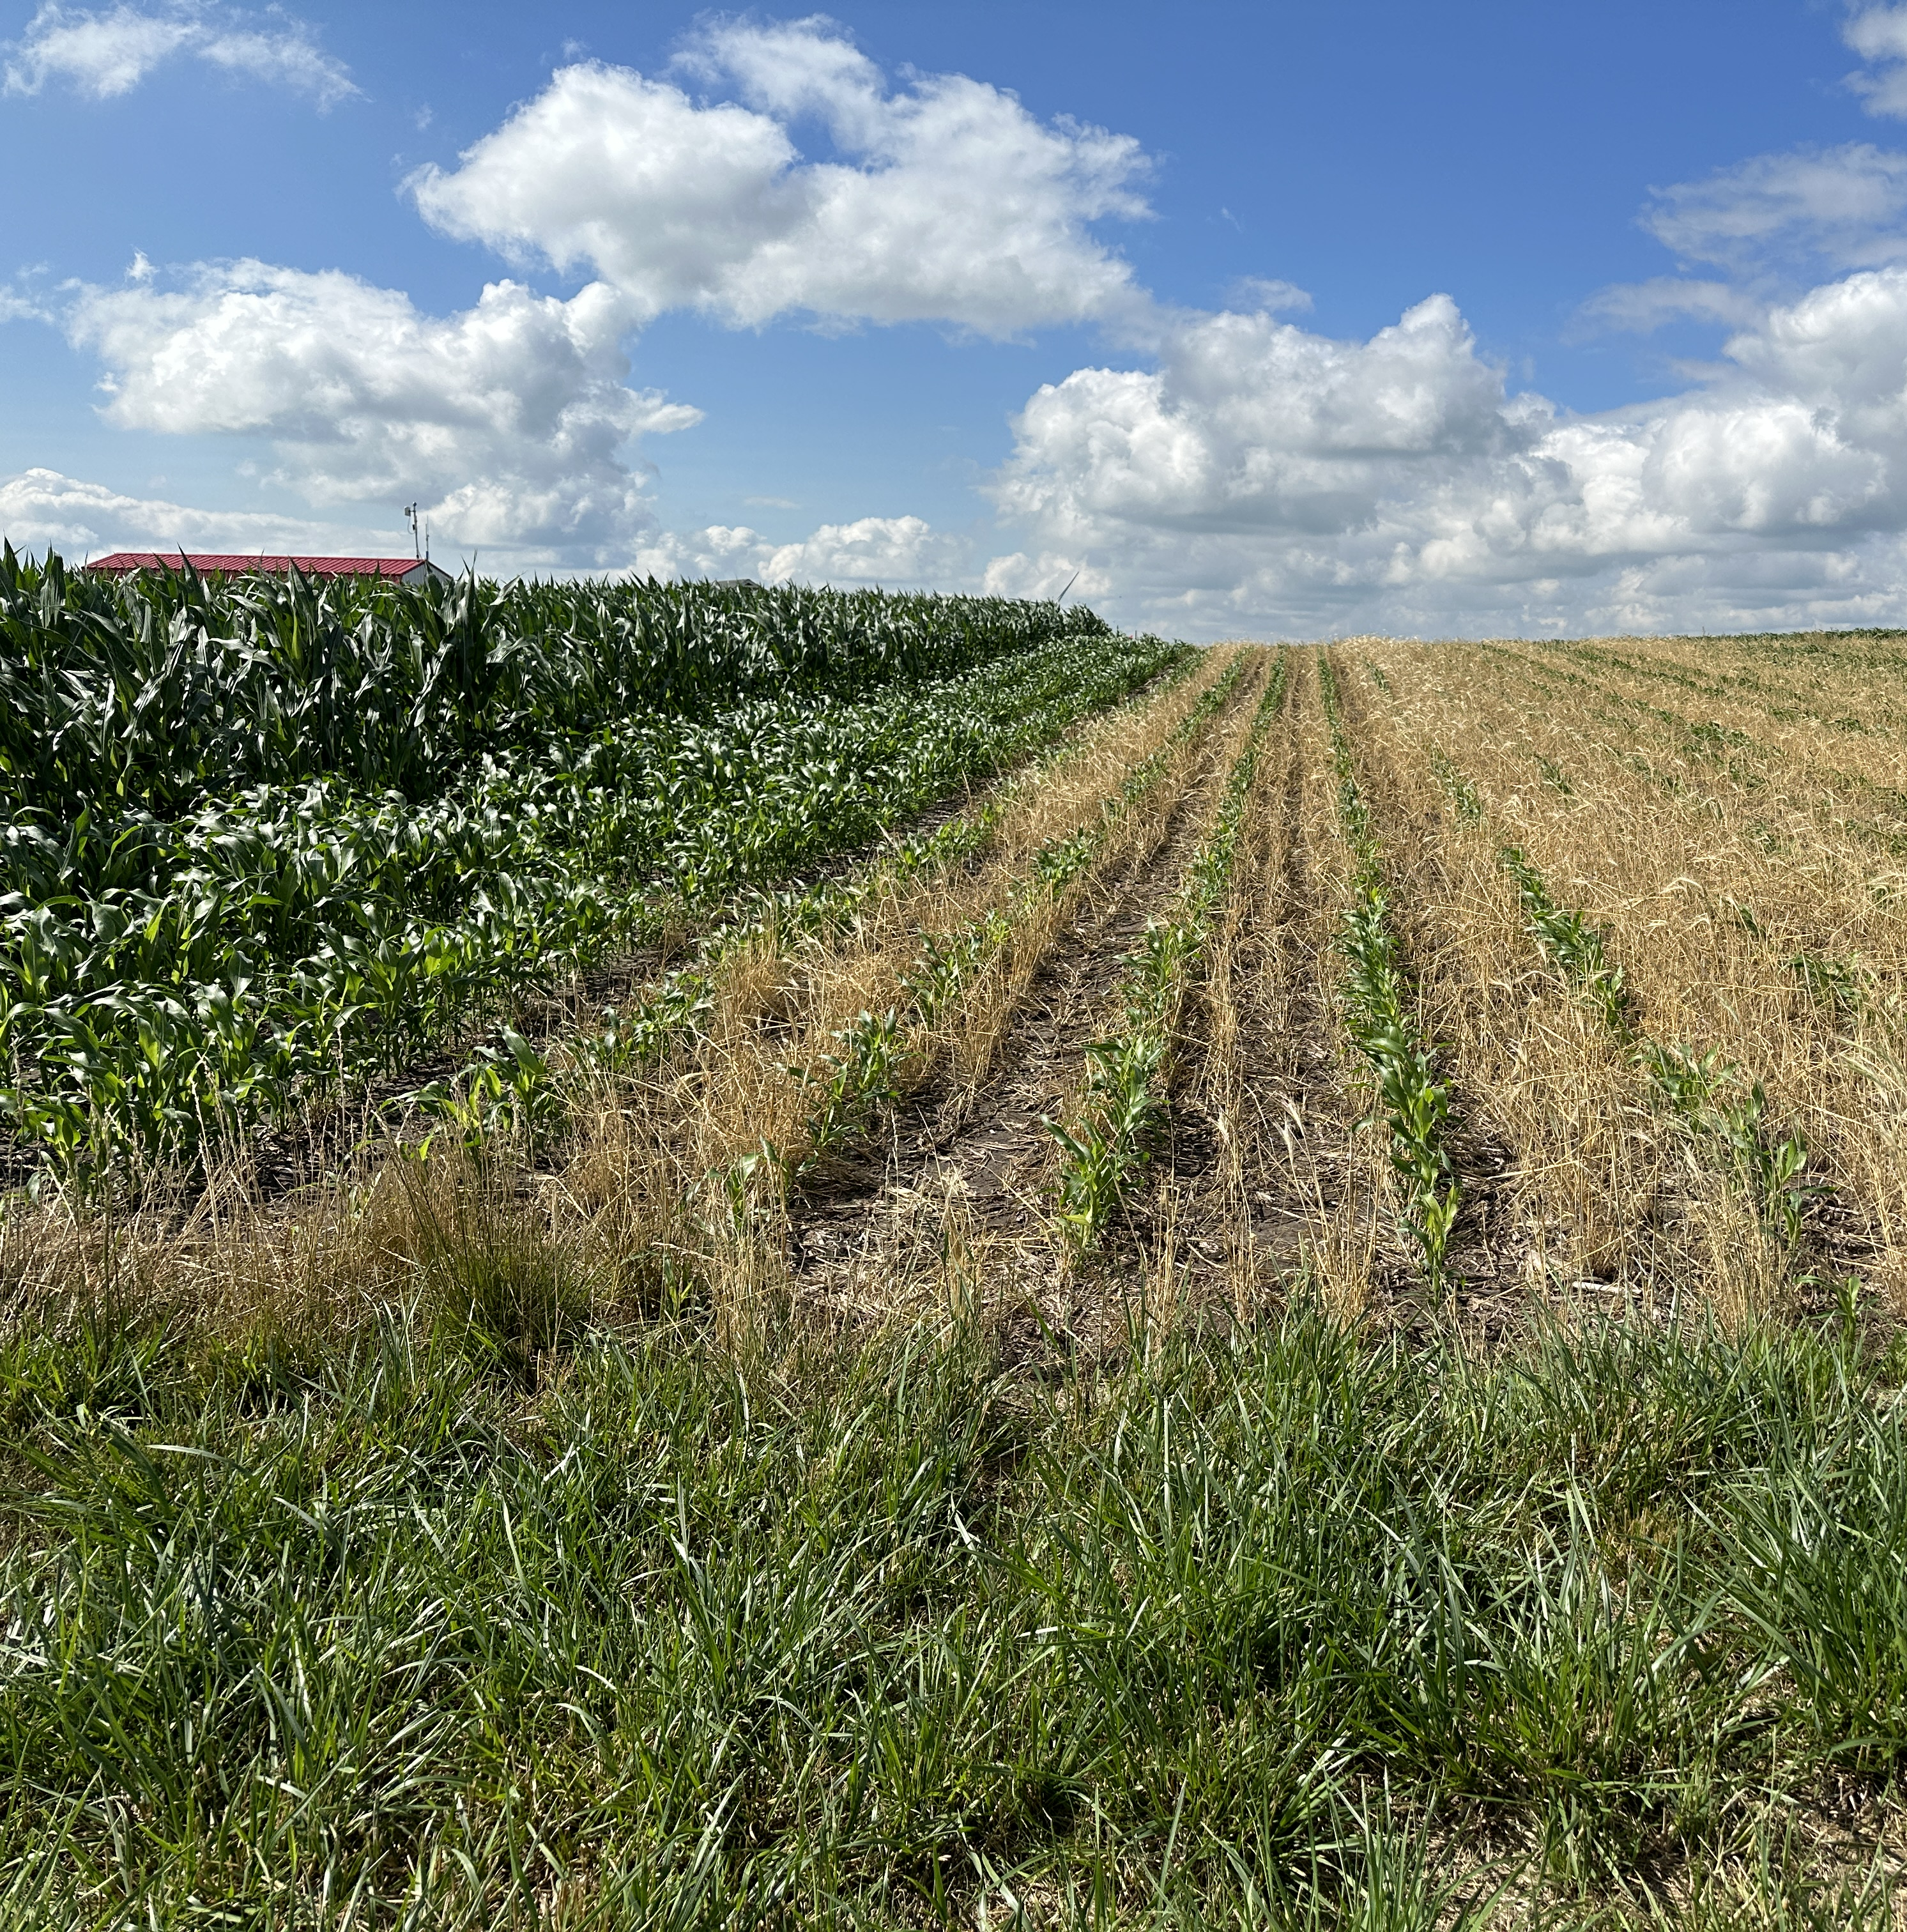
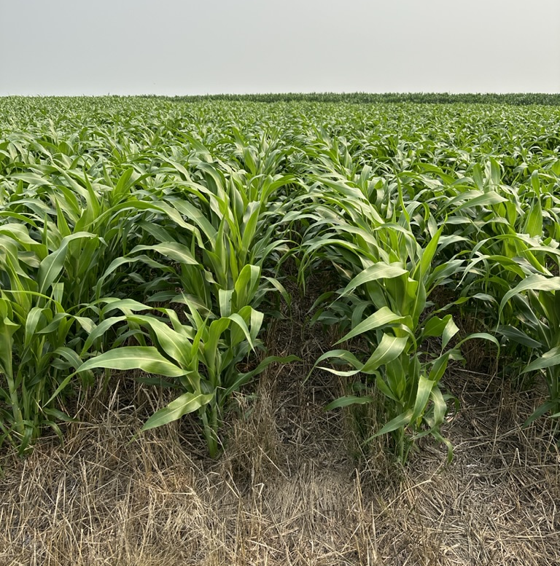
June 26 to July 16th Sorghum + Rye

Slide 5
Notes:
Red line is fertilizer date

Slide 7
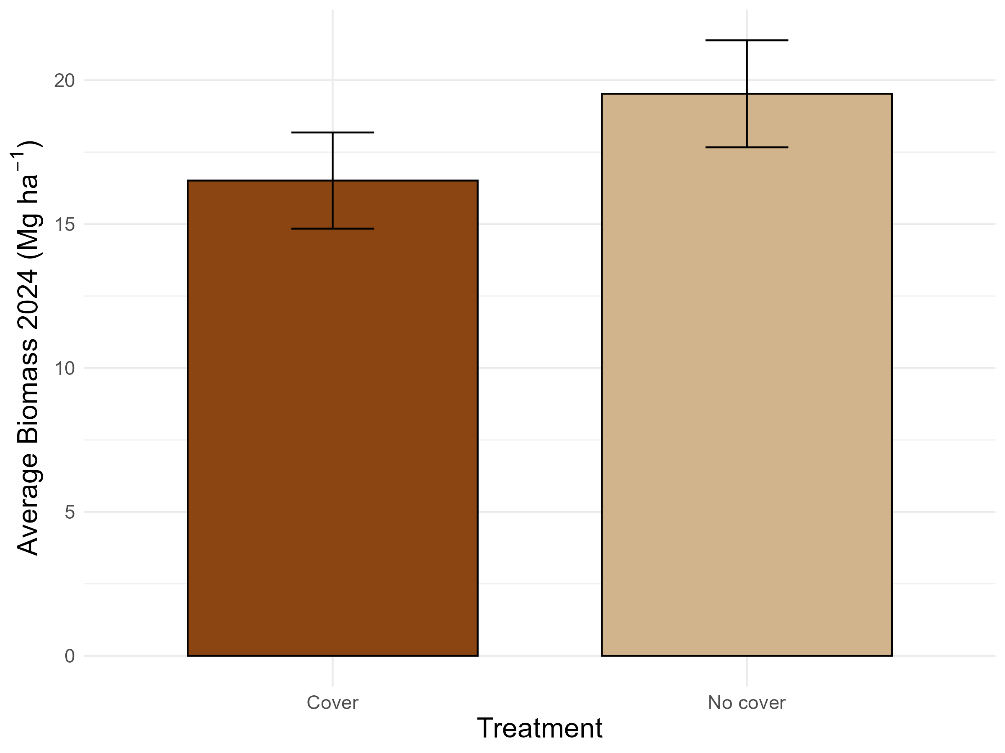

Slide 8
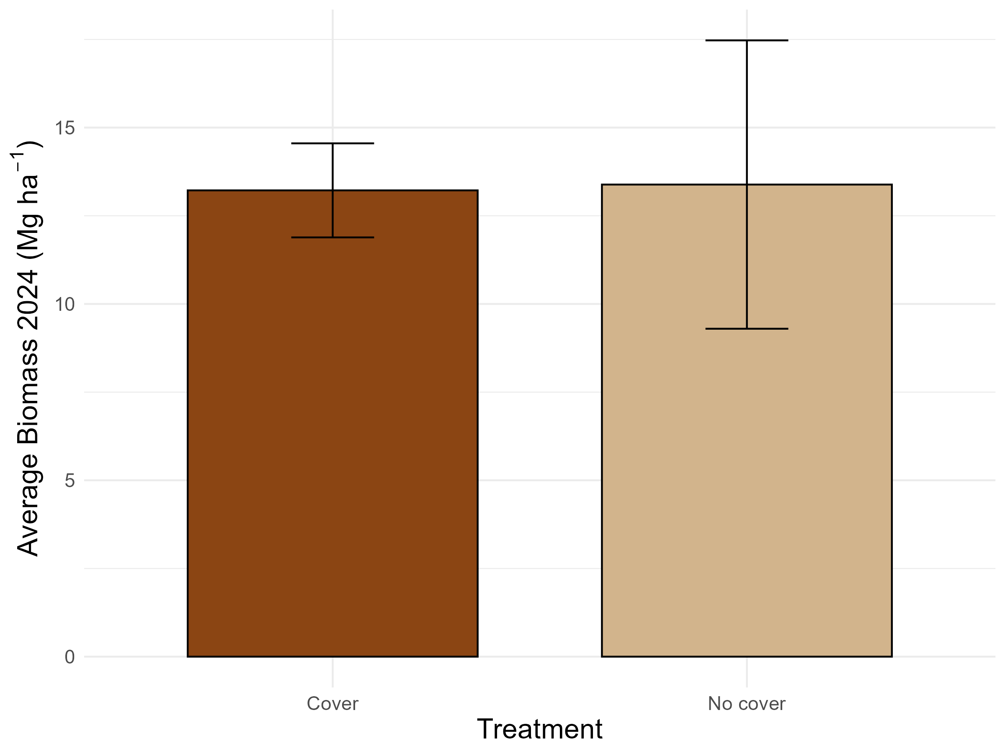

Slide 9
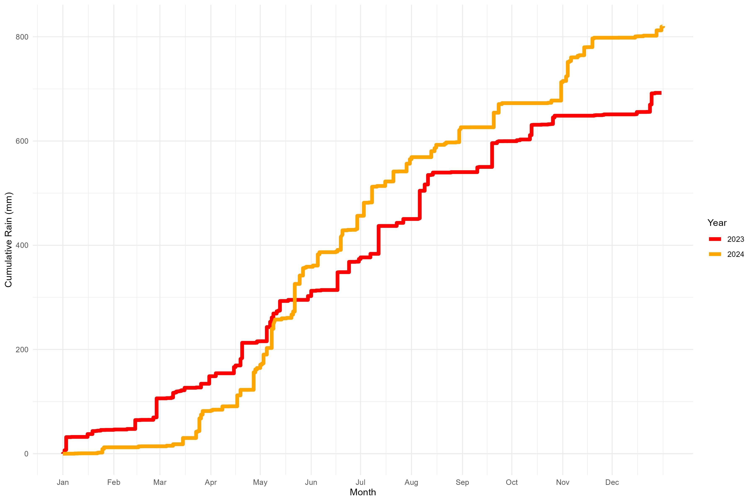
Notes:
Here is a precipitation plot showing a couple rain events in May2024

Slide 10
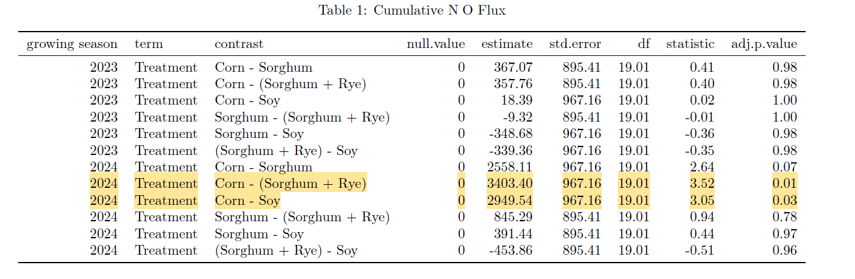

Slide 11
