Slide 1
Blood Glucose Data Analyzer
Joseph Flinn

Slide 2
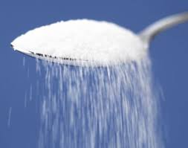
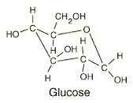
Glucose
What is Glucose?
Blood Glucose
Range
Units

Slide 3
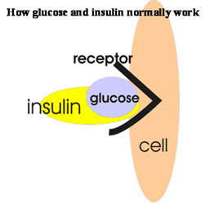
Insulin
Hormone
Pancreas
“Key”
Diabetes Type I
Relation to Blood Glucose

Slide 4
What does this have to do with my program?

