Slide 1
New Investigator Award
(my experience of writing one)
James Fleming

Slide 2
Intro
I submitted my EPSRC New Investigator Award last year – and won it.
I think I wrote a good proposal, but there was definitely some luck involved too.
This ~15 minute talk is to share my experiences and thoughts on how to write a good NIA bid.
Outline:
My NIA – what did I write, how long did it take, etc?
The main proposal documents – how to write
Things I learned (that I wish I realised before I started writing)
And a quick warning: EPSRC has now moved from Je-S to a new system and the NIA format changed – I have looked at the new documents required, but my knowledge may be out of date, apologies for any errors

Slide 3
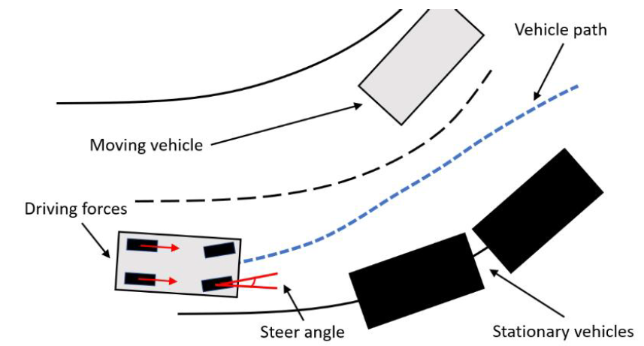
My New Investigator Award proposal - concept
“Learning of safety critical model predictive controllers for autonomous systems” (EP/X015459/1)
What’s it about?
Consider a collision avoidance problem for an autonomous car.
How do we control the steering etc to avoid a crash?
Two current approaches:
Model-based predictive control – MPC (well understood, has safety guarantees, but complex to design and implement, need to redesign it for every vehicle)
Reinforcement learning – RL (AI method, neural networks, data-driven, so ‘design’ is easy, but no safety guarantees)
Idea: Can we ‘reinforcement learn’ a safe, model-based controller? This could give us the best of both worlds, i.e. a safe controller that is learned automatically from data.
Important questions to ask yourself:
Is it novel? (Yes, current RL methods learn neural networks, not model-based controllers)
Is it important? (Yes, it’s bad if autonomous vehicles crash, and several companies are currently developing them)
Is it timely? (Yes, some prerequisite mathematics about how to differentiate MPC controllers was only discovered in 2019/2020)
Is it low TRL / fundamental research? (Yes, new mathematical theory and algorithms are needed)

Slide 4
My New Investigator Award proposal – other details
How long did it take me to write?
A long time! (~10-12 months total)
~6 months for a first draft of the Case for Support (now ‘Vision and Approach’ and ‘Applicant and team capability to deliver’)
Another 4-5 months getting comments from people and fine tuning, writing the other parts.
I did other things during this period too, but wanted to take my time and get it right.
Did I have project partners / letters of support?
Yes – one industrial partner (a small company who produce software to simulate motorcycle dynamics),
One academic partner also – an old colleague who is a Prof at the University of Padova in Italy,
Each wrote me a letter of support:
The company are allowing me a free licence for their software
The Prof in Padova is letting me test my new algorithms in his lab, on his ‘self-balancing motorbike’
They are both only involved in one work package of the bid (WP3)
Not the first time I have written a proposal to EPSRC – I was a researcher co-I previously (unsuccessful, a reviewer criticised it as ‘not low TRL’ – scores: 653)
If you want to see my NIA, I’m more than happy to send you my submitted documents (drop me an email) – but be aware the format has changed

Slide 5
The main proposal documents – how to write (1)
Vision and approach (6-page pdf) – pages 3-8 in the ‘case for support’ previously
The longest and most important document in the bid, needs to be well structured and clearly written for the reviewers.
The first two criteria on the old EPSRC review form were ‘Quality and Excellence’ and ‘Importance’ – this is where you demonstrate these (state these things explicitly):
(Quality) Is the research novel, what has and has not been done before?
(Quality) Is the research timely? What transformative outcomes will it have?
(Importance) Does it meet UK needs? Does it complement the current EPSRC grant portfolio?
The structure I used (headings in the document):
Summary of bid
Research hypothesis (overall idea, timeliness, key questions)
Objective 1
(what I will do, why it is novel)
WP 1
(how I will do it,
+ deliverables)
Contribution to Knowledge (how to disseminate)
Background (short lit review)
Objective 2
WP 2
National Importance (UK needs, compare with EPSRC portfolio)
Objective 3
WP 3
Important that things fit together – do the objectives explore the hypothesis? Do the WPs achieve the objectives? Are all the deliverables planned to be disseminated? Be explicit – e.g. in WP1 “This WP targets Objective 1 of the project.”

Slide 6
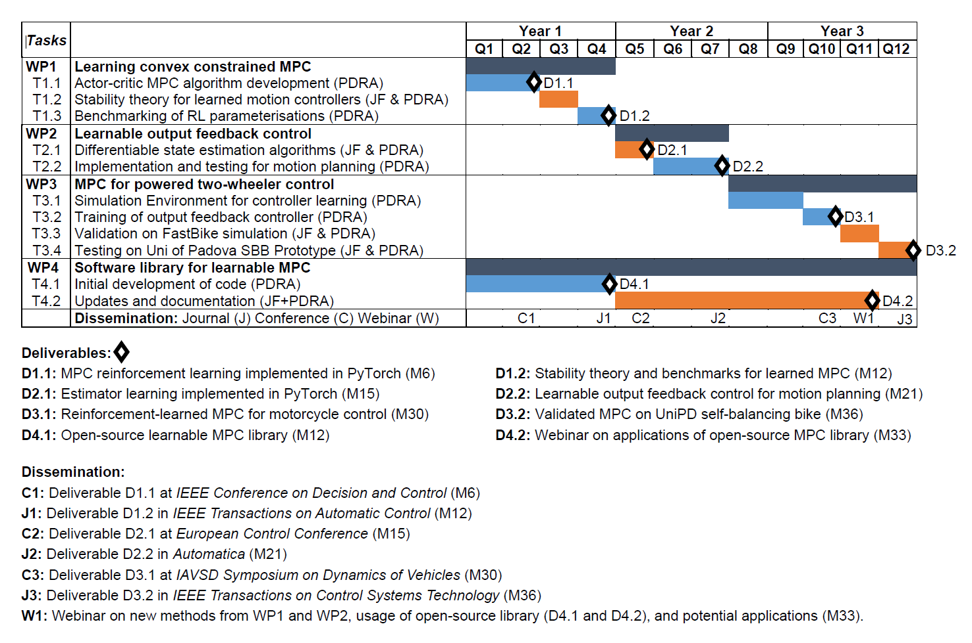
The main proposal documents – how to write (2)
Workplan (1 page attachment to ‘vision and approach’ pdf) – very important to get right, a useful planning tool if you do it early:
Alan had a nice word template for this, modify as needed
Incorporate dissemination (planned journals, conferences) and any impact activities
I think it’s easiest to do this before you write about each WP in your ‘Vision and Approach’
Check that the deliverables, timings, etc. etc. match those in the ‘Vision and Approach’ pdf

Slide 7
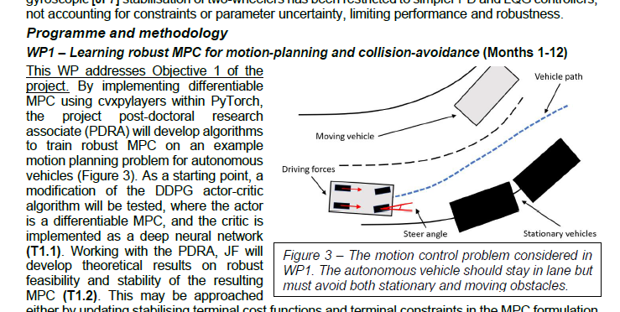
The main proposal documents – how to write (3)
There are other things to prepare. E.g:
‘Applicant and partnerships’ section
‘Resources and cost justification’
‘Host organisation statement’
(important to get right, but to be honest, I spent less time on these)
After you have a first draft, download the EPSRC reviewer form and self-assess (Quality, Importance, etc). If you were reviewing it, can you ‘tick all the boxes’?
Get comments and feedback from several people (I think there is now a formal process for this, I did it informally - ask anyone you think might be useful).
Make and use diagrams in the ‘Vision and Approach‘ pdf if they will help explain your idea – easy to make them in PowerPoint, makes things much clearer for a reviewer:

Slide 8
Things I learned (1)
It is possible for people to misunderstand your writing.
Here is a sentence from a draft that I sent to a colleague for feedback:
“The research team consists of JF (PI), who has extensive experience and a PhD in the area of model predictive control and a post-doctoral researcher (PDRA) recruited specifically for the project.”
What I meant: My own PhD is in the area of model predictive control, so I’m an expert in this area, and I will hire a PDRA too.
What they understood: The research team is me, a PhD student of mine who researches model predictive control, and the PDRA.
This was my fault – because the original sentence is not very clear.
The colleague highlighted the above sentence in my draft and commented:
“As you will have a PhD and a PDRA, you should be more specific about who will contribute to which WPs in the workplan”
What I learned: If this was a reviewer, they might have thought my workplan lacked detail, because it didn’t mention this extra PhD student! This is one reason it is important to be very clear in your writing and get several other people to read the bid.

Slide 9
Things I learned (2)
Do I need prior experience in all areas of a proposal – e.g. can I suggest using AI/RL in the bid if I am not an expert on AI/RL?
I agonised over this for a while. You need a track record, but also need to do something new.
‘Ability to deliver’ is on the EPSRC reviewer form, but as a secondary criterion.
In my case, my NIA mostly involves two technical methods:
Model Predictive Control (I have done this, several papers in it)
Reinforcement Learning (I have not used it much, I understand it, but no relevant papers)
My eventual solution to this was to say that I would hire a PDRA who had used RL in their PhD. The reviewers commented on this, but seemed satisfied:
“The applicant's background in Reinforcement Learning does not appear as strong as MPC, but I am sure appropriate advice will be sought from others in the field if necessary.”
“it is not particularly clear how much exposure to Reinforcement Learning the PI had but this is not a major concern, especially if a PDRA with appropriate understanding of RL is employed.”
What I learned: You need to show you can carry out the work, but don’t need to be an expert in every technique (although maybe I got lucky with the reviewers!).

Slide 10
Things I learned (3)
A few others (hopefully still true under the new system):
The review process takes a long time (~6 months for me) but then you might only have ~1 week to write a PI response. Be ready to drop everything else you are doing when needed.
You can sign up for the EPSRC peer review college, and they may send you bids to review in your specialism (I sometimes get asked to review bids involving MPC, some of these were before I put in the NIA). Filling in the form from a reviewer perspective is useful.
There is support available: In particular, Alan Kirk is a very thorough proofreader, and a fantastic help in general in terms of ticking all the reviewer’s boxes, be sure to let him check over your documents when you are nearly ready to submit (and for the PI response).

Slide 11
Questions?
Thanks for listening!
Happy to answer any questions
Feel free to email me any time, too: j.fleming@lboro.ac.uk

