Slide 1
Electrical and Robotics Community talk: EPSRC NIA
James Fleming
27th November 2024

Slide 2
Intro
I submitted my EPSRC New Investigator Award in 2022 – and won it. The project started mid-2023.
Will asked me to share some thoughts about what I learned from the process.
If you have been to Anish’s writing retreats, you may have seen some of this before! I’ve updated it, so hopefully you’re not too bored :-)
Outline:
My NIA – what is it about? (2 slides)
Writing the proposal (2 slides)
Things I learned (2 slides)

Slide 3
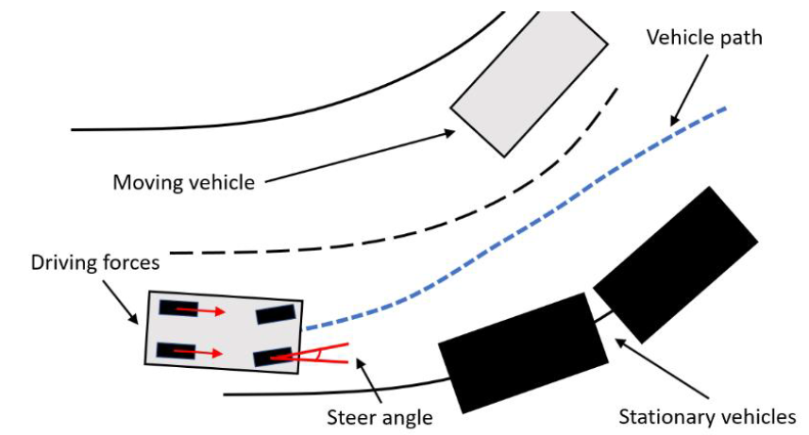
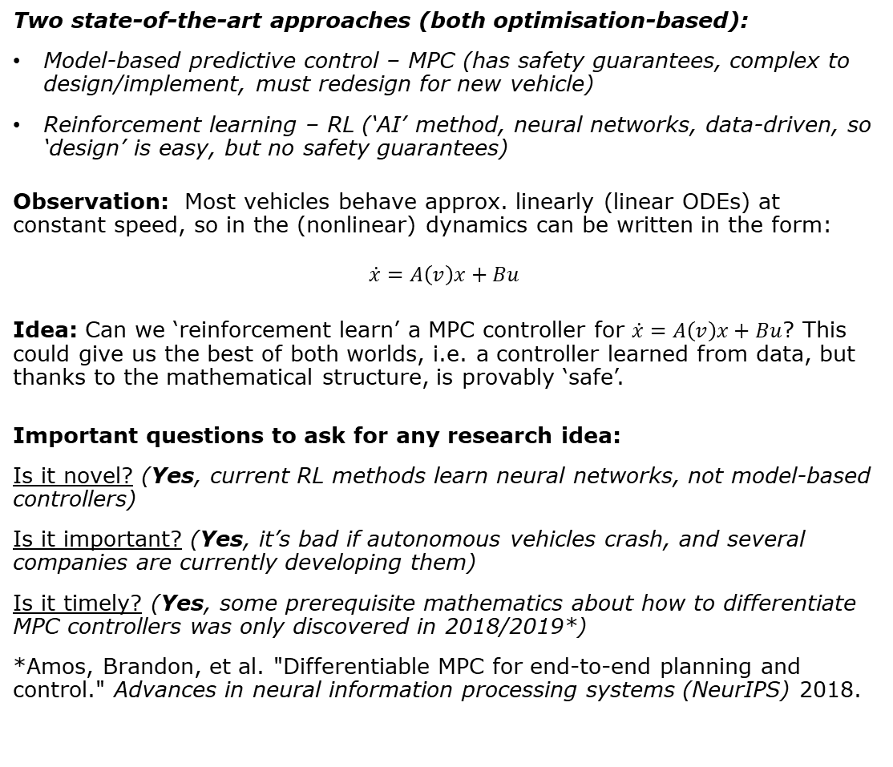
My New Investigator Award proposal
“Learning of safety critical model predictive controllers for autonomous systems”
(EP/X015459/1)
What’s it about?
Consider a collision avoidance problem for an autonomous vehicle (e.g. a car).
How do we control the steering, acceleration, braking etc to avoid a crash?
Two state-of-the-art approaches (both optimisation-based):
Model-based predictive control – MPC (has safety guarantees, complex to design/implement, must redesign for new vehicle)
Reinforcement learning – RL (‘AI’ method, neural networks, data-driven, so ‘design’ is easy, but no safety guarantees)
Observation: Most vehicles behave approx. linearly (linear ODEs) at constant speed, so in the (nonlinear) dynamics can be written in the form:
$$\dot{x}=A\left(v\right)x+Bu$$
Idea: Can we ‘reinforcement learn’ a MPC controller for $\dot{x}=A\left(v\right)x+Bu$? This could give us the best of both worlds, i.e. a controller learned from data, but thanks to the mathematical structure, is provably ‘safe’.
Important questions to ask for any research idea:
Is it novel? (Yes, current RL methods learn neural networks, not model-based controllers)
Is it important? (Yes, it’s bad if autonomous vehicles crash, and several companies are currently developing them)
Is it timely? (Yes, some prerequisite mathematics about how to differentiate MPC controllers was only discovered in 2018/2019*)
*Amos, Brandon, et al. "Differentiable MPC for end-to-end planning and control." Advances in neural information processing systems (NeurIPS) 2018.

Slide 4

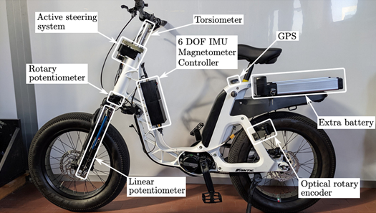
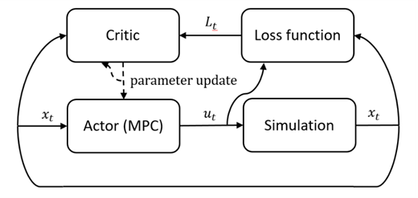

Work packages and progress so far…
Outputs so far:
J. Fleming and Q. Hawari. "Robust tube MPC using gain-scheduled policies for a class of LPV systems." IEEE Control Systems Letters (2024).
Papers and presentations, IEEE CDC 2024 (WP1), ECC 2025 (WP3 sims)
Coming soon:
Visit to Padova, Italy, to test WP1 algorithm on Prof Roberto Lot’s bike
Paper to Vehicle System Dynamics about WP3 control problem
MATLAB toolbox on github for researchers/industry to design WP1 controllers
WP1: MPC algorithms for $\dot{x}=A\left(v\right)x+Bu$
WP3: Test on a tough control problem (self-driving bike)
Related things we are doing:
PhD projects: fast path planning using convex optimisation (Mohammad Abdallah), energy-efficient driving (Samia Qamar), motorcycle stability assistance (Usama Qureshi), platooning of trains (Mehdi Zangeneh).
WP2: Actor-critic RL for the MPC controllers

Slide 5
Writing the proposal (1)
Vision and approach (6-page pdf) – Used to be the “Case for Support”
This is the most important document. My structure for it:
Summary of bid
Research hypothesis (overall idea, timeliness, key questions)
Objective 1
(what I will do, why it is novel)
WP 1
(how I will do it,
+ deliverables)
Contribution to Knowledge (how to disseminate)
Background (short lit review)
Objective 2
WP 2
National Importance (UK needs, compare with EPSRC portfolio)
Objective 3
WP 3
Important that things fit together – do the objectives explore the hypothesis? Do the WPs achieve the objectives? Are all the deliverables planned to be disseminated? Be explicit – e.g. in WP1 “This WP targets Objective 1 of the project.”
Make and use diagrams in the ‘Vision and Approach‘ pdf if they will help explain your idea (I use powerpoint for this)
Get feedback from several people (find people who will criticise your idea, and let them do it).

Slide 6
Writing the proposal (2)
Current EPSRC reviewer guidance, as of November 2024 (from the online form where you enter your review) – this is from a standard grant I was asked to review last week:
Vision
To what extent has the applicant explained how their proposed work:
is of excellent quality and importance within or beyond the field(s) or area(s)
has the potential to advance current understanding, generates new knowledge, thinking or discovery within or beyond the field or area
is timely given current trends, context, and needs
impacts world-leading research, society, the economy, or the environment
Approach
To what extent has the applicant demonstrated that they have designed their approach so that it:
is effective and appropriate to achieve their objectives
is feasible, and comprehensively identifies any risks to delivery and how they will be managed
…
After you have a first draft, use the EPSRC reviewer guidance and self-assess. If you were reviewing it, can you ‘tick all the boxes’?
If anyone needs a copy (I’m not sure the current version is on the EPSRC website) I can share it

Slide 7
Things I learned (1)
It is possible for people to misunderstand your writing.
Here is a sentence from a draft that I sent to a colleague for feedback:
“The research team consists of JF (PI), who has extensive experience and a PhD in the area of model predictive control and a post-doctoral researcher (PDRA) recruited specifically for the project.”
What I meant: My own PhD is in the area of model predictive control, so I’m an expert in this area, and I will hire a PDRA too.
What they understood: The research team is me, a PhD student of mine who researches model predictive control, and the PDRA.
This was my fault – because the original sentence is not very clear.
The colleague highlighted the above sentence in my draft and commented:
“As you will have a PhD and a PDRA, you should be more specific about who will contribute to which WPs in the workplan”
What I learned: If this was a reviewer, they might have thought my workplan lacked detail, because it didn’t mention this extra PhD student! This is why it is important to get other people to read the bid.

Slide 8
Things I learned (2)
The review process is long (~6-7 months for me) but then you might only have ~1 week to write a PI response. Be ready.
You can sign up for the EPSRC peer review college, and they may send you bids to review in your area (I get asked to review bids involving MPC, some of these were before I put in the NIA). Filling in the form from a reviewer perspective is very useful.
Writing takes much longer than you think (I kept iterating and tweaking after getting feedback, it took me about a year total).

Slide 9
Questions?
Happy to answer any questions
If you are writing an NIA and would like to see mine, I’m happy to share, ask me and I’ll email it over (j.fleming@lboro.ac.uk)
I hope you have a great day!

