Slide 1

Predicting Well-Being With Geo-Referenced Data Collected from Social Media Platforms
João Loff, Manuel Reis and Bruno Martins
University of Lisbon and INESC-ID
ACM SAC 2015

Slide 2
Motivation
How can we know how happy people are?
Subjective well-being has been widely studied in psychology and related disciplines
Measuring well-being can help individuals, organizations, and governments choose policies that are not just in the best economic interest, but which truly improve well-being
Well-being is being tracked by governmental agencies and by private surveying organizations, such as Gallup-Healthways
Traditional surveying methodologies (i.e., expensive, coarse-grained temporal and spatial resolutions, …)

Slide 3
Our Work
Measuring well-being based on language in social media
We report on a initial study leverage existing resources:
Large amounts of geo-referenced Twitter data
Existing lexicons associating words to emotion ratings
Data from previous well-being surveys (Gallup-Healthways)
Learn predictive models for estimating well-being with basis on variables (i.e., word counts) derived from textual contents

Slide 4
Overview
Motivation
The Proposed Work
Related Work
Estimating Well-Being
Experiments and Results
Conclusions
Future Work

Slide 5
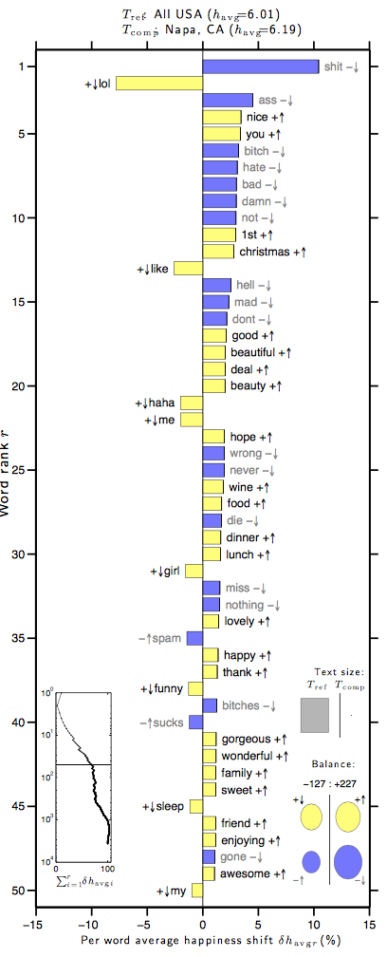
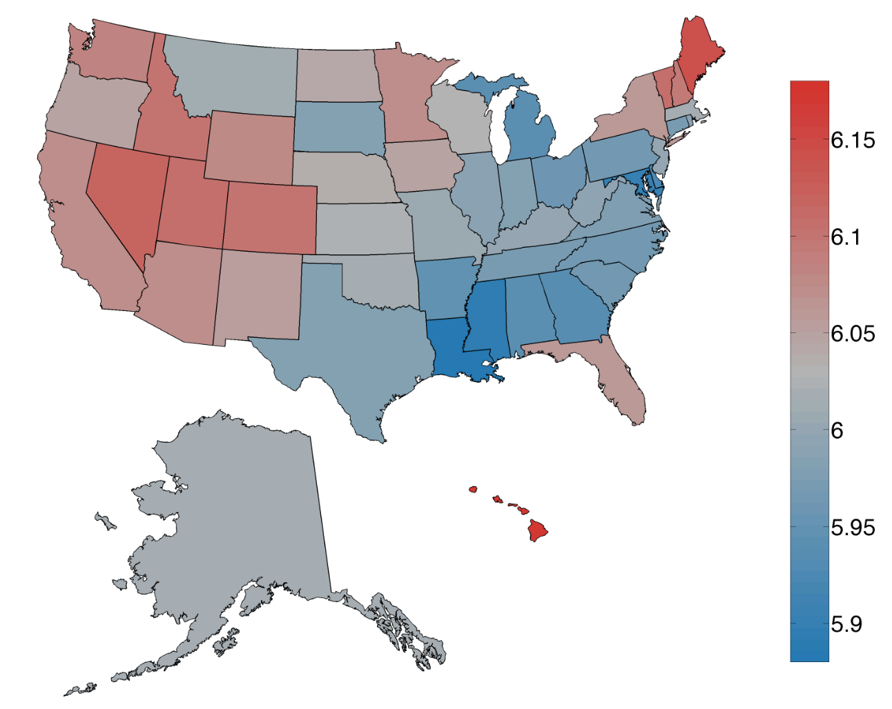
Related Work (1)
The Hedonometer Project - http://hedonometer.org/
Crowdsourcing methodology to collect human evaluations on the “happiness” of words.
Simple procedure for extrapolating ratings into textual corpora (e.g., tweets from a given month/region).
…An instrument that measures the happiness of large populations in real time!

Slide 6
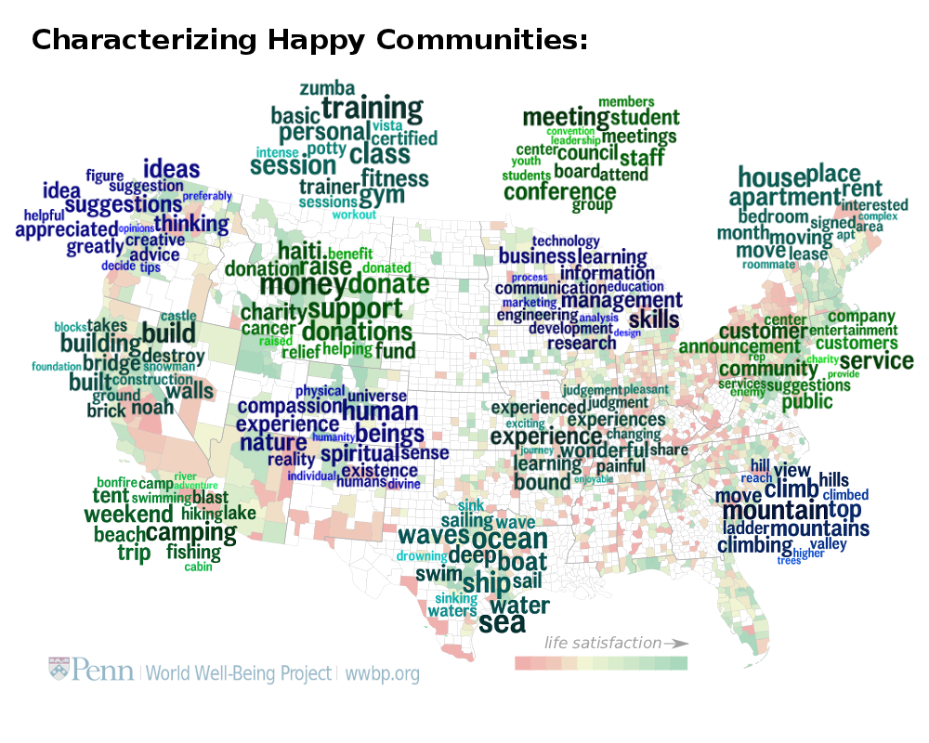
Related Work (2)
The World Well Being Project - http://wwbp.org
Language used in tweets from different U.S. counties was able to predict the results from a well-being survey.
Other studies within wwbp:
Psychological Language on Twitter Predicts County-Level Heart Disease Mortality
Towards Assessing Changes in Degree of Depression through Facebook

Slide 7
Overview
Motivation
The Proposed Work
Related Work
Estimating Well-Being
Lexicons considered in this study
Features representing well-being within particular geo-spatial regions
Predictive modeling
Experiments and Results
Conclusions
Future Work

Slide 8

Emotion Lexicons
Our approach is based on counting words over tweets…
Affective Norms for English Words (ANEW) Lexicon
A total of 1,034 English words rated by humans according to:
Valence, pleasantness of the stimulus (i.e., from happy to unhappy)
Arousal, intensity of feeling (i.e., from excited to relaxed)
Dominance, how much the reader feels in control
Adapted into other languages (e.g., Spanish)
LabMT Lexicon from the Hedonometer
A total of 10,222 English words rated according to happiness
(i.e., valence in the ANEW study) through crowdsourcing
Consistent with ratings from the ANEW study

Slide 9
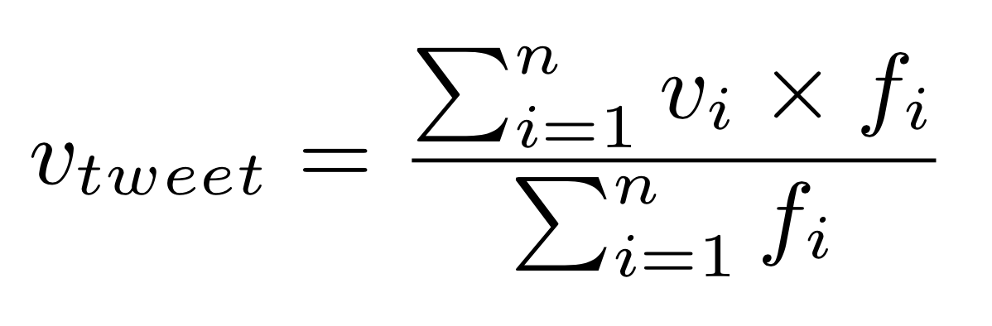
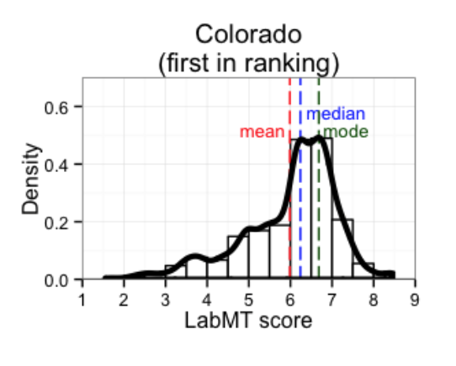
Features Leveraging the Lexicons
Extrapolate word ratings into tweets… for each dimension:
Compute features for geo-spatial regions, with basis on the corresponding geo-referenced tweets
Features capturing the distribution of the tweet ratings
Mean, median, mode, standard deviation, …
Also capturing num. of tweets
A total of 46 features

Slide 10
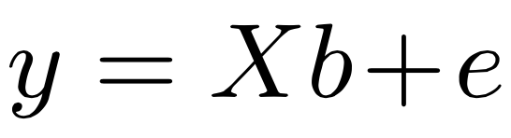
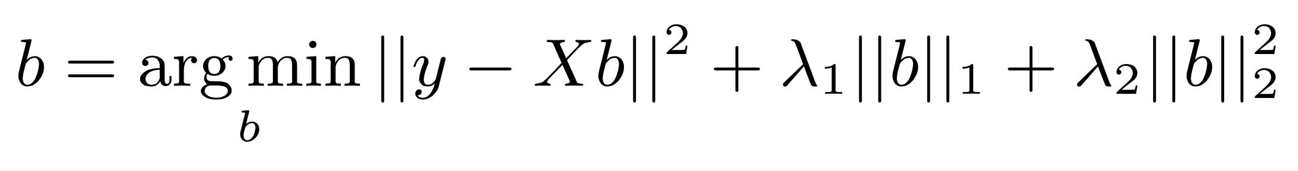
Predictive Modeling
Regions are represented as 46-dimensional feature vectors…
Regions are associated to well-being scores, as obtained through traditional surveys…
Regression modeling for estimating well-being:
Linear least-squares regression modeling
Model training with Elastic Net regularization approach

Slide 11
Experimental Methodology
Large collection of Twitter data geo-referenced to the U.S. territory
Approximately 500,000 tweets from the year of 2012
Tweets containing words from the lexica used in our study
48 states in continental U.S. (i.e., except Hawaii and Alaska)
Gallup-Healthways Well-Being Index for 2012
Phone interviews with approx. 1,000 individuals (7 days/week)
National average of 66.5 in 100.0 (61.3 in West Virginia ; 69.4 in Colorado)
Evaluation through leave-one-out cross-validation
Mean Absolute Error (MAE)
Root Mean Squared Error (RMSE)
Pearson’s correlation (ρ)
Kendall’s correlation (τ)

Slide 12
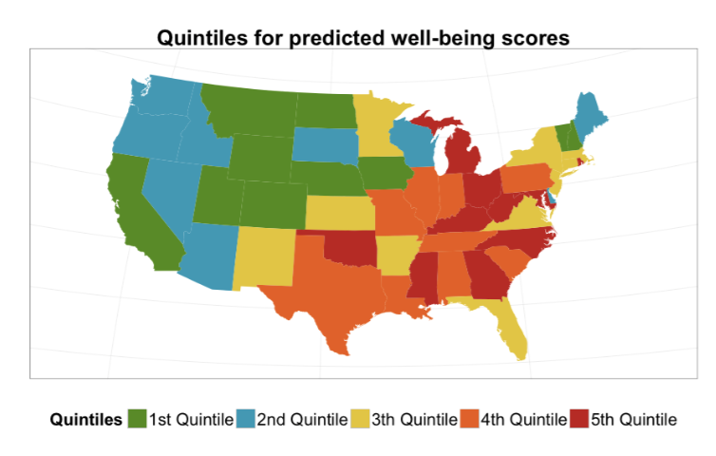
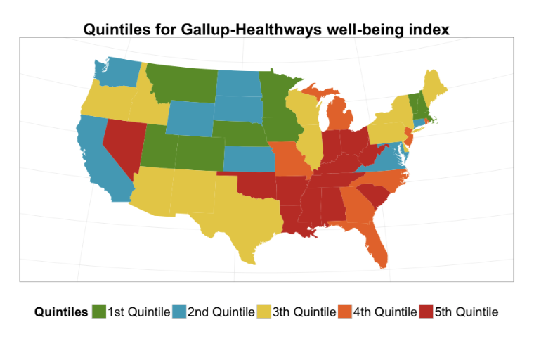
Experimental results (1)
Correlations of ρ = 0.7441 and τ = 0.5862
Study from the wwbp reported on slightly inferior values on data from 2010
Low errors of MAE=0.92 and a RMSE=1.22
Assigning average corresponds to MAE=1.40 and RMSE=1.73
Errors in ranking states like Maryland, Minnesota and Nevada…

Slide 13
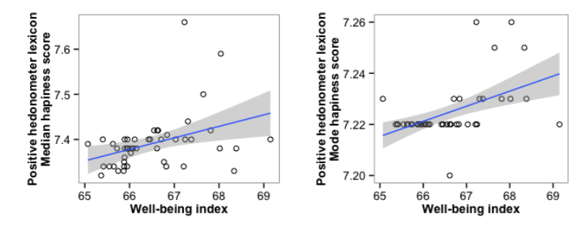
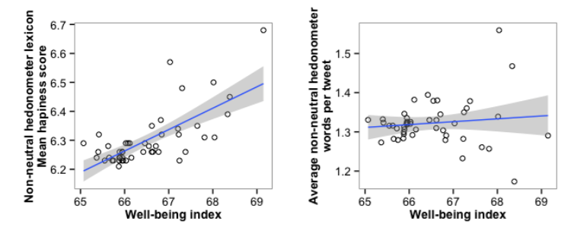
Experimental results (2)
Elastic Net regularization:
Only 28 features were informative for the regression model (of 46)
Most of the features with positive values in the estimated regression coefficients were obtained from the hedonometer lexicon.
mode of the happiness score obtained from filtered version of lexicon, only considering non-neutral words

Slide 14
Main Conclusions
We evaluated a simple approach for estimating well-being through predictive models leveraging Twitter data
Promising results in terms of correlations towards existing well-being surveys, although much remains to be done:
Check if our predictive models generalize well to other years and/or across geographic regions
Additional variables for accounting with Twitter’s demographics

Slide 15
Future work
Increasing the number of geo-referenced tweets
Explore automated geo-coding methods
Important for thin-grained spatial-temporal resolutions
Estimate happiness ratings for more tweets
Use distributional representations for words / documents
Unsupervised embeddings (e.g., word2vec)
Leverage ANEW-like lexicons for building predictive models for rating new words and/or documents
Other application domains besides tracking well-being
Public health surveillance, public opinion, political pools, etc.
See for instance www.popstar.pt

Slide 16

Thanks for your attention!
Predicting Well-Being With Geo-Referenced Data Collected from Social Media Platforms
Research work financed by FCT through projects
KD-LBSN, DATASTORM and through INESC-ID’s multi-annual funding
Bruno Emanuel Martins
bruno.g.martins@ist.utl.pt

