Slide 1


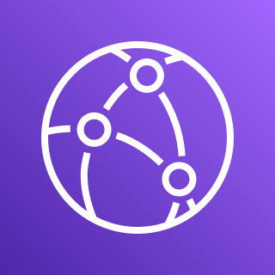


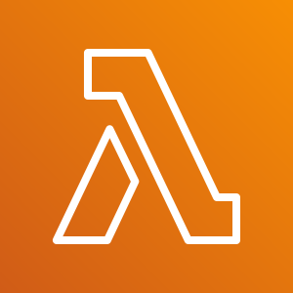


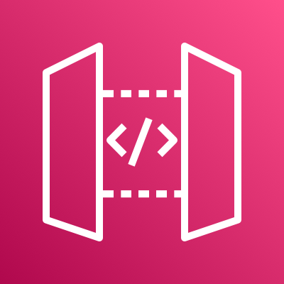
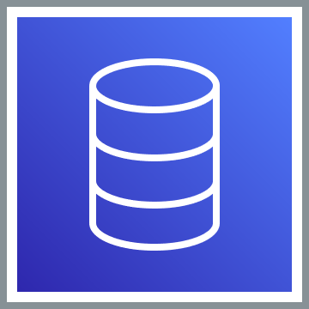






Users
VPC
Public subnet
Private subnet
CloudFront
AWS Lambda
IAM Authentication
S3 Bucket
(React Apps)
API Gateway
RDS Proxy
Internet Gateway
NAT gateway
User/Password
Authenticate
Authorize
Amazon Cognito
Bastian Host
Aurora/MySQL
PEM + User/Password
Developer

