Slide 1

ECEN 403-902
Single Phase Motor Startup Final Presentation
Samantha Wilson
John Florek

Slide 2
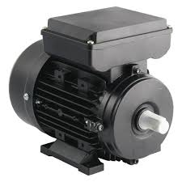
Executive summary
Problem statement:
When single phase motors startup, the rotor needs a lot of initial power to start running
This amount of inrush current is too much for power lines to safely provide, and can lead to regional blackouts
Our startup design will:
Switch the motor from the electric grid to a power supply during startup
Once the rotor speed is normalized, switch the motor back to the grid
Will be designing for a 1 hp motor, with eventual concept to be used for a 20 hp motor

Slide 3







Subsystem Overview
Grid
Charger
Relay
Inverter
Battery
Optoisolator
MCU
Notes:
Cloud server and database

Slide 4
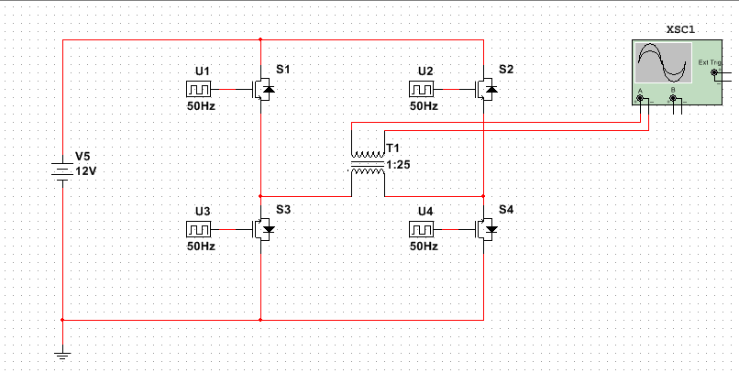
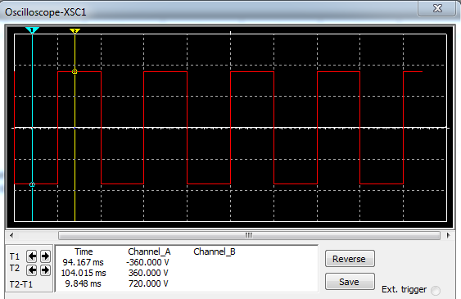
Power & Inverter Subsystem
Design Requirements:
Components rated for 12 V, 62 A, and 746 W
Switching frequency of 50 kHZ
Transistor Specifications:
IGBT - FGY40T120SMD
Ratings: 1200 V, 80 A, 882 W, 65 ns R.R.T.
Built in antiparallel diodes
Transformer Specifications:
First side rated for 400 V
Second side rated for 12 V, 83 A
Rated for 1000 VA

Slide 5
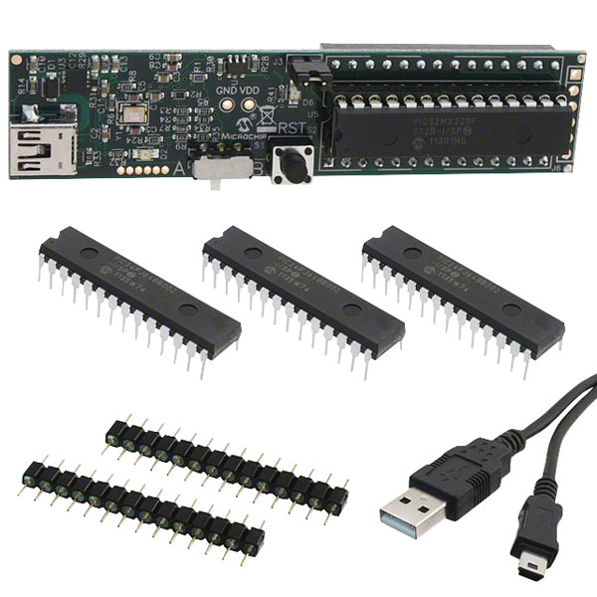
Microcontroller
Switched from MATLAB to MPLAB
PIC16F628A switched for DsPIC33FJ128MC802
Microstick II

Slide 6
Project Planner
October | Inverter design study and design selection | List of parts selected
November 11/1 – 11/15 | Microcontroller code started in Matlab | Inverter design started in Simulink
November 11/16-11/30 | Microcontroller code changed from Matlab to MPLAB | Tests performed to confirm that microcontroller could receive code from MPLAB | Complete inverter simulation
December 12/1-12/15 | Final Presentation | Design circuit using Eagle software | Order PCB with sponsor
Winter Break | Continued debugging on microcontroller code | Solder components to PCB

Slide 7
Questions?

