Slide 1
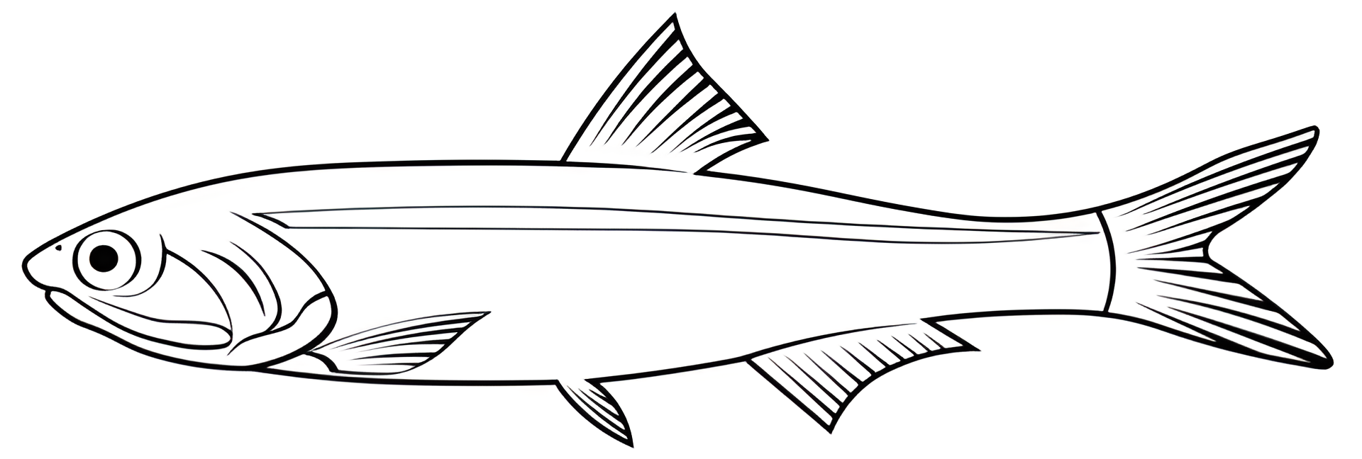





Somatic Maintenance
Food
Structure ($V$)
Maturation ($E_{H}$)
Reserve ($E$)
Reproduction ($E_{R}$)
Gametes ($E_{GAM}$)
Maturity Maintenance

