Slide 1
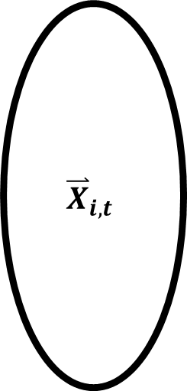
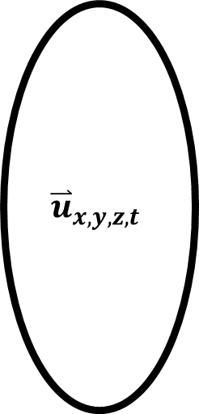
CROCO
Hydrodynamic
Model
$${\overset{⃑}{u}}_{x,y,z,t}$$
Ichthyop
Individual-Based Model
Transport
$${\overset{⃑}{X}}_{i,t}$$

Slide 2
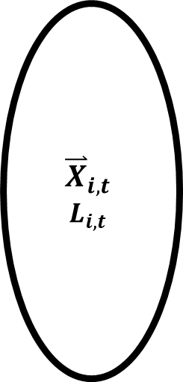
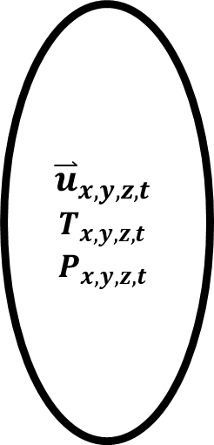
CROCO-PISCES
Hydrodynamic
(Biogeochemical)
Model
$${\overset{⃑}{u}}_{x,y,z,t}$$
$$T_{x,y,z,t}$$
$$P_{x,y,z,t}$$
Ichthyop-DEB
Individual-Based Model
Transport, Growth, Mortality
$${\overset{⃑}{X}}_{i,t}$$
$$L_{i,t}$$

