Slide 1
Unify your local music library
[WORKSHOP] Introducing MusicBrainz,
Picard, and ultimate music categorization
Justin W. Flory (licensed under CC-BY-SA 4.0)

Slide 2

: Wat?
Open source music metadata encyclopedia (est. 2000)
Store, categorize, sort (all languages and scripts)
Used by…
Developers: Build cool music apps!
Commercial users: Update local music databases with live updates from MusicBrainz (Spotify, Amazon, Google, Last.fm, etc.)
Users (that’s us!): Tagging your own music

Slide 3
Is MusicBrainz really that big?
Let’s look at some numbers…
Artists: 1,189,376
Releases: 1,769,002
Recordings: 17,152,131
Artist locations:
Countries: 259
Cities: 74,087
Islands: 96
Editor accounts: 1,781,906 registered (1,329 active last week)

Slide 4

But what about my audio dramas?
Yes, you can have your audio dramas, all 257 of them.

Slide 5

Metadata matters
Visibility
Find your music!
Record keeping
Write music history!
Research
Discover music science!
Notes:
Why does music metadata matter?
Visibility: To find music you want
Record keeping: To document music as a representation of culture or history
Research: To allow for easier analysis of music and trends related to music

Slide 6

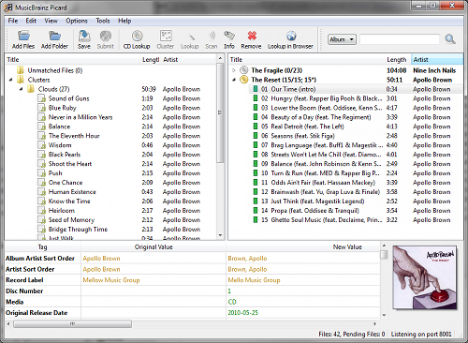
Introducing…
Tool to sort, scan, and correct metadata for you
References MusicBrainz database
Puts the right metadata in the right place
Album name, artist name, album artwork, release year…
Helpful for music tracking services (e.g. Last.fm / Libre.fm)
Helpful for cloud music players (upload and forget)
Available for Windows, macOS, Linux

Slide 7
Installing and using

Slide 8
Available for… almost everything
picard.musicbrainz.org
Windows / macOS: Installers available
Linux:
Ubuntu:
sudo add-apt-repository ppa:musicbrainz-developers/stable
sudo apt-get update
Fedora:
sudo dnf install picard chromaprint-tools
Why do I need chromaprint-tools?
Arch Linux, Debian, Gentoo, OpenSUSE, and others (see the docs)

Slide 9
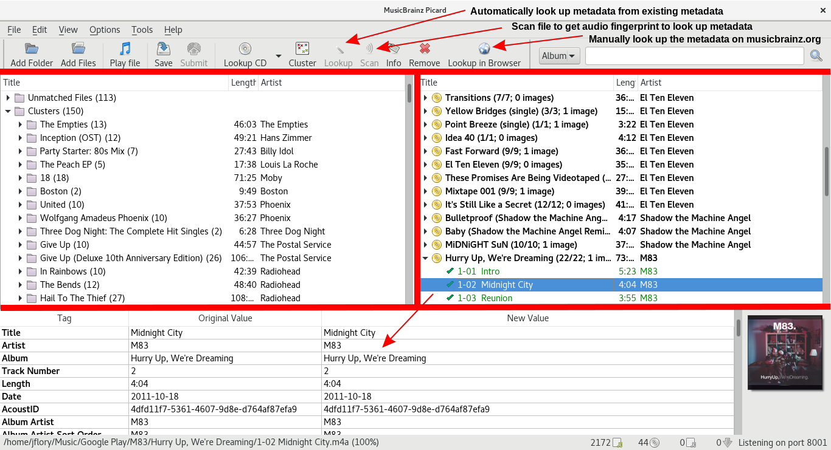
Exploring the MusicBrainz Picard interface

Slide 10
Conceptual demo

Slide 11
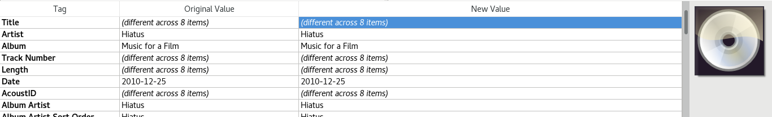
(1) Hey, look, this album doesn’t have album artwork, but I have it on my computer.

Slide 12
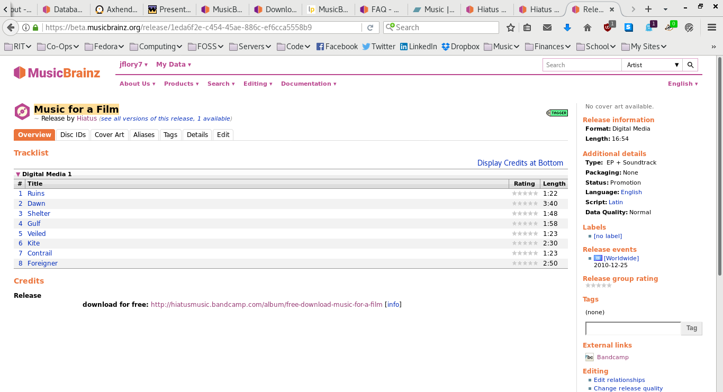
(2) Looks like there’s no artwork added to this release… let’s fix that!

Slide 13
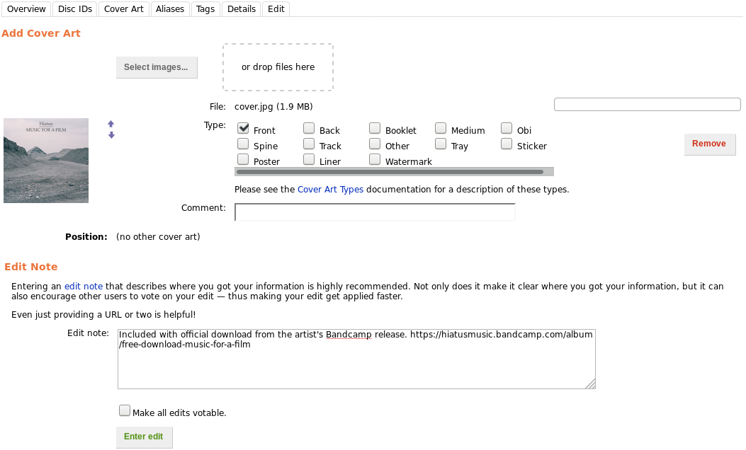
(3) Adding the front cover of the album artwork to the album (and cite the source!)

Slide 14
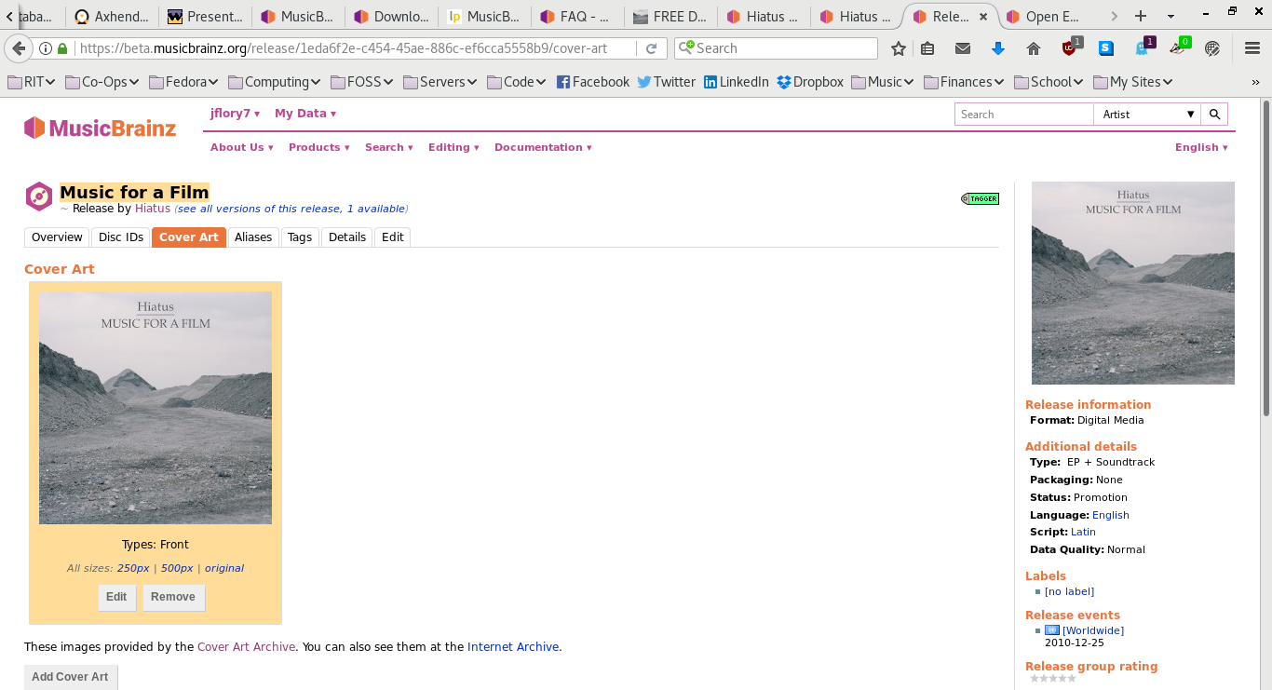
(4) Awesome, we did it! Album artwork is open to review for seven days before approval.

Slide 15
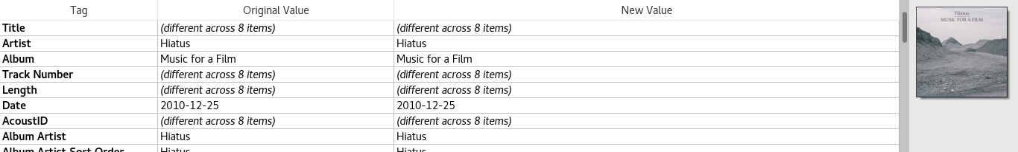
(5) Guess who's album artwork is in their music player now?

Slide 16
Hands-on demo!

Slide 17
Two different scenarios…
I know what I downloaded, but the music metadata could be improved or be more accurate. Now what?
I have literally no idea what this MP3 is or where it came from, but it’s catchy and I want to know more about it. Halp?

Slide 18
Open floor!
Comments? Questions? Ideas?
Find these slides
and more at:
git.io/vSU2d

