Slide 1
Open Source 101
Justin W. Flory
CC-BY-SA 4.0

Slide 2
What are we covering today?

Slide 3
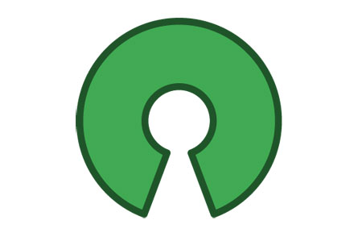
Agenda
What is open source?
  Quick gist of what it is and what it means
Open source beyond software
Getting git
Contributing to open source projects
  Finding a project and finding a good one
  Taking the first step into the Fedora Project

Slide 4
So, uh… what is open source?

Slide 5

At a literal glance
FOSS: free and open source software
Free as in speech, not just free as in pizza
Source code publicly available for reading, use, modification
Not only to describe software, but development practices, licensing, and communities that help build the software
Common set of values
Where is open source?
Your pocket
This room
Powering the Internet

Slide 6
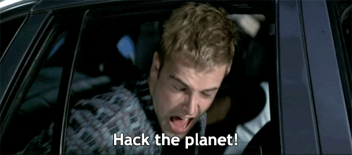
Beyond the code
Open source: Public code, but why?
Control: Examine the code, “have it your way!”
Training: Study guides! Get feedback. Share mistakes.
Security: More eyes on code, can be quicker to fix things
Stability: Open standards, if the maintainer leaves, someone else can lead
Timeline
1983: Richard Stallman, GNU project
1985: Free Software Foundation (FSF)
1989: GNU Public License (GPL)
1997: The Cathedral and the Bazaar
1998: Open Source Initiative

Slide 7
Four Freedoms of Open Source
Read: Freedom to read the code
Run: Freedom to run the code any way you like
Revise: Freedom to make changes to suit your needs
Redistribute: Freedom to redistribute your changes to others
These four principles (or four R’s) are part of what makes “free and open source software” free and open source

Slide 8
Linus's Law: Given enough eyeballs, all bugs are shallow

Slide 9
Examples of open source
On the web:
Linux: Powering ~79.3% of the web’s infrastructure
Apache HTTPD Server: “The Number One HTTP Server On The Internet”
Web technologies like Node.js, Flask, Ruby on Rails
In your pocket: Android, Reddit… teleirc!
On your laptop: Firefox, Chromium, SpigotMC (Minecraft)
In your code: Python, Swift, Dotnet

Slide 10
“…open source is an intellectual property destroyer. I can't imagine something that could be worse than this for the software business and the intellectual-property business.”
Microsoft, 2001

Slide 11
“Microsoft has been working with open source for a while — over ten years already. It started with support for Novell and PHP. […] Last year, Microsoft CEO Satya Nadella publicly declared the company's love for Linux, and he's remained true to his word since. Microsoft is now involved with 140 workgroups dealing with open standards, and actively supports more than 400 projects where code is written before being given back to the community.”
Microsoft, 2016

Slide 12
Open source beyond software
Maker movement
Open hardware
Using open standards to create and innovate
Open source goes beyond just code… it includes hardware and even the maker movement

Slide 13
Getting git

Slide 14
Git? What? What are we getting?
git: free and open source distributed version control system designed to handle everything from small to very large projects with speed and efficiency
English? tl;dr?
Save points in a video game
Revert back to a previous time in your code
Ledger of all revisions to your code, like a list of save points
Simplifies working collaboratively with others asynchronously

Slide 15
Application: Homework assignment
Imagine working on a homework assignment
Each time you add a major feature or hit part of rubric, you “commit” your code with git
You decide to be ambitious and go for bonus points
Uh-oh, you accidentally the entire assignment
It’s 3am and you want to go back to where you were three hours ago because that met the rubric requirements and was technically done
Revert back to a specific commit with git
Like magic, your code is restored to that point in time
Hooray! You can go to sleep with a completed homework assignment and secret disappointment over not getting the bonus

Slide 16
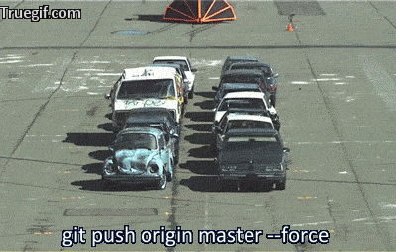
An alternative solution…

Slide 17
“Tag” milestones of your code
Another handy feature of git is tagging
“Tag” a commit as a specific point in history, like a version number
Create a “tag” as referenceable milestone in your code
For example, a personal project you are working on
You get it working and minimal functional, hooray! V1.0
Later, you hope to expand the features and add some other things
Skip ahead in the future, yay! It’s ready. V1.1
Both tags are easily reference for later

Slide 18
Working collaboratively

Slide 19

Git is great at code parties
Git makes collaboration with others easier
Handle commits from multiple “authors”, automatically merge them if there are conflicts (or make it easier to merge them manually)
More convenient than copy+pasting code among team members
Introducing pull requests*
Great way to handle code review
Partner 1 works on project and has code ready
Opens pull request against git repo (i.e. your code homebase)
Pull request has the code viewable by anyone but it is not actually “in” the main code
Once teammates review and look over it, they can accept and merge, or reject the pull request

Slide 20
What did the * mean?
A note about pull requests
Not really an “actual” feature of Git
More of a front-end tool

Slide 21
Where does GitHub fit in?
First, know this: git is just software
Anyone can download and install
Actual powerhouse behind this whole thing
GitHub is a public place for you to host repositories
GitHub adds fancy web presence for your project on their website
Easy to browse code online and sometimes even make small edits
Also comes with helpful tools like issue trackers, wikis, and project website hosting (for free!)
GitHub is only a front-end for git

Slide 22
In the real world

Slide 23
Why bother with this git thing?
Outside of using git to make projects and homeworks easier, it is widely in use
Git is industry standard for version control
Likely to experience it eventually while working for your degree
After graduating, if you write code in an organization or company, you are almost guaranteed to find git
It’s literally everywhere
Learning this now and applying it to “small” things like homeworks or projects make your future self’s life easier

Slide 24
“I can just learn this later.”
You can learn it later, but employers are already looking
Not uncommon for employers / interviewers to ask for your GitHub profile
Learning git and open sourcing your code is great way to show off experience and knowledge
Also has an ethical aspect about open source and what exactly that means for you and your code

Slide 25
Git is going to get you sooner or later.

Slide 26
Confused? Lost? Wondering how to actually do this?
Worry not!
Git is everywhere, thus…
Countless websites, guides, and documentation teaching git
By default, Git is a command line utility
If you’re just getting started, can be intimidating
The GitHub Desktop app is a great place to get started (desktop.github.com)
Has an easy-to-use, understandable, and functional GUI for interacting with Git and GitHub

Slide 27
Contributing to open source

Slide 28
Before going further…
Open source is something absolutely realistic for students to pursue!
Can be tough and confusing at first
But it’s not as hard as it seems from the outside!
There are many different projects of varying sizes – difference processes for getting involved
Here’s some tips for getting started with FOSS and what opportunities come with it!
Two big criteria for the search

Slide 29
(1) Finding a project that interests you
MOST important part of contributing to open source is contributing to something that interests you
Interest drives motivation and drives your likelihood to succeed
Wrong way to approach it is choosing a project based on connections you might make or trying to get your name out
Important, but will come in time
Look at your computer, your phone: what’s something you like? Is it open source? Are they using open source software?

Slide 30
(2) Aligning personal experience with interests
After finding a project, compare the project your own experience and knowledge
You don’t have to be an expert – but enough to break in somewhere is enough
Most obvious thing is programming language: Python, Java, JavaScript, Ruby, Rust, GoLang… the list goes on
There are more “hats” than just programmers
Open source needs designers, community people, marketing people, and writers as much as programmers!

Slide 31
Before jumping in, evaluate
Evaluating the project before immersing yourself is important: consider the community
Important to choose a community that will support you contributing to their project and acknowledge that you are a student
Read mailing lists, chat logs, hang out in development rooms… get an idea of what the community is like
Inclusivity and positive engagements are characteristics to look for
Also: look for helpful tips to get starting (a.k.a. on-boarding materials)

Slide 32
Benefits of contributing
Apply what you’re learning to real-world projects
Gain experience and build your skills further – and have something to point to
Networking
Meet brilliant people from across the tech world
Leadership opportunities
Chance to help lead on something you are passionate about
Your perspective matters
More students and young people need to be in open source
Friendships and travel opportunities

Slide 33
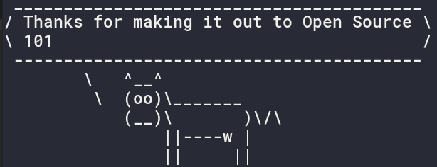
Questions? Comments? Concerns?
Stickers available on request!
Author: Justin W. Flory
Date: 2017 March 24
License: CC-BY-SA 4.0

Slide 34
References
https://opensource.com/resources/what-open-source
https://opensource.com/life/15/12/why-open-source
https://en.wikipedia.org/wiki/Free_and_open-source_software
https://www.gnu.org/licenses/gpl.html
https://opensource.com/life/16/10/my-open-source-story-justin-flory

