Slide 1


What open source and J.K. Rowling have in common
Importance of storytelling in open source projects
Speaker: Justin W. Flory
License: CC-BY-SA 4.0

Slide 2






Who am I?
Notes:
Open source aficionado:
Former community moderator, SpigotMC
Occasional MusicBrainz contributor
IT student from Rochester, NY
Fedora contributor:
Community Operations team lead
Fedora Magazine editor-in-chief
Fedora Community Blog editor-in-chief
Marketing team member
Ambassador
Diversity Team member
Games SIG member
Fedora Badges sysadmin

Slide 3

What I really do?
Notes:
Remove titles and names, get to the point:
Mostly involved in non-technical areas inside of technical communities
Always a listener!
Like discovering and contributing to a never-ending novel of Fedora community (more later)

Slide 4

“Was the talk title just clickbait?!”
Why J.K. Rowling? Is there “magic” in open source?
Storytelling ability: Captivation
Rowling’s line of work not unique to literature…
Uncommon but vital
Notes:
Clickbait?
Is the punchline that there’s magic in open source? Well, not quite…
Storytelling ability:
Rowling is an artist of suspense and captivation
Her works are page turners: when reading, you’re actively looking forward to what’s next
And guess what? Open source can be like that too!
Not unique to literature:
Storytelling isn’t only for books
Important component of open source projects to communicate our own stories to the world
It’s uncommon, but vital

Slide 5
“But… how is it part of open source?”

Slide 6

Where storytelling fits in
In a world of CODE… COMMITS… SOFTWARE…
Where does storytelling fit?
Meeting a goal, scratching an itch
Unique problems
Notes:
[dramatic intro] In a world… of CODE, COMMITS, SOFTWARE…
Where does storytelling fit into all of this?
Software is designed because someone had a need or a want (“to scratch an itch”)
Your mission: Goal to solve the unique problem by building software to address it
Like a plot in a novel, there’s a story behind your project’s mission and purpose
Challenge is how to communicate it

Slide 7

Why are stories important?
Two audiences: users and contributors
Users: Communicate purpose
Contributors: Knowing different sides of a project without being involved
Purpose: Keep people on the same page
  Like windows between two houses
Case study: Fedora <3 Python
Notes:
Two audiences:
Users: Communicate purpose, the reason your project exists
Need to demonstrate why project solves problem and why it effectively solves problem
More along the lines of traditional marketing: Art of persuasion and convincing
Contributors: In bigger projects, there’s a LOT of things happening!
Difficult to know what’s happening in different parts of a larger community
Example: Design teams and Ambassadors / product advocates
Purpose: Stay on the same page
Make it easier to show what’s happening in different parts of the project for contributors
Find the stories, pull them out, share them with the community
Encourage positive culture of sharing news with others
Metaphor: Windows between two houses
Case study: Fedora <3 Python
Communication between Fedora Design team, Marketing team, Python developers
Everyone was involved for the entire process
No “pass-offs” or linear processing – all synchronous
When communicating the story of this campaign proved helpful and built better product

Slide 8
“Okay, so how do I tell the stories?”

Slide 9
How to tell the open source story
Following “best practices”, using certain tooling
Helps extract story, improve visibility
WARNING: If looking for secret software or well-guarded secret to be revealed… sorry.
Goal is to use existing tools to maximum potential
Following tools are ordered from LEAST frequent to MOST frequent (but not by importance!)
Notes:
Telling the open source story: Following “best practices” and using certain types of tooling
Doing this helps you find and extract the story, boost visibility
Not as much specific tools as specific types of tools
Use existing tools to maximum potential: Tools are there, but are we using them the right way?
Following is quick selection of tools, ordered by least frequent to most frequent for when you use them
List is not exhaustive, so you can use some creativity for how it applies to your project

Slide 10
(1) README / project overview
Front door; first impression; first EVERYTHING for ANYONE
Users and contributors alike
You have one shot… make it count!
Prioritize, organize
Notes:
Front door / first impression: This is how you introduce your project to anyone for the first time
Both users and potential contributors will reference this
Set them off on the right foot! Communicate the big points clearly.
One shot: First impressions can be everything, so make sure you get it ready
Think back to target audiences
Make it easy for users to understand why your software rocks
Make it easy for potential contributors to get involved
Where to submit bugs, where the community talks / communicates, any easyfix bugs
Prioritize, organize: Better to have no README than too messy of a README
Think about how you present information – project overview should flow in a logical way
Use headers appropriately, can even categorize by audience

Slide 11
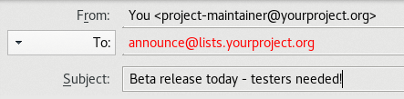
(2) Announcement mailing lists
Understandable to worry about sending too many emails, but…
Be cautious of frequency, but don’t make that an excuse
Notes:
Email frequency: Okay to be cautious, but don’t make this an excuse!
Mailing list is an asynchronous way for people to get updates
Voluntary subscription: They wanted to be there in the first place!
If following news and updates wasn’t interesting, they wouldn’t have subscribed…
So make a presence! Make use of it with thought, but be consistent

Slide 12

(3) Writing and blogging
Larger projects: Centralize!
Smaller projects: Consolidate!
Short and sweet
Better than long and “why did I ever think this was a good idea”
Case study: Fedora Community Blog
  communityblog.fedoraproject.org
Notes:
Larger projects:
Centralize information and news together, improve accessibility
Growing open source project is like a growing urban population: suburbanization!
Things get drift apart and become isolated
Need to bring together
Example: Contributor planet / aggregator, community news blog
Smaller projects:
Consolidate existing pages together, be consistent and vocal
Clearly document where to follow news, keep up with events
Short and sweet:
Don’t overthink – something small is better than nothing
Short and sweet keeps reader’s attention better
Try to get to point, connect to project purpose / goals
Community Blog:
Centralized community news site for larger project
Goal was to centralize contributor news by subproject to make it easier to find and discover
Sorted by sub-projects
New articles every week
Stats:
October 2015: 217
June 2016: 9,761
March 2017: 17,587
Effective communication that enables contributors to see the stories happening in Fedora

Slide 13




(4) Social media
Short, sweet, to the point!
Did you do something this week? Plans on the horizon?
Can you fit it into 140 characters? Great!
Notes:
Short and sweet – again!
This updates can be the most frequent and the easiest to write
Don’t have to write the life story of your project
Did you do something this week?
Have some goals on the horizon? Old bug that’s being worked on? New feature request?
Can you fit it into 140 characters? AWESOME. Tweet away!
Quality over quantity, but be consistent!
Give your followers and fans something to expect

Slide 14
“How do I know it makes a difference?”

Slide 15

Measuring success
How to measure success?
Case study: Fedora and fedmsg
Commits, builds, bugs, blog posts, translations, Ansible playbook runs, ticket comments, Ask Fedora questions
www.fedmsg.com
See: Fedora at FOSDEM 2016 (j.jwf.io/fedora-fosdem-2016)
Notes:
How to measure success?
Biggest question when forming a plan
To add context, will first look at case study with Fedora and fedmsg
Fedora and fedmsg:
Messaging bus that tracks many types of events happening in the project
Fedmsg is a firehose of data: together, it’s meaningless; filtered down, storytelling tool
Bee’s blog post:
Fedora’s impact at FOSDEM 2016 measured through badges
Who did we interact with as a newcomer? Who was already a contributor? What else can we learn?

Slide 16
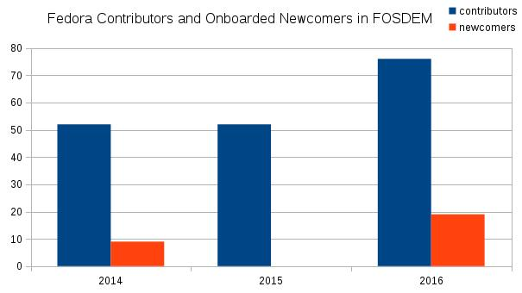
Who’s saying hello for the first time?
Notes:
Easy to see who we engaged with over the three year sample:
Summary: We met a number of newcomers, but we mostly engaged with contributors – either past or present

Slide 17

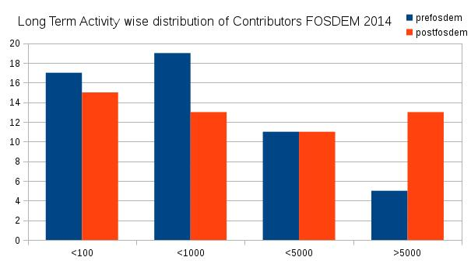
“It’s not worth it for Fedora to go to FOSDEM!”
“Out of 52 contributors who attended FOSDEM 2014…
…18 contributors increased long term activity and went up from lower to higher activity groups after FOSDEM…
…while 3 contributors had a decrease in their long term activity and went into lower activity regions after FOSDEM.”
Notes:
The real story at FOSDEM
Through fedmsg and data tools…
Able to draw firm conclusion about impact of Fedora presence at FOSDEM
Better able to show a story of Fedora as a community empowered by human, people interaction

Slide 18
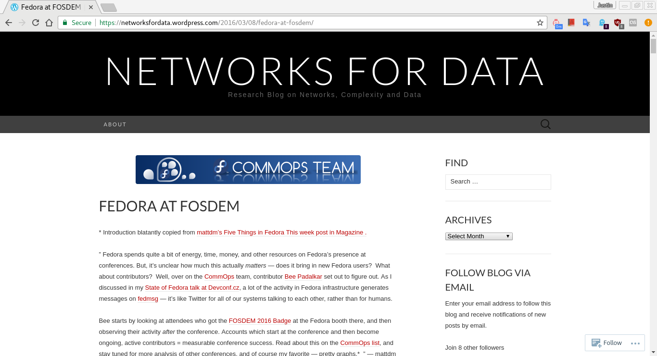
j.jwf.io/fedora-fosdem-2016
Notes:
Full analysis and details are on this blog, recommend reading!

Slide 19
Efforts meet results
How to show results?
Not everyone has tools like fedmsg
Common patterns to understand success
Measure # of commits / issues / pull requests
Account registrations
Conference / event engagement
Translated strings / languages
Notes:
How to show results?
Obviously, not everyone had fedmsg
But there’s ways you can make your own data observations with things you already have
Follow common patterns to understand success
Every project has some sort of mechanism that can be tracked
Specifics will depend on your project, but some of these might include…

Slide 20
There is a story.
Notes:
But in the big picture, there is a story.

Slide 21



One person saw a world of wizards, witches, and magic. She shared it. She inspired billions.

Slide 22
You have a story. Find your story. And share it.

Slide 23
Thank you!
Questions?
Speaker: Justin W. Flory
License: CC-BY-SA 4.0

Slide 24
Credits / attribution
Images / data
Books by Mikhail Pavstyuk, Unsplash
Fedora at FOSDEM, Bhagyashree (Bee) Padalkar
Harry Potter: The Perfect Fictional Hero by Annie Ryan
Find me!
Email: jwf@fedoraproject.org
Twitter: @jflory7
Inspiration
Remy DeCausemaker (decause)
Brian Exelbierd (bexelbie)
Fedora CommOps team (you guys rock!)
Stephen Jacobs, Dan Schneiderman
Fedora community for all of the lessons I’ve learned…
SpigotMC community and Michael Dardis
So many, many, many more incredible people!

