Slide 1
Cognitive Trainer for Computer Science Professionals
Charleston Southern University, Fall 2023
CSCI 499 – Senior Project Defense
Presenter: Mr. Jonathan Flum
Notes:
Introduction (0:30)

Slide 2
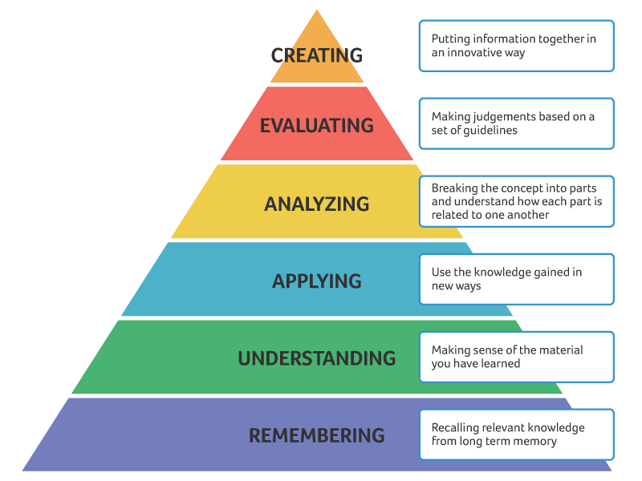
Bloom’s Taxonomy
Establishes levels/domains of teaching, learning, and assessment.
Higher orders represent increasing levels of knowledge mastery.
Where do we tend to operate within our day to day lives?
Potential for unpredictable results if not accustomed.
Fig. 1. Bloom’s Taxonomy (Revised). Image credit: University of Connecticut (CETL)
Notes:
Context (1:30)

Slide 3
Neuroplasticity (cognitive training)
Establishing neuropathways that are more effective at processing information.
How can we more frequently access these higher orders?
Some examples:
Reading regularly
Solving puzzles
Playing an instrument
What else?
Fig. 1. Bloom’s Taxonomy (Revised). Image credit: University of Connecticut (CETL)
Notes:
Context (1:30)

Slide 4


The Problem
Large Time Investment
Extensive Requisite Knowledge
VS
But, what if we could utilize basic information that the user has already mastered and combine that data in new, challenging ways?
Notes:
The Problem (0:30)

Slide 5

The Solution
Premise of the Cognitive Trainer:
The user is presented with various data sets (Tiles) consisting of various combinations of the following:
Colors
Numbers
Shapes
Any text representation of the above attributes
And one or more queries that require:
Interpretation of the data (via analysis/evaluation).
A timely and accurate response.
BG color
Shape/ Shape color
Number/
Number color
Tile ID number
Fig. 2. Example Tile (Intermediate difficulty)
Notes:
The Solution (2:00)

Slide 6
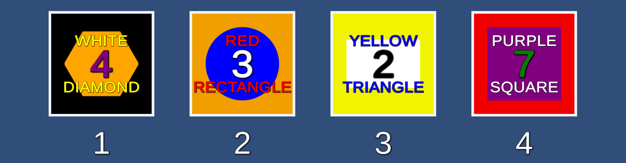
The Solution (cont.)
Fig. 3. Example Playfield (Experienced difficulty)
Complexity + Pressure = Critical Thinking
Notes:
The Solution (2:00)

Slide 7

Notes:
Practical Application (3:00 max)

Slide 8
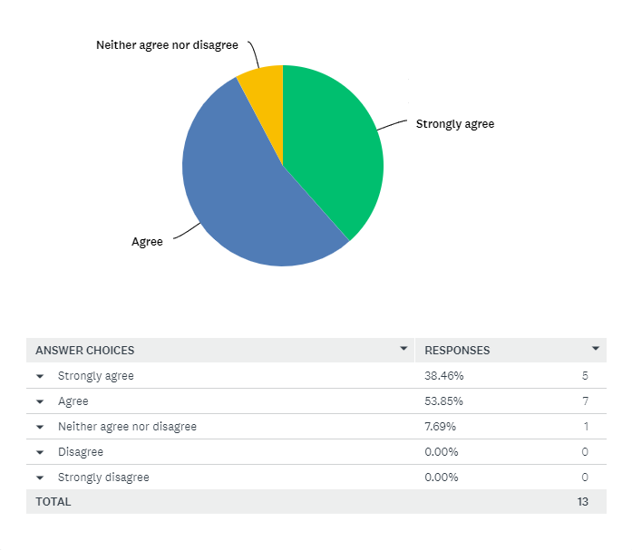
Usability Results
“I would be interested in engaging with this product on my own time (e.g., if it were not required as part of an academic or professional development curriculum).”
Notes:
Results (1:00)

Slide 9
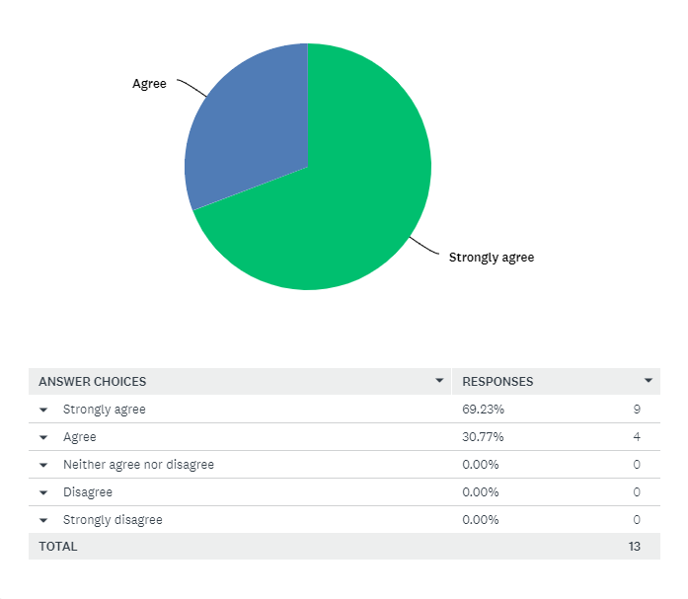
Usability Results
“This product challenged me to apply knowledge, analyze information, or critically evaluate data.
Notes:
Results (1:00)

Slide 10

Usability Results
“This product challenged me to achieve accurate and decisive problem resolution.”
Notes:
Results (1:00)

Slide 11
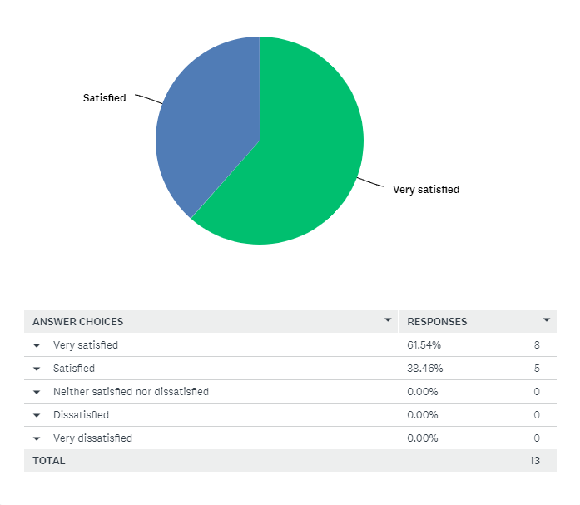
Usability Results
“Please rate your overall experience and satisfaction with the application.”
Notes:
Results (1:00)

Slide 12

Future Enhancement
Case Study Validation
A controlled experiment should be conducted comparing the academic performance of students within a specific course of study who engage in a prescribed use of the program versus those who do not.
Functional Extension
Centralized user account mechanism (DBMS)
Administration functionality suitable for academic or professional integrations.
Notes:
Future Enhancements (1:00)

Slide 13
Questions?
Play in browser at https://jflum.github.io/Cog_Trainer/
Notes:
Questions (5:00)

