Slide 1
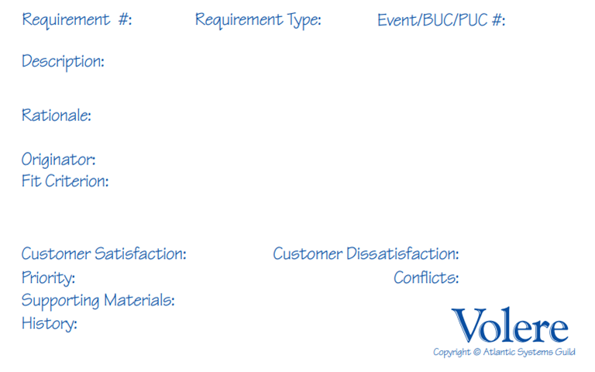
1.01
Functional
The program shall display randomly generated cards containing compound data assembled from colors, numbers, and shapes.
Compound data, whose individual parts have already been mastered, form the basis of information that necessitates complex thought.
J. Flum
Per round, four tiles shall be instantiated, each containing a background color, a colored shape within it, a colored number, and colored text describing a written number and a written shape.
5
5
High
n/a
n/a
n/a
Notes:
Status dots: GREEN – pass, YELLOW – modified pass, ORANGE – not implemented, GREY – requires further testing

Slide 2
1.02
Functional
The program shall prompt the user with a query that requires evaluation and analysis of the displayed tiles in order to answer.
Performing evaluation and analysis of compound data will facilitate (and isolate) training to higher orders of cognizance.
J. Flum
Per round, a query will be generated from the instantiated tile set consisting of a minimum of two operations a user must perform on the presented data.
5
5
High
n/a
n/a
n/a

Slide 3
1.03
Functional
The program shall begin a countdown timer once a tile set and query have been displayed to the user.
Performing evaluation and analysis of data under a time constraint supports the development of user speed and decisiveness.
J. Flum
Per round, a brief window be afforded for users to analyze and interpret the presented data against a specified query. The timer shall indicate remaining seconds and prevent input once expired.
5
4
High
n/a
n/a
n/a

Slide 4
1.04
Functional
The program shall accept a user’s input as response to a query in text form and validate the answer against the appropriate solution.
Evaluating the accuracy of a user’s response is a fundamental aspect of developing critical thought and proficiency.
J. Flum
Per round, a user’s response will evaluated against the generated tile set and query presented. The answer will be either correct or incorrect, with no facility for partially accurate answers.
5
4
High
n/a
n/a
n/a

Slide 5
1.05
Functional
The program shall continue presenting data and associated queries for a specified number of rounds or a specified amount of time.
Repetition over a short period of time, will aid in long-term proficiency of the skills required for analysis and evaluation.
J. Flum
Per game, after initial presentation, a new round will take place upon answering (correctly) or on time expiration and the game will terminate upon set time or round limitations.
4
5
High
n/a
n/a
n/a

Slide 6
1.06
Functional
The program shall measure and report the accuracy of a user’s game session, as well as track performance over time.
Gameplay usage and statistics are helpful metrics in motivating use, by establishing a personal baseline and measuring improvements.
J. Flum
Per game, upon completion of a session, the user will be presented a ‘score’ indicating performance metrics derived from the number of correct and incorrect answers, as well as speed.
4
3
Med.
n/a
n/a
n/a

Slide 7
2.01
Look and Feel - Appearance
The program shall be attractive to college-aged students and/or adult professionals.
Engagement and acceptance of the target audience is a necessary component of the program’s initial and repeated use.
J. Flum
Provided a random, representative sample of the target population, a majority of users (>50%) will, of their own volition, engage with the product.
4
3
High
n/a
n/a
n/a

Slide 8
2.02
Look and Feel - Style
The program shall be professional and simple in design, more representative of a game than productivity software or a utility.
To maximize repeat engagement and enjoyment of the program, the user should not associate performing the tasks as ‘work.’
J. Flum
Provided a random, representative sample of the engaged target population, a large majority of users (>75%) will, of their own volition, demonstrate reuse of the product.
4
3
Med.
n/a
n/a
n/a

Slide 9
3.01
Usability – Ease of Use
The program shall successfully facilitate a productive game session for users with no prior experience.
While still being challenging, the goals of the query and response format should be intuitive in order to not discourage new users.
J. Flum
Provided a random, representative sample of the target population, a majority of users (>50%) will see a game session to completion with at least one correct answer.
3
4
Med.
n/a
n/a
n/a

Slide 10
3.02
Usability – Personalization
The program shall allow configuration options for the length of time allotted per round as well as associated problem complexity.
The current skill set of each user will be different. Difficulty options provide and allow for a challenge while not being discouraging.
J. Flum
Provided a random, representative sample of the target population, a vast majority of users (>90%) will be able to achieve an accuracy rate of 50% or greater by adjusting difficulty.
4
5
Med.
n/a
n/a
n/a

Slide 11
3.03
Usability – Learning
The program shall contain a tutorial mode, which allows, but does not require, new users to gain confidence in the gameplay loop.
Learning how the program operates in its intended format (time restricted) may not be suitable for all persons.
J. Flum
Provided a random, representative sample of the target population, all users (100%) will see a tutorial session to completion with at least one correct answer.
4
3
Low
n/a
n/a
n/a

Slide 12
3.04
Usability – Understandability
The program shall utilize commonly recognized terminology and iconography for common actions, such as accessing settings.
The user should not be burdened with an interface that introduces ambiguity with regard to their desired selections.
J. Flum
Provided a random, representative sample of the target population, a large majority of first-time users (>75%) will report a clear understanding and predictability of interface actions.
3
5
High
n/a
n/a
n/a

Slide 13
3.05
Usability – Accessibility
The program shall implement an alternative color scheme option for users who may have a visual impairment.
The correct identification of colors is one of three main requirements for solving a query. As such, an alternative needs to be available.
J. Flum
Provided a random, representative sample of the target population having visual impairment(s), a majority of users (>50%) will be able to perform color analysis tasks.
2
4
Low
n/a
n/a
n/a

Slide 14
3.06
Usability – Accessibility
The program shall implement a larger, alternative text option for users who may have a visual impairment.
The correct identification of text objects is one of three main requirements for solving a query. Readability should be configurable.
J. Flum
Provided a random, representative sample of the target population having visual impairment(s), a majority of users (>50%) will be able to perform text analysis tasks.
2
4
Low
n/a
n/a
n/a

Slide 15
3.07
Usability – Convenience
The program shall ‘remember’ a user and his/her personalization settings, options, and past performance.
Requiring a registered or logged in user to adjust their settings for every session would likely lead to product abandonment.
J. Flum
Provided a random, representative sample of the engaged target population, a vast majority of returning users (>90%) will rate the process of resuming their training to be “simple” and “easy.”
3
5
Med.
n/a
n/a
n/a

Slide 16
4.01
Performance - Speed
The program shall have an initial, non-cached, maximum load time of 30 seconds.
Excessive load times for a web-based application can have detrimental effects on user acceptable and therefore deter use.
J. Flum
Provided a random, representative sample of the target population with a high-speed internet connection, a vast majority of users (>90%) will be able to load the program within 30 sec.
2
5
Med.
n/a
n/a
n/a

Slide 17
4.02
Performance – Safety Critical
The program shall not permit game sessions exceeding a reasonable amount of time, as to not induce typing injuries.
Extended, high-intensity, and repetitive keyboard use can cause or exacerbate hand and arm injuries in some persons.
J. Flum
In accordance with OSHA Computer Workstation guidelines, user configurable game sessions will be limited to a maximum of one hour, requiring a 5 minute break before a new one can be started.
1
2
Low
n/a
https://www.osha.gov/etools/computer-workstations/additional-information
n/a

Slide 18
4.03
Performance - Accuracy
The program shall validate user responses to query with 100% string accuracy, disallowing like-type matches.
Because the nature of the program is to develop critical accuracy skills of user, partial matches and/or typos will be deemed incorrect.
J. Flum
Provided a random, representative sample of the target population, all users’ (100%) input must be accurately evaluated, identifying each response properly as correct or incorrect.
4
5
High
n/a
n/a
n/a

Slide 19
4.04
Performance - Availability
The program shall be available nearly 24 hours a day, via public web access, at a measure of 99% uptime.
The efficacy of the program relies on the user’s ability to access it and perform tasks at his/her convenience, which may be any time.
J. Flum
Provided a random, representative sample of the target population, all users (100%) will report successful access to the program within 10 minutes of an attempt (if not immediate).
3
4
Med.
n/a
n/a
n/a

Slide 20
4.05
Performance - Fault-Tolerance
The program shall implement a redundant user profile database as a backup in the event of data loss/corruption.
If users were to lose their ‘progress’ or past performance metrics, as well as personal settings, it could lead to product abandonment.
J. Flum
The program’s primary database will be backed up on a weekly basis to ensure minimal data loss in a fault or failure case requiring a restoration event.
3
5
Med.
n/a
n/a
n/a

Slide 21
4.06
Performance - Capacity
The program shall support 100 concurrent users/site visitors, with minimal, if any degradation to performance.
In the event that many users wish to access the program at the same time, e.g. during peak hours, latency should not become intrusive.
J. Flum
As the program will be hosted via GitHub Pages, bandwidth and traffic limitations are not of direct control, however file sizes may not exceed 100Mb individually and 1Gb in total.
2
4
Low
n/a
n/a
n/a

Slide 22
4.06
Performance - Scalability
The program shall support 100 concurrent users/site visitors upon launch, but its user base is expected to grow to 500 within 3 years.
The initial implementation, with regard to it user database and initial hosting, via GitHub, may reach inadequacy in the near future.
J. Flum
As the program will be hosted via GitHub Pages, if bandwidth usage reaches 80% of allocated throughput at any given point, migration/extension efforts should be commenced.
2
3
Low
n/a
n/a
n/a

