Slide 1
Ethics in Computer Benchmarking
Jonathan Flum

Slide 2

What is benchmarking?
Real world performance evaluation of a computing system
Processing speed
Memory/storage capacity
Battery Life
Assists consumers in determining value
Ultimately influences purchase

Slide 3
Why is this important?
LAPTOP BRAND | CPU | RAM/HDD | BATTERY LIFE | PRICE
“Samsung” | 2.5 GHz | 8G/1TB | 4 hours | $599
“Lenovo” | 2.5 GHz | 8G/1TB | 6 hours | $599
“Acer” | 2.5 GHz | 8G/1TB | 5 hours | $599
“Toshiba” | 2.5 GHz | 8G/1TB | 12 hours | $599
But… are Toshiba’s claims accurate?

Slide 4
Why make false claims?
Not “made up” specifications:
Technically accurate, but…
Not representative of intended use
Misleads consumer
False sense of value
Persists due to marketing advantages/competition

Slide 5

Common Exploits
Using out-of-date testing software
Reduces measurement accuracy
Computer setting manipulation
Artificially boosts performance
Exploitation of software flaws
Produces biased data output

Slide 6
Evolution of Testing Methods
Process development over 50 years has increased benchmark precision
Older versions contain greater amount of inaccuracies/assumptions
Out-of-date software can be utilized to inflate system specifications
Level of Accuracy
Manual/Software
cir. 1960
Time
Present

Slide 7
Settings Manipulation
Unrealistic setting adjustment → longer battery life
Minimum screen brightness
Reducing screen resolution
Disabling WI-Fi, other peripherals
Relying solely on solid state storage
(Optical drives, physical drives, etc. disabled)

Slide 8
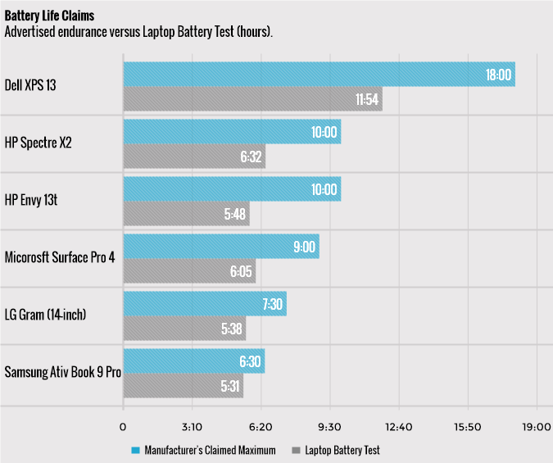
Battery Life Comparison

Slide 9
Cheating Benchmark Software
Computer code optimized to favor specific benchmarks
Tweaking drivers to ignore certain processes
Lowering computation accuracy to increase performance
Process offloading to other areas
Relying solely on solid state storage
Optimization results in higher benchmark score
Has no real impact in real world performance

Slide 10








Known Industry Culprits
Documented cases, lawsuits, and/or inquiries over benchmark manipulation

Slide 11

Summary
Be a wise consumer!
Look out for:
Inaccurate Performance claims
Inflated Battery life claims
Specifications that do not contribute to real world usage
Do your own research
Get the most bang for your buck.

Slide 12
Questions?

