Slide 1
The PlayStation Network Breach and Outage (2011) “..the biggest Internet security break-in ever“ – Reuters News Agency
Jonathan flum
Csci 301

Slide 2
Context that led up to the breach:
January – Sony sues hacker “GeoHot” and his accomplices for circumventing the security system of the PlayStation 3 and making the jailbreak tools publicly available
March – Courts authorize Sony’s request to obtain the IP addresses of every person that that accessed his website to download these tools
April 3rd – The hacktivist group “Anonymous” launches various cyber attacks on Sony websites in retaliation for their legal pursuit.

Slide 3
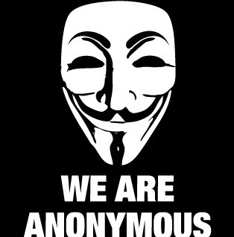
A looming threat:
April 11th – Sony settles lawsuit with “GeoHot,” but “Anonymous” announces it will continue its protest…

Slide 4
“Anonymous” keeps their word:
April 19th – Sony’s network team detects unauthorized activity in the PlayStation Network system.
4 servers are taken offline
April 20th – Early investigation indicates that data of some kind was transferred off their servers.
6 more servers are taken offline.
Sony is unable to determine what information was stolen and shuts down the entire network that same day.
The remaining 120 servers are taken offline.

Slide 5
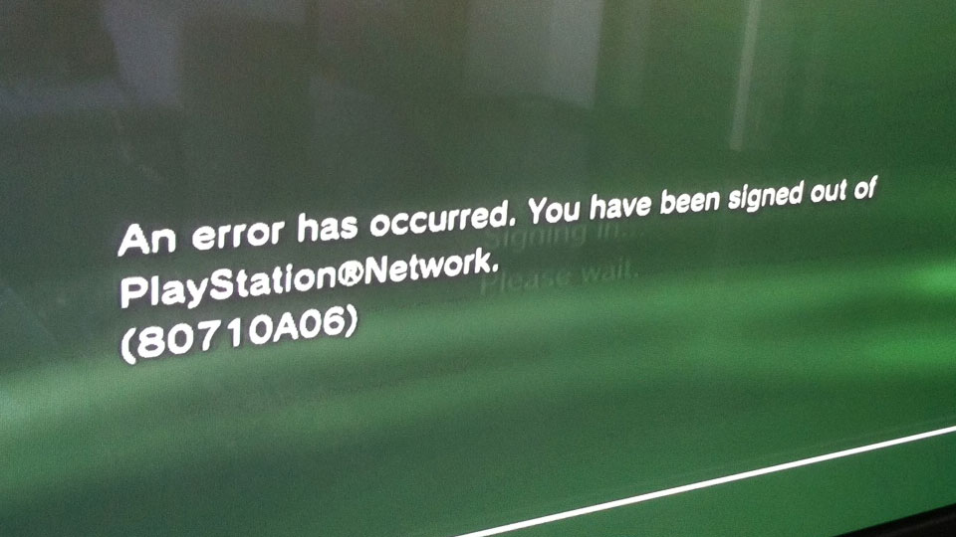
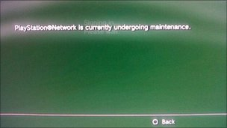
Users are confused…

Slide 6
Sony’s action and response:
April 21st - 25th – A second forensic team and computer security firm is hired, investigations intensify
The scope of data loss is determined, effectively all PII for every user
April 26th – Sony provides a public statement regarding the intrusion (note: 6 days after the breach)
Does not immediately confirm Credit Card data was stolen
May 14th – Firmware update 3.61 is released as a security patch and the PlayStation Network began restoring in geographical phases.

Slide 7
The aftermath and verdict:
$171 million dollars in losses (just for Sony)
Sony’s “Welcome Back” Program = 2 free games and a 30 day PS Plus subscription for your trouble.
Public out roar, consolation prize not even close to being commensurate with potential for personal damages
Thus, several lawsuits filed against Sony
Loss of public trust in safeguarding information
Rulings indicated that there is no such thing as a perfect, unbreachable system
Sony later offered credit monitoring & identity theft insurance to affected users.

Slide 8
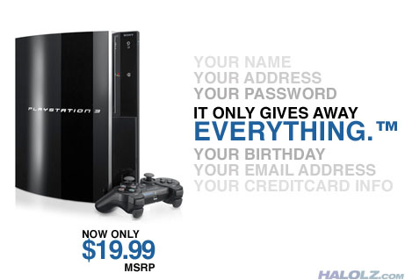
The aftermath and verdict, cont.:
77 million accounts compromised:
Name, address, and other personal details
Email accounts/passwords and other credentials
Credit card, stored payment information
Majority of data was not encrypted on the network!

Slide 9
How did it happen?
Exact vector of attack never made public, but understood to likely have been a software exploit.
SQL Injection?
External to network
Security vulnerability found through previous DDoS attacks on Sony?
Development unit / Rebug CFW exploit?
Internal to network
Trusted credentials that allow access to customer details database

Slide 10

How could it have been prevented?
If we subscribe to the Rebug custom firmware (CFW) theory:
PSN recognized the hardware (falsely) as a Development Unit
“Trusted Access” permission was given to console, authorizing access to databases and other internal network data
Sony’s network security software likely did not account for an attack of this type to take place from within it’s ‘trusted network.’
Therefore, no mechanism in place to prevent it

Slide 11
How can we do better in the future?
All powerful “Trusted Access” credentials are a bad idea
Store Personally Identifiable Data with encryption
Consider all the possible vectors, both internal and external
Implement redundant safeguards where possible
Continually evaluate, improve, and deploy measures

Slide 12
Questions?

