Slide 1
Segmenting and Clustering Neighborhoods in Boston
John F. McCarthy
Coursea Capstone Project
August 23, 1019

Slide 2
Introduction
Hypothesis
Health status indicators directly correlate with the frequency of specific venues within 500 meters of the centroids in 24 Boston neighborhoods
Value of Analysis
This analysis should be of interest to both public health officials and city planners, as well as developers, in attempting to remediate health related disparities and improve community health

Slide 3
Data
Geospatial Data
Latitude and Longitude of each Boston neighborhood was derived from the shape files at https://data.boston.gov
The centroids of each neighborhood were calculated using Arcgis online and the tools provided
Health Status Data
Health status indicators were obtained by manually populating a CSV file from data contained within the online document “Health of Boston 2016-2017” at http://www.bphc.org/healthdata/health-of-boston-report/Documents/_HOB_16-17_FINAL_SINGLE%20PAGES.pdf.

Slide 4
Methodology
Processing Geospatial Data
Pandas data frame created from CSV file at https://data.boston.gov
Python used to filter and relabel some columns
Geocoder library (geopy.geocoders) was used to extract longitude and latitude for each neighborhood
Folium library used to create a map of the Boston neighborhoods with superimposed centroids
Foursquare API was employed to generate a list of venues in each Boston neighborhood
Resultant JSON file was processed to create a new data frame containing the category name of each venue and one-hot encoding was then used to obtain the frequency of venue occurrence by neighborhood
KMeans clustering was applied using the scikit-learn library (sklearn.cluster) with cluster size of 5 (k=5)
Resultant clusters were superimposed on the Boston neighborhood map using the Folium library and the top 10 venue categories in each of the clusters were examined

Slide 5
Methodology
Processing Health Status Data
A CSV file was created and populated using data extracted from neighborhood maps contained in the online document “Health of Boston 2016-2017” and loaded into a Pandas data frame
Each health status indicator was coded as less than the neighborhood average (-1), equal to the neighborhood average (0), or greater than the neighborhood average (1)
Ethnicity was coded as white (1), mixed (0), or black (-1).
Population density was coded as within the IQR (0), above the IQR (1), or below the IQR (-1)
KMeans clustering using the scikit-learn library with 5 clusters (k=5) was performed
Clusters were summarized by taking the mean across each neighborhood health metric within a cluster
Each cluster summary metric was reported on a -1, 0, 1 scale for below, equal, or above the cluster mean
The degree of neighborhood overlap between each vendor cluster and its corresponding health status cluster was determined
Each health status cluster was examined, aligned with the corresponding venue cluster, and speculations proposed regarding the impact of specific vendor categories on the heath status of neighborhoods in a given cluster

Slide 6
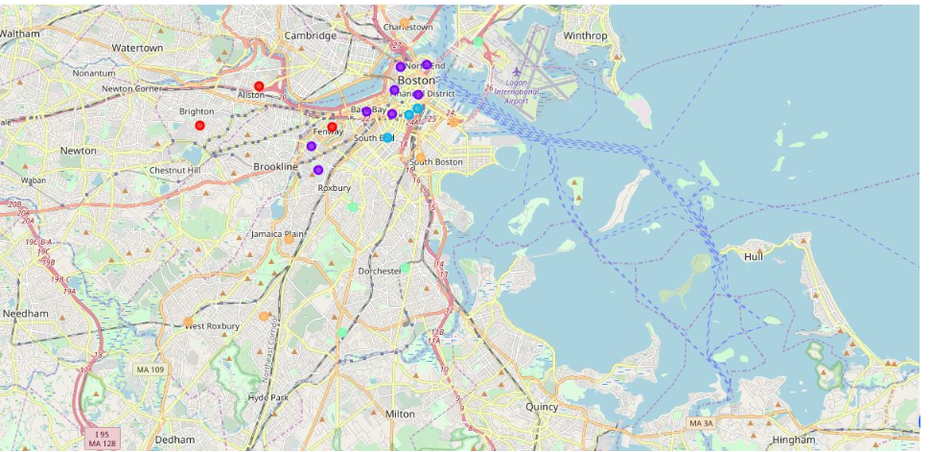
Results
Clustering by Health Status

Slide 7
Results
Health Status Clusters
Cluster 1:
Size=3
Neighborhoods: Alston, Brighton, Fenway
Health Status: White, Age>65, HS Educated, Low Unemployment, Much Open Space, Physically active, Low Uninsured, Nonsmoking, Low sugary drink consumption, Good nutrition, Low obesity, Low chronic and infectious disease mortality, Low substance and opioid mortality, High psychiatric hospitalization, High life expectancy.
Cluster 2:
Size=8
Neighborhoods: Back Bay, Bay Village, Beacon Hill, Downtown, Longwood, Mission Hill, North End, West End
Health Status: White, HS Educated, Low Unemployment, Much Open Space, Low Uninsured, Nonsmoking, Low sugary drink consumption, Good nutrition, Low obesity, Low chronic and infectious disease mortality, High life expectancy.
Cluster 3:
Size=3
Neighborhoods: Chinatown, Leather District, South End.
Health Status: White, Not HS Educated, High hepatitis B & C, Gonorrhea incidence, High ER visits for injury and assault
Cluster 4:
Size=4
Neighborhoods: Dorchester, East Boston, Mattapan, Roxbury
Health Status: Mixed, Low income, Low hepatitis B & C, High psychiatric hospitalization, Low salmonella incidence, Low substance and opioid mortality.
Cluster 5:
Size=6
Neighborhoods: Charlestown, Jamaica Plain, Roslindale, South Boston, South Boston Waterfront, West Roxbury
Health Status: White, High income, HS Educated, Low unemployment, Low uninsured, Low hepatitis B, Low Chlamydia incidence, Low ER visits for assault

Slide 8
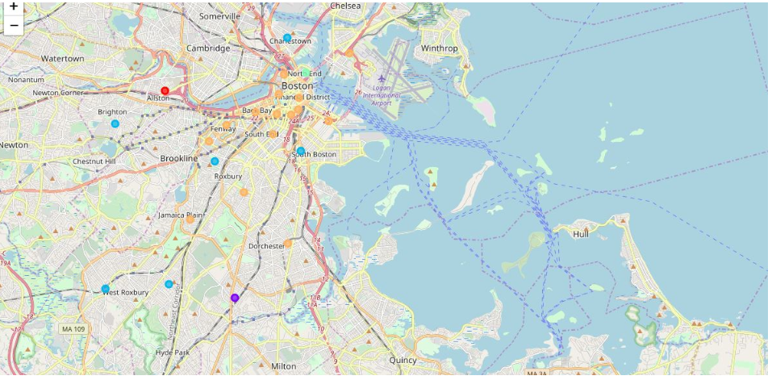
Results
Clustering by Venues Within 500 M of Neighborhood Centroids

Slide 9
Results
Neighborhood Venue Clusters
Cluster 1:
Size=1
Neighborhoods: Alston
Venues: Rental Car Location, Donut Shop, Convenience Store, Thrift Vintage Store, Smoke Shop, Liquor Store, Plaza, Pizza Place, Dance Studio, Deli.
Cluster 2:
Size=1
Neighborhoods: Mattapan
Venues: Ice Cream Shop, Furniture Home Store, French Restaurant, Food Court, Flower Shop, Fish Market, Fast Food Restaurant, Farmers Market, Falafel Restaurant, Event Space.
Cluster 3:
Size=6
Neighborhoods: Brighton, Charlestown, Mission Hill, Roslindale, South Boston, West Roxbury
Venues (Top 5): Pizza Place, Ice Cream Shop, Climbing Gym, Grocery Store, Convenience Store, Sandwich Place, Train, Coffee Shop, Plaza, Chinese Restaurant, Pharmacy, Thai Restaurant, Farmers Market, Pub, Pet Store, Bar, Park.
Cluster 4:
Size=1
Neighborhoods: North End
Venues: Italian Restaurant, Park, Seafood Restaurant, Pizza Place, Bakery, Wine Shop, Café, Market, Grocery Store, Coffee Shop.
Cluster 5:
Size=15
Neighborhoods: Back Bay, Bay Village, Beacon Hill, Chinatown, Dorchester, Downtown, East Boston, Fenway, Jamaica Plain, Leather District, Longwood, Roxbury, South Boston Waterfront, South End, West End.
Venues (Top 5): American Restaurant, Theater, Pizza Place, Chinese Restaurant, Vietnamese Restaurant, Coffee Shop, Park, Bakery, Coffee Shop, Fried Chicken Joint, Sandwich Place, Spa, Playground, Asian Restaurant, Café, Pizza Place, Fast Food Restaurant, Wine Bar, Italian Restaurant, Hotel, Pub, Gym, Falafel Restaurant, Basketball Court, Mexican Restaurant, Clothing Store, Sushi Restaurant, Airport Terminal, Electronics Store, Donut Shop, Seafood Restaurant, Plaza, Bubble Tea Shop, Cajun Creole Restaurant, Bus Stop, Museum, Pet Store, Bar.

Slide 10
Results
Venue and Health Status Cluster Overlap
https://dataplatform.cloud.ibm.com/analytics/notebooks/v2/6e071441-50b2-4929-a02a-8ab3a62d57ce/view?access_token=34354aa0dafb5b42073f8fedf1d2d515e35b640d6877523aa6e166a986183648
Venue Cluster # Health Status Cluster #
1 1 (33%)
2 4 (25%)
3 5 (67%)
4 2 (13%)
5 2 (75%)
3 (100%)
4 (75%)
5 (33%)

Slide 11
Discussion
Results of this cluster comparison analysis suggest that there is not significant overlap between neighborhood clustering of venues and neighborhood clustering of health status indicators
While it is difficult to infer, base solely on correlation, a causal relationship between a given neighborhood venue and a specific health status indicator, several plausible relationships between each of the 5 pairs of neighborhood cluster categories seem to make sense
In Venue Cluster 1, the 10 most frequent venues among which are Rental Car Location, Convenience and Thrift Vintage Stores, as well a Deli and Dance Studio, in addition to plenty of Open Space, seem appropriate for a white, older, well educated, healthy and physically active population as described by Health Status Cluster 1. The high rate of psychiatric hospitalization may simply be due to the aged population and high rates of health insurance including Medicare
In Venue Cluster 2, the top 10 venues appear to be food establishments which may support the healthy, but otherwise low income, mixed population of food workers as described in Health Status Cluster 4
In Venue Cluster 3, the top 10 venues include Ice Cream Shops, Climbing Gyms, Grocery Stores, Sandwich and Coffee Shops, as well Pet Stores and ethnic restaurants. These are venues which would be largely consistent with the white, high income, healthy, and well-educated population of Health Status Cluster 5
In Venue Cluster 4, the top 10 venues appear to be high end restaurants and specialty stores which are supported by the white and well-educated population of Health Status Cluster 2
In Venue Cluster 5 the wide variety of ethnic restaurants may provide employment for primarily the white, poorly educated workers in Health Status Cluster 3
The high rates of Hepatitis B & C seem consistent with spread by food contamination from untrained food preparers
The high rate of Gonorrhea may also be linked to lack of education on safe sexual practices
To a lesser extent, populations from Health Status Clusters 2, 4, and 5 may be consumers of goods and services produced in Venue Cluster 5

Slide 12
Conclusion
No significant overlap between the way Boston Neighborhoods cluster by top Venues and Health Status indicators
Venues in a neighborhood may not be a significant contributor to the heath status of a neighborhood and that other factors may be more influential in impacting neighborhood health
While we can speculate on several potential correlations between health status indicators and venues in a neighborhood, this is difficult to prove and causality cannot be inferred
The granularity of neighborhoods in the venue clusters was greater than in the health status clusters
Result of having to combine some neighborhoods together due to unavailability of neighborhood specific health metrics possibly introducing some bias in the results of this study.
Further limitations of the present study include absence of additional significant health indicators and lack of significant differences in the venues available in the immediate neighborhoods surrounding Boston.
Undertaking a similar study across more diverse regions and populations may produces more insightful findings.

