Slide 1
How to create tests cases for judge42

Slide 2
Problem statement [1/2]
Write a program that reads two integer numbers and output the result of they product and they addition.
INPUTS
Two lines each one with an integer number.
OUTPUTS
Two lines, first one must show «A x B = C» where A and B are the integer numbers readed and C is result of they product. Second line must show «A + B = C», where A and B are the integer numbers readed and C is result of they addition.

Slide 3
Problem statement [2/2]
INPUTS AND OUTPUTS EXAMPLES
INPUT | OUTPUT
2 3 | 2 x 3 = 6 2 + 3 = 5
9 9 | 9 x 9 = 81 9 + 9 = 18
30 20 | 30 x 20 = 60 30 + 20 = 50

Slide 4
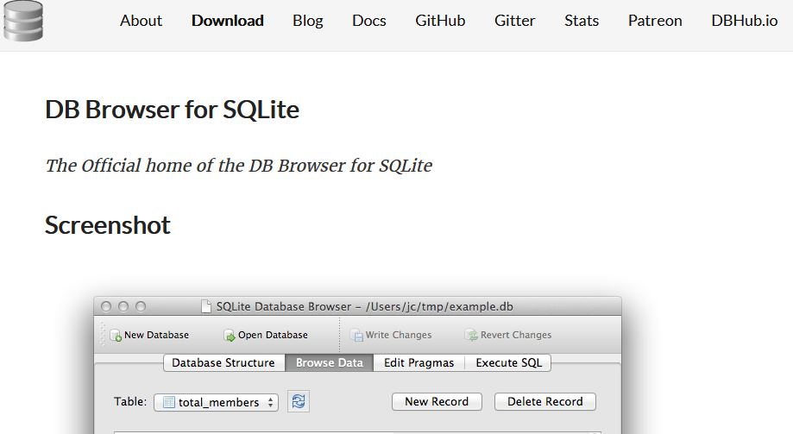
Create a tests cases [1/7]
Download and install (or unzip) SQLiteDatabaseBrowser:
https://sqlitebrowser.org/

Slide 5
Create a tests cases [2/7]
Download judge42.db from GitHub repo of judge42 project
https://github.com/jfmunozf/judge42
Open DB Browser for SQLite
Click File
Click Open Database…
Open database judge42.db

Slide 6
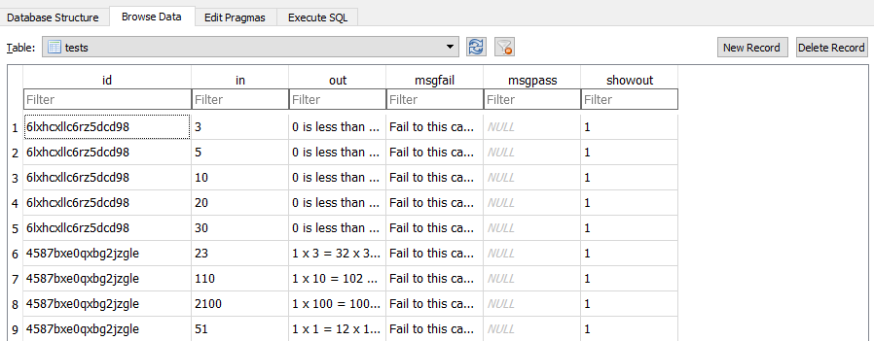
Create a tests cases [3/7]
Clic on Browse Data tab
You can (and want) delete demo tests cases in a database

Slide 7
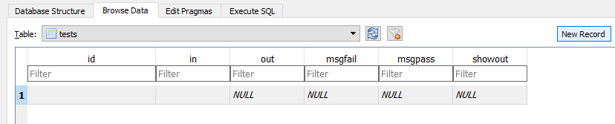
Create a tests cases [4/7]
Begin with an empty tests table and clic in New Record to create a new blank record in a tests table.

Slide 8
Database fields description
id: Unique ID of this problem statement. Every problem statement can contains multiple tests cases, every test case is a record in a table. You could record multiple tests cases for multiple problem statements.
in: Inputs of the this test case
out: Expected outputs for this test case
msgfail: A message that show to student when this test case fails.
msgpass: A message that show to student when this test case pass.
showout
1: Show expected output for this case when this test case fails.
NULL: Don’t show expected output for this case when this test case fails.

Slide 9
Create a tests cases [5/7]
Create a first test case according to Inputs and Outputs examples in a problem statement at the begining of this document.
To record first test case use right panel of DB Browser for SQLite to edit cell. For example, to record Inputs of the first test case:
Clic on in cell
Type data: one line for each input according to problem statement
Clic Apply button to set this entry in cell.

Slide 10
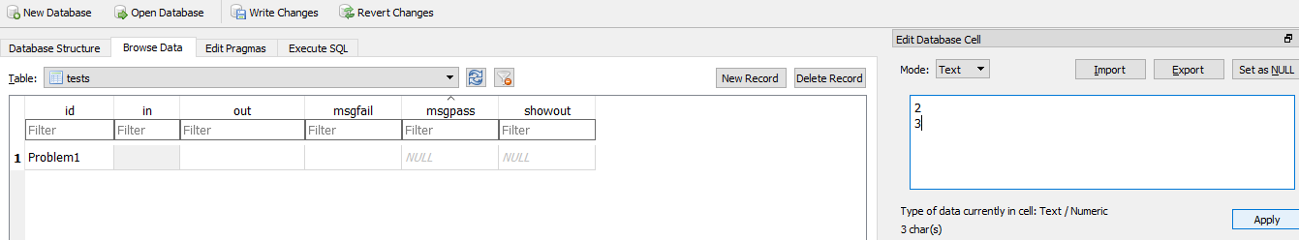
Clic on in cell
Clic Apply
Write inputs of this test case: one input per line according to problem statement. No more breaklines at the end: just two lines.

Slide 11
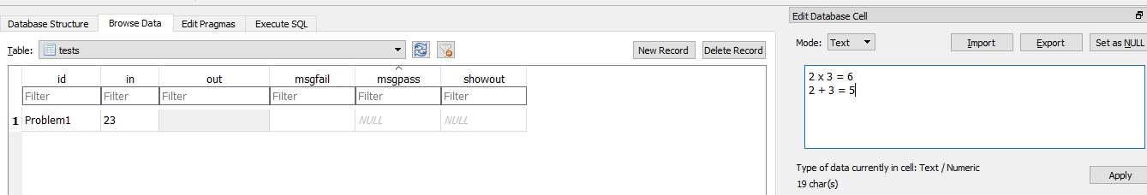
Create a tests cases [6/7]
Example of outputs for this test case: just two lines according to (format) problem statement

Slide 12
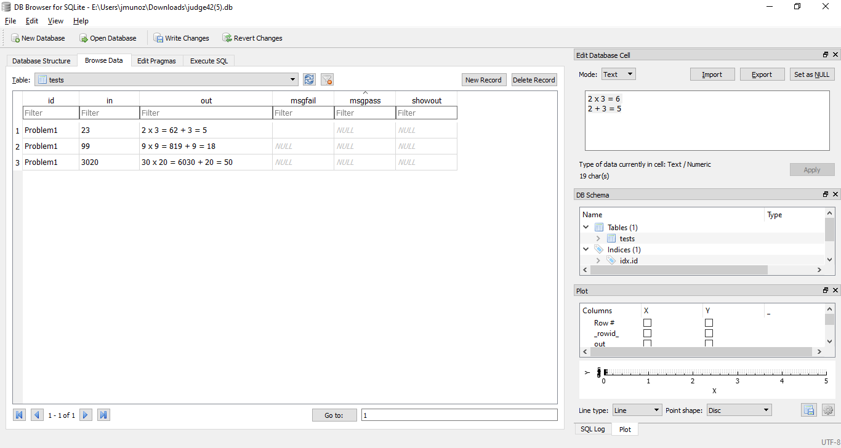
Create a tests cases [7/7]
At the end, the three test cases for problem statement:
This fields are optional

Slide 13
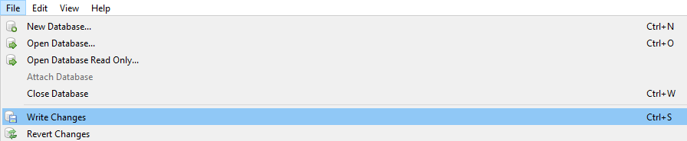
Write changes to a database
Clic on File
Select Write Changes or CTRL + S

Slide 14
Thats all
Deploy judge42.py and judge42.db
In this example, first line of code to test with this tests cases must be (exacly)
# __judge42__id__ = Problem1

Slide 15
Deployments examples
https://github.com/jfmunozf/judge42
Google Colab
Replit in a Console aplication (fork the deployment to your account)
Replit in a Web application (fork the deployment to your account)
Python anywhere in a Web application

Slide 16
https://github.com/jfmunozf/judge42
Juan Felipe Muñoz Fernández

