Slide 1

Team 2
Joseph Fodera, Alex Kuang, Felipe Alves

Slide 2
The Agenda
Description of what College Exam Hub is and its use cases.
Introduce personas and demonstrate trial runs for them.
Go more in depth about specific features showcased in demo and how we made them.
Discuss what the future could look like for College Exam Hub.
Notes:
Felipe

Slide 3
What is College Exam Hub?
College Exam Hub is a web application meant to simplify the process of acquiring back exams here at RPI
As a finished product, it would be a dynamically updated repository for back exams, sourced by the students
As a user, you can search for exams, view ratings, and download any exam you'd like
If you confirm your university email, you gain the options of uploading your own back exams, along with leaving rating on individual exams
We developed this mockup with the idea of expansion to other schools a possibility
Notes:
Joe

Slide 4

Why even make this?
Difficult to find good back exams
Curriculum changes make older exams irrelevant
Searching on the web is time-consuming - exams can be found in many different places on the web
Going to APO is also a hassle - having to go to the Union to sort through file cabinets of exams is annoying
Benefits of having one single place with all exams:
Quick and easy to find good exams
Easier to help others - upload and rate exams
Notes:
(Alex)
Hard to find good back exams
If the curriculum changes, older exams may have irrelevant content
Getting back exams from APO is a hassle
https://www.shutterstock.com/image-vector/disappointed-depressed-young-guy-struggles-comprehend-1847331367

Slide 5


Bob Intro
Bob’s an RPI student that has a Data Structures test coming up and he desperately needs practice with the course content
There were changes in the curriculum made fairly recently - he needs the most recent exams available
Older back exams that he has are not very useful so he goes to College Exam Hub
Notes:
(Alex)
Opens up to main page
types in data structures
travels to home page
Sorts by rating
Clicks on one with highest rating
Scrolls through a bit and then downloads the exam
https://www.google.com/url?sa=i&url=https%3A%2F%2Fwww.bairesdev.com%2Fblog%2Fbest-c-plus-plus-ide-text-editor%2F&psig=AOvVaw0AJLvJ5vFh2-L3xcGGQhWU&ust=1713470539345000&source=images&cd=vfe&opi=89978449&ved=0CBQQjhxqFwoTCNicqqmFyoUDFQAAAAAdAAAAABAE
https://www.google.com/url?sa=i&url=https%3A%2F%2Fwww.istockphoto.com%2Fphoto%2Fstandardized-test-with-pencil-gm462153091-32043774&psig=AOvVaw0Oee96gejR84wn_WTsI3eG&ust=1713470688829000&source=images&cd=vfe&opi=89978449&ved=0CBQQjhxqFwoTCNjQopWGyoUDFQAAAAAdAAAAABAE

Slide 6
Mike Intro
Mike is a student and a Physics mentor at RPI and it's getting close to final exam time
His students have been struggling with exam questions specifically because they haven't gotten enough practice
Mike realizes that he has a really relevant back exam with a lot of questions that his students have been struggling on
He figured that instead of printing out a ton of copies, he would just upload them to college exam hub so everyone could use them
Notes:
Goes to main page
Clicks confirm email
clicks finds exams
Navigates within the computer to thee test
Selects course he is uploading to
Clicks and uploads
Then Types in physics, navigates to his page, and gives himself a 5 star review on his exam

Slide 7
Areas of Focus - Functionalities
Our Primary Area of Focus was Javascript Interactivity
College selection dropdown bar
Search bar/autocomplete on multiple pages with consistent functionality
File drag and drop Functionality
Confirmed email session storage across all pages
Sorting/filtering exams on course pages
Reading in of JSON files using ajax made easily replicable with consistent AI design
Our Secondary Area of Focus was HTML/CSS and graphics
Consistent header and footer
Overall theme
Basically doing all we can to make it look good!
Notes:
Now we are going to Transition behind the scenes and highlight some of what we think are the coolest features that we implemented in our prototype.

Slide 8
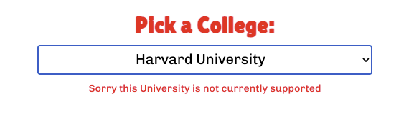
Home Page
We have a custom logo that we designed
A functional header that works on all pages, thanks to a universal css file
There is also this school selector that you can use to select which college you go to, currently RPI is the only one supported

Slide 9
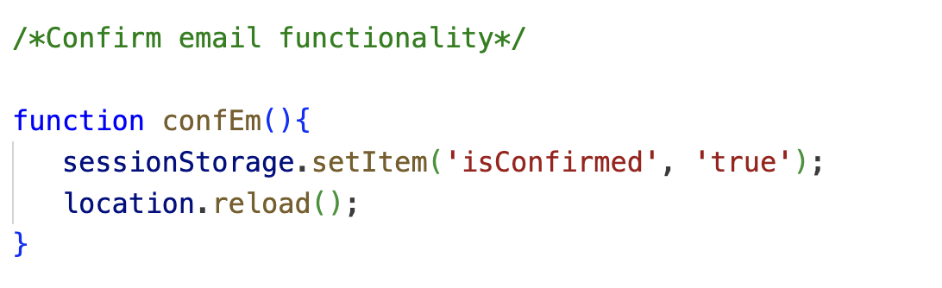
Confirm Email Button
The main part of the homepage that we want to discuss is the confirm email button as we learned some new methods in order to implement it
Clicking on the button will set a variable called isConfirmed and store it in session storage:
This means that the variable is present on all pages and is only deleted when the user closes out the tab
This was very useful as because of it, we could now hide and show certain functionalities that were restricted for users that only had confirmed their emails
Notes:
Mention that there is no actual email checking involved in this prototype and that just clicking the button represents being "confirmed"
Transition to next slide "one of these functionalities being the drag and drop:"

Slide 10
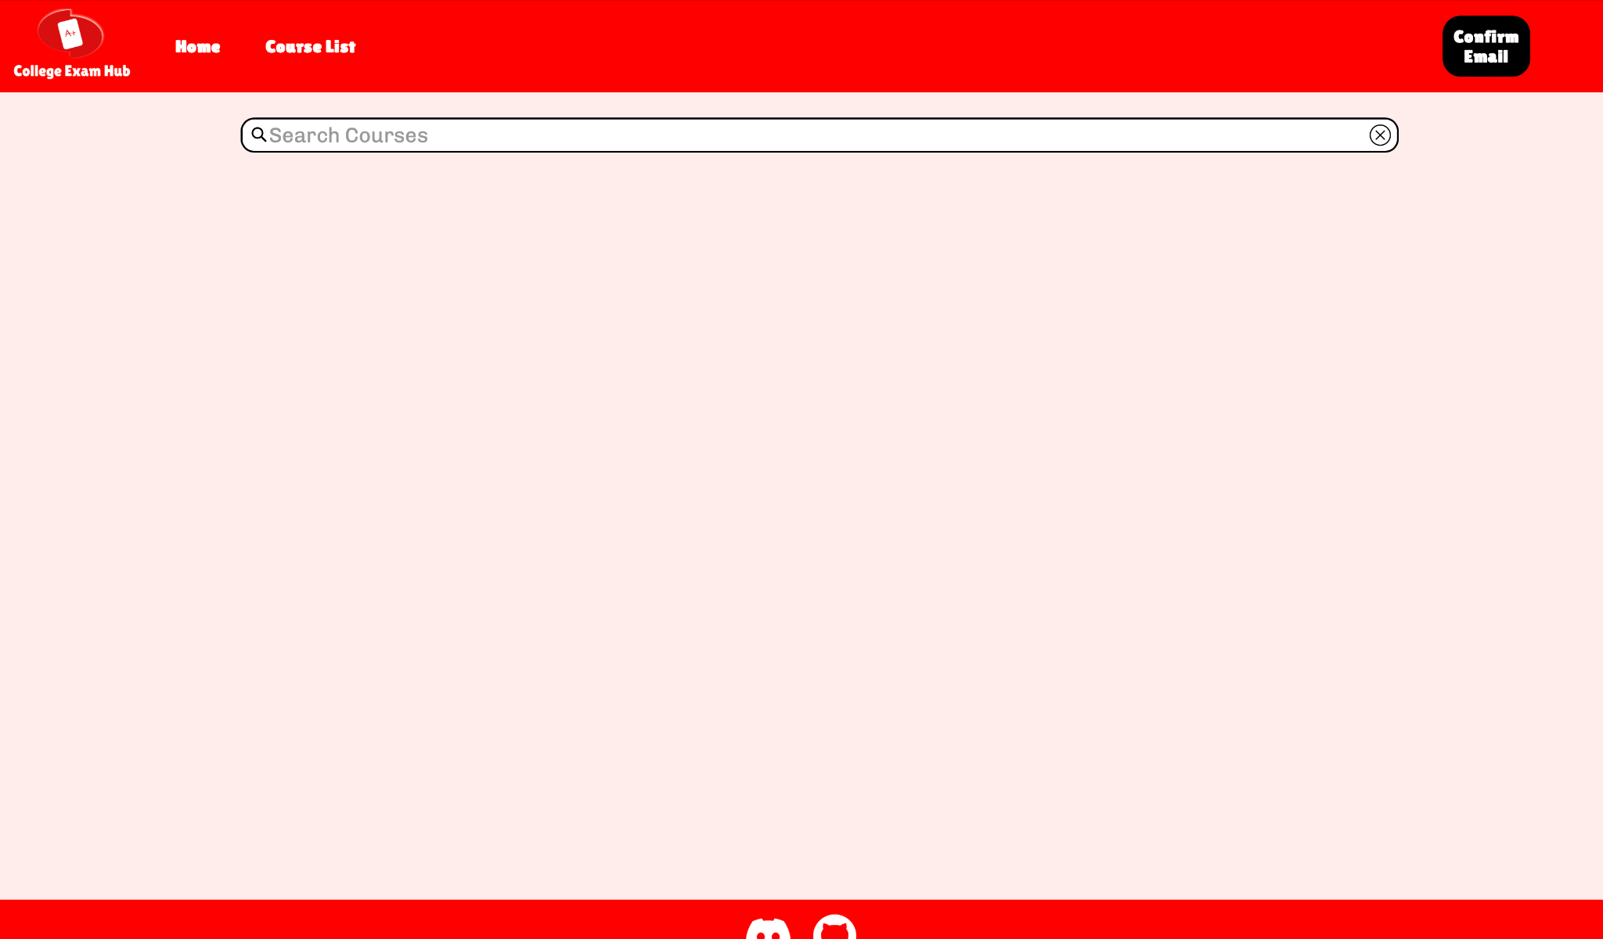
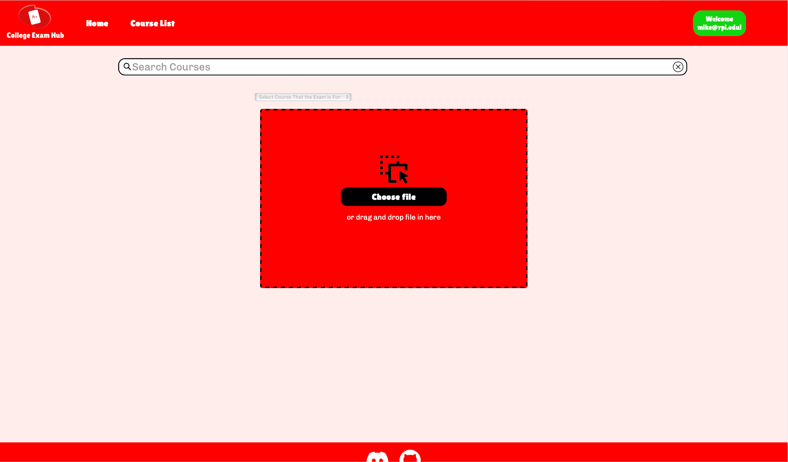
Non-Confirmed Email
Confirmed Email
As seen in the demonstration, only users who have confirmed their email address can access this drag and drop functionality

Slide 11
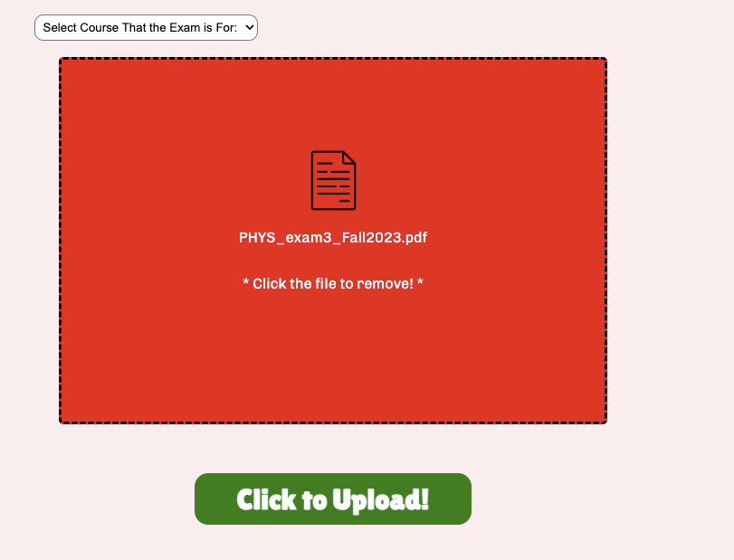
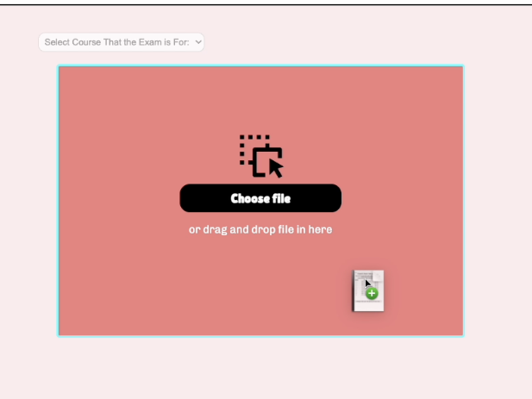
Drag And Drop Exam Files
User has the option to drag and drop their exam into the target box or click the choose file button to allow them to choose a file from their file explorer
Once user selects the file they want, they can either click upload file to the website or remove the file to select another one
If user chooses to upload file, they need to select the course the exam is for from the dropdown as seen in Mike's demo
Notes:
There is also a searchbar on the find exam bar in which Joe will talk about now

Slide 12
Search Bar For Finding Courses
Our site has search bar+autocomplete functionality that works the same way on every page it is located on
This is thanks to a standard js search file that we developed, which takes advantage of absolute links so that each page would not need their own copy
The autocomplete functionality was a pretty challenging aspect but after a lot of trial and error, we got a pretty good implementation down

Slide 13
Autocomplete
Basically, every time the user changes the input on the search bar element, a function is called
This function checks how closely the query aligns with the possible destinations
If it finds something that has the same order of letters that have been typed so far, it presents it to the user in the form of a div, with the overlapping letters being in bold
If the user clicks on this suggestion, the value of the search bar input element is updated to match
Notes:
Transition to next topic, once the users has typed in a valid Query, it will take them to the course landing page

Slide 14
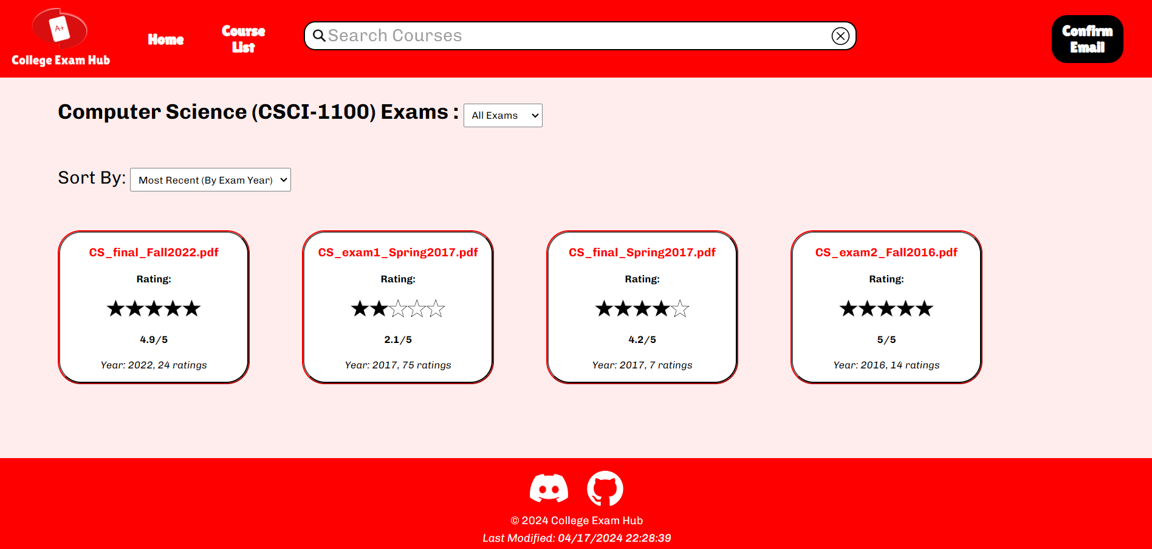
Course Landing Page
Shows exams for each course
Sort them by year, rating, popularity (# of users that rated exam)
Filter them by type (1st exam, midterm, final, etc)
Used JSON, AJAX
Notes:
The searchbar can be used to go to course landing pages, and every course has one. This is where users can access all the courses exams. Users can sort them by the how recent they were given, the rating, and how many users added a rating, and filter them by the type of exam. I used AJAX and JSON with javascript to make this thing functional, and I’ll talk about how it works

Slide 15
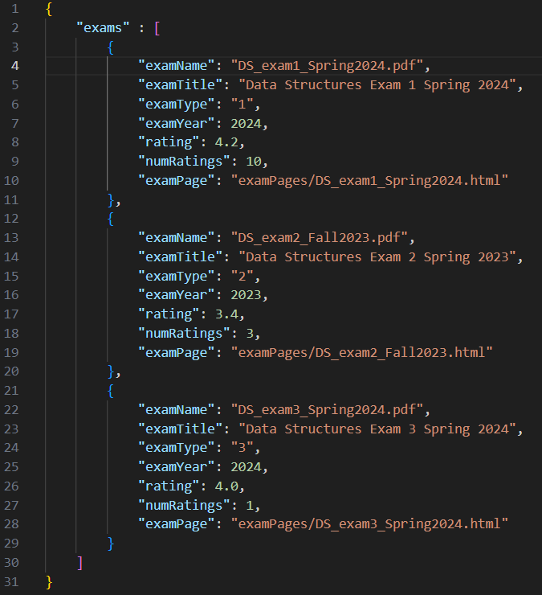
JSON Exam Info File
Notes:
For every course, there’s a JSON file that stores info about each exam

Slide 16
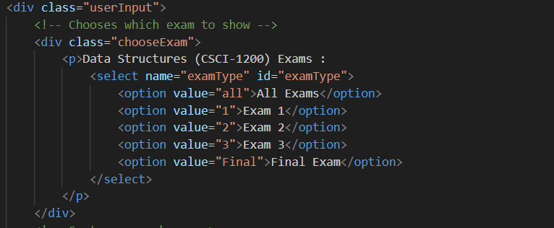
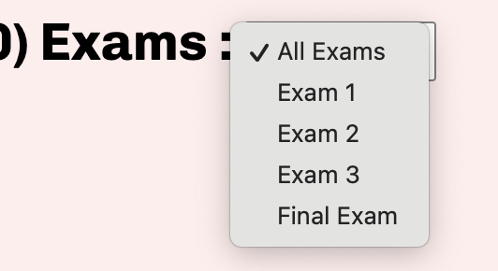
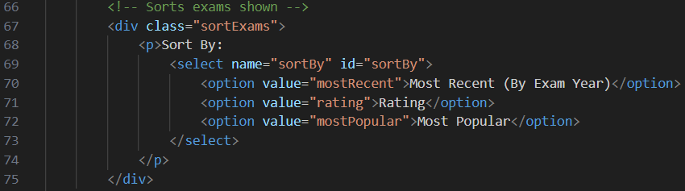
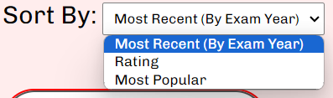
HTML
Notes:
The html file for every course page has select elements that create drop down menus. The Javascript code reads information from these drop down menus, specifically the values of examType and sortBy, as well as the JSOn file with exam info, and edits the page accordingly

Slide 17
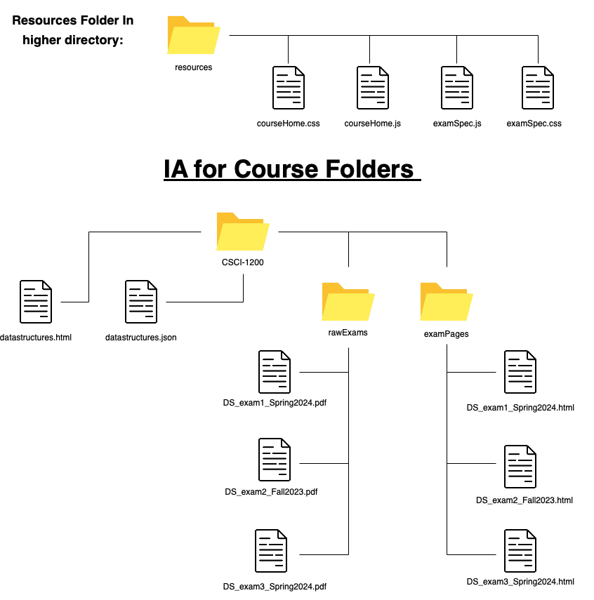
Notes:
For the sake of consistency, scalability, and easy replication, all of our course folders have the same file layout.
The naming of the files is also vital to the functionality as well,
as the main course page (.html) must have the same name as the json file in order for the json parsing to work correctly
Go through the IA:
We developed the 4 files you see at the top, specifically so all differentiations between course and exam files could be specified by the JSON file specific to each course
This allowed us to have pretty much the same exact base HTML code in every corresponding Course page and Exam Page, leaving it up to the json, js and css to populate and style the variable information within the page.

Slide 18
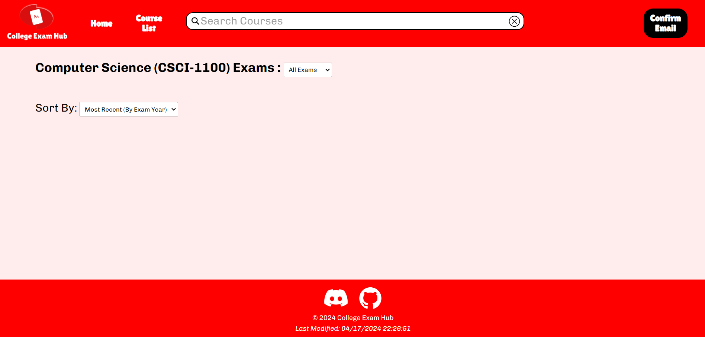

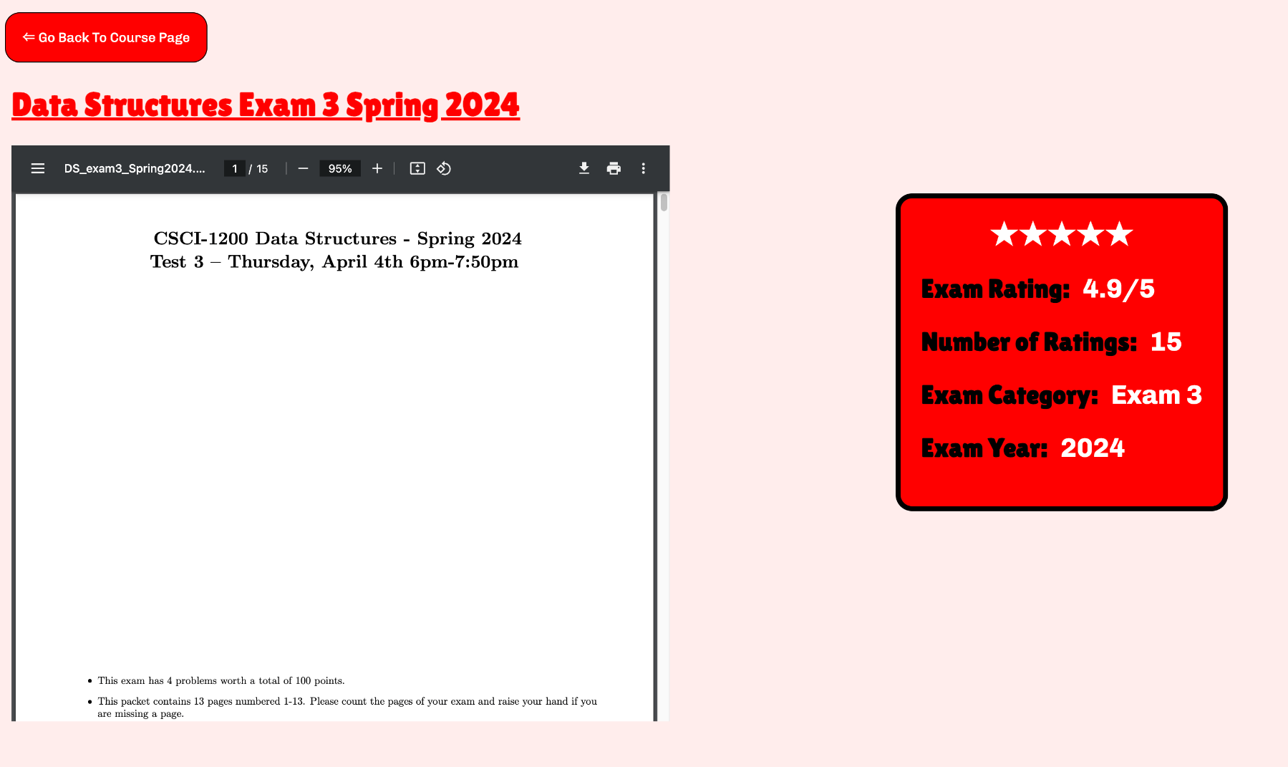
Raw HTML
Populated
Notes:
This shows what the combination of the js and json files do for each page. We used Ajax functions to make this possible.
Make this into 2 slides

Slide 19
Future Features
When user leaves a rating, make it actually edit the JSON file
Create a database to store exams
Make it compatible with multiple universities
Add a comments section for each exam landing page
Users can discuss exam solutions
Some sort of automated content reviewer/moderator to verify if people are actually uploading exams and not other files

Slide 20
Thank you!

