Slide 1
Capstone II Housing Prices
Presented by: Jason Fong

Slide 2
Project Goal
Do any of the following characteristics of homes have an impact on housing prices?
Having central air
Type of road access
Overall condition of the home
Kitchen Quality

Slide 3
Hypothesis
Null Hypothesis 1 (H₀): The inclusion of central AC does not have an effect on housing prices.
Alternative Hypothesis 1 (H₁): The inclusion of central AC does not have an effect on housing prices.
Null Hypothesis 2 (H₀): The type of road access (pavel or gravel) does not affects housing prices.
Alternative Hypothesis 2 (H₁): The type of road access does affect housing prices.
Null Hypothesis 3 (H₃): Overall conditions of homes does not have an effect on housing prices.
Alternative Hypothesis 3 (H₃): Overall conditions of homes does have an effect on housing prices.
Null Hypothesis 4 (H₄): Kitchen quality has no effect on housing prices.
Alternative Hypothesis 4 (H₄): Kitchen quality has an effect on housing prices.

Slide 4
Process
Analyze data from housing prices dataset (Kaggle) and understand column variables.
Conduct statistical analysis on said variable with housing prices using the data analysis function in Excel from the Analysis Toolpack.
Compare p-values with critical values in our analysis.

Slide 5
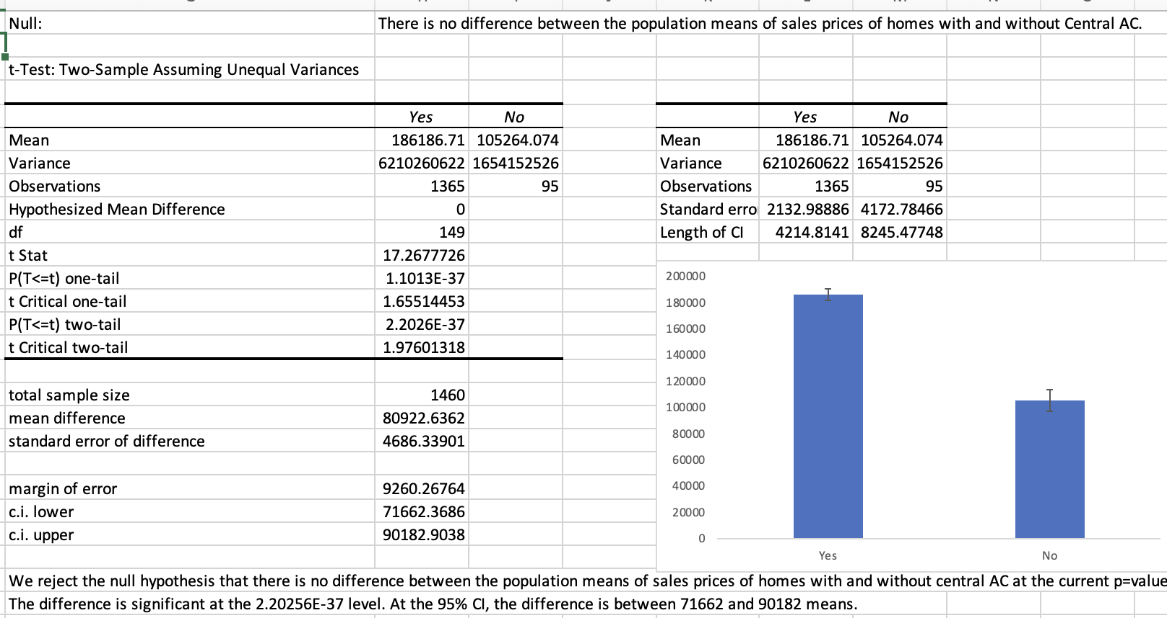
Analysis of Central AC
(We reject the null hypothesis)
Conclusion:
There is a significant difference in housing prices for homes with and without central AC. Hence, we can conclude that having central AC affects housing prices.

Slide 6
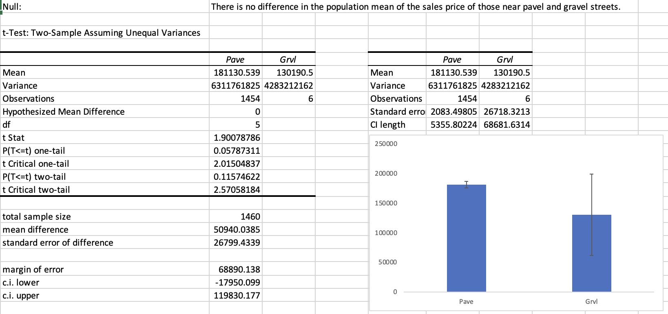
Analysis of Street (Pavel or Gravel)
(We fail to reject the null hypothesis)
Conclusion:
The difference is not significant at the 95% confidence level. Hence, we fail to prove that the type of street has an affect on housing prices.

Slide 7
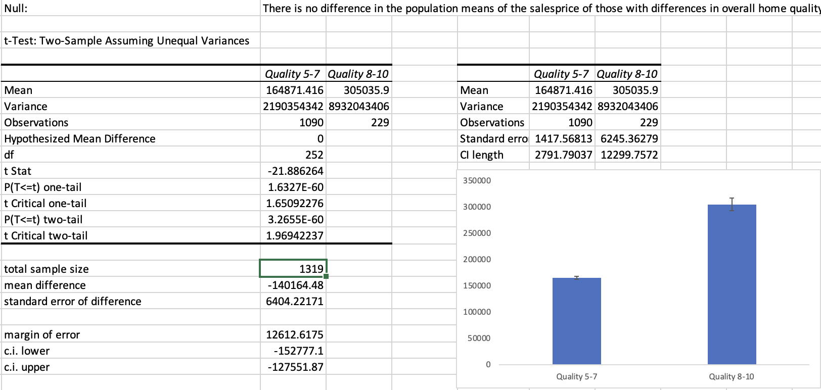
Analysis of Overall Quality
(We reject the null hypothesis)
Conclusion:
We find that there is a significant difference in housing prices depending on the overall quality of the home. Hence, we can conclude that overall quality has an affect on housing prices.

Slide 8
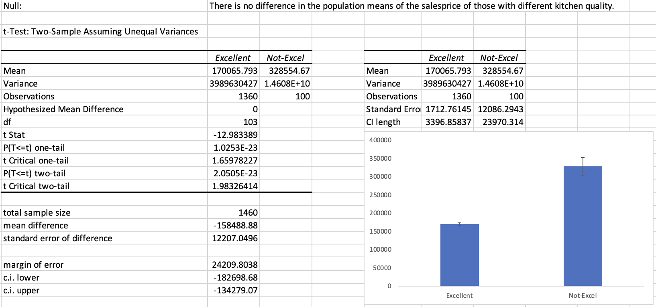
Analysis of Kitchen Quality
(We reject the null hypothesis)
Conclusion:
We find that there is a significant difference in housing prices in homes depending on the kitchen qualities. Hence, we can conclude that kitchen quality affects housing prices.

Slide 9
Final Message and Recommendations
Our statistical analysis of the housing prices dataset showed that housing prices:
Are affected by the including of Central AC.
Are not affected by the type of road access (pavel or gravel).
Are affected by the overall quality of the house.
Are affected by the kitchen quality
Recommendation:
When predicting house prices, we should place a greater weight of judgement based on inclusion of central AC, overall house quality, and kitchen quality.

