Slide 1
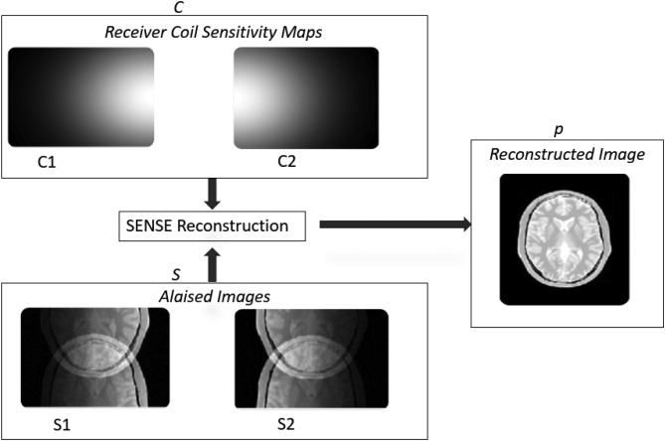
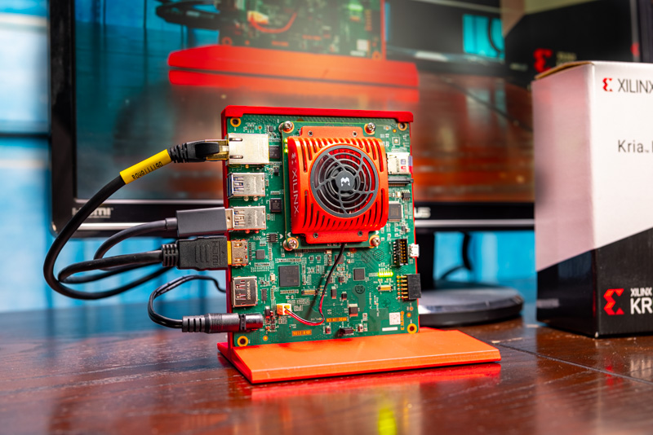
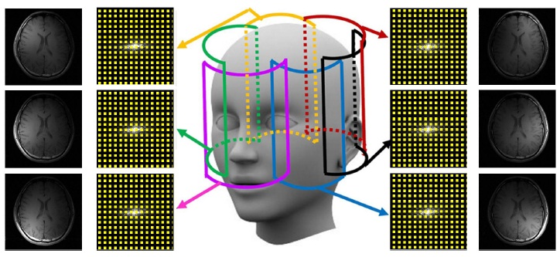
Implementación en FPGA de una arquitectura para la reconstrucción acelerada de imágenes de pMRI a partir de datos de k-espacio
Weekly report: 20/02/2026

Slide 2
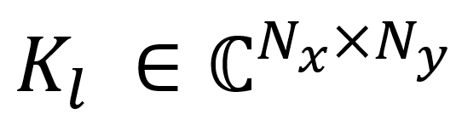
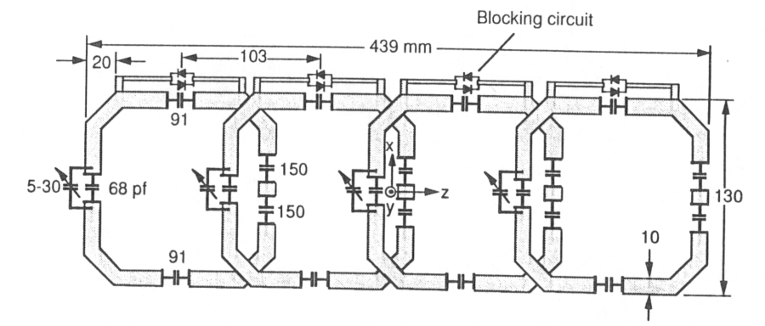
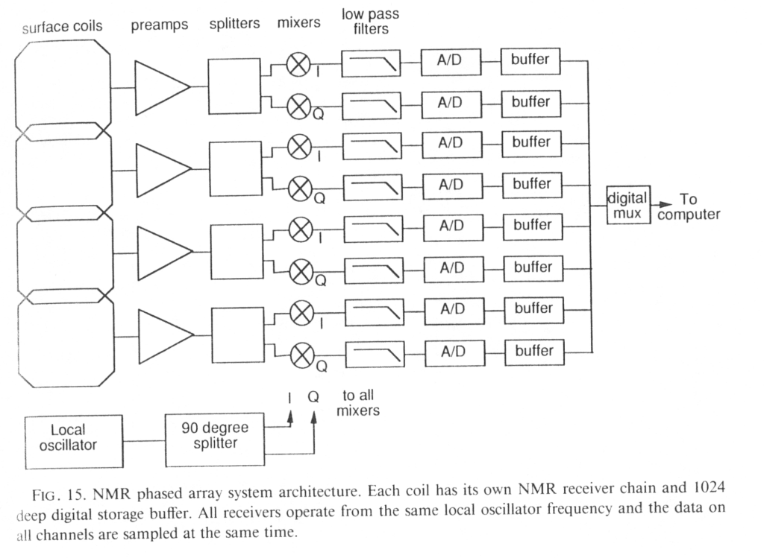
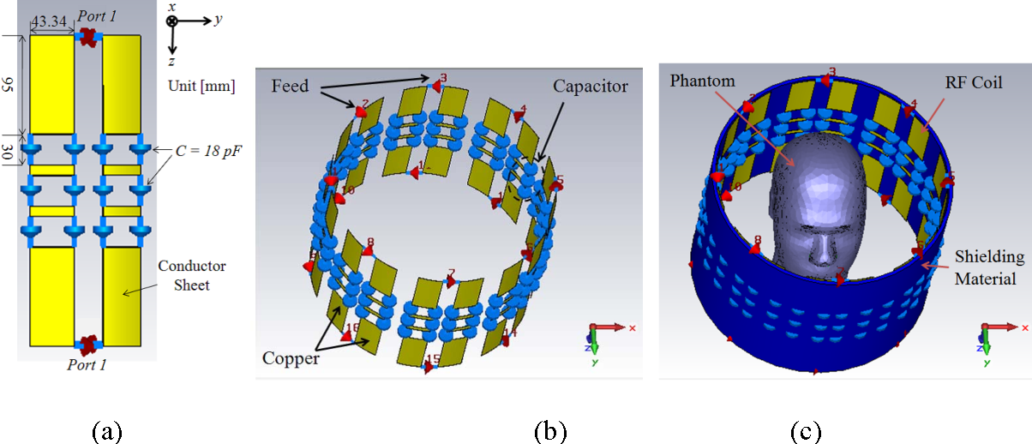
Phased array coils

Slide 3
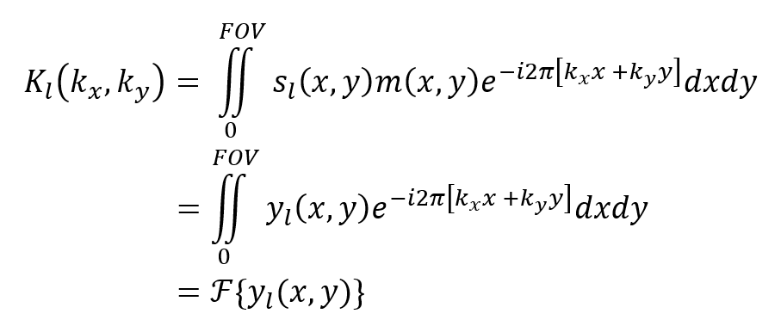
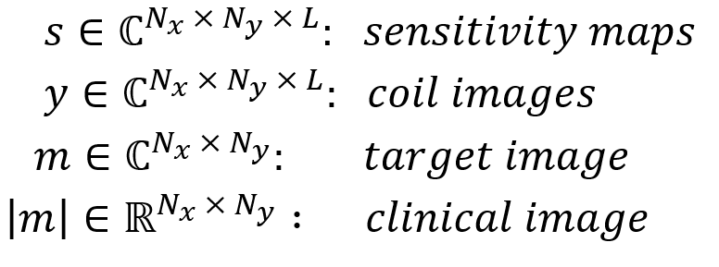
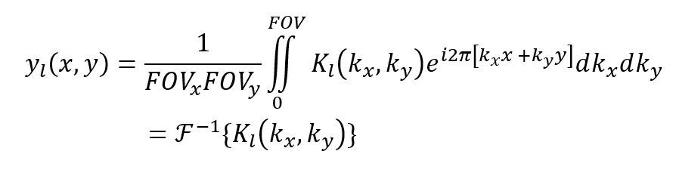
Mathematical description of aquisition domains
Continuos Time

Slide 4
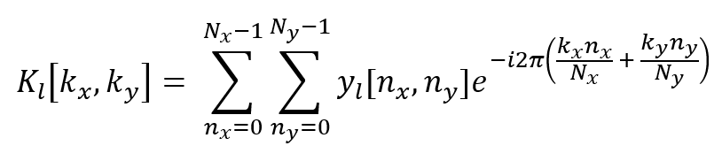
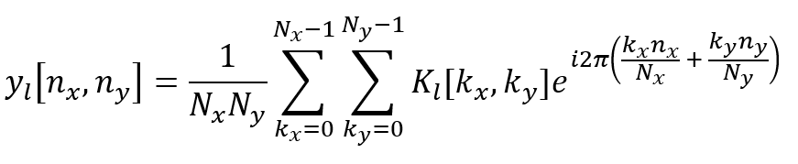
Mathematical description of aquisition domains
Discrete Time

Slide 5
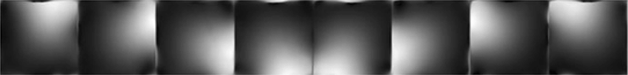
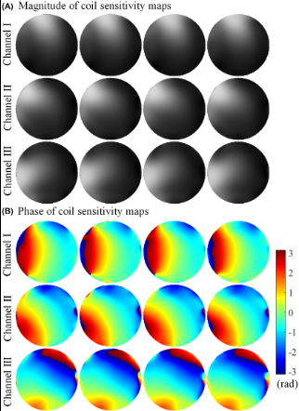

Sensitivity map: pre-scan method

Slide 6
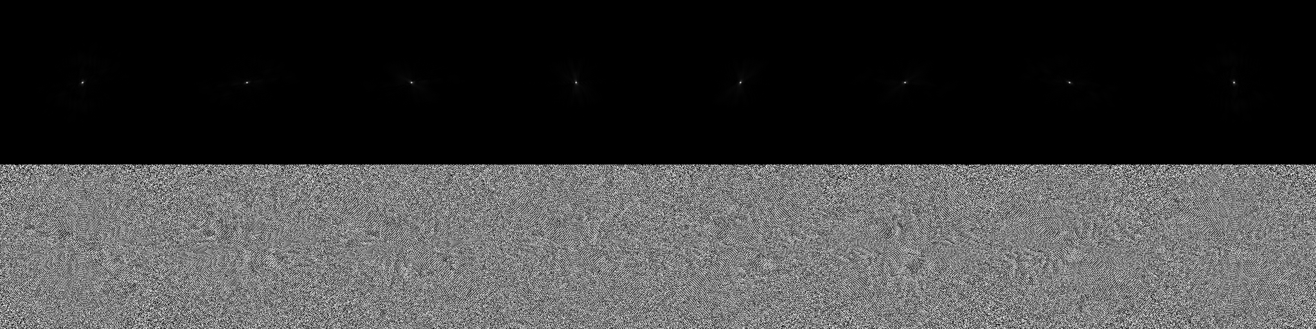
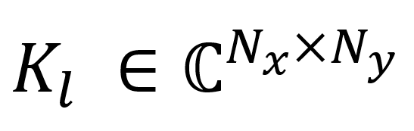
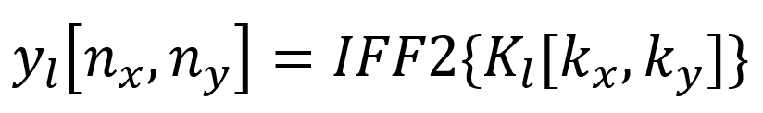
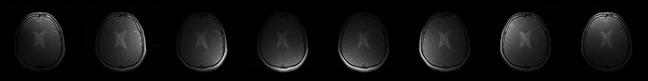
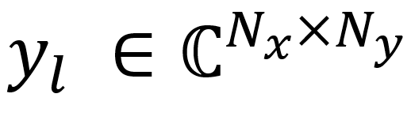
Raw data from coils k-space
If no undersampling applied: Af = 1
SENSE algorithm input

Slide 7
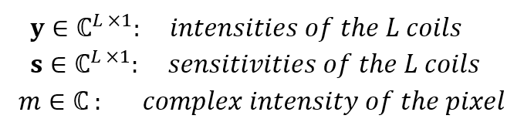
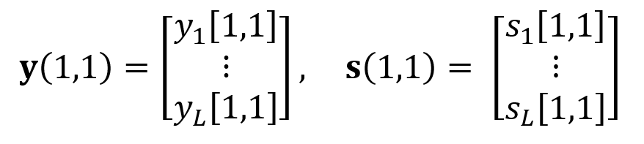

SENSE with Af = 1: pixel by pixel model
Let’s take one pixel, e.g. (1,1)
(noise is ignored for simplicity)
Vector notation:

Slide 8

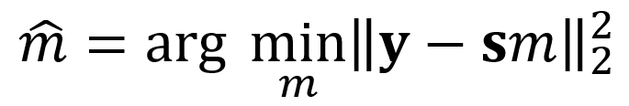
SENSE with Af = 1: least-squares solution
We need to find the value of m that minimizes the quadratic error between the data and the model
Data
Model
This is an optimization problem, written as:

Slide 9
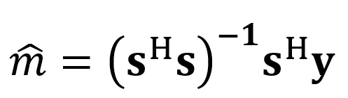
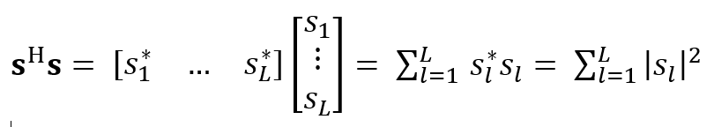
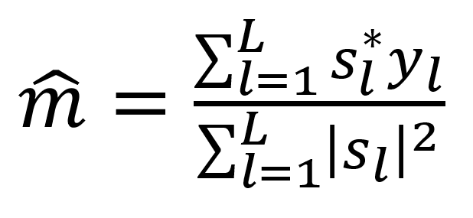
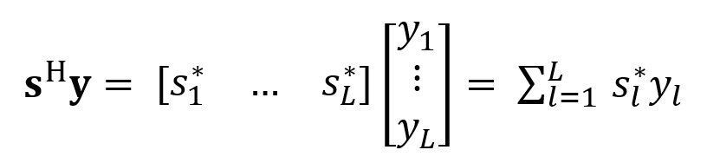
SENSE with Af = 1: Moore-Penrose pesudoinverse
This is a well-known problem and can be resolved using the Moore-Penrose pseudoinverse, written as:
Decomposed as:

Slide 10
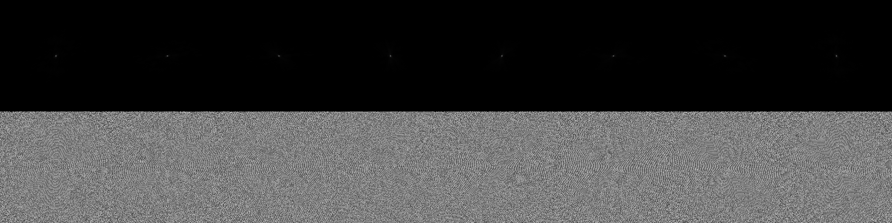
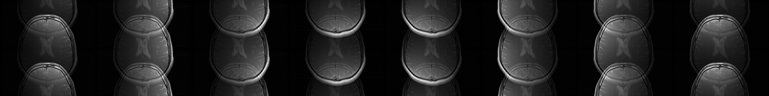
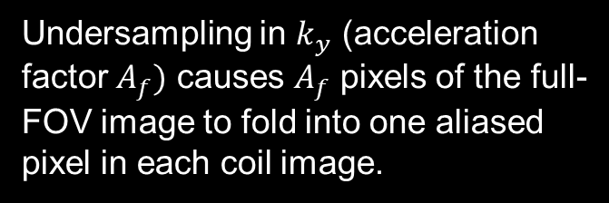
Raw data from coils k-space
Undersampling applied: Af = 2
Undersampling in $k_{y}$ (acceleration factor $A_{f})$ causes $A_{f}$ pixels of the full-FOV image to fold into one aliased pixel in each coil image.
SENSE algorithm input

Slide 11
Same sensitvity maps…

Slide 12
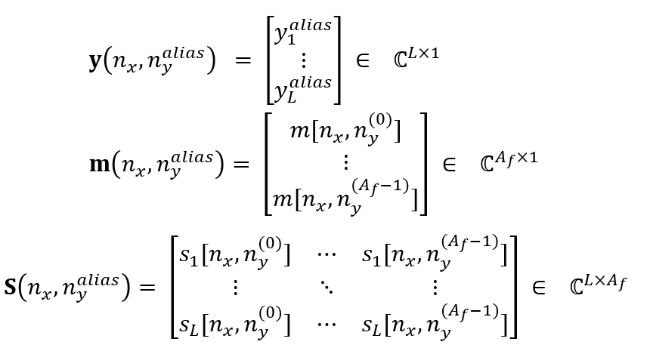
SENSE with Af > 1: now we gotta scale with aliasing
Let’s take one folded pixel, e.g. ($n_{x}$, $n_{y}^{alias}$) (Will asume undersampling in the y direction)
(again, noise is ignored for simplicity)
Matrix notation:

Slide 13

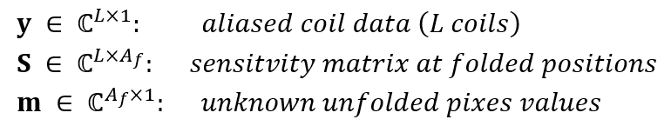


SENSE with Af > 1: now we use matrices instead of vectors
With Af = 1:
With Af > 1:

Slide 14
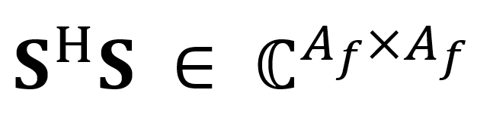
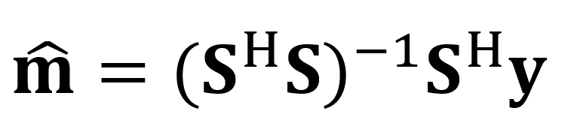
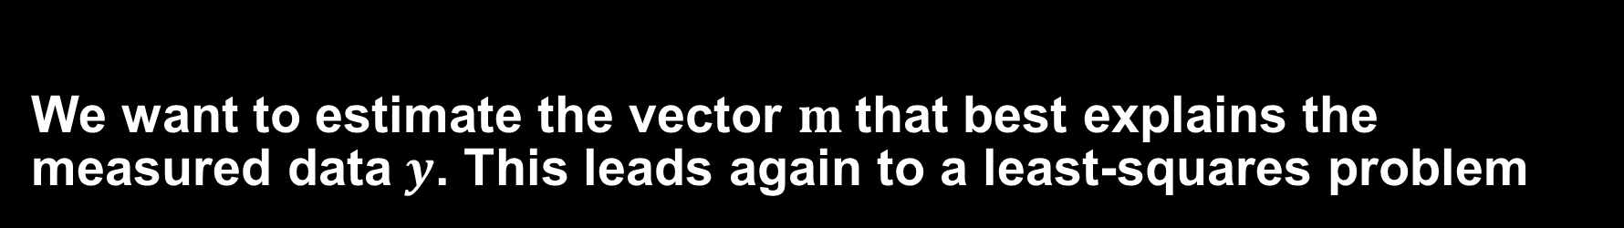
SENSE with Af > 1: least-squares solution
We want to estimate the vector $m$that best explains the measured data $y$. This leads again to a least-squares problem
Data
Model
Note that now:
Again, this leads to:
This means we can use Cholesky, LU decomposition, gauss elimination, etc

