Slide 1
Venninator (original): all-vs-all BLAST
Gene A
Gene B
Gene C
Gene D
Gene E
…
Gene A
Gene B
Gene C
Gene D
Gene E
…
Gene A
Gene B
Gene C
Gene D
Gene E
…
Gene A
Gene B
Gene C
Gene D
Gene E
…
Gene A
Gene B
Gene C
Gene D
Gene E
…
Genome 1
Genome 2
Genome 3
Genome 4
Genome 5

Slide 2
Venninator (original): all-vs-all BLAST
Initial Generous Cutoff = e^-5
Query | Hit | E-Value
A1 | B1 | 0.000012
A1 | B237 | 0.009
A1 | B5612 | 0.05
A1 | C7545 | 0.00451301
A1 | G3088 | 0.00151
A1 | Q32 | 0.0000042
A2 | B4956 | 0.055

Slide 3
Venninator (original): e-value filter
Query | Hit | E-Value
A1 | B1 | 0.000012
A1 | B237 | 0.009
A1 | B5612 | 0.05
A1 | C7545 | 0.00451301
A1 | G3088 | 0.00151
A1 | Q32 | 0.0000042
A2 | B4956 | 0.055

Slide 4
Single Linkage Clustering
A B
B C
C D
A E
D F
A
F
e^-5
B
E
C
D
A B
B C
A E
D F
A
D
B
e^-20
E
F
C
Modified from Lienau et al. 2006
Notes:
Single linkage clustering, transitive property
F → D is turned into D → F

Slide 5
Venninator Matrix creation
Desallius 11111111111 ...
Katjaforme 11101011011 ...
Fooxamecium 11101001011 ...
Jeffasaurus 01101111011 ...
Siddallica 01000111010 ...
Apurvittans 01100111110 ...
Yes: assign 1
D
K₁ K₂
F K₃
Is [X] present in this cluster?
No: assign 0
Notes:
No particular order to columns; can take advantage of dictionary format in Python?

Slide 6
OrthoMCL: all-vs-all with BLASTP
Gene A
Gene B
Gene C
Gene D
Gene E
…
Gene A
Gene B
Gene C
Gene D
Gene E
…
Gene A
Gene B
Gene C
Gene D
Gene E
…
Gene A
Gene B
Gene C
Gene D
Gene E
…
Gene A
Gene B
Gene C
Gene D
Gene E
…
Genome 1
Genome 2
Genome 3
Genome 4
Genome 5

Slide 7
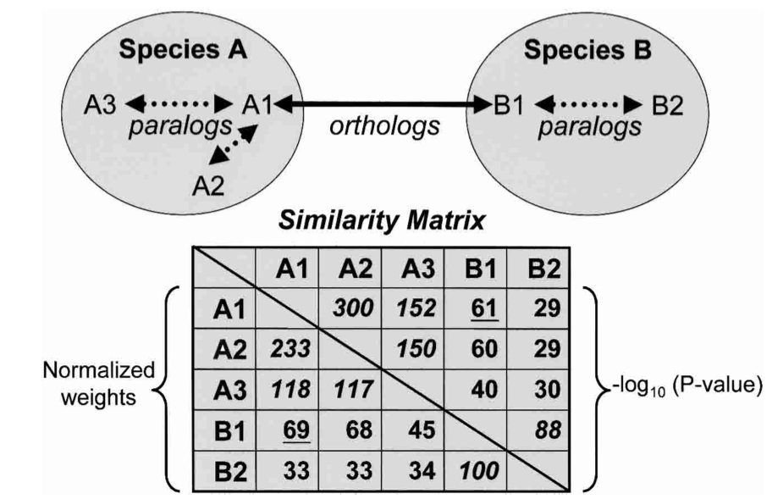
w_{ij}
W_{ij}/W
Notes:
-log10 P-value is average of two similarity scores between i and j – so are they not always the same, as they were presumed to be in alphabetization?
How generate similarity scores for ALL pairwise? Does BLAST return score against every single sequence?
Equation: Similairty btwn two nodes / (average weight of all orthologs between these two species / average weight of all orthologs)

Slide 8
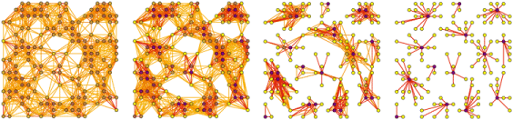
MCL Clustering
Nodes = sequences; edges = similarity score
“Using flow simulation, considers all relationships in graph globally and simultaneously”
Iteratively randomly walks thru graphspace and calculates probability of making that particular walk
Weaker connections are iteratively removed
Continues until “equilibrium” (all clusters are isolated)
Notes:
Core idea is that more similarly related nodes will have a greater number of “higher level” pathways between them than less related nodes, so over time those pathways prevail

Slide 9
OrthoMCL Matrix creation
Same???

Slide 10
If MCL, then where do we incorporate e-value gradient?
Similarity matrix requires all comparisons; MCL random walk inherently filters weak hits.
“A P-value cutoff of 1e-5 was chosen for putative orthologs or paralogs, based on empirical studies.”
E-value adjusted during initial searches, and if insignificant hit, e = 1?
Would iterative approach of making new similarity matrix, then doing MCL search, be too computationally intensive?
Inflation and expansion operators?

Slide 11
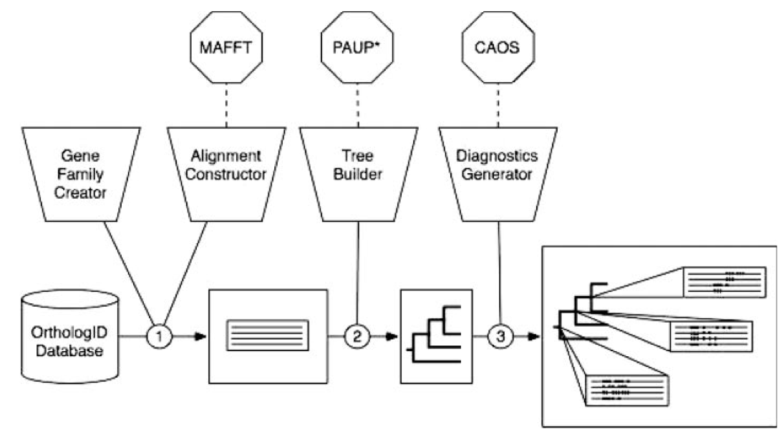
OrthologID: Phylogenetic approach(?)
Creates gene families
Performs global sequence alignment
Constructs parsimony trees
Identifies diagnostic characters

Slide 12
OrthologID 1. “Gene Family Creator”
Searches with static e-value = e^-20
Gene 1 and gene 2 are “clusterable” if:
BLAST of g1 is within e-value of g2
Alignable regions > 80% of longer sequence
After all-vs-all: randomly picks gene, looks for clusterables, searches thru gene’s BLAST result again for new members, repeat until no more genes can be added. GFC then starts a new family and above is repeated.

Slide 13
OrthologID
MAFFT L-INS-i algorithm, with 3 parameter sets that are compared
Build parsimony trees for each gene family using PAUP*
Diagnostic characters for orthologous groups identified with CAOS
For the purposes of building an online database and matching future queries?
Characteristic features of orthlogs are identified phylogenetically. However, the actual generation of the gene families is still based on BLAST-based similarity.
Notes:
OrthologID paper doesn’t mention anything about how to accept or reject putative orthologs based on trees.

Slide 14
Annotation retention
Query | Hit | E-Value
A1 | B1 | 0.000012
B1 | C1 | 0.009
C1 | D1 | 0.05
A1
B1
C1 D1
Column 0001: A1
B1
C1
D1

Slide 15
Possible workflow
All-vs-all BLAST approach
blastn? blastx? tblastx?
Create global similarity matrix
How to normalize?
MCL clustering → gene content matrix. Separate file with annotations. [Repeat 1-3 under many e-values, generate many gene content matrices!]
Incorporate phylogenetic step?
Notes:
tblastx takes a nucleotide query sequence, translates it in all six frames, and compares those translations to the database sequences dynamically translated in all six frames. This effectively performs a more sensitive blastp search without doing the manual translation.
tblastx gets around the potential frame-shift and ambiguities that may prevent certain open reading frames from being detected. This is very useful in identifying potential proteins encoded by single pass read ESTs. In addition, it can be a good tool for identifying novel genes.
This type of search is computationally intensive and should be used only as last resort. Searching with large genomic queries is NOT recommended.

