Slide 1
DESKTOP
Name in Font
Nav Bar
Project 1
Project 2
Project 3
Project 4

Slide 2
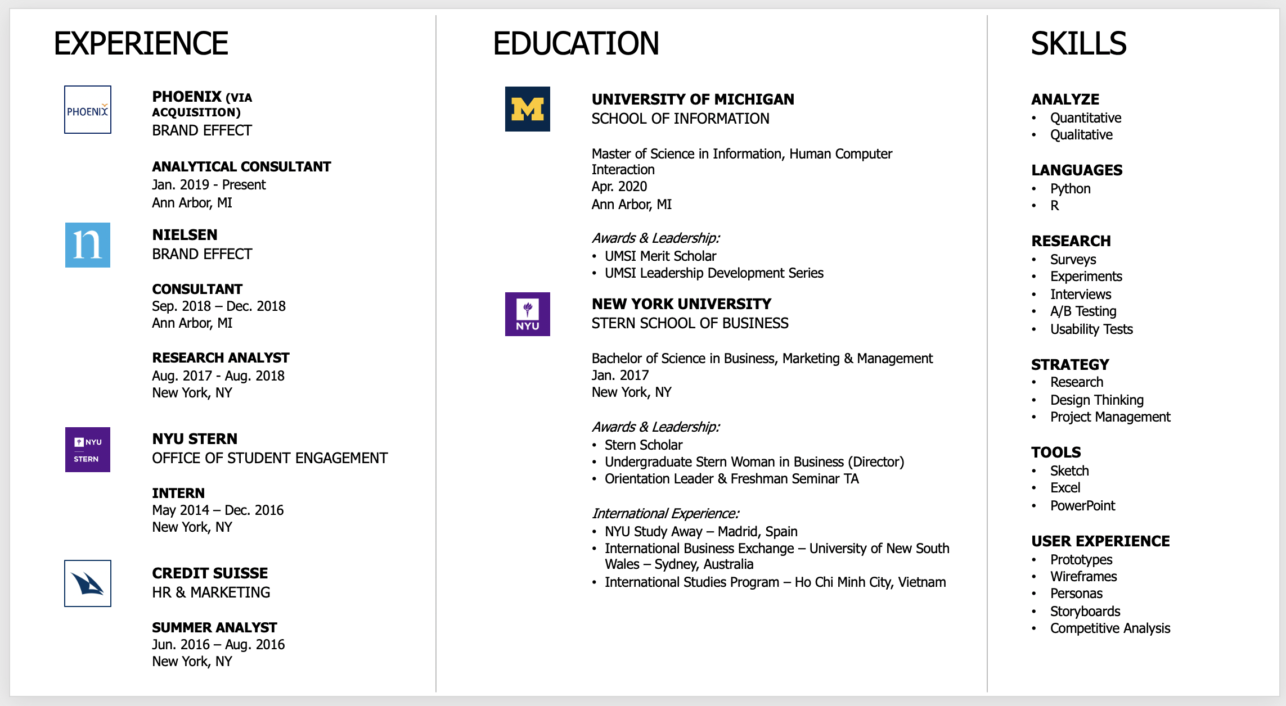
DESKTOP - RESUME
Name in Font
Nav Bar

