Slide 1
Question 3 – Jonathan Ezeugo
Looking at the Texas crimes and population data the following questions were considered:
How do inmates in the Texas prison system segregate by age and gender in the top 10 counties and top 10 offenses?
Import, cleanup and produce data frame with all needed data
Dissect data frame into age brackets using age bins
Structure data frame for bar plot visualizations
How do the age and gender segregations compare with the county population data of respective age groups?
Import population data, cleanup and produce population data frame
Merge population data frame with offenses and counties data frame to produce new base data frame
Structure data frame for various bar plot visualizations

Slide 2
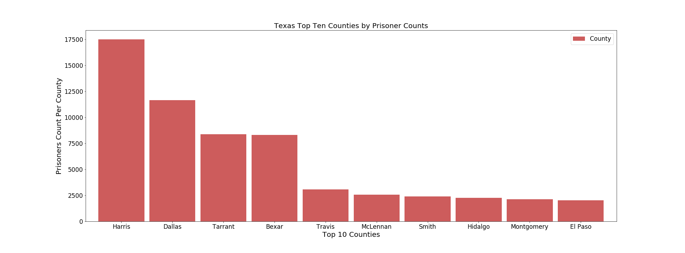
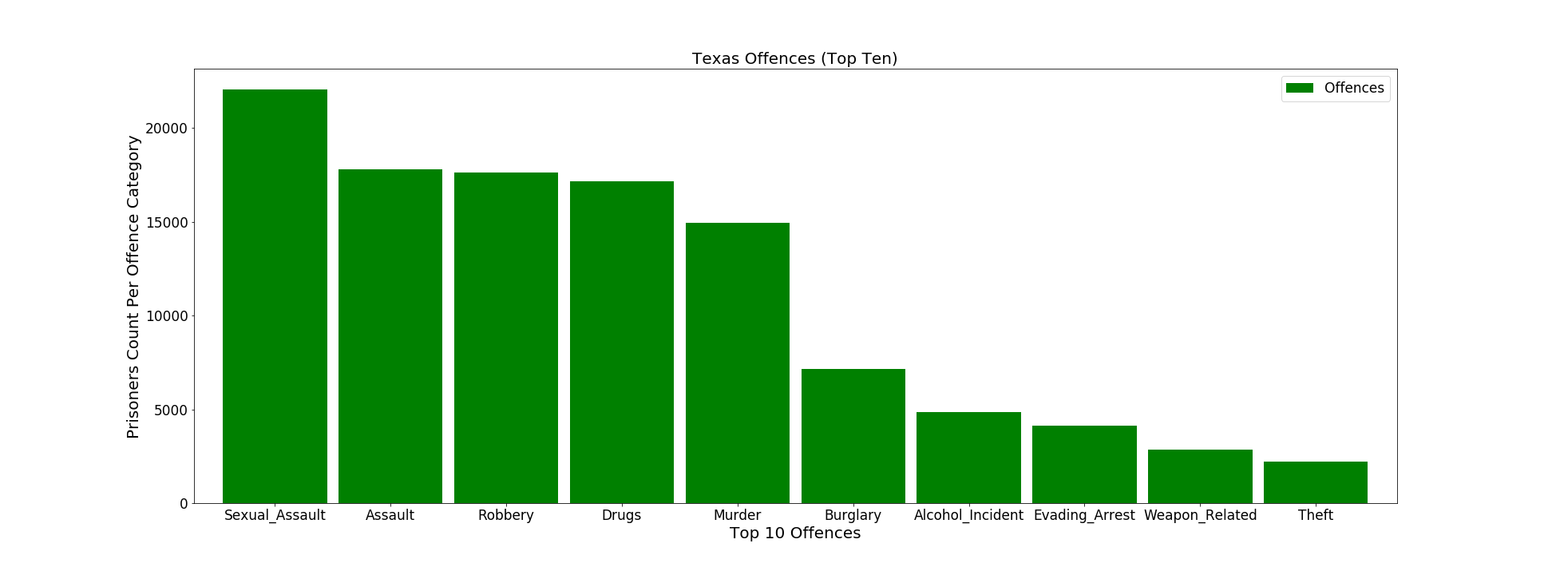
Foundational Data
Top 10 Counties
Top 10 Offences

Slide 3
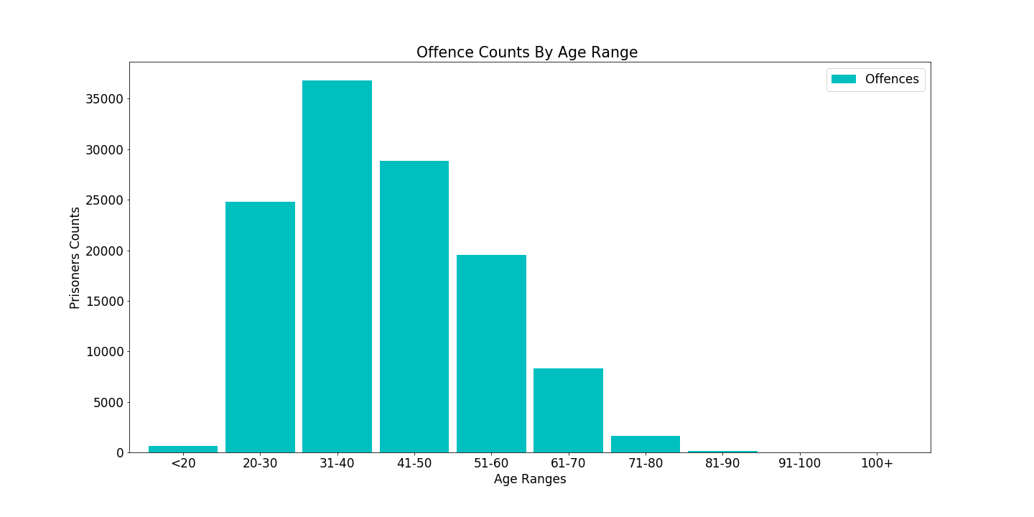
Texas Prisoners Spread By Age Groups

Slide 4
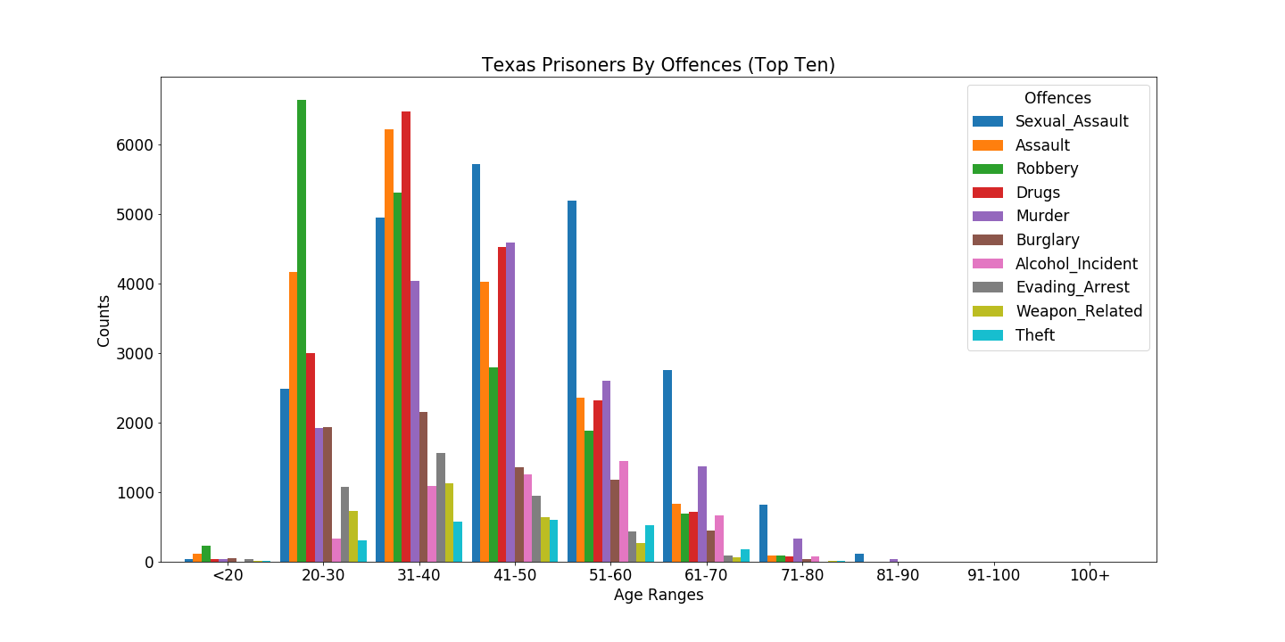
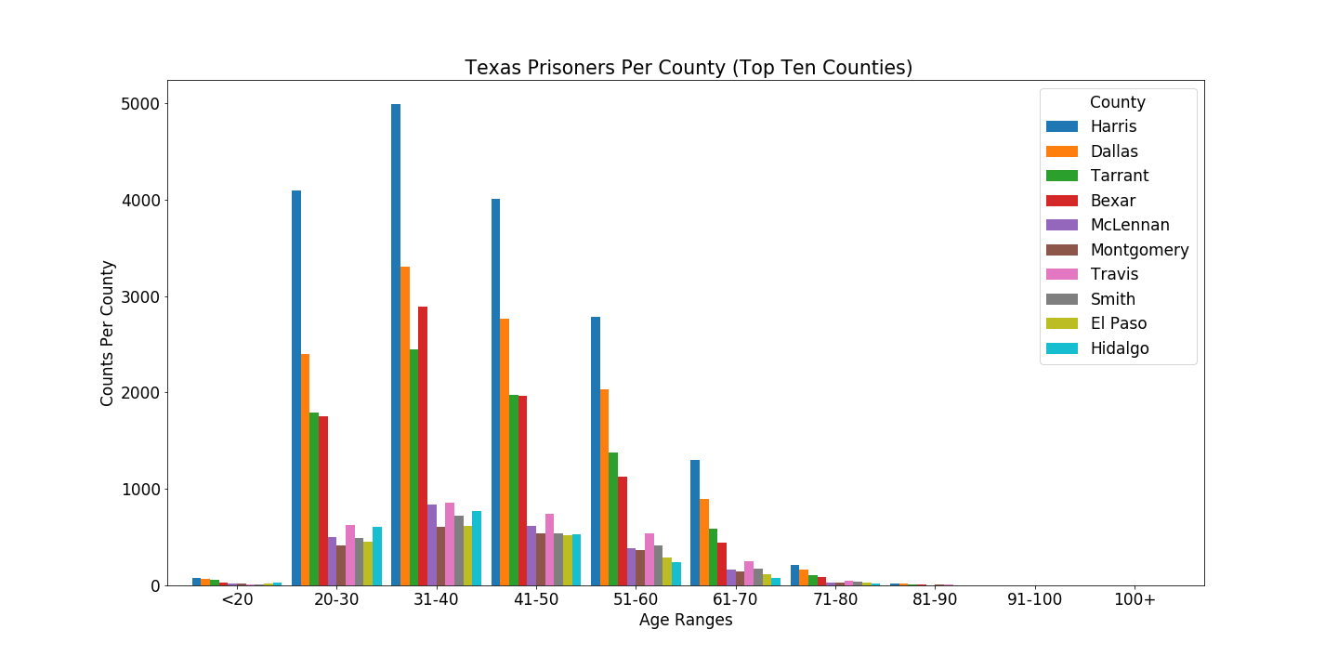
Texas Prisoners Age Spread
Age Spread By Offences
Age Spread By Counties

Slide 5
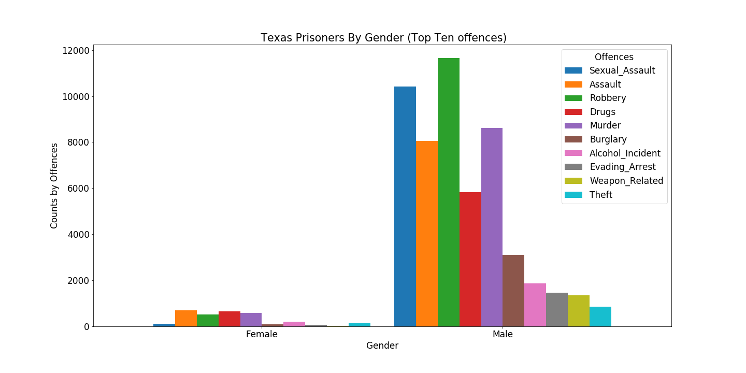

Gender Segregation Across Texas Prison System
Computation of Texas Prison Inmates Gender Percentage

Slide 6
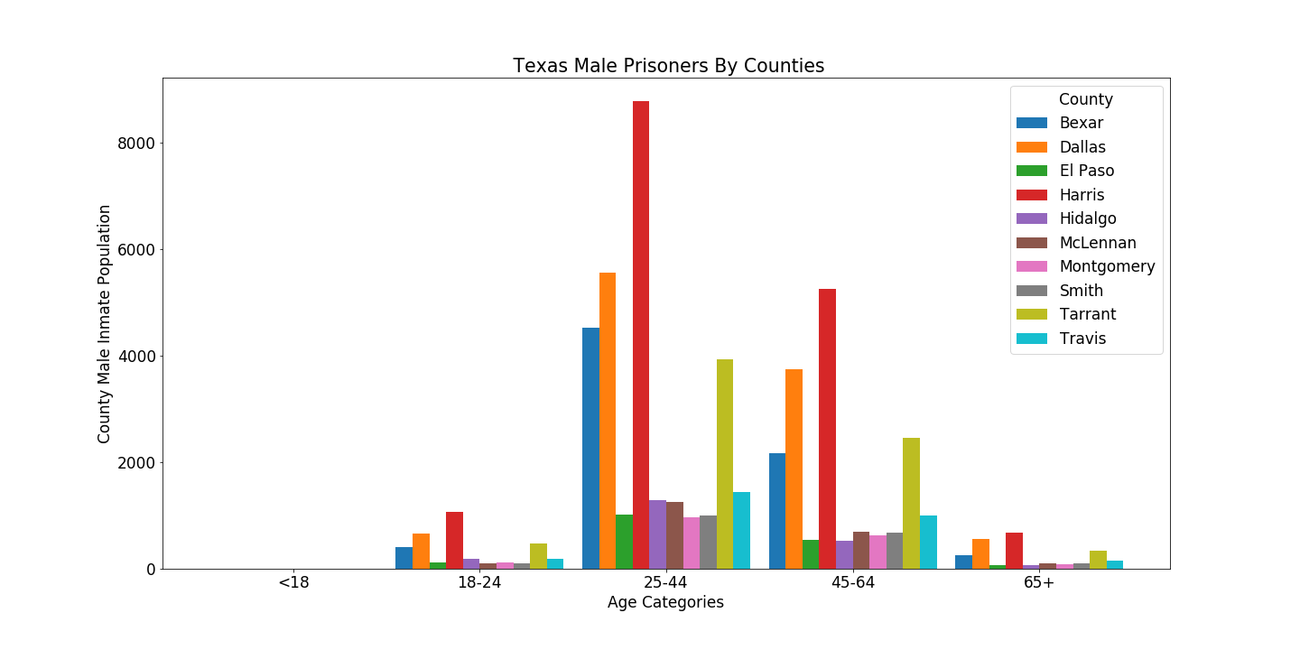
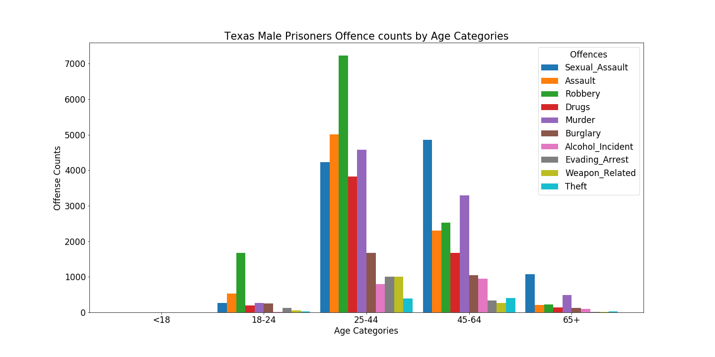
Texas Male Prison Inmate Age Segregation By Offense and Counties.
Male Inmates By Offenses
Male Inmates By Counties

Slide 7
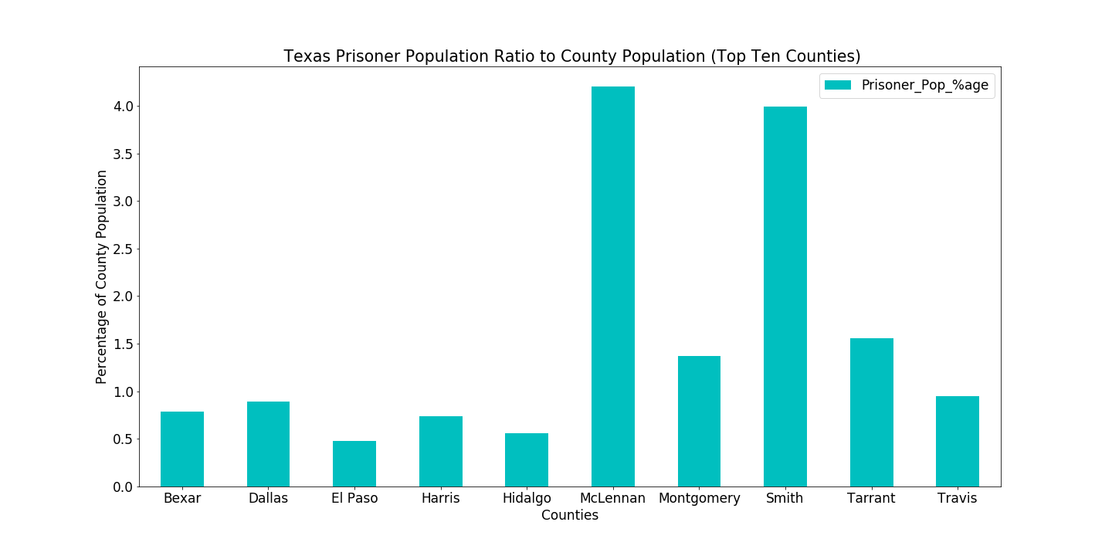
Texas Prison Inmates Population Vs County Population By Percentage

Slide 8
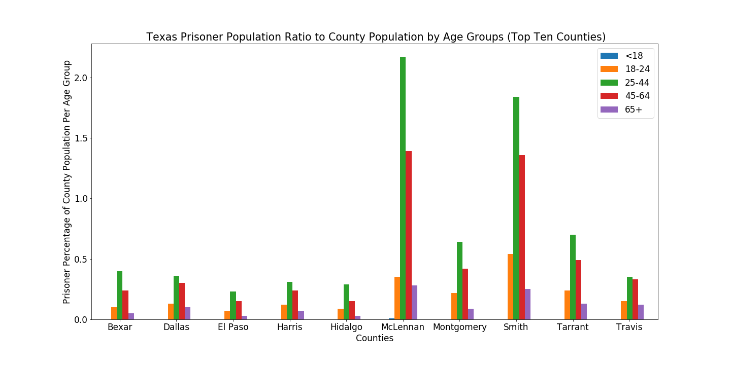
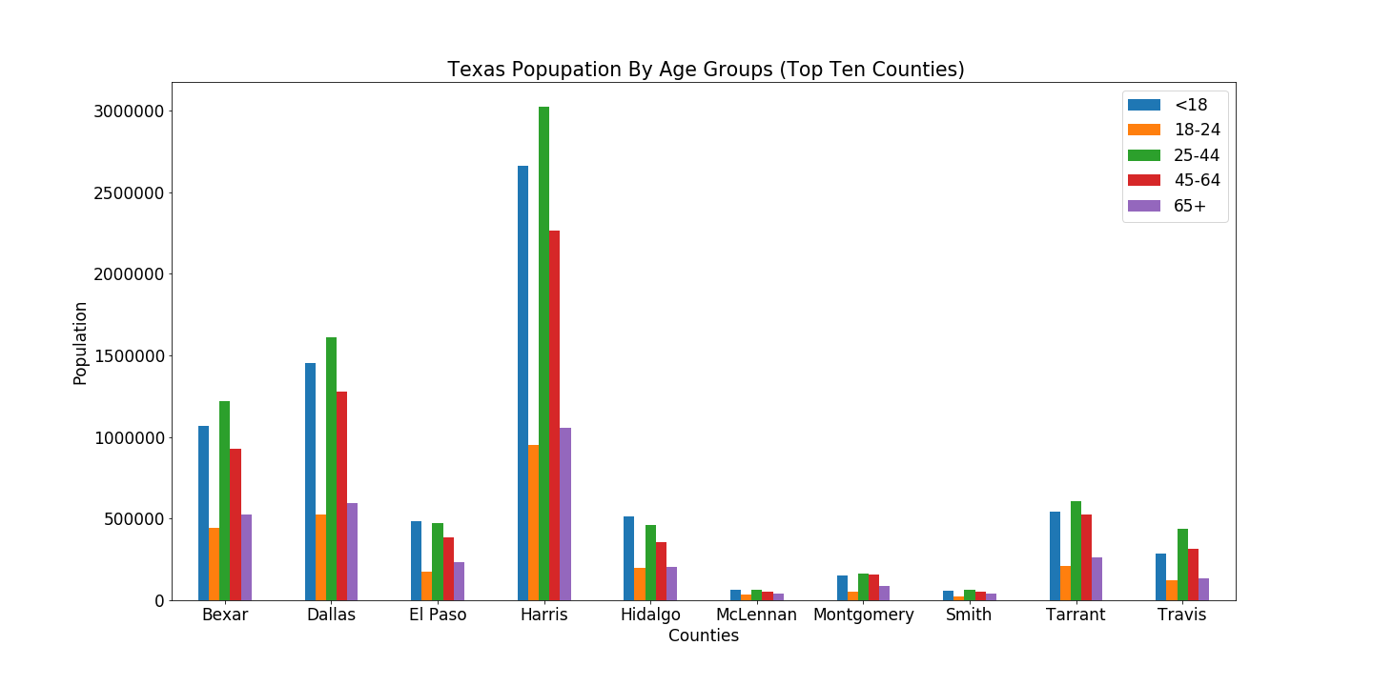
Texas Inmates Analyzed For Comparison With County Population
Percentage of Inmate Population to County Population By Age Brackets
Counties Population By Age Brackets

Slide 9
Question 3 – Conclusions
Much can be gleaned by combining various plots to get an image of the inmates in the Texas prison system. The data shows that Harris county as most populated Texas county has the most inmates across all age groups, even when only male inmates are examined. Some 95% of inmates are male.
Sexual assault become more prevalent from ages above 40 years. Even when only male inmates are considered, from age 45 years, sexual assault is the most obvious offense. Being male, a reasonable inference is that these persons likely find themselves more in broken relationships, consume plenty of pornographic materials and take their frustrations out on women. May be best to explore policy solutions that potentially address these social ills, while enhancing social programs that emphasize proper treatment of other people, especially the opposite sex.
From all 10 counties in this study, of those incarcerated in the Texas prison system, our most productive age groups, i.e., 20 to 60 years are incarcerated. We can think of the impact on families – raising children, instilling proper values in them, and enhancing chance they do not end up in the prison system. Policy makers want to structure programs that enhance inclusion in various ways and engage these ones in productive ways.
With McLennan and Smith having over 3.5% of their county population between ages 25- and 64-year-olds incarcerated in the Texas prison system, largely for sexual assault and drugs, county policy makers would look at the early education system to ensure it improves ethics and values.
By hierarchy, drugs-related crimes have about 15,000 young men between ages 20 and 60 years in prison. There are considerations about decriminalizing these issues, but better focus may be on determining individual extent in the crime and if some of these young men could be re-admitted into society as productive members and new policy measures adopted to rehabilitate such people.

