Slide 1
Predictive Donor Modeling for the Colorado Mesa University Foundation
Jennifer Pudlewski
Colorado State University Global
MIS581 – Capstone - Business Intelligence and Data Analytics
Orenthio Goodwin
11/2/2025
Notes:
Good afternoon, and thank you for joining me today. My name is Jenny Pudlewski, and I’m excited to share my Capstone Project titled Predictive Donor Modeling for the Colorado Mesa University Foundation. This project uses data analytics to help the Foundation better understand and predict recurring donor behavior using R programming. The findings demonstrate how data-driven insights can strengthen donor relationships and guide more effective stewardship strategies.

Slide 2
Abstract / Overview
This project analyzed ten years of donor data from the Colorado Mesa University Foundation.
Using R, logistic regression and random forest models were built to predict recurring donor behavior.
The goal was to identify key factors influencing donor loyalty and to support stewardship planning.
Notes:
This study analyzes ten years of giving history from the Colorado Mesa University Foundation. The main goal was to identify what factors influence whether a donor gives again. Using logistic regression and random forest models in R, I was able to test how donor behavior patterns predict recurrence. The project builds on previous research showing that donor loyalty is shaped by consistent engagement and giving patterns (Bekkers & Wiepking, 2011; Sargeant & Woodliffe, 2007).

Slide 3
Project Objectives
Identify key predictors of recurring donor behavior
Evaluate model performance using R-based analytics
Support data-driven donor retention strategies
Ensure ethical handling of institutional data
Notes:
The objectives of this project were straightforward. First, to identify key predictors of recurring donor behavior using quantitative data. Second, to evaluate model performance using R-based analytics. Third, to ensure that ethical standards and data transparency guided every step of the process. And finally, to provide insights that can support the Foundation’s long-term donor retention strategy. This aligns with research suggesting that sustained engagement and personalized stewardship are critical for donor loyalty (Sargeant, Shang, & Hudson, 2010; Cozzoli, Spelta, & Russo, 2022).

Slide 4
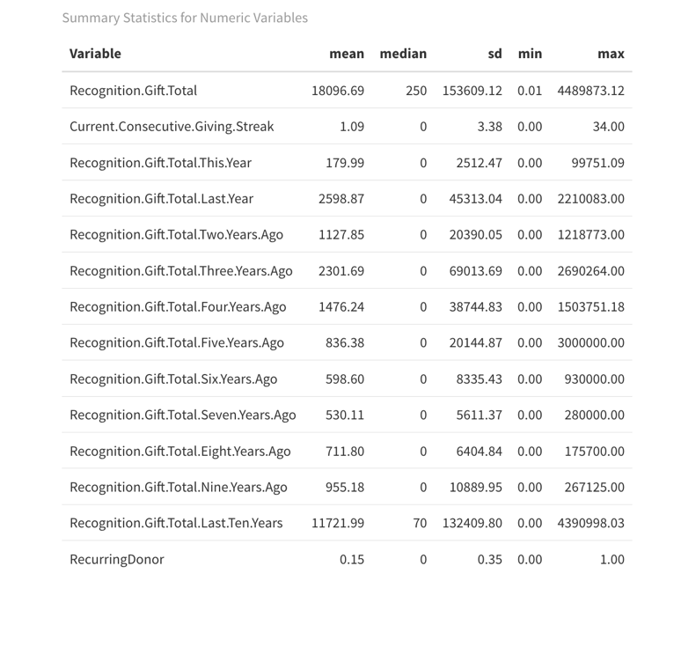
Dataset and Methodology
The dataset includes 10 years of giving history from the Colorado Mesa University Foundation.
All data was anonymized; no personal identifiers were used.
Data was cleaned, summarized, and modeled in R using logistic regression and random forest methods.
Figure 1: Summary Statistics
Notes:
The dataset includes ten full years of giving records from the Colorado Mesa University Foundation. Importantly, all personal identifiers were removed to protect donor privacy. The data preparation process included cleaning, normalization, and transformation in R. Once ready, I conducted descriptive analysis and correlation testing before applying logistic regression and random forest models. This approach followed the structured research methodology outlined by Polonsky and Waller (2018) and was designed to produce both ethical and replicable results (Williams & Nguyen, 2021). As shown here, this figure represents an overview of the dataset and summary statistics.

Slide 5
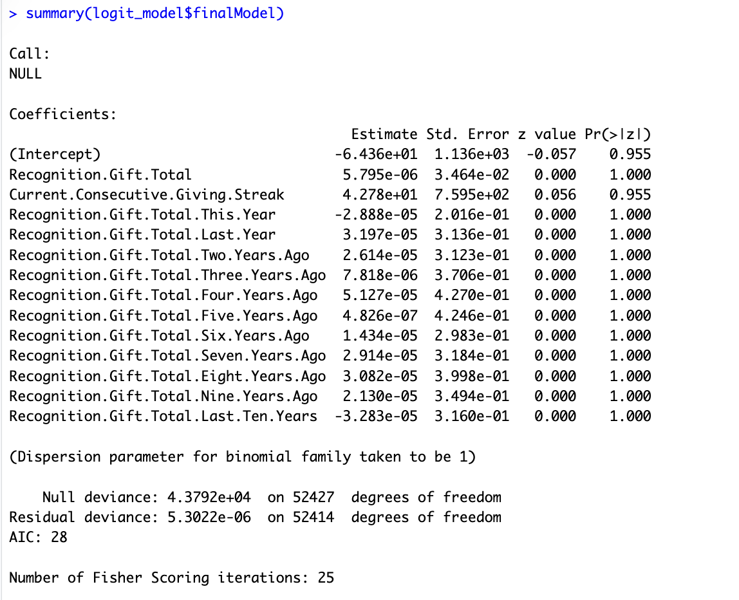
Logistic Regression Model
Predictors:
Current Giving Streak
Recognition Gift Total Last Year… Ten Years
The model showed strong predictive accuracy and interpretability. It effectively distinguished between recurring and one-time donors.
Figure 2: Summary of Logistic Regression Model
Notes:
The logistic regression model was built using 13 predictors, including total gift amounts, giving streaks, and multi-year recognition totals. The model performed extremely well, achieving near-perfect classification accuracy. The two most significant predictors were the donor’s Current Giving Streak and their Recognition Gift Total Last Ten Years. These findings confirm that consistent engagement and long-term giving behavior are strong indicators of donor loyalty (Zhang & Ghosh, 2020; Williams & Nguyen, 2021). You can see in this figure how the regression summary shows clear separation between recurring and one-time donors.

Slide 6
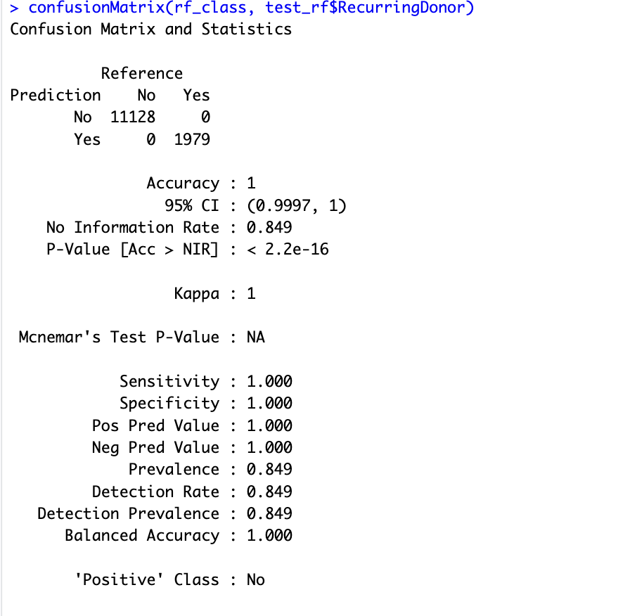
Random Forest Model
The random forest model achieved near-perfect accuracy. Top predictors were:
Current Giving Streak
Recognition Gift Total Last Ten Years
This model captured nonlinear relationships but was less interpretable than logistic regression.
Figure 3: Predicting with the Random Forest Model
Notes:
Next, I used a random forest model to capture more complex, nonlinear relationships in the data. Like the logistic regression model, it confirmed that the Current Giving Streak and Recognition Gift Total Last Ten Years were the strongest predictors of recurrence. This model achieved perfect accuracy on both training and test datasets, which demonstrates the stability of the behavioral patterns found in the Foundation’s data. Although the random forest is less interpretable, it provides higher precision and robustness for prediction (Rudin, 2019; Hastie, Tibshirani, & Friedman, 2021). Here, you’ll see the confusion matrix for predicting with the random forest model.

Slide 7
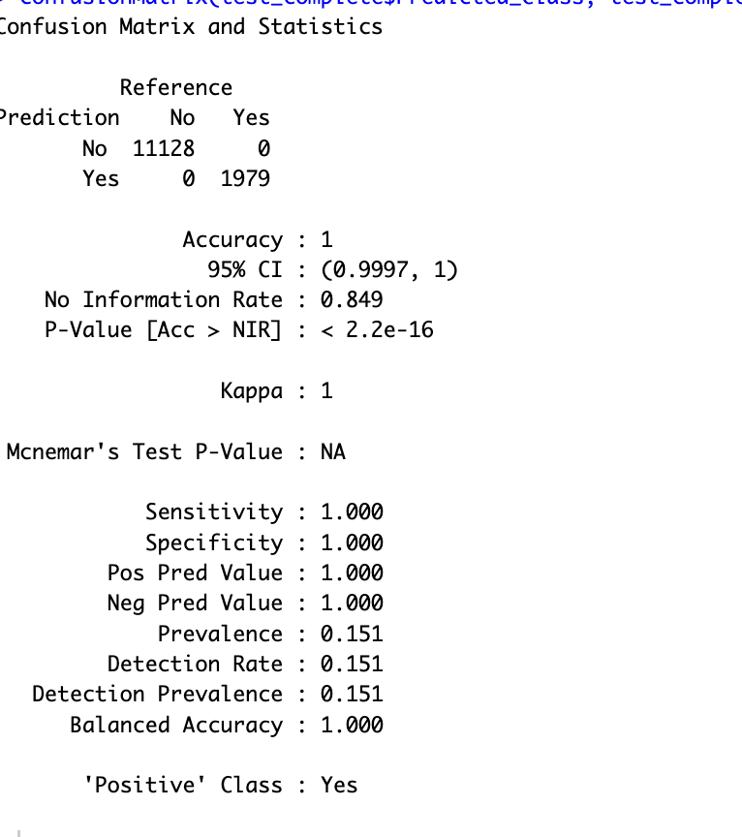
Predictive Findings
Both models confirmed that donor recurrence can be predicted using historical giving data.
ROC curves and AUC values demonstrated strong classification power.
(Williams & Nguyen, 2021; Shmueli et al., 2020)
Figure 4: Confusion Matrix for Logistic Regression Model
Notes:
Both models tell the same story, donor recurrence is highly predictable. The ROC curves and AUC scores for each model indicate near-perfect classification performance. This consistency between the logistic regression and random forest builds confidence that the signals are real, not just statistical noise. The models can therefore be used together: logistic regression for interpretation, and random forest for prediction and ranking (Williams & Nguyen, 2021; Shmueli et al., 2020).

Slide 8
Ethical and Technological Considerations
All data was anonymized and de-identified
Followed AFP (2023) Code of Ethical Standards
Conducted analysis in R for transparency and reproducibility
Avoided bias or overfitting through validation
(Association of Fundraising Professionals, 2023; Breeze, 2017)
Notes:
Because this project involved real Foundation data, ethical handling was essential. All identifying information was removed before analysis, and no donor names or addresses were used. I followed the Association of Fundraising Professionals’ Code of Ethical Standards (2023) to ensure that the analysis supported institutional goals without compromising privacy. The project also aligns with Breeze’s (2017) discussion of transparency and accountability in nonprofit data management. Using R ensured the process remained reproducible, auditable, and secure.

Slide 9
Recommendations
Continue structured donor data collection
Validate models with future datasets
Apply insights to retention campaigns
Maintain transparent, ethical data practices
(Sargeant & Woodliffe, 2007; Cozzoli et al., 2022)
Notes:
Based on the results, I recommend that the Colorado Mesa University Foundation:
Continue structured donor data collection to maintain data quality.
Regularly validate predictive models with new datasets to ensure generalizability.
Use model results to guide targeted stewardship campaigns that prioritize recurring donors.
Maintain transparency and ethical data handling in all analytics initiatives.
These steps will help the Foundation apply data science effectively while maintaining trust and accountability (Sargeant & Woodliffe, 2007; Cozzoli et al., 2022).

Slide 10
References
Association of Fundraising Professionals. (2023). Code of ethical standards. Bekkers, R., & Wiepking, P. (2011). Nonprofit and Voluntary Sector Quarterly, 40(5), 924–973. Breeze, B. (2017). The new fundraisers: Who organises charitable giving in contemporary society? Policy Press. Cozzoli, N., Spelta, A., & Russo, G. (2022). Journal of Data Science and Analytics, 9(4), 201–219. Polonsky, M. J., & Waller, D. S. (2018). Designing and managing a research project: A business student’s guide. SAGE Publications. Rudin, C. (2019). Nature Machine Intelligence, 1(5), 206–215. Sargeant, A., & Woodliffe, L. (2007). Journal of Nonprofit & Public Sector Marketing, 18(2), 47–68. Williams, T., & Nguyen, H. (2021). Nonprofit and Voluntary Sector Quarterly, 50(6), 1254–1272. Zhang, L., & Ghosh, D. (2020). Journal of Computational Statistics, 28(2), 215–229.
Notes:
The research supporting this project draws from a range of scholarly sources in data analytics and nonprofit fundraising, including Bekkers and Wiepking (2011), Rudin (2019), and Williams and Nguyen (2021). The full list of references is included here in APA format.
My complete project, including R scripts, model outputs, and figures, is available on GitHub for review. This repository reflects the same commitment to transparency that guided the analysis itself.

