Slide 1

Institut for Parallel and Distributed Systems
Numerical Simulation
fluid solver for laminar flow with arbitrary geometries & heat flow

Slide 2
Task and Implementation
Numerical Simulation

Slide 3
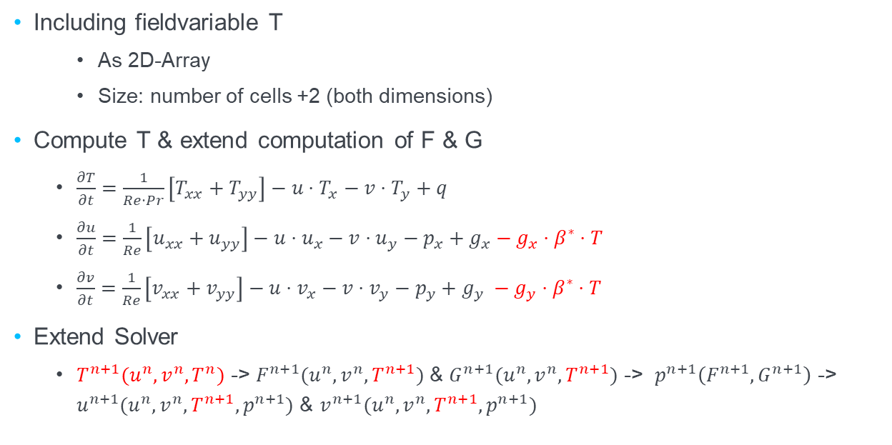
Including fieldvariable T
As 2D-Array
Size: number of cells +2 (both dimensions)
Compute T & extend computation of F & G
$\frac{∂T}{∂t}=\frac{1}{Re⋅Pr}\left[T_{xx}+T_{yy}\right]−u⋅T_{x}−v⋅T_{y}+q$
$\frac{∂u}{∂t}=\frac{1}{Re}\left[u_{xx}+u_{yy}\right]−u⋅u_{x}−v⋅u_{y}−p_{x}+g_{x}−g_{x}⋅β^{∗}⋅T$
$\frac{∂v}{∂t}=\frac{1}{Re}\left[v_{xx}+v_{yy}\right]−u⋅v_{x}−v⋅v_{y}−p_{y}+g_{y} −g_{y}⋅β^{∗}⋅T$
Extend Solver
$T^{n+1}(u^{n}, v^{n}, T^{n})$ -> $F^{n+1}(u^{n}, v^{n}, T^{n+1})$ & $G^{n+1}(u^{n}, v^{n}, T^{n+1})$ -> $p^{n+1}\left(F^{n+1}, G^{n+1}\right)$ -> $u^{n+1}(u^{n}, v^{n}, T^{n+1}, p^{n+1})$ & $v^{n+1}(u^{n}, v^{n}, T^{n+1}, p^{n+1})$

Slide 4
Other Stuff
Compute dt
New criteria pr included
Reading parameters
Beta, gamma, pr, T_init
Extend output writer
New temperature array

Slide 5
Flag matrix no slip objects therefore no values needed
Only calculate when fluid
Set boundary if Object -> way more complicated set_boundary function
Empty do nothing
Celltype Fluid, Empty, Object
1D-Array for boundary advanced inflow outflow,….
Array for boundary condition type
Array for boundary value
Bottom, top, left, right
Different applying for boundary condotion depending on positon in objcect -> object subdivide

Slide 6
Other stuff:
Output wirter now staggered grid
New input file handling (dict)
Because of Temperature:
Two more 2D Matrices for temperature boundary condition type & value
Extend 1-D bounddary arrays with temperature bondary condition & value

Slide 7
New Paramters.txt
The boundary conditions need to be determined differently, this is a commented example:
{
Type = Bottombound
Velocity= Dirichlet; 0; 0
Pressure= Neumann; 0
Temperature = Neumann; 0
Position = 0; 1
}
Ellipse: Position x_1,y_1, a, b
Rectangle: Position:

Slide 8
Rectangle see Readme
Ellipse
Triangle

Slide 9
Simulation to standard form
Channel Step comparison
Temperature stuff (Rayleigh-Bernard)
springbrunnen
Crazy stuff

Slide 10
e-mail
enter address
phone +49 (0) 711 685-
www.
enter address
University of Stuttgart

Slide 11
e-mail
enter address
phone +49 (0) 711 685-
www.
enter address
University of Stuttgart

