Slide 1
The Technology Value Stream
Understanding Lead Time, Processing Time, and DevOps Ideals
Jose Franco
CSD-380
Module 1.2 Assignment
05/31/2025

Slide 2
Introduction to the Technology Value Stream
Definition: A sequence of activities that transforms a business hypothesis into a technology-enabled service delivering value to the customer.
Encompasses everything from idea to deployment.
Critical for identifying bottlenecks, improving efficiency, and ensuring customer satisfaction.

Slide 3
Lead Time vs. Processing Time
• Lead Time: Total duration from a request initiation to its fulfillment.
• Processing Time: Actual time spent working on the request, excluding delays.
• Goal: Minimize lead time to enhance responsiveness and customer satisfaction.

Slide 4
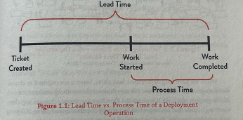
Visualizing Lead Time vs. Processing Time
Source: Kim, G (2021). The devops handbook.

Slide 5

Common Scenario: Deployment Lead Times Requiring Months
• Common in large, tightly coupled, monolithic systems.
Issues:
Long waits for integration and test environments.
Extensive manual testing.
Multiple approval gates.
Result: Heroics required, frequent delays, and poor customer outcomes.

Slide 6
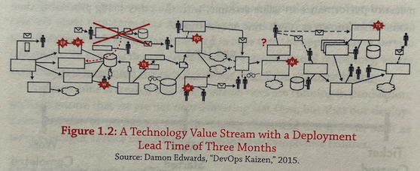
Value Stream with a Three-Month Deployment Lead Time
Source: Kim, G (2021). The devops handbook.

Slide 7
DevOps Ideal: Deployment Lead Times of Minutes
Goal: Fast, continuous feedback and rapid deployment.
Enabled by:
Small, incremental code changes.
Automated testing and deployment pipelines.
Minimal manual approvals.
Benefits: Faster delivery, improved quality, higher confidence in deployments.

Slide 8
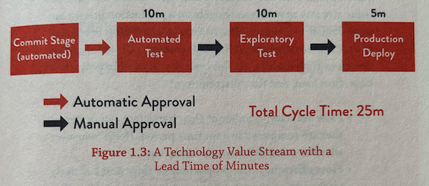
Value Stream with Deployment Lead Time of Minutes
Source: Kim, G (2021). The devops handbook.

Slide 9

Key Takeaways
Lead time is crucial for customer experience.
Traditional models create long delays and risks.
DevOps principles reduce deployment times dramatically through automation and continuous feedback.
Focus should be on reducing both lead and process times to improve business value delivery.

Slide 10
References
Kim, G., Humble, J., Debois, P., Willis, J., Forsgren, N., & Allspaw, J. (2021). The devops handbook: How to create world-class agility, reliability, & Security in Technology Organizations (2nd ed.). IT Revolution Press.
Microsoft Learn. https://learn.microsoft.com/en-us/azure/devops/report/dashboards/cycle-time-and-lead-time?view=azure-devops
SmartDraw. https://www.smartdraw.com/value-stream-map/
DORA. https://dora.dev/guides/value-stream-management/

