Slide 1
Barriers to Implementing a Just, Learning Culture
Jose Franco
CSD-380
Assignment 9.2
July 12, 2025

Slide 2
Understanding Just Culture
A 'just culture' promotes accountability without blame.
Encourages open discussion of errors to support learning and improvement.
Defined in The DevOps Handbook as a mindset that treats failure as a learning opportunity.
Requires trust, psychological safety, and systems thinking.

Slide 3
Blame Culture and the 'Bad Apple' Theory
Traditional thinking assumes individual negligence ('bad apples') cause failures.
Sidney Dekker: 'Human error is a consequence of the system, not a cause.'
Blame stifles learning, discourages transparency, and reinforces fear.
Barrier: Shaming individuals undermines systemic analysis.

Slide 4
Fear of Punishment
Employees fear disciplinary actions or reputation damage.
Fear discourages reporting of mistakes or near-misses.
Creates a culture of secrecy and silence, not safety.
Common in healthcare and engineering fields.
Source: https://justculture.hqa.ca/overcoming-barriers-to-a-just-culture/

Slide 5
Bureaucracy & Inconsistent Processes
Excessive procedures hinder responsiveness and agility.
Inconsistent rules for assessing incidents erode trust.
Conflicting policies confuse teams on what's safe to report.
Focus shifts from learning to compliance.
Source: https://humanisticsystems.com/2023/10/18/why-is-it-just-so-difficult-barriers-to-just-culture-in-the-real-world/

Slide 6
Lack of Leadership Support
Leaders often fail to model openness or take responsibility.
Mixed messages: 'Speak up, but face consequences.'
Without leadership buy-in, culture changes remain superficial.
Frontline staff need psychological safety.
Quoting Etsy's John Allspaw:
“When engineers feel safe, they become enthusiastic about sharing.”

Slide 7
Legal, Media, and External Pressures
Organizations may revert to blame under external pressure.
Sources include regulators, legal threats, and media scrutiny.
Transparency feels risky without protection from punitive outcomes.
Culture becomes risk-averse instead of open to learning.
Example: Healthcare with high malpractice exposure.

Slide 8
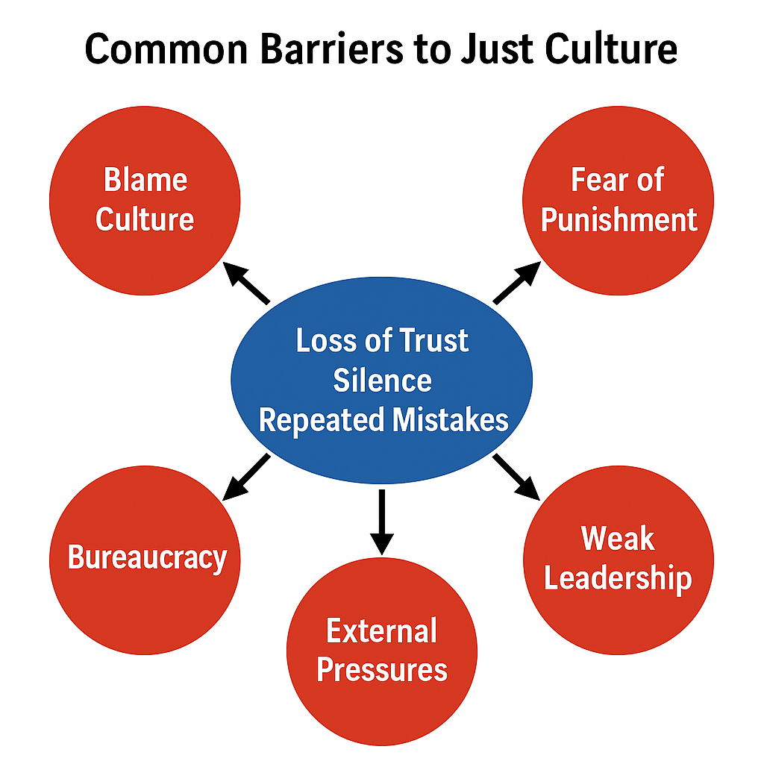
Common Barriers to Just Culture

Slide 9
Strategies to Overcome Barriers
Implement blameless post-mortems and learning reviews.
1
Promote systems thinking instead of individual blame.
2
Train leaders in psychological safety and transparency.
3
Use controlled failures (e.g., Chaos Engineering).
4
Align policies to support reporting and reduce fear.
5

Slide 10
References
1. Kim, G., Humble, J., Debois, P., & Willis, J. (2016). The DevOps Handbook.
2. 'Overcoming Barriers to a Just Culture.’ https://justculture.hqa.ca/overcoming-barriers-to-a-just-culture/
3. 'Why is it just so difficult?' https://humanisticsystems.com/2023/10/18/why-is-it-just-so-difficult-barriers-to-just-culture-in-the-real-world/

