Slide 1
Using Arduino and Cheap Ultrasonic Transducer for Robotics
Nick Carter 1/9/2016
nickstech@outlook.com

Slide 2
Content
Explain component and how it works and how well it works
Explain how to interface it to Arduino and ping and newping libraries
Explain results using it in various ways seen on Internet
One sensor limited avoidance
3 sensors – online video of smart robot using this.
Up to 16 sensors – all around scan – no servo – each sends and receives
Explain my different ideas and experience for using it
Test for how well it works how to use it & limitations
Test using one sender and multiple receivers
Detect obstacles by echo
Locate obstacles by ping time difference
Scanning SONAR – Lucky Larry’s implementation
Description and demo

Slide 3
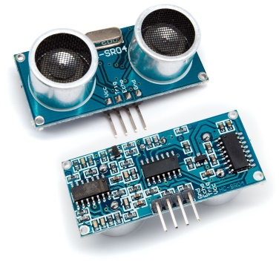
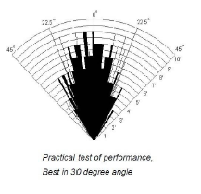
SR-04 Ultrasonic Sensor
This is the widest available, cheapest sensor
I got 10 for $13.50
Uses 5V supply (20mA)
Compatible with TTL I/O
Inaudible (40 kHz)
Range from 2 cm to 500 cm
Accuracy /- 0.3 cm
30 degree angle of detection
It also comes in 3 and 5 pin variants
If 3 pin it uses 1 pin for Trig and Echo

Slide 4
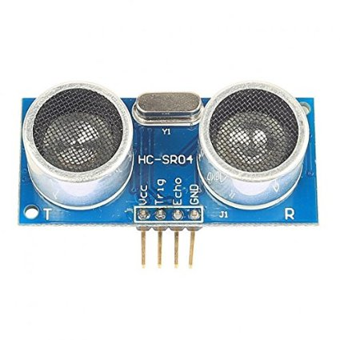
The SR04 Sensor

Slide 5
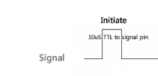


Operating the Sensor
Sequence
Set Trig low for 5 uS
Set Trig high for 10 uS
Set Trig low
Delay 50 mS before next attempt in case no echo
50 mS min recommended
Trig Ping (out)
Echo Pin (input)
If no object is detected it will give a 38mS pulse out
Basically – define the digital output Trigger Pin and digital input Echo Pin
Then do the following:
digitalWrite(TRIG_PIN, LOW);
delayMicroseconds(5);
digitalWrite(TRIG_PIN, HIGH);
delayMicroseconds(10);
digitalWrite(TRIG_PIN, LOW);
duration = pulseIn(ECHO_PIN,HIGH); //pulsein mS = cm
delay(50); // convert the time into a distance
distanceCm = duration / 29.1 / 2 ; //half the round trip time 29.1 mS per cm
distanceIn = duration / 74 / 2; //half the round trip time 74 mS per inch
Check for error conditions, 38 mS pulse e.g. No response e.g.

Slide 6
Arduino Library Ping (Old) THIS USES A 3 PIN “PING)))” SENSOR
Ping Explanation is at http://playground.arduino.cc/Code/Ping
//Use PING and put result on Serial Port
//Same pin used for Trigger and Echo pulse on SEN136B5B sensor
#include <Ping.h>
Ping ping = Ping(13,0,0); // Parameters are - output pin,
void setup(){
Serial.begin(115200);
}
void loop(){
ping.fire();
Serial.print("Microseconds: ");
Serial.print(ping.microseconds());
Serial.print(" | Inches ");
Serial.print(ping.inches());
Serial.print(" | Centimeters: ");
Serial.print(ping.centimeters());
Serial.println();
delay(1000);
}

Slide 7
NewPing Library (New and Better)
NewPing Explanation is here
http://playground.arduino.cc/Code/NewPing
#include <NewPing.h>
#define TRIGGER_PIN 12
#define ECHO_PIN 11
#define MAX_DISTANCE 200
NewPing sonar(TRIGGER_PIN, ECHO_PIN, MAX_DISTANCE);
void setup() {
Serial.begin(115200);
}
void loop() {
delay(50);
int uS = sonar.ping();
Serial.print("Ping: ");
Serial.print(uS / US_ROUNDTRIP_CM);
Serial.println("cm");
}
Benefits
Interfaces to 3, 4, 5 pin SONAR devices
Provides method returning mean for multiple samples
Can provide Ping result in mS, cm, in.
Multiple Timer functions
Provides maximum distance - return s “0” if nothing in that range
Page gives code for multiple sensor example

Slide 8
Using a Single Ultrasonic Sensor
Motion Control, using the Sensor for feedback
Find obstacle distance from moving robot
e.g. avoid bumping into things - Back up and turn
Detect Moving Object
Find distance of moving object from stationary sensor.
E.g. open door when person is close.
Limitations
Range up to 500cm – about 16 ft
Angle of detection – 20 to 30 degrees

Slide 9
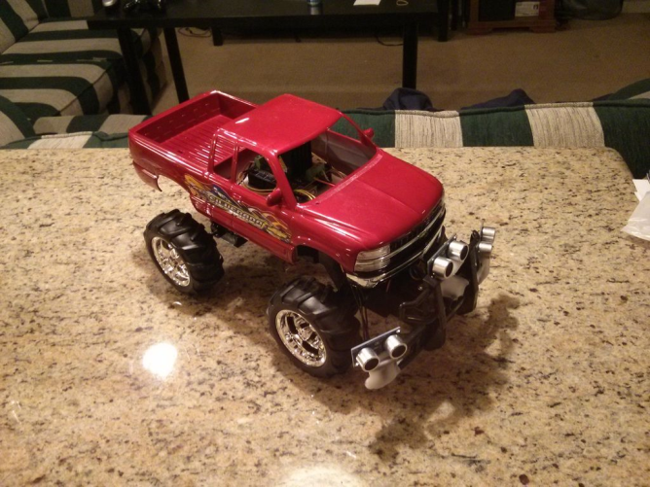
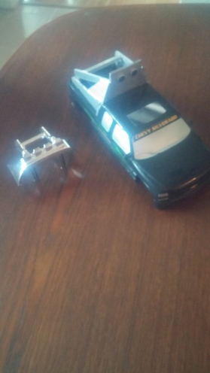
Use 3 (or more) Sensors for Detection
This gives Left, Center and Right detection
It can be used for “smart” behavior
E.G. http://www.instructables.com/id/RC-Truck-Arduino-Robot/
Sensors cover drivable directions
and you can navigate well enough.
Video is good but looks like it overcorrects
I tried this configuration using newping, but did not navigate from it, only looked at detection.
Disadvantage is each sensor takes up to 50 mS if pinged sequentially so can be slow to respond if you use a lot of sensors.
My implementation with 1 sensor on right, implemented as augmentation to manual controller.
This truck has a small turning angle compared to Red truck so is implemented just to backup if too close to something while under manual RC, letting operator figure it out.
Also looking at adding speed control so not always driving at max speed.

Slide 10
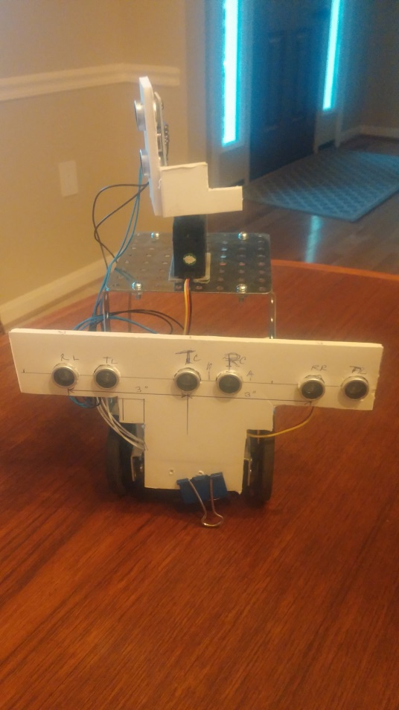
Object Location ? How?
Can detect distance and only within 20-30 degree arc so only the approximate location is known
Can move known distance to another location and use new reading to triangulate and fix the location (repeating for greater accuracy.)
You can use multiple sensors but better to use a receiver array
You can use multiple sensors, trigger them all off same trig pulse so they have identical start timing
Block off Tx emitter on all except 1 sensor.
Use varied response times from Receivers to locate object based on triangulating different ping times
I tried this using 2 Rx separated by 6 inches and a central Tx and got reasonable results for time differences but did not pursue yet for navigation

Slide 11
Object Location/Direction
Difference in ping time is greater if each sensor uses its own transmit pulse but will be inaccurate if sensors are in motion. Better to use DC for range and calculate angle with DL, DS and DR.
Can use “Cosine Rule” on either triangle DL/DC/DS or DR/DC/DS to find the angle from the reference line. E.g. In DL/DC/DS , Cos ( DL angle) = (DC^2 + DS^2 - DL^2 )/2*DS*DC. Look up ARCCOS angle.
Direction Angle = (90 – DL Angle)
Assume Tx/Rx separation is negligible.
Can use multiple sequential pings (Tx/Rx) or single Tx ping multiple Rx as desired.
Biggest angle is 15 deg max
- may not get all sensors
responding if greater.
Direction Angle
Distance = DC
Distance = DR
Distance =DL
DL Angle
Rx
Tx
Tx
Rx
Tx
Rx
pingTimeL
pingTimeC
pingTimeR
DS
DS

Slide 12
15 Sensors Give 360 Degree Sensing
The newPing library accommodates multiple sensors
This page has an example using 15 sensors with a 33 mS delay. http://playground.arduino.cc/Code/NewPing
Total time for reading 15 sensors is 0.495 Secs. So this can eat into other Arduino activities you need.
15 sensors give you 360 degrees coverage giving sensors 24 degrees each
There is also the limitation of number of Arduino in/out pins.
I used the example as basis for testing 3 sensors and also modified it for the single Tx, multiple Rx case.
For one Tx multiple Rx I connected all Trig together and taped off all Tx sensors I wanted not to use to stop sound coming out.

Slide 13
Using Scanning Sensor for Navigation
There are lots of Ultrasonic sensing robots on Internet with designs and videos. There are many ways to optimize this.
Some scan while moving
Some stop scanning while turning https://youtu.be/zX0DeAb9vcQ
Some scan 180 degrees, some scan less, getting a faster update over a smaller angle
Some stop, scan to find best direction, turn then move https://youtu.be/shUTyHMPXCs
This video gives a good idea of how well objects are detected https://youtu.be/zX0DeAb9vcQ
This is a self parking car using Mindstorms but is an interesting application. https://youtu.be/shUTyHMPXCs

Slide 14
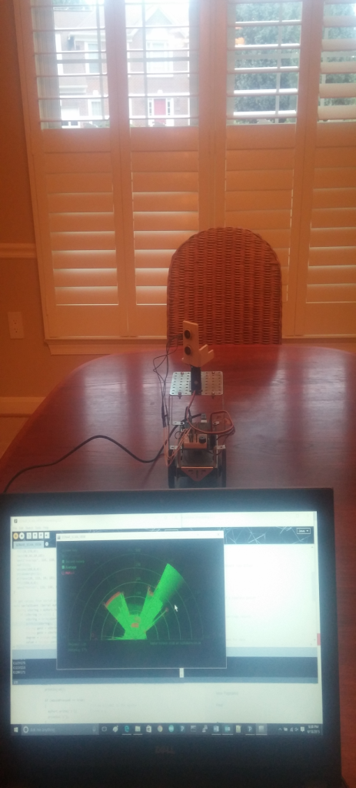
BOEbot on Dining table scanning with “SONAR” display This is implemented using design by “Lucky Larry”
Microcontroller on Bot moves 180 degree servo at fixed angle increment
Then pings to get distance to reflection – and averages 15 ping results.
The data is sent to the PC on a serial/USB port data link and displayed with a program running in the “Processing” application.
The programs displays an image like old fashioned RADAR units, rotating a radial line left to right and illuminating when the screen is wiped.
Green is open space.
Standard Rotating RADAR uses opposite notation:
Objects are lit up not freespace
30 deg sensing Aperture makes it inaccurate.

Slide 15
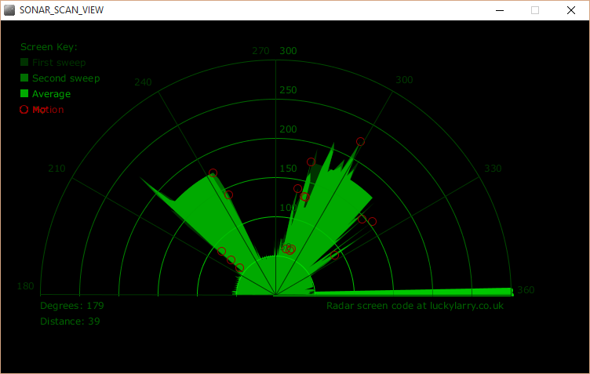
Environment and Display
Chair
Chair
Chair
PC
me
Chair
BOEbot with scanning
+/- 90 deg and SR-04

Slide 16
Can We Get Better Performance ??
Sensor has big aperture ~ 30 degrees
Object is in there somewhere……..
Possible fixes (not tried)
Use 2 sensors angled for narrow overlap and detect when BOTH sensors see something ONLY.
Use one sensor but use leading edge of detection to find object – going both L→ R and R → L.
Not so good when sensor is moving
Need to verify is not just noise and is seen for rest of aperture too
Other options – anyone??
1
2

Slide 17
Measurement Errors/Issues
Air Temperature
The speed of sound varies with temperature
S = 331.3 + 0.606 × Temperature_in_C
so for 20 degrees C it would be
S = 331.3 + 0.606 × 20 = 343.42 m/s
Other effects - Air Pressure , Humidity, C02, frequency, are negligible in this application
So you might need a correction depending what you do.
Environmental effects
Some places are very noisy - this may limit the range
The ground surface is rough and reflects sound - may make measurement unpredictable
Target objects may not reflect sound well - flat surfaces vs rounded/pitted objects

