Slide 1
Project Sizzle
hear what’s cooking

Slide 2
Cook Smarter
Cooking from recipes without having to touch a book or even a device.
Guiding home cooks at their own pace, and saving them time while we’re at it.
Respond to user requests for help to make them better cooks.

Slide 3
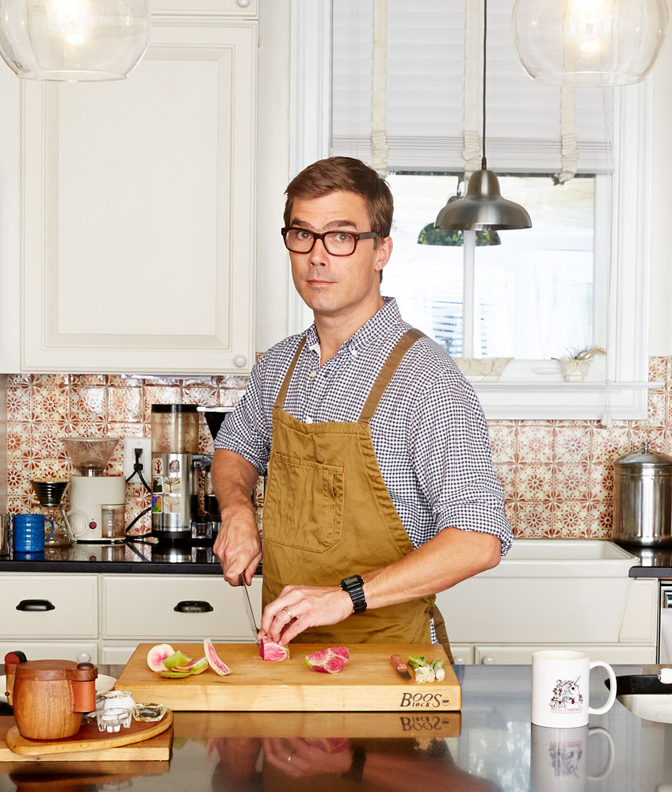
Cooking with Blaire
Stay at home dad with two kids
Has a busy schedule
Cooks a lot of the same food
New recipes take too long to make

Slide 4
Saving Time with Speech
Hands free with Apple’s latest text to speech technology
Context base controls using voice commands
Never loose your place in the steps
Keep your ingredients and tools in hand

Slide 5

Learning with Stephanie
College student
Living on her own for the first time and doesn’t know how to cook
Can’t afford classes, her family is too far away, and she has school work to get done.

Slide 6
Lessons When You Need It
Don’t know what dicing means? Ask
Not sure if you sautéed your onions enough? Too much? Ask for a picture of the result.

Slide 7
Competitive Analysis
 | Text To Speech | Voice Commands | Recipes | Bookmarks | Custom Recipes | Metric Conversion | Serving Size | Other
Yes Chef | Microsoft Cognitive Services. Poor defaults. Long winded | Once enabled fails most of the time. Requires button press | Organized and Searchable Library | Yes. Empty list displayed poorly | No | Settings for metric measurements | Cannot adjust
SideChef | Long winded | Doesn't confirm commands. Slow to respond | Organized and Searchable Library | Yes, hard to find list | Premium Subscription | No | Yes | Small Text
AllRecipes | No | No | Extensive User Created Library | Yes | Yes | Yes | Yes
Yummly | No | No | Aggregator | Yes | No | Does not change all ingredients | Yes
Key Ingredient's Recipe Reader | Doesn't pace itself based on steps | No | Large Library | Have to use website | Subscription Required | Separate App | Unknown | Expensive dedicated hardware.

Slide 8
What Will Make Sizzle Successful
A voice interface as a core feature and not an after thought
Concise steps that can easily be followed.
Intelligent commands to navigate the instructions.
As much or as little information as the user needs at the moment.

Slide 9
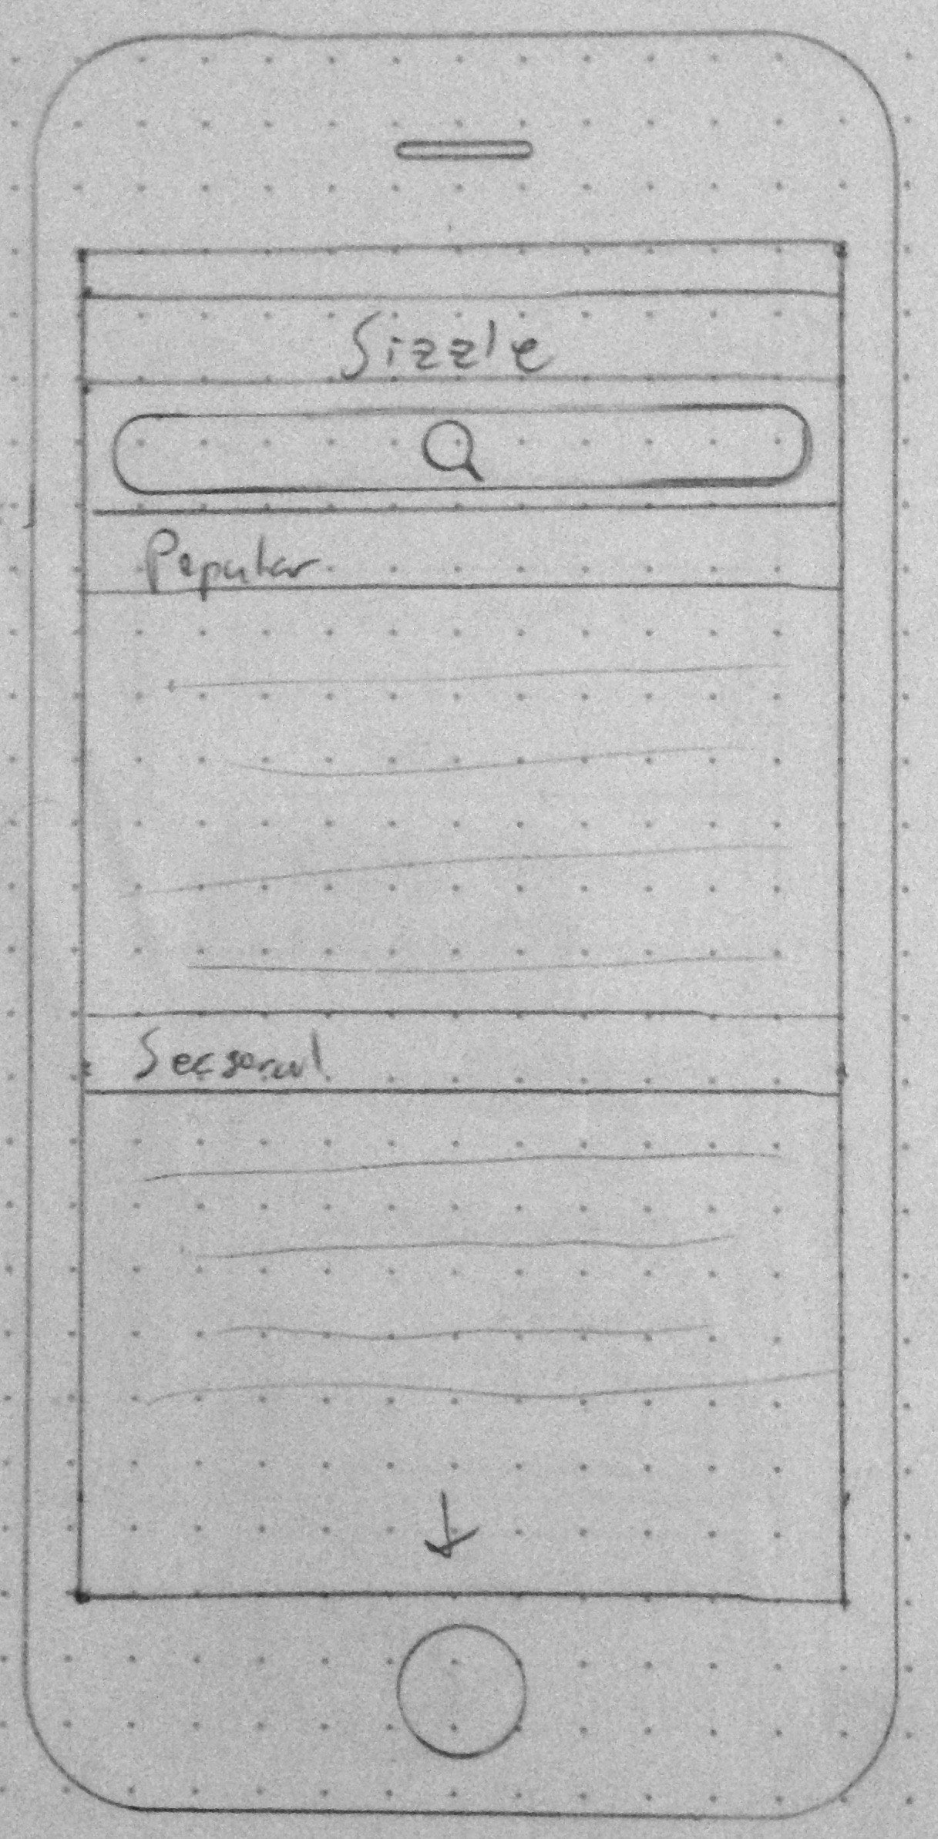
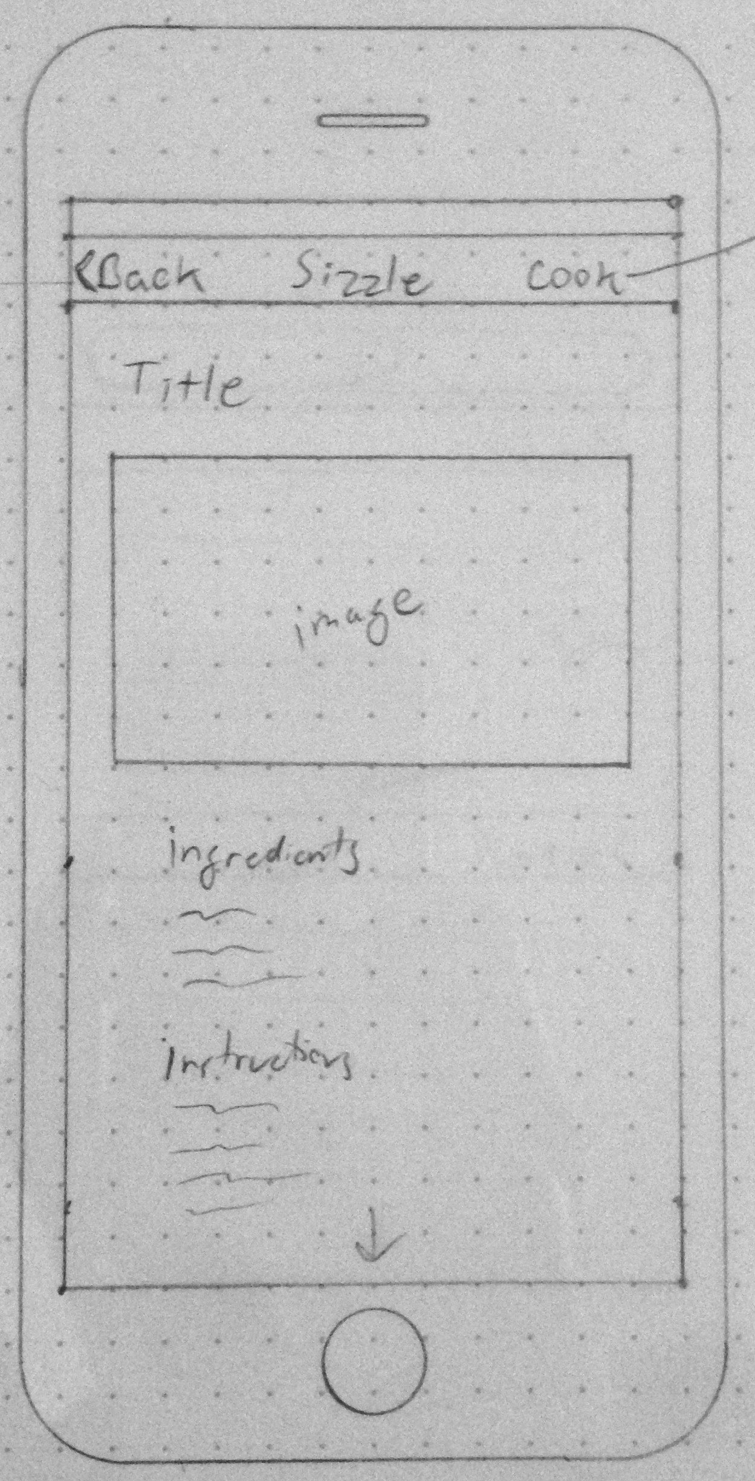
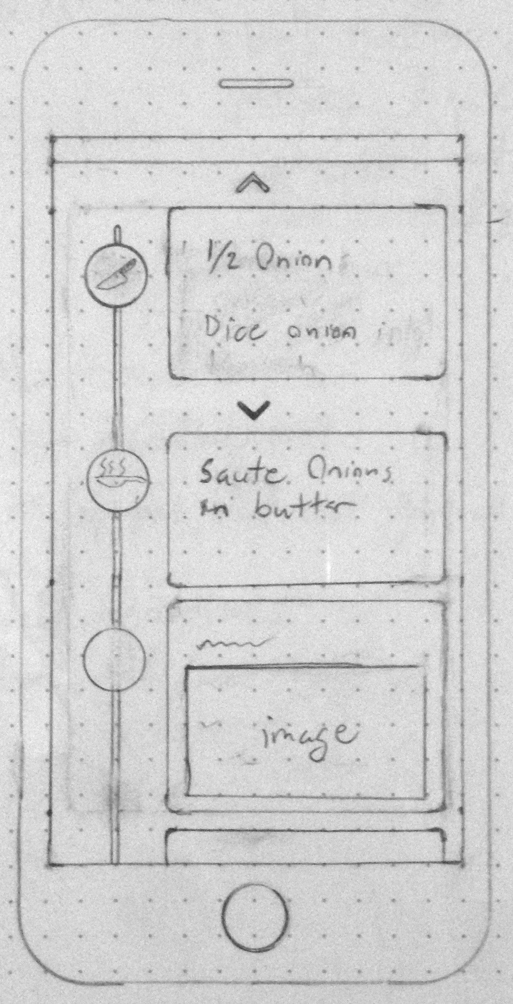
Prototype

Slide 10
Monetization
Featured recipes for chefs, food blogs, etc.
Banner advertising, product placement.
Premium content. Recipes from popular chefs with custom audio tie ins.
Product placement. (brand names in place of generics, Guinness instead of stout beer)

Slide 11
Roadmap
Milestone 1: Basic recipe list and core voice features
Milestone 2: Advanced voice controls
Milestone 3: Refined UI, expanded content
Milestone 4: additional features like bookmarks, custom recipes, unit conversions

