Slide 1
Assistance
a Wasted Computing Power Socialized Reutilization System

Slide 2
User’s Code
Initialize;
Do_something();
mapData = new generateMapData();
assistanceQuest1 = Assistance.solveTSP(mapData, NOWAIT);
doSomething();
Assistance.synchronize(this, assistanceQuest1);
doSomething(mapData);
…

Slide 3
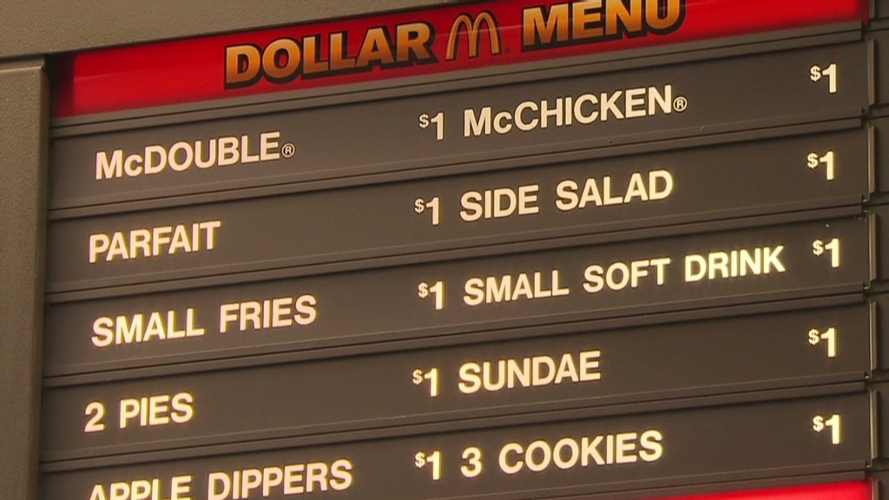
Tasks

Slide 4
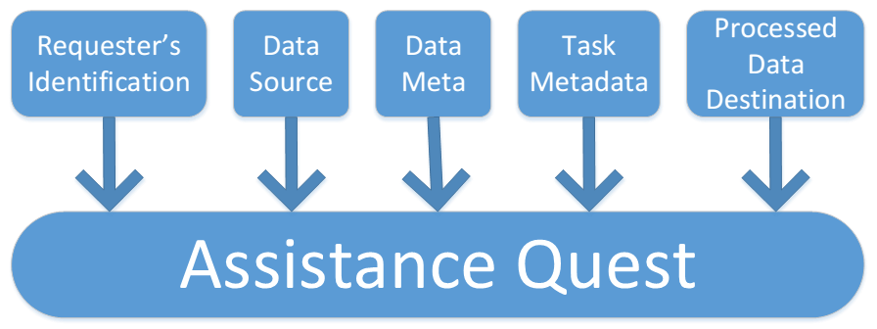
Quest

Slide 5
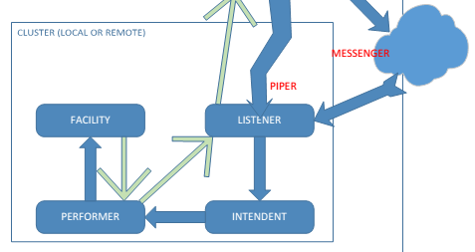
Decision to give Assistance or not

Slide 6

Assistance is only given if there are enough resources available.
If more resources are needed, the system automatically stops all Assistance processes.

Slide 7
Assistance Network
Flexible.
Light.
Secure.
Horizontally Scalable.
Portable.
Easy to deploy.
Easy to maintain.
Ideal for Mobile Platforms.
For Everyone to have a Powerful Machine.
For No One to have a Expensive Web Browser Brick.
- Together, we do it.

