Slide 1
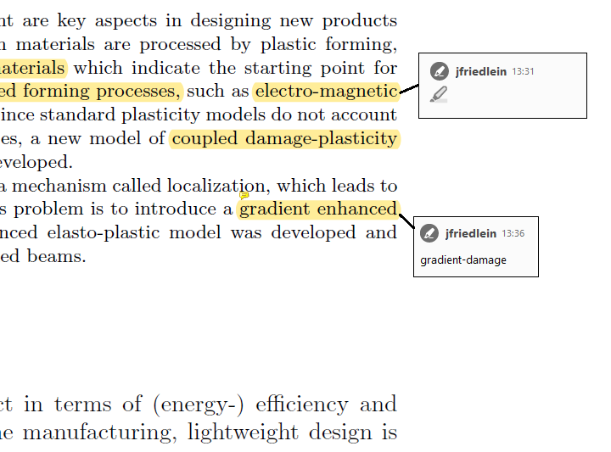
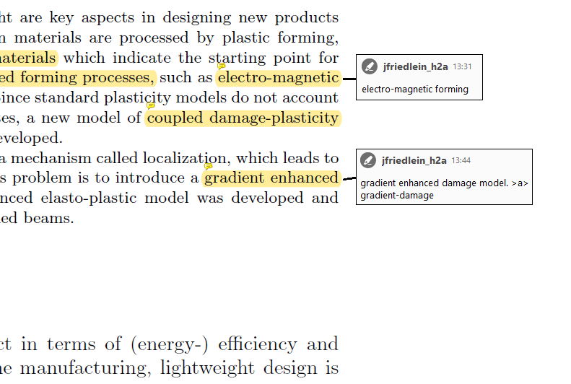
PDF with highlighted text and user-comments
PDF with annotations containing the extracted highlighted text and user-comments
h2a

