Slide 1
Intro to Federated and Distributed Social Networking
Jon Robbins
Centralized networks are not very concerned with user privacy. Luckily there are other options
2014.07.22

Slide 2
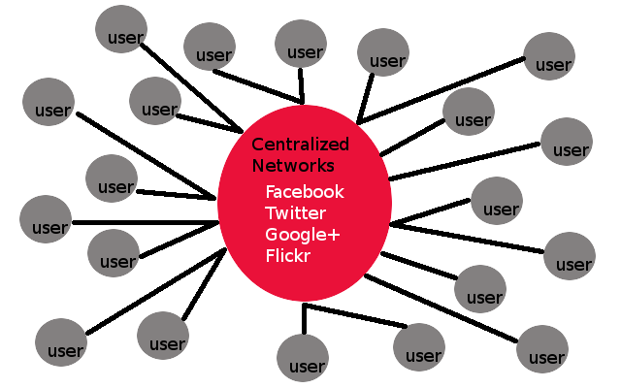
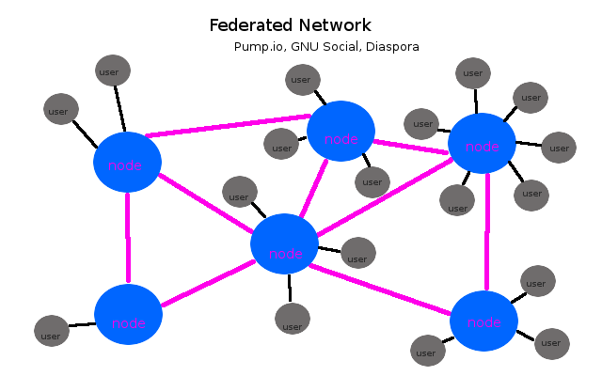
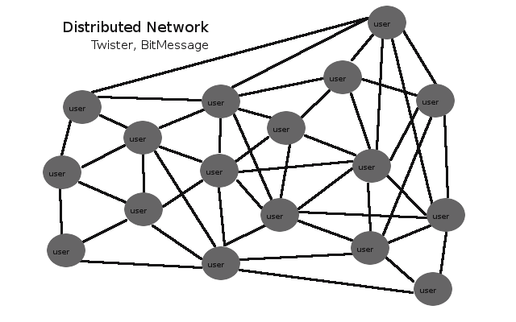
Social Network Types

Slide 3
Centralized Networks
Don't care (or cary very little) about user privacy
Probably freedom-hating
Little or no control of your own data
They are making money off of you (ads, see privacy above)
Node failure affects whole network (ie fail whale)

Slide 4
Distributed Networks
No central servers
Impossible to shutdown entirely
Privacy-focused
Everyone runs their own node

Slide 5
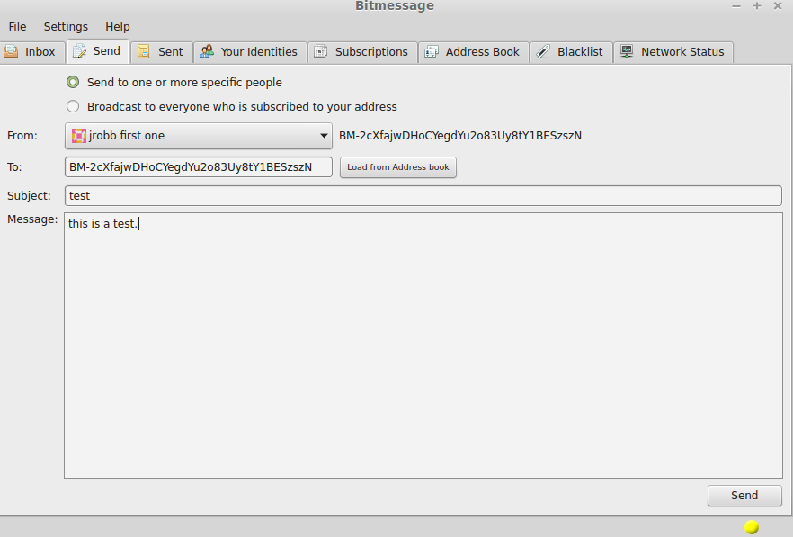
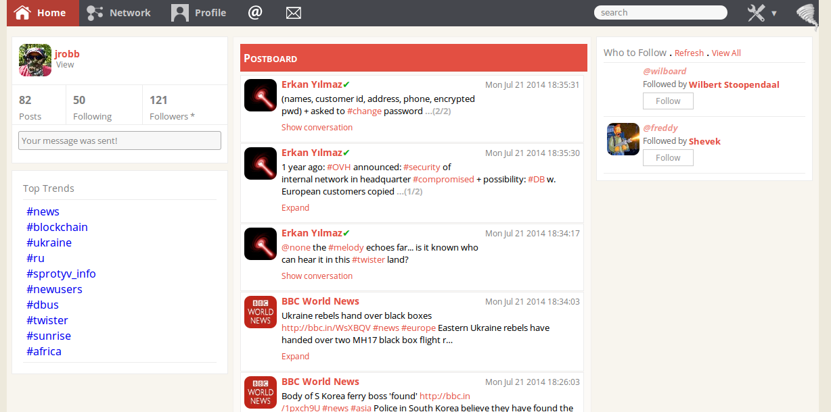
Distributed Example: Twister/Bitmessage
Compile and run your own 'node' locally on your machine
These examples both use the BitCoin protocol
BitMessage uses BitTorrent for propagation-- here's how
BM is very similar to encrypted email
Twister is like a distributed twitter

Slide 6
Federated Networks
Privacy-focused
Run your own node
Or join a public one!
Free Software
Single node failure does not affect whole network
Pump.io, GNU Social, Diaspora, Friendica, Tent
Notes:
Maybe pink was a bad choice

Slide 7
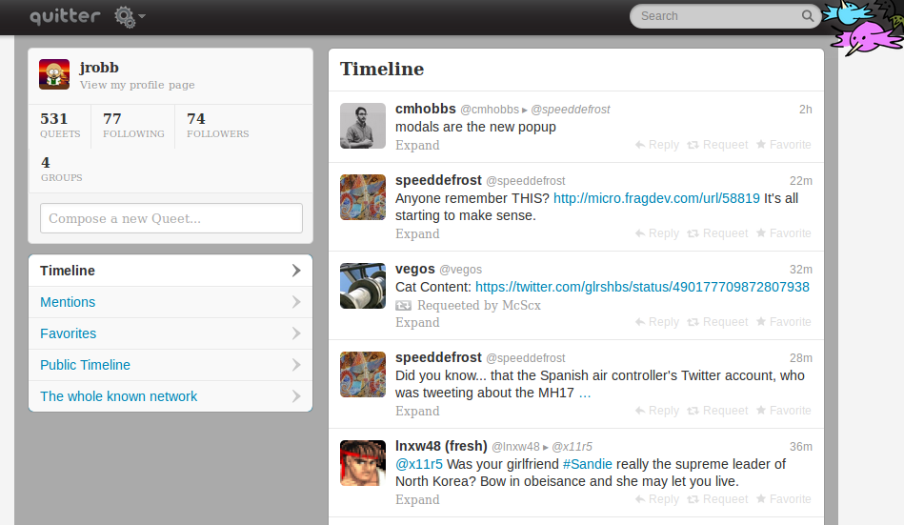
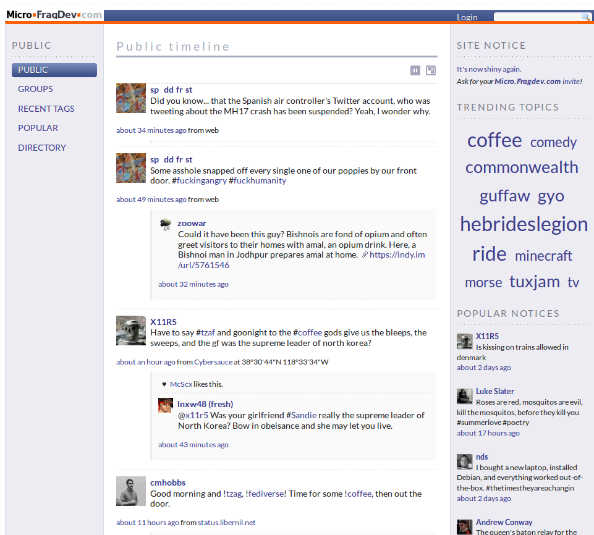
Federated Example: GNU Social
Formerly StatusNet
Runs on standard LAMP stack
Written in PHP
Can consume a lot (>2GB) of RAM without MySQL/MariaDB tweaking
Free Software! (Affero GPLv3+)
Public nodes include:
quitter.se
micro.fragdev.com

Slide 8
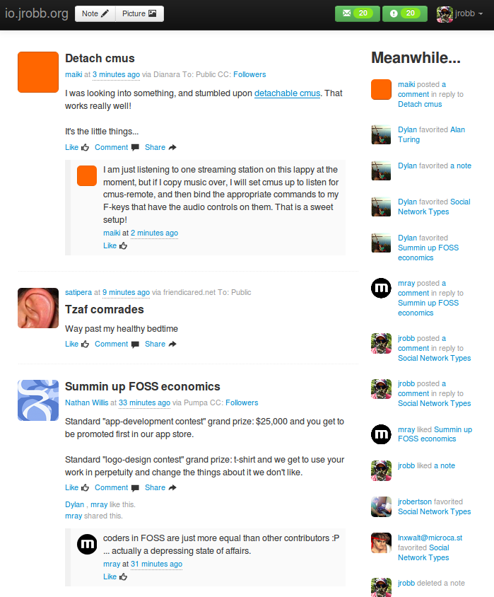
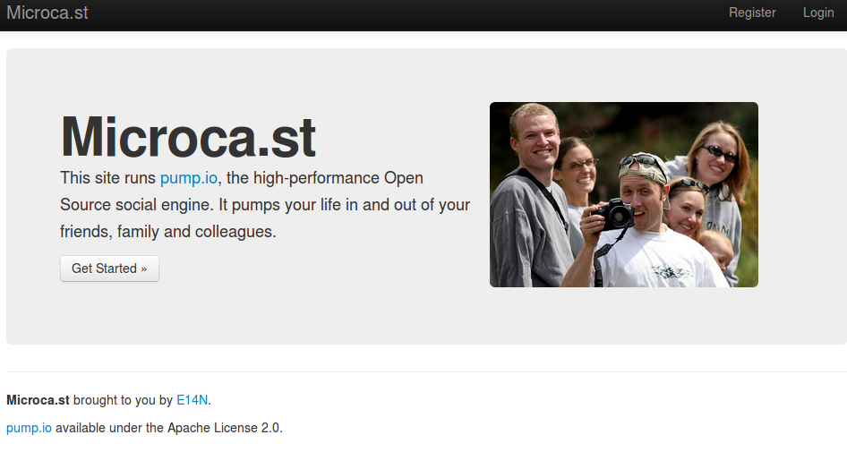
Federated Example: Pump.io
Written in Javascript/Coffeescript to run with nodejs
Uses Databank module (mongoDB, Redis, etc)
Runs well with ~1GB or > RAM
Can run on a Raspberry Pi! (HPR #1338 ) ...Sortof
Focus on Developer-friendly API (allows for 3rd party clients, bridges to other networks, web services, games, etc)
Still early in development
Free Software! (Apache License 2.0)

Slide 9
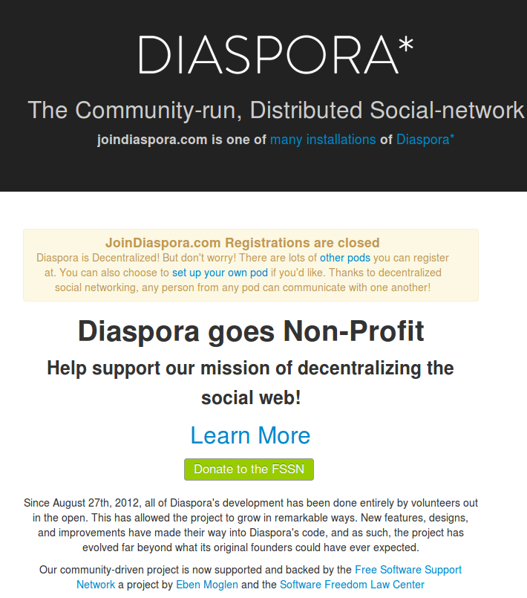
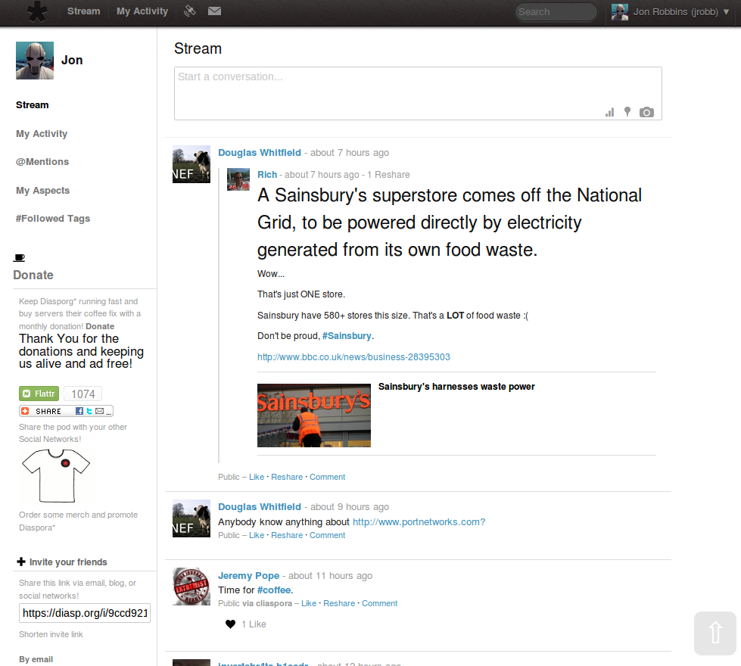
Federated Example: Diaspora
Written in Ruby on Rails
Uses MySQL/MariaDB/PostgresSQL backend
Requires >= 1GB RAM
Ton of dependencies?
Stable once installed

Slide 10
Why a good API is important
With a good open standard, can allow for interropability with other networks (ie. Friendica can communicate to/from GNU Social via OStatus)
More flexibility with 3rd party clients (pump.io has a few)
Attracts developers – who wants to use a complicated API?
GNU MediaGoblin is working on federation using the pump.io API
If more networks adopt a solid API that uses a good open standard, it would be possible for more networks to communicate. This would provide true federation.

Slide 11
Other Applications That I self-host
Mumble
GNU Mediagoblin--a FOSS replacement for Flickr or Youtube (and is easily self-hosted)
Owncloud--FOSS dropbox replacement that is easily self-hosted (and is one of my favorite applications)
Ejabberd XMPP server
Hastebin – paste bin
Minecraft (sometimes)
* Some of these I run on a $5/month VPS, others from my home

Slide 12
Conclusion
Questions?

Slide 13
Contact
Pump.io : jrobb@io.jrobb.org
GNU Social : jrobb@quitter.se
Diaspora : jrobb@diasp.org
Twister : @jrobb
BitMessage : BM-2cXfajwDHoCYegdYu2o83Uy8tY1BESzszN
Google+ : +JonathanRobbinsNC
Email : GPG key 0xF69AB08C

Slide 14
Afterthought: Wikipedia
Wikipedia is amazing!
However...
We don't really talk about it much, but the sum of human knowledge under one org, no matter how responsible, has many of the same issues that the other centralized networks have. That is a hard nut to crack, but something to get folks thinking about.
– quote from maiki

Slide 15
Content
The content of this file (images/text/etc) is free to modify/use/whatever under CC BY-SA 3.0
Raw files can be found here

