Slide 1

The Pig Dice Game
Presented by Team 4:
Patrick Flynn
Robert Griffin
Justus Frye

Slide 2
Overview & Functionality of the Game
Our team chose to build the Pig Dice Game. The basic rules of the game are as follows:
Two Players play to 100 points, the first to 100 wins!
During each player’s turn, a player repeatedly rolls a die until either a 1 is rolled or the player chooses to hold and scores the sum of the rolls.
After each player’s roll, the player decides to either roll or hold. If the player rolls a 1 there score is 0 for that turn and it moves to the next players turn. If they roll other than a 1 that sum is added to there score.
Creative Additions Added to Our Game:
1 or 2 Player – We allowed the user the option to choose either to play against another user or play against the computer.
All Variations of the Game – We allowed the user to select which variation of the game they would like to play including: standard Pig Dice, Two-Dice Pig, Big Pig, and Hog.
Instructions are included with every variation to provide more clarity on how the game works.
Color Added- We also added color to signify certain aspects of the game including a decorative game menu, highlighting the player who wins, and to distinguish between dice 1 and dice 2.

Slide 3


Rand Function
To build this game the rand function was a necessity and was an essential part to the build.
We first initiated the srand function in int main to make all numbers truly random by passing time as 0.
To make all dice rolls random we used rand inside of our randomDice function. This allowed all dice to be randomized when this function was called during the game.
Lastly we used rand while creating the Hog variation computer player. We made a random number generate for the number of dice to be rolled by the computer player.

Slide 4
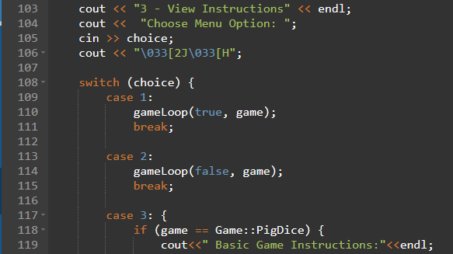
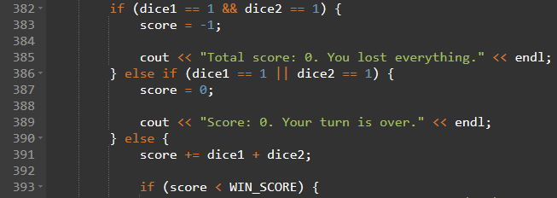
Branching
Throughout our program we used two main branching methods: switch statements and if/else statements.
We relied heavily on switch statements when it came to creating our menus. The program has both a main menu and a sub menu. These switch statements allowed the user to put in the menu option they would like and the switch statement would execute the necessary actions.
We used if/else statements in many locations throughout our program, mainly where more precise branching was needed. An example of usage is to check both dice and proceed accordingly.

Slide 5


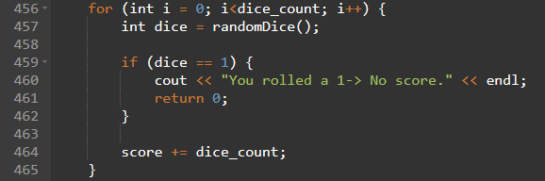
Loops
We used all available loops based on our needs for the project. This included while, do while, and for loops.
We used while loops in cases where we needed to check the condition first. An example of this would be to check the score after each players turn to determine if there is a winner.
An example of a do while loop used in our program would be in our created game function to ensure that the dice are rolled at least once.
The for loop was used when we had a specific range involved such as in the Hog Dice game where the user indicates how many dice they would like to roll. A for loop is used to roll the number of dice chosen.

Slide 6
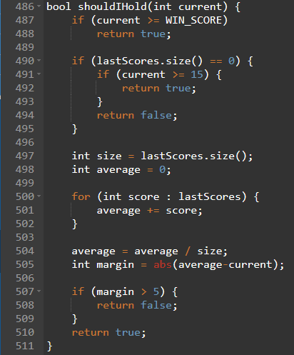
Vectors (possibly AI)
We used a vector for our computer player version in calculating on to determine whether to hold or roll. This was located in our Boolean function shouldIHold.
Another example of vector usage was when we stored score values to our vector throughout the game.

Slide 7
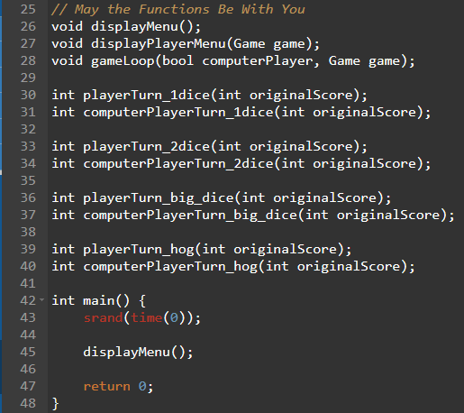
Functions & More Functions
We used functions heavily throughout program. This was done to create more clarity in our programming as well as allow for code reuse.
We used the main function to set the random number generator and call the main menu function. All other tasks were divided into appropriate functions including each game variation.
An example of one of our function’s is our gameLoop function. The purpose of this function is to check the player’s score and switch the game to the next player’s turn.

Slide 8
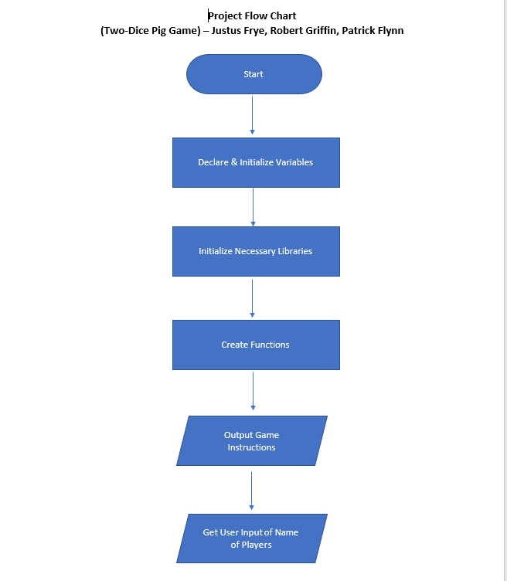
Evolution of Team Flowchart
The initial flow chart created was under the assumption we would create a program that only did the standard Two-Dice Pig Game with 2 players.
Throughout the project we evolved into making our program more in-depth by adding all variations to the game menu. We also added the player option to either play another player or play the computer.

Slide 9
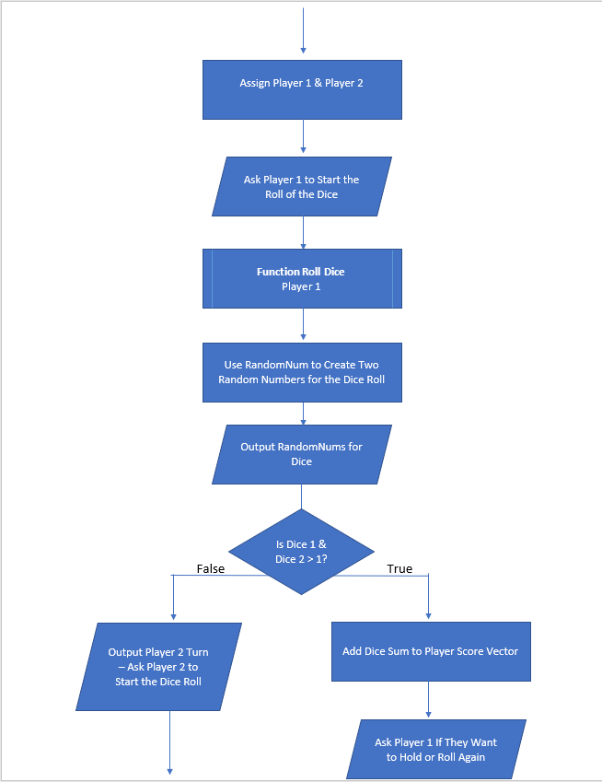
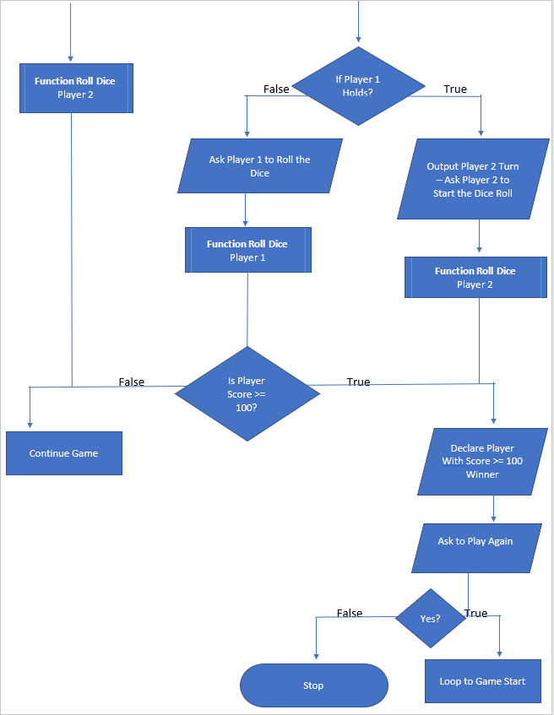
Evolution of Team Flowchart (cont)

Slide 10
Challenges Faced
The biggest challenged faced with this project was the logistics of meeting and not being able to meet in person. However, we were able to over come this challenge though as every team member put in the effort and made the project a priority.
We first started a group message via text the day that teams were assigned. This helped dramatically with communication and allowed us to quickly and efficiently schedule team meetings and set internal due dates for the project material.
Another challenge was making sure everyone was on the same page. An efficient tool we used was GitHub, which allowed us to manage the code. We created a repository and stored all necessary documents, C++ files, and notes that were pertinent to the project. This allowed all team members to view everything necessary as well as make changes even if we were not in a meeting.

Slide 11
Sources
Pig Picture Source - https://pixabay.com/vectors/pig-pink-cute-animal-face-funny-161381/
GitHub Repository - https://github.com/patrickf2000/ECGR-2103

