Slide 1
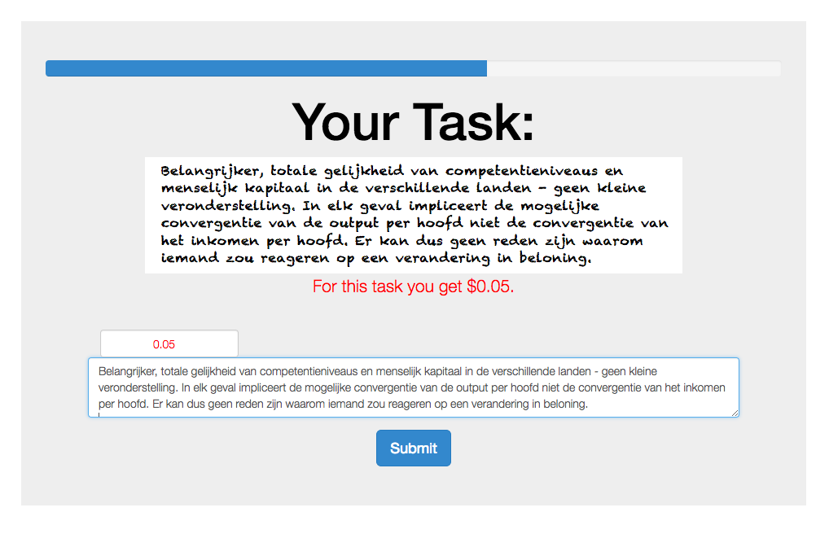
This progress bar tells you how far until the completion of the experiment.
This is your current bonus for this task. This bonus may change during the experiment!
confirm your current bonus here.
copy the text into this box.
Finally press Submit to continue.

