Slide 1
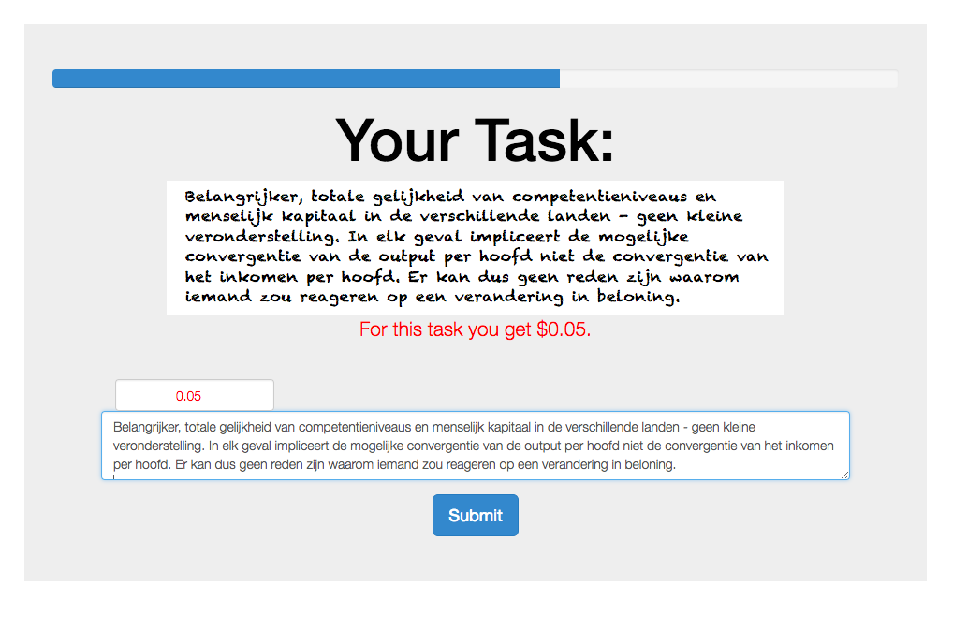
The progress bar tells you how far you have come in the experiment.
This is where you confirm your bonus payment.
This is your bonus payment for this task.
This is where you should type the above text into.

