Slide 1
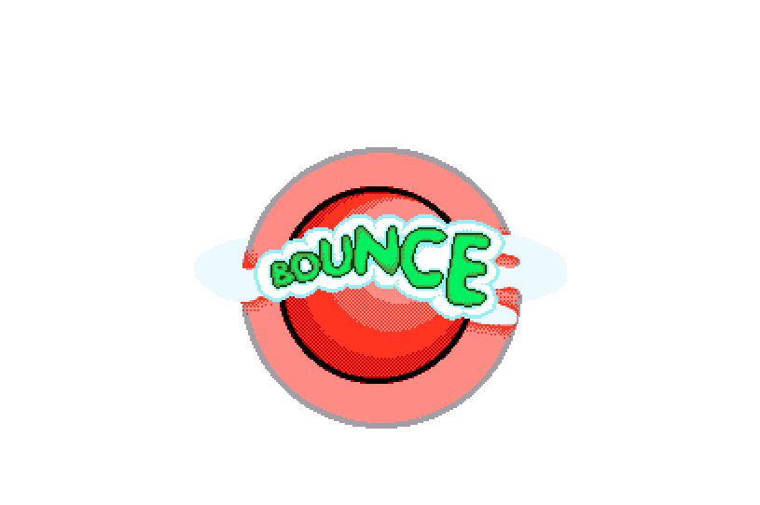
Team Bouncy
EPL653: Computer Games Software Technology
Agathoklis Vakanas
Aliki Gregoriou
Jiayi Fu

Slide 2
About
Remake of original Bounce
Suitable and tested on Android devices

Slide 3
Gameplay mechanics
1. Animation : Portal opening when we collect every ring in current level
2. Collision Detection: Everything we touch. e.g. rings, collectable items, walls
3. Audio Rendering for Games: Sound effect in collectable items and the rings. Also background music in each scene.
4. Physics in Games: Bouncy and Jack are moving with Physics, they have rigidbody.
5. Particle Systems: In level 3 we added a fountain of youth in order to make our game prettier.

Slide 4
Design Decisions
Same design principles as the original Bounce except that:
Stages are linearly connected
If the player lose, the game starts from the very first level
The player can change Bounce’s texture
Score System
Local Leaderboard

Slide 5
Problems
Conflicting changes
Solved using GameManager
Give impression that bounce jumps in between the rings
Bounce movement:
Solved using Raycasting2D
Camera movement not working properly in different resolutions

Slide 6

Thank you for listening!

