Slide 1

Red Wine Quality Prediction
What makes red wine good?

Slide 2
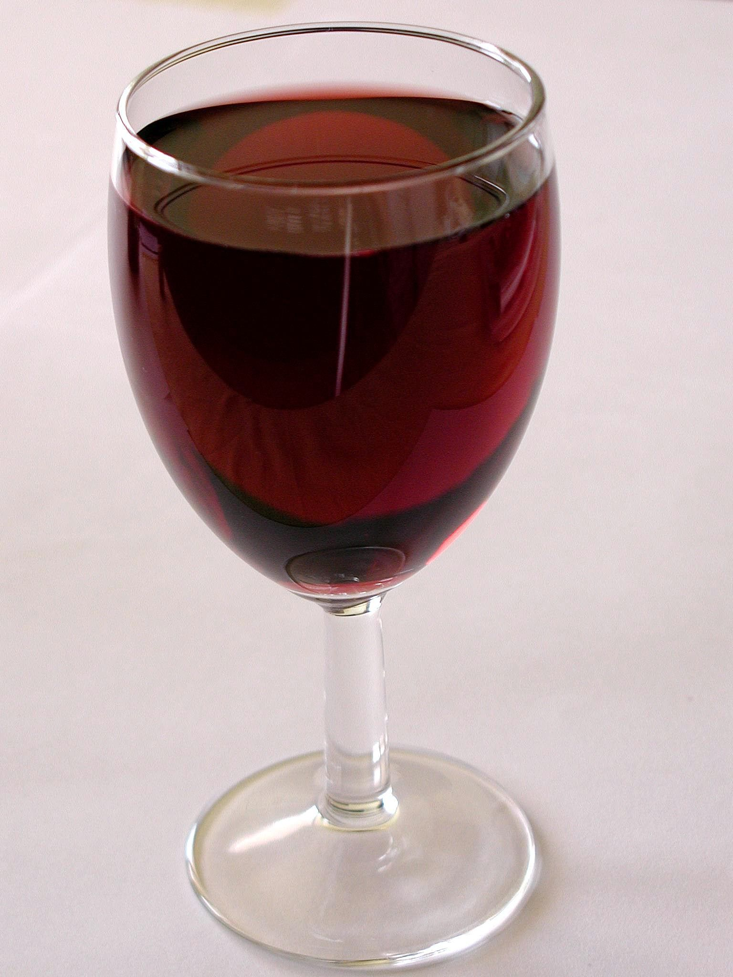
Problem
Data
Data Visualization
Algorithms
Model Building
Results

Slide 3
The Problem
The goal of the data mining project is to analyze wine ingredients and determine the factors that contribute to the quality of wine. Using classification as the main data mining method, the project aims to develop a model that can accurately classify wines into different quality categories based on their ingredient composition. Additionally, data visualization techniques will be employed to gain insights and refine the analysis of the wine data. Understanding the key factors that contribute to the quality of wine is crucial for winemakers to optimize their production processes and improve the taste and reputation of their wines. Furthermore, consumers can benefit from this knowledge by making informed purchasing decisions and appreciating the characteristics of high-quality wines.

Slide 4
Objectives
Identification of important wine ingredients
The classification model will reveal the ingredients that significantly influence wine quality.
Creation of a predictive model
The project will develop a classification model that can accurately predict the quality category of a wine based on its ingredient composition.
Data visualization insights
Through data visualization techniques such as scatter plots, bar charts, and heatmaps, the project will provide visual representations of ingredient relationships, patterns, and correlations with wine quality.

Slide 5
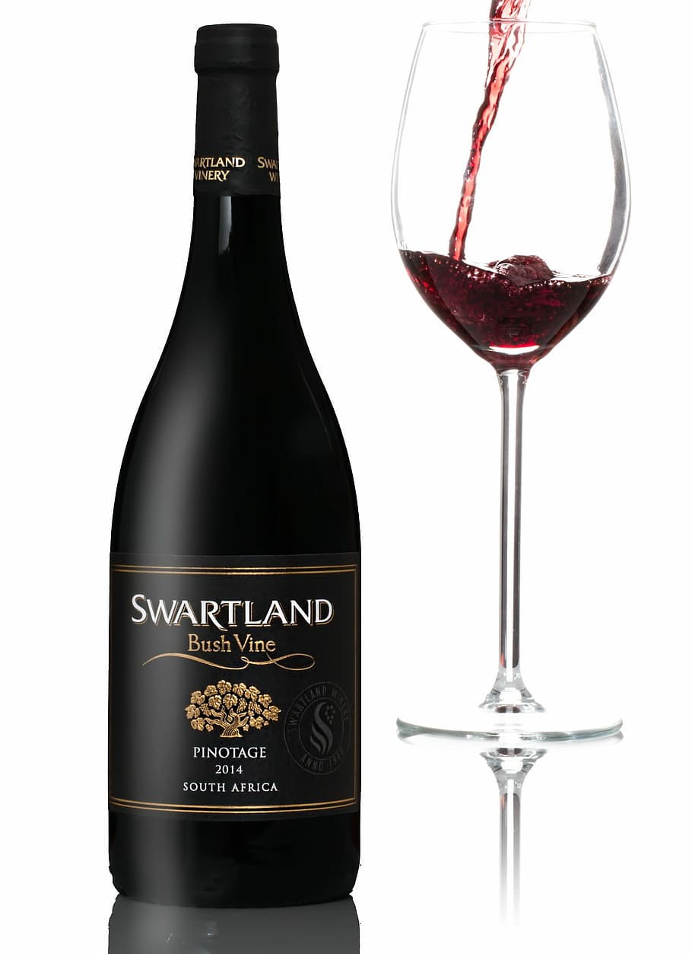
fixed acidity
volatile acidity
citric acid
residual sugar
chlorides
free sulfur dioxide
total sulfur dioxide
density
pH
sulphates
alcohol
quality
Data
The data for this project would consist of a collection of wine samples, each with associated attributes. Dataset consists of 1599 rows and 12 columns.This dataset is related to red variants of the Portuguese "Vinho Verde".
www.kaggle.com

Slide 6

Histoplot
Pairplot
Scatterplot
Smooth Kernel Density with Marginal Histograms
Regplot
Hexagonal Binned Plot
Visualization with Plotly Express
Heatmap and Correlation
Data Visualization
These visualizations can reveal patterns, trends, and potential outliers in the data.

Slide 7

Algorithms
Classification Models
K-Nearest Neighbors Model
Gradient Boosting Machines Model
Light GBM

Slide 8

Model Building
Search the best parameters with GridSearchCV method
Build model with best scores
Accuracy Score/Classification Report

Slide 9
Results
KNN - Classification Report
precision recall f1-score support
0 0.78 0.81 0.79 188
1 0.82 0.80 0.81 212
accuracy 0.80 400
macro avg 0.80 0.80 0.80 400
weighted avg 0.80 0.80 0.80 400

Slide 10
Results
GBM - Classification Report
precision recall f1-score support
0 0.76 0.82 0.79 188
1 0.83 0.77 0.80 212
accuracy 0.80 400
macro avg 0.80 0.80 0.79 400
weighted avg 0.80 0.80 0.80 400

Slide 11
Results
Light GBM - Classification Report
precision recall f1-score support
0 0.77 0.85 0.81 188
1 0.85 0.78 0.81 212
accuracy 0.81 400
macro avg 0.81 0.81 0.81 400
weighted avg 0.82 0.81 0.81 400

Slide 12
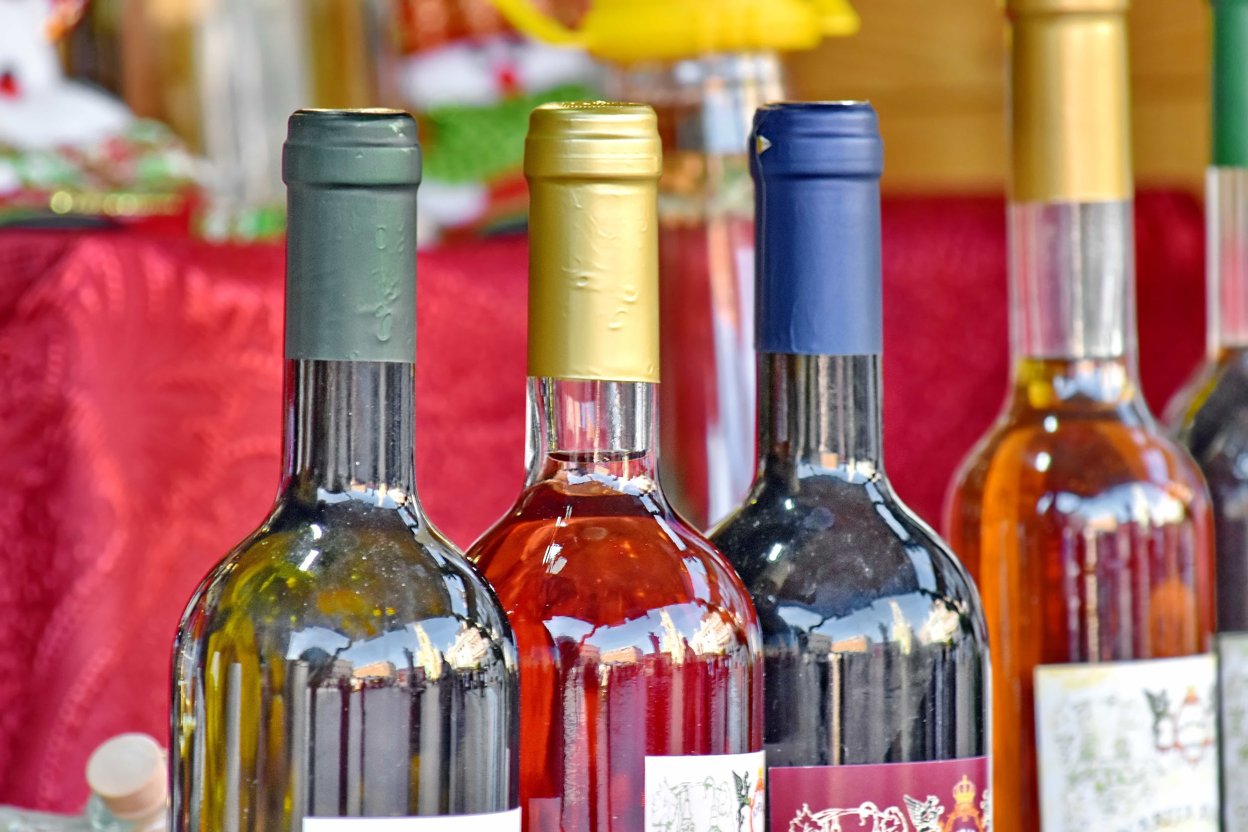
Conclusion
The Light Gradient Boosting Machines Model is the most accurate when classifying this dataset. Direct correlations can be visualized as to which ingredients are more prevalent in good tasting red wine. From this data, wineries can reform their cultivation techniques to invoke the characteristics of good tasting wine.

Slide 13

CHEERS

