Slide 1
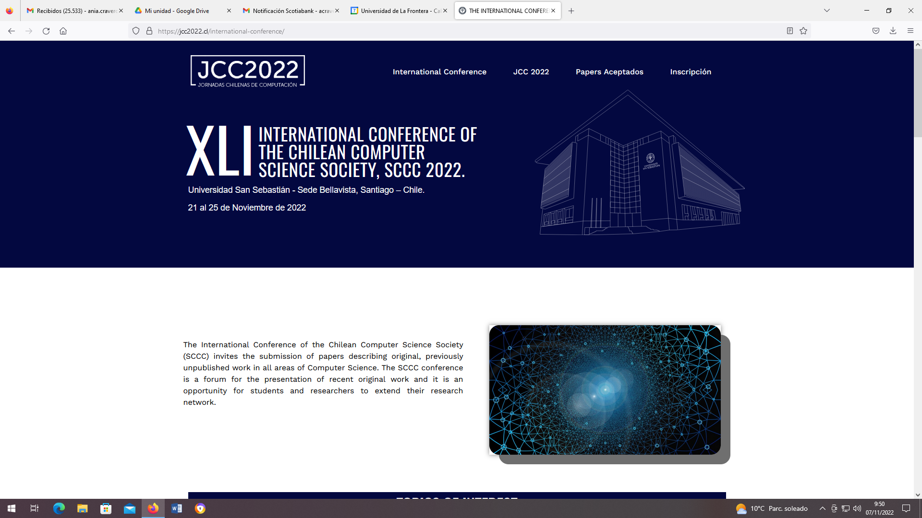

Slide 2
Personal presentation

Slide 3
Introduction
(1 minute)

Slide 4
Motivation - Problem
(1 minute)

Slide 5
Methodology
(1 minute)

Slide 6
Proposal
(3 minute)

Slide 7
Results
(3 minute)

Slide 8
Conclusions
(1 minute)

Slide 9
References

