Slide 1
Products page
Jonathan Fung

Slide 2
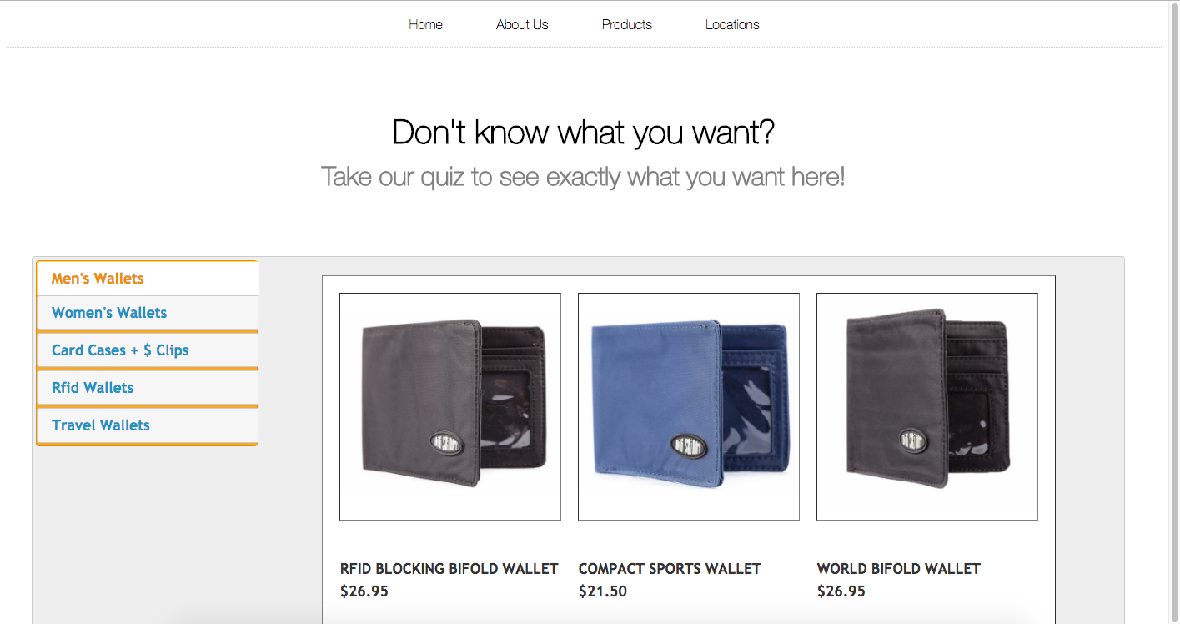
Main Products page
Link to take quiz
Side tabs to make it easier to find wallet
Clean look
Click on image brings you to detailed page

Slide 3
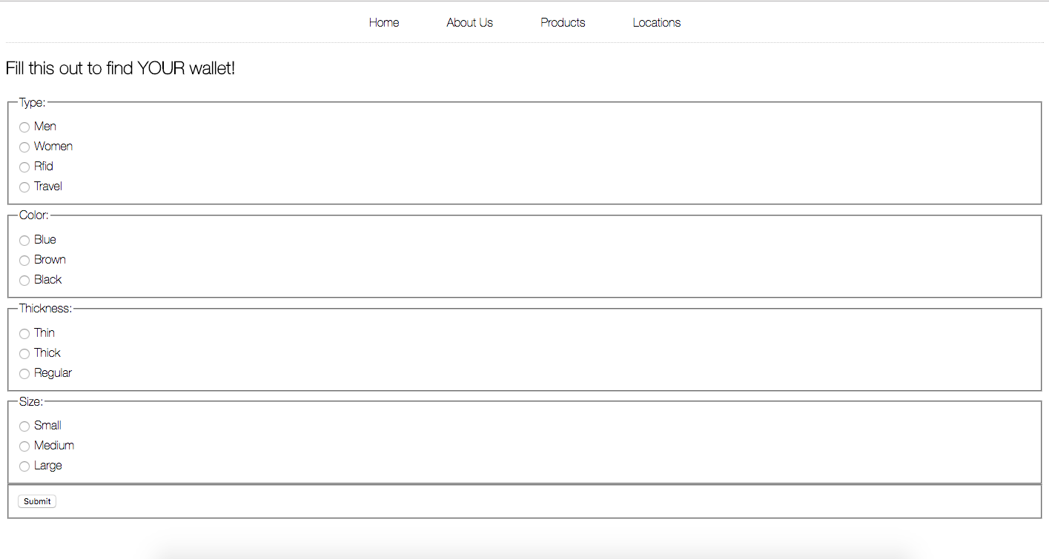
Quiz Page
To allow users to find wallet they want
Simple and quick
Uses algorithm to find best match wallet among database

Slide 4
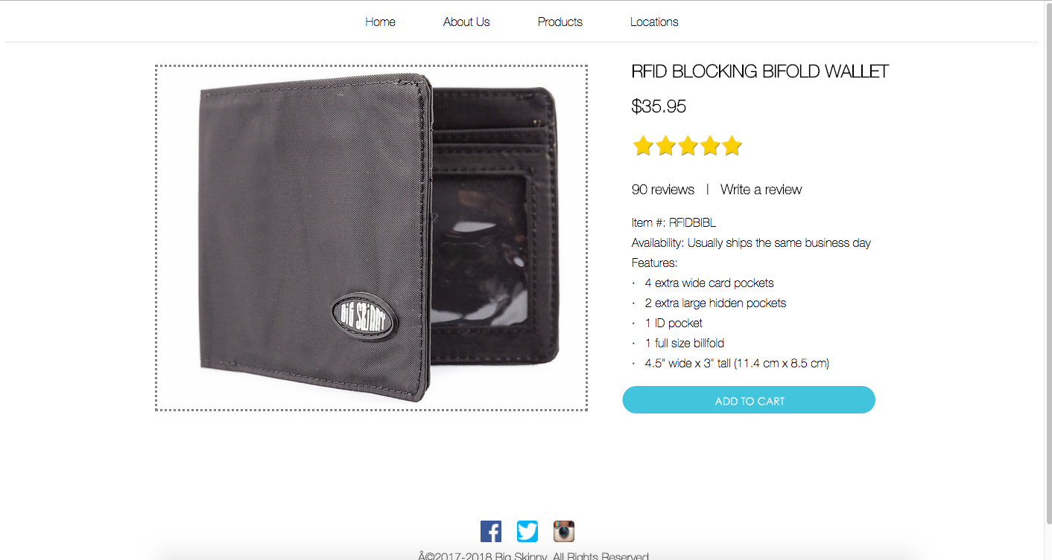
Wallet Info page
Clean, simple look
Displays all info you need in clear fashion
Minimal to not overwhelm users

