Slide 1




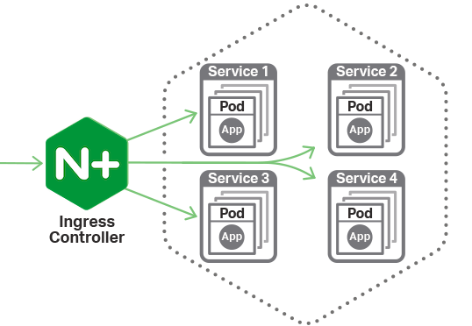


Slide 3
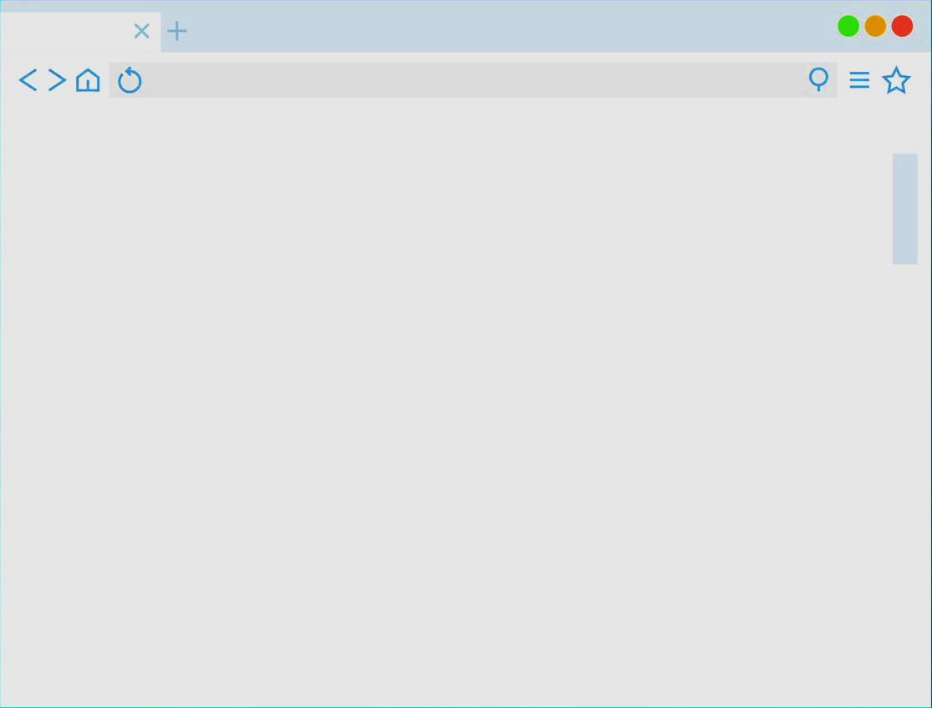
Appl
Pod1
Service
Appl
Pod2

Slide 4
JWTA Controller Pod
Configure
Ingress
Deploy
JwtAuthorizator

Slide 5
SPA app
Nginx serving with static SPA
API
Service
API

Slide 6
basic app
/public
/admin
Web server pod
(apache, nginx…)

