Slide 1
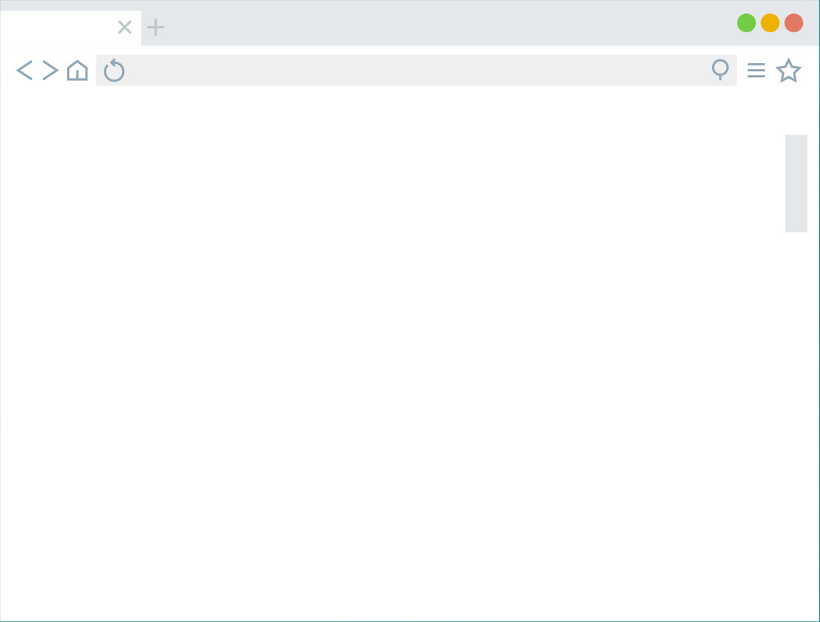
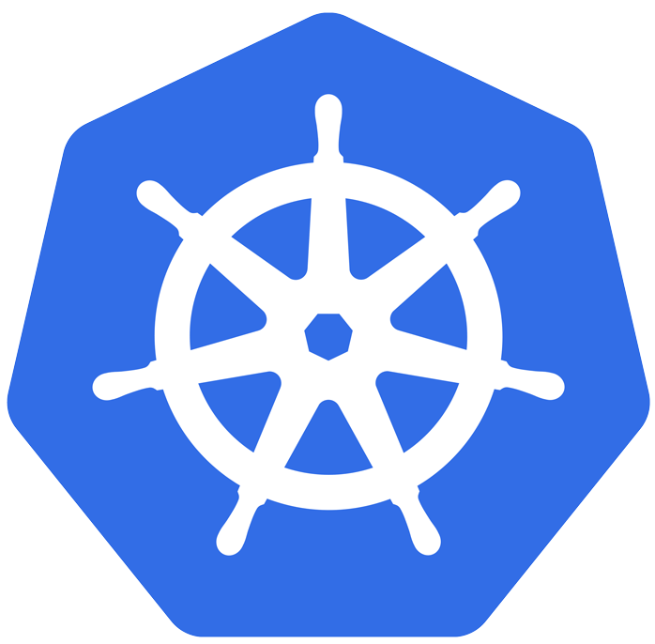


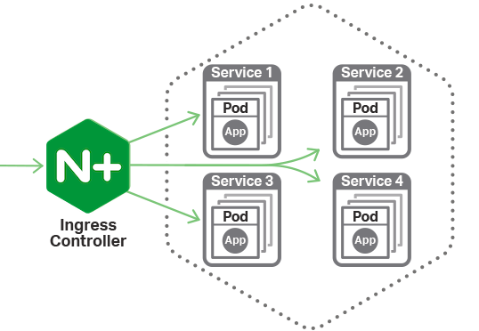


Slide 2
Architecture

Slide 3
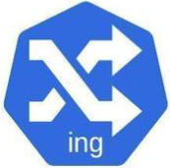
cotrolplane
Oberkorn Controller Pod
Configure
Ingress
Deploy
ObkAuthorizator
Oberkorn
Authorizator

Slide 4
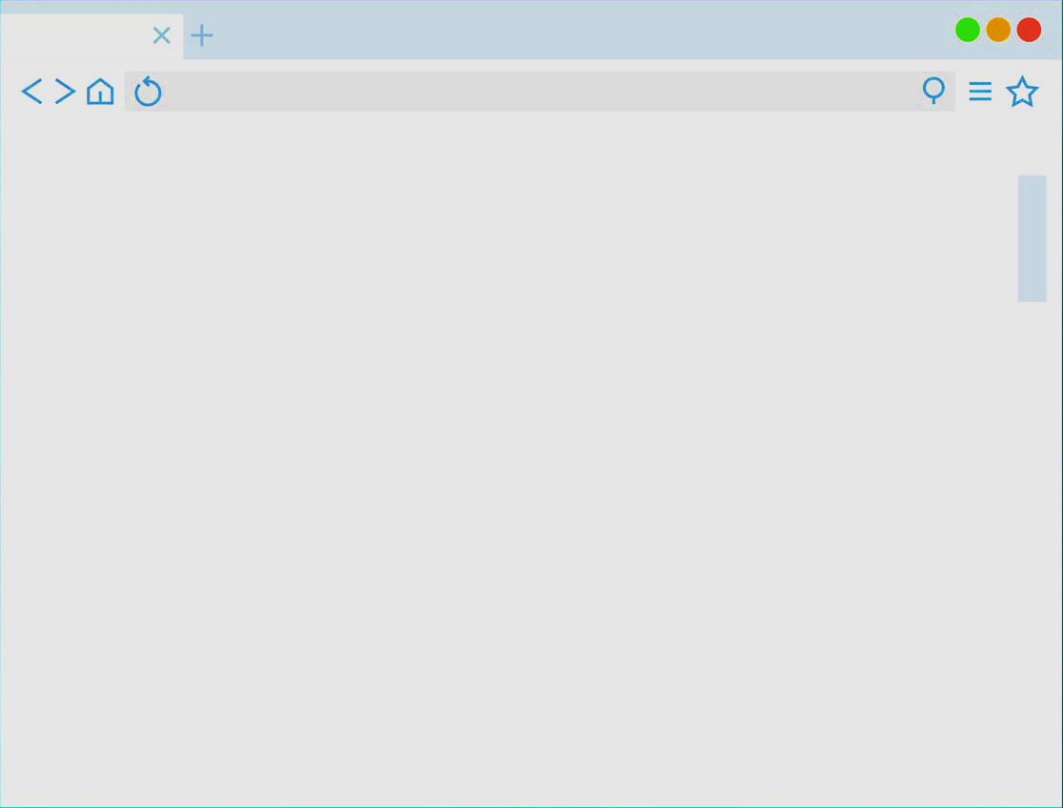
dataplane
Appl
Pod1
Service
Appl
Pod2

Slide 5

architecture
Oberkorn
Controller
Configure
Ingress
Pull
Image
Create
ObkAuthorizator Deployment
User
Requests
Create
ObkAuthorizator Service
Pull
Image
Deployment
Oberkorn
Authorizator
Ask for
authrizations
OberkornService
Oberkorn Authorizator

Slide 6
Architecture V2
OberkornService
Oberkorn
Console
Authorizator
Oberkorn
Controller
web
Console
(SPA)
Web console
Front & API)
Pull
Image
API
Proxy
API requests
User
Requests
Configure Ingress
Pull
Image
Create
ObkAuthorizator
Service
Create
ObkAuthorizator
Deployment
Deployment
Oberkorn
Authorizator
Ask for
authorizations
OberkornService
Oberkorn Authorizator
Web console traffic
Data Plane
Control Plane
API requests
(control plane)

Slide 7
Scenarios

Slide 8
basic app
/public
/admin
Web server pod
(apache, nginx…)

Slide 9
SPA app
Nginx serving with static SPA
API
Service
API

Slide 10
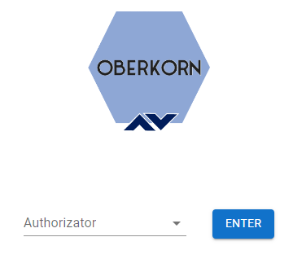
web console
Validate
console access
OberkornService
Oberkorn
Console
Authorizator
Oberkorn
Controller
web
Console
(SPA)
API
Proxy
API requests
Deployment
Any Oberkorn
Authorizator
Invoke
authorizator API
OberkornService
Any Oberkorn Authorizator

