Slide 1
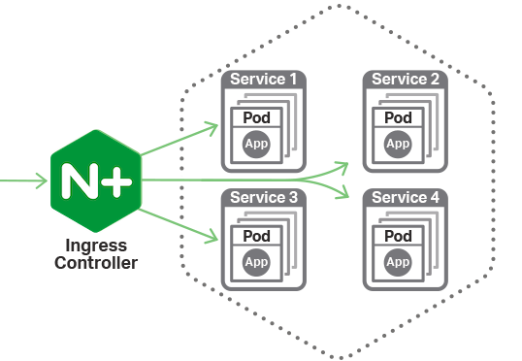
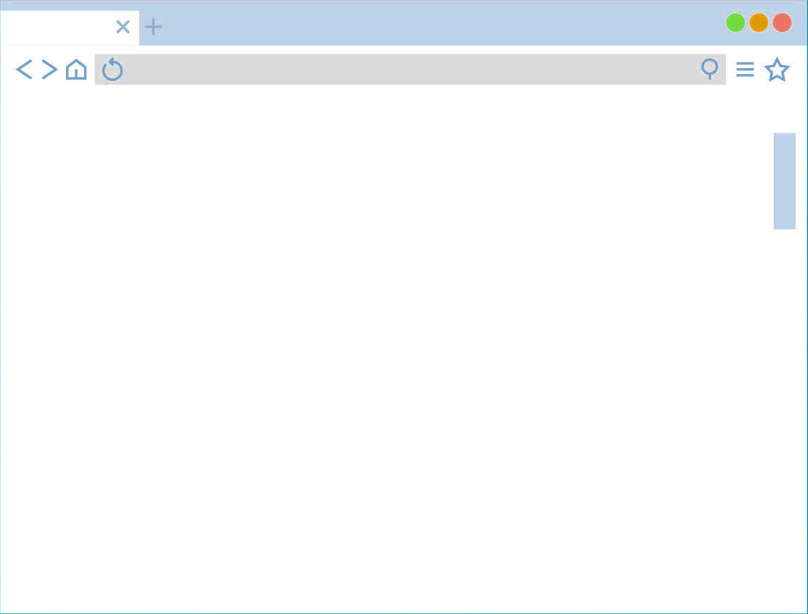
General NIC architecture

Slide 2
Adding authorization to NIC

Slide 3






Slide 5
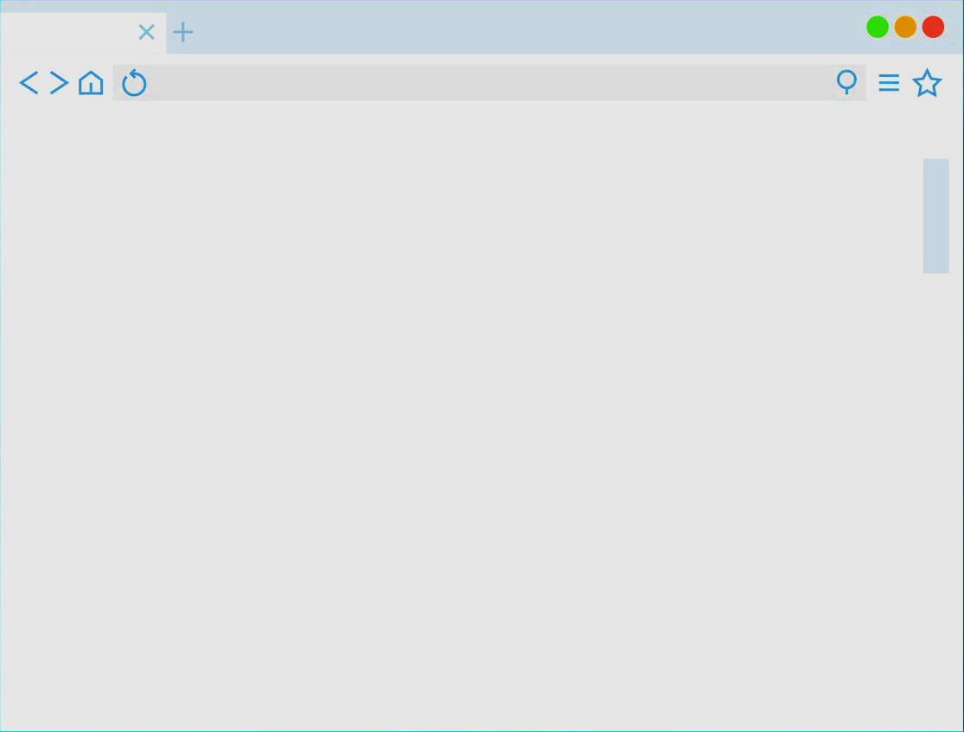
Appl
Pod1
Service
Appl
Pod2

Slide 6
JWTA Controller Pod
Configure
Ingress
Deploy
JwtAuthorizator

