Slide 1
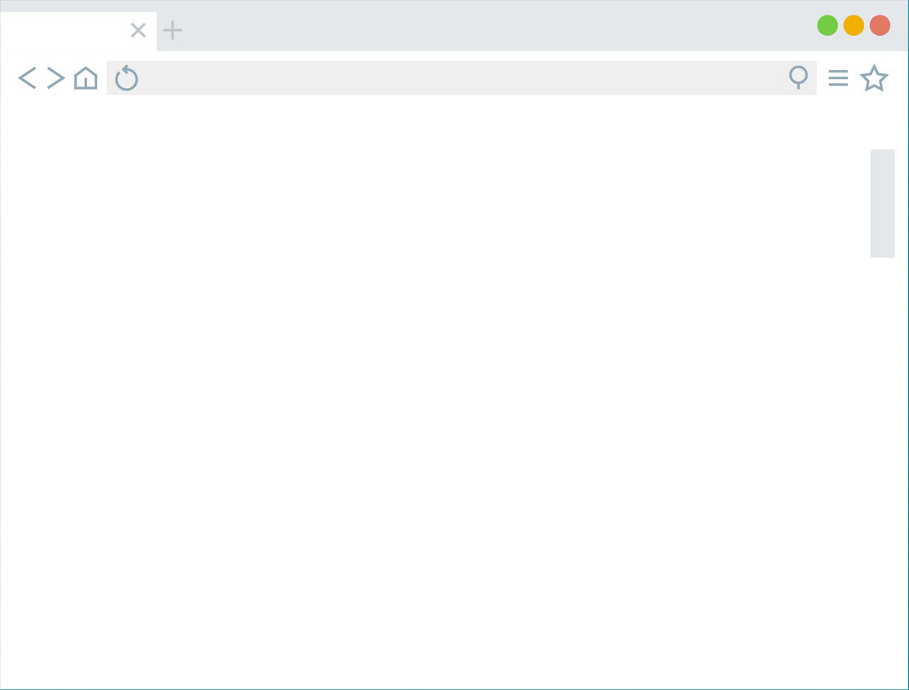
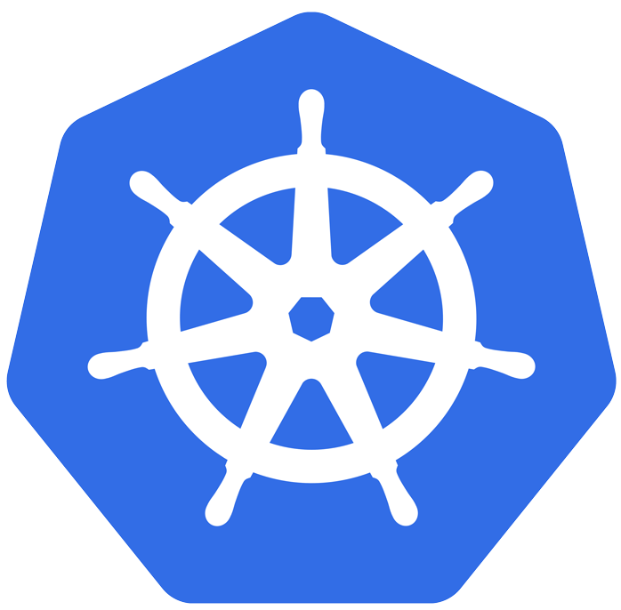


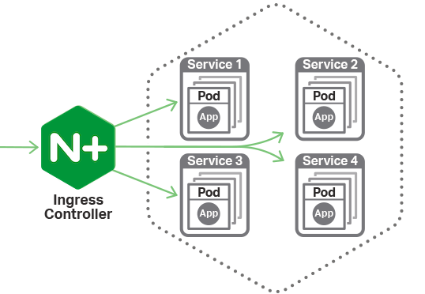


Slide 3
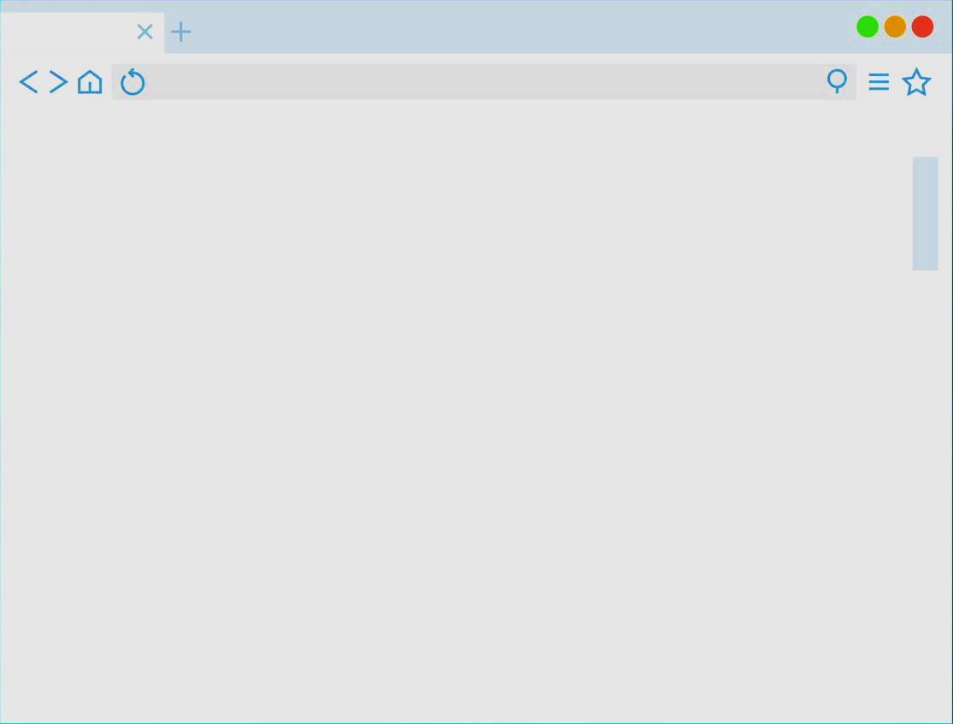
Appl
Pod1
Service
Appl
Pod2

Slide 4
SPA app
Nginx serving with static SPA
API
Service
API

Slide 5
basic app
/public
/admin
Web server pod
(apache, nginx…)

Slide 6
oberkorn
JWTA Controller Pod
Configure
Ingress
Deploy
JwtAuthorizator

Slide 7

Oberkorn-detail
JWTA Controller
Configure
Ingress
Pull
Image
Create
JwtAuthorizator Deployment
User
Requests
Create
JwtAuthorizator Service
Pull
Image
Deployment
JWT Authorizator
OberkornService
JWT Authorizator

