Slide 1
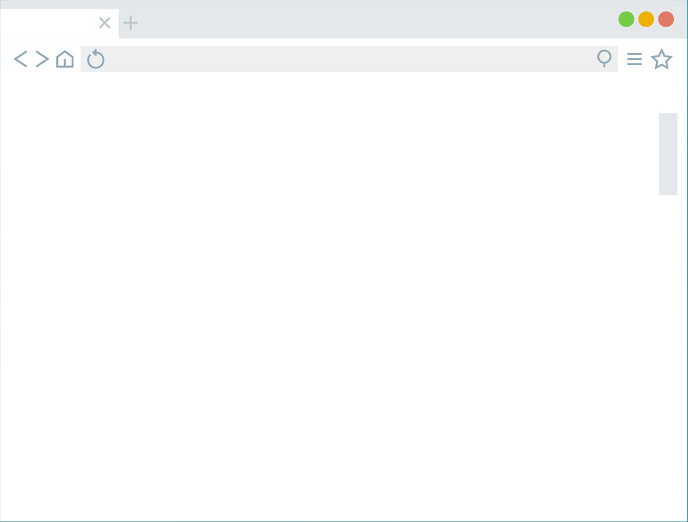
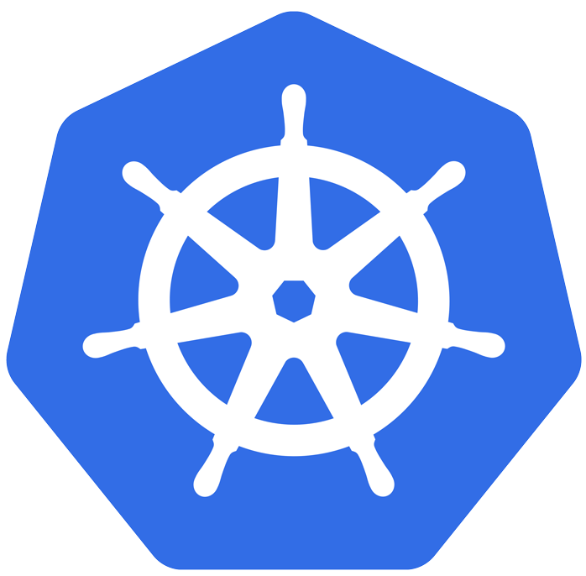


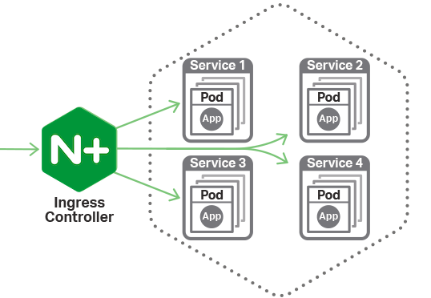


Slide 2
Architecture

Slide 3

cotrolplane
Oberkorn Controller Pod
Configure
Ingress
Deploy
ObkAuthorizator
Oberkorn
Authorizator

Slide 4
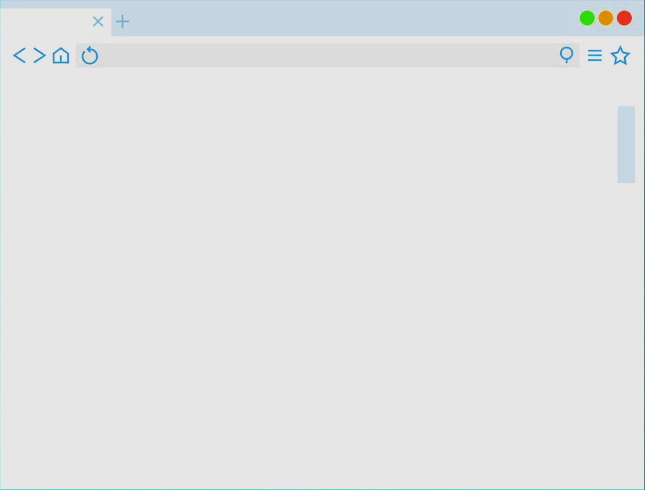
dataplane
Appl
Pod1
Service
Appl
Pod2

Slide 5

architecture
Oberkorn
Controller
Configure
Ingress
Pull
Image
Create
ObkAuthorizator Deployment
User
Requests
Create
ObkAuthorizator Service
Pull
Image
Deployment
Oberkorn
Authorizator
Ask for
authrizations
OberkornService
Oberkorn Authorizator

Slide 6
Scenarios

Slide 7
basic app
/public
/admin
Web server pod
(apache, nginx…)

Slide 8
SPA app
Nginx serving with static SPA
API
Service
API

Slide 9
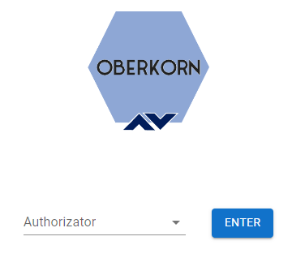
web console
Validate
console access
OberkornService
Oberkorn
Console
Authorizator
Oberkorn
Controller
web
Console
(SPA)
API
Proxy
API requests
Deployment
Any Oberkorn
Authorizator
Invoke
authorizator API
OberkornService
Any Oberkorn Authorizator

