Slide 1
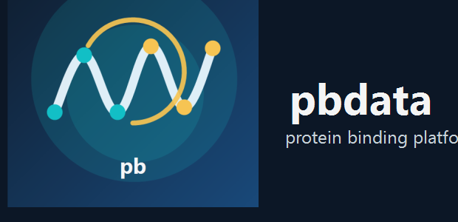

PROTEOSPHERE
A protein intelligence platform for building trustworthy biological ML datasets and workflows
ProteoSphere is designed to overcome the limits of small, fragile, siloed protein-ML studies by unifying source packaging, curation, leakage-resistant dataset design, graph-aware modeling, and an intuitive desktop workflow.
READY SOURCES
BOOTSTRAP INDEX
CANDIDATE POOL
SELECTED SET
12/12
39,318
896
500
Source packages currently staged for local-first operation.
PDB records in the fast local planning layer.
Model-ready pairs available for selection.
Current curated examples in the active training set.

Slide 2
Why a different approach is needed
Most biological ML efforts still operate at a scale and workflow maturity that make their conclusions hard to generalize, compare, or reuse.
Limitations of typical small-scale studies
ProteoSphere response
• Narrow, manually assembled datasets with limited provenance.
• Random or shallow splits that leak sequence, family, or assay similarity.
• Single-source assumptions that hide conflicts and coverage gaps.
• One-off graph or feature designs that do not scale beyond the original experiment.
• Tooling that is difficult to inspect, explain, or share with collaborators.
• Local-first source packaging with explicit refresh and retention rules.
• Canonical planning, identity mapping, and decision-grade field auditing.
• Representative subset design plus leakage-resistant split governance.
• Multiple graph scopes and model pathways instead of a single narrow architecture.
• A GUI that makes the curation and modeling process understandable on screen.

Slide 3
Pipeline strategy
The pipeline is intentionally layered so each stage adds scientific value, provenance, and reusability rather than just producing another flat table.
1. Source packaging
2. Bootstrap planning
Stage broad local snapshots from structural, affinity, annotation, and pathway resources.
Index PDB-level facts for fast selection, coverage review, and targeted refresh planning.
3. Extraction + normalization
4. Screening + field audit
Parse structures, assays, interfaces, and metadata into a coherent local schema.
Populate and validate decision-grade fields before they can influence curation policy.
5. Training-set design
6. Split governance
Select representative examples while controlling cluster dominance and source bias.
Build pair-aware, leakage-resistant train/validation/test partitions.
7. Graph + feature packaging
8. Model review + inference
Export multiple structural graph designs plus engineered descriptor context.
Train and compare suitable model paths, then surface explainable predictions.

Slide 4
Graph and feature design principles
ProteoSphere is designed to support multiple structural representations rather than locking the project into one convenient graph story.
Supported graph design space
Why this matters
• Whole-protein graphs for global structural context.
• Interface-only graphs for contact-driven tasks.
• Shell and neighborhood graphs for focused local environments.
• Residue-level and atom-level graph constructions.
• Protein-ligand, protein-protein, and multimodal packaging.
• Different biological questions need different structural neighborhoods.
• Graph choice should be a controlled design variable, not an accidental default.
• Feature and graph coverage must stay tied to the actual dataset rows.
• Packaging should support both scalable baselines and richer graph-native models.

Slide 5
Robust training-set creation
The goal is not to maximize row count at any cost. The goal is to build a set that is representative, diverse, auditable, and realistic for downstream evaluation.
CANDIDATE POOL
SELECTED SET
CLUSTERS
QUALITY
896
500
181
0.857
Model-ready pairs available for selection.
Curated examples in the active training subset.
Receptor clusters represented in the selected set.
Mean quality score for selected examples.
Selection principles
Current diversity indicators
• Prefer representative coverage over near-duplicate clusters.
• Use explicit quality and provenance signals.
• Keep field-population quality visible before policy decisions are made.
• 156 metadata families represented.
• 147 pathway groups represented.
• 111 fold groups represented.

Slide 6
Leakage-resistant split strategy
Train/test splits are treated as a scientific design problem, not a final randomization step.
Split controls
Train
Validation
Test
• Pair-aware grouping to keep related pairs together.
• Sequence and family-aware grouping instead of naive row splitting.
• Mutation-cluster and source effects treated as leakage risks.
• Release split assignments kept explicit in the exported tables.
627
134
135
What makes this stronger than typical practice
• Current strategy: pair_aware_grouped.
• The split logic is built to defend against inflated benchmark scores.
• The platform keeps the split story visible in both CLI and GUI outputs.

Slide 7
Model architecture strategy
ProteoSphere is not built around a single favorite model. It is built to compare and justify model paths based on the evidence available in the current dataset.
Supported modeling philosophy
Benefits over one-off model studies
• Use strong tabular baselines where graph coverage is weak.
• Escalate to graph-native or hybrid models when graph coverage justifies it.
• Treat recommendation, runtime readiness, and actual training behavior as one consistent system.
• Preserve provenance for recommended family, fallback behavior, and saved runs.
• Architecture choice is grounded in dataset readiness, not wishful complexity.
• Graph, feature, and runtime constraints are surfaced before training starts.
• Saved outputs are easier to compare, reload, explain, and communicate.

Slide 8
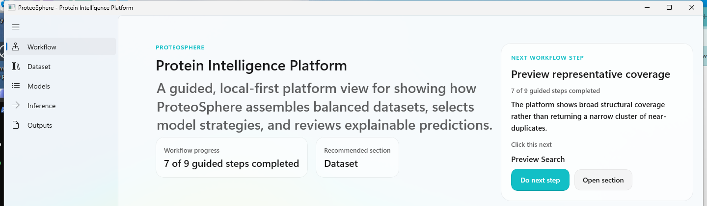
Usability and workflow clarity
A major advantage of ProteoSphere is that the workflow is visible and explainable to collaborators who are not living inside the codebase.
Guided workflow
Platform literacy
Research communication
Clear next-step guidance across data, models, inference, and outputs.
The interface explains the pipeline rather than hiding it behind scripts.
Makes it easier to walk collaborators through methods, assumptions, and outputs.

Slide 9
Why this approach is stronger
ProteoSphere is designed to produce work that is broader, more reproducible, and easier to trust than the usual narrow-study pipeline.
Typical small-scale effort
ProteoSphere approach
• Small hand-built dataset
• Limited source coverage
• Weak provenance and conflict handling
• Random or weakly governed splits
• One graph or feature design treated as universal
• Difficult to present or reuse
• 12 staged source families with local-first packaging.
• 39,318 PDB records in the planning layer.
• Decision-grade field audit before policy use.
• Representative subset design and explicit split governance.
• Multiple graph designs and architecture paths.
• GUI-driven workflow built for research communication.

Slide 10
ProteoSphere
A local-first platform for moving protein interaction ML from narrow, fragile studies toward scalable, reproducible, and explainable scientific workflows.
Core promise: broader source integration, stronger dataset governance, richer graph design, honest model selection, and a workflow that collaborators can actually follow.
ProteoSphere | protein intelligence platform

