Slide 1
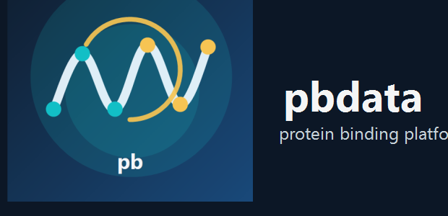

pbdata
Protein Binding Data Platform
A local-first biological data platform for curating representative protein interaction datasets, building leakage-resistant training splits, and presenting model decisions through a polished desktop workflow.
READY SOURCES
BOOTSTRAP INDEX
CANDIDATE POOL
SELECTED SET
12/12
39,318
896
500
Local source packages staged for bootstrap and enrichment.
PDB-level facts indexed in the fast local planning layer.
Model-ready binding pairs available for selection and review.
Current curated training subset built from live workspace artifacts.
Prepared for external overview sharing | March 17, 2026

Slide 2
Why this project exists
Protein interaction ML pipelines often fail because the data layer is too narrow, too opaque, or too easy to leak across train and test.
Common pain points
Project response
Research value
• Data are fragmented across structures, affinity tables, domain resources, and pathway context.
• Train/test splits overestimate model quality because near-duplicates leak across folds.
• Source provenance and conflict handling are rarely visible enough for scientific review.
• Most tools are script-heavy and hard to walk through with collaborators.
• Local-first source packaging and refresh planning instead of ad hoc API dependence.
• Canonical entity resolution across proteins, ligands, and pair identities.
• Decision-grade field auditing so empty columns never silently drive policy.
• A GUI that explains the workflow rather than hiding it behind scripts.
• Build datasets that are easier to trust, inspect, reproduce, and extend.
• Support multiple interaction types, graph designs, and model families.
• Make the path from curation to modeling visible to scientific collaborators.

Slide 3
Design strategy
The platform is designed as a local-first system of cooperating layers rather than a single monolithic dataset script.
Source packaging
Bulk snapshots, manifests, freshness rules, targeted refresh.
Canonical planning layer
Bootstrap store for fast PDB-level planning and source coverage.
Curation engine
Representative candidate selection, auditing, and policy gates.
Leakage-resistant splits
Pair-aware grouping, sequence/family-aware governance, release tracking.
Graph + model layer
Multiple graph scopes and honest model-family/runtime selection.
WinUI workflow
A polished shell for walkthroughs, decision review, and next-step guidance.
Key principle: demo/presentation state and live functional state should be visually polished, but never confused with one another.

Slide 4
Local-first data foundation
The current workspace is structured around pre-populated local source packages, a canonical bootstrap store, and targeted refresh only where it adds value.
TRACKED SOURCES
READY SOURCES
BOOTSTRAP RECORDS
REFRESH STRATEGY
12
12
39,318
Targeted
Major local source families currently staged.
Sources with local assets ready for wiring and use.
Indexed PDB entries available for fast planning.
Broad initial population, then refresh only selected PDB IDs.
Staged source categories
Structures
RCSB PDB, PDBbind, BioLiP, AlphaFold DB
Affinity data
BindingDB, ChEMBL, SKEMPI v2
Protein context
UniProt, InterPro, Pfam
Structural classes
CATH, SCOPe
Pathways
Reactome

Slide 5
Curation and training-set quality
The current workspace now produces real populated exports, a live selected training subset, and split artifacts tied to an explicit governance strategy.
Selection status
Split governance
Field audit
• 896 model-ready pairs in the current candidate pool.
• 500 selected examples in the current curated set.
• 181 receptor clusters represented.
• 156 metadata families and 111 fold groups represented.
• Strategy: pair_aware_grouped.
• Train/val/test sizes: 627 / 134 / 135.
• Goal is honest generalization, not inflated benchmark scores.
• Grouping is designed to reduce family and sequence leakage.
• Unsafe tracked policy fields: 0.
• Restricted advisory-only fields: 5.
• Mean selected quality score: 0.857.
• Decision-grade fields are now separated from advisory-only narrative fields.

Slide 6
Modeling strategy
pbdata is built to support multiple graph designs and model paths, while staying honest about what is runnable today versus what remains roadmap work.
Graph design space
Model Studio principles
• Whole-protein, interface-only, and shell/neighborhood graphs.
• Residue-level and atom-level graph constructions.
• Protein-ligand, protein-protein, and multimodal graph exports.
• Packaging for graph-aware training without collapsing to a single representation.
• Recommend models from real workspace evidence instead of fixed heuristics.
• Surface runtime readiness and backend fallbacks clearly.
• Tie training runs to explicit execution strategy and provenance.
• Use the GUI to review architecture tradeoffs, training evidence, and saved outputs.

Slide 7
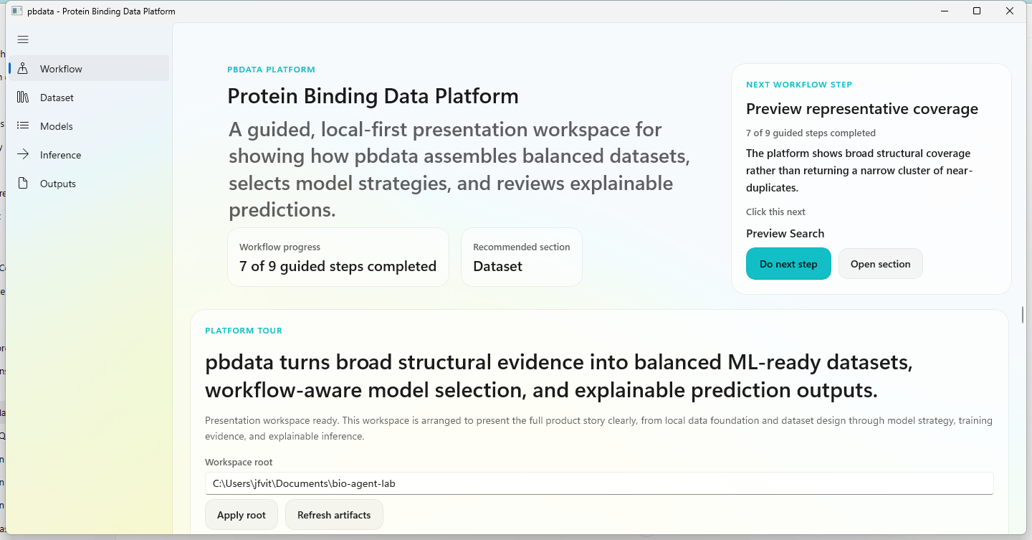
WinUI presentation shell
The desktop experience is designed to present the platform clearly: guided workflow, local-first data foundation, dataset design, model review, inference, and outputs.

Slide 8
Near-term priorities
The platform is now demonstrable. The next phase is about deepening functional truthfulness and expanding scientific coverage.
Data engine
Dataset rigor
Modeling + UX
• Complete more bulk/local ingestion paths from staged sources.
• Keep bootstrap summaries lightweight enough for GitHub distribution.
• Continue explicit freshness, retention, and deletion rules per source.
• Keep improving split diagnostics and leakage-aware grouping.
• Expand metadata breadth and source diversity in the selected set.
• Maintain decision-grade field auditing as the corpus grows.
• Strengthen graph-backed training coverage and evaluation depth.
• Keep the WinUI shell polished for presentations and truthful in functional mode.
• Turn current platform maturity into a repeatable external-ready workflow.
Collaboration angle: this is positioned as a research platform for reproducible curation, robust dataset assembly, and interpretable downstream modeling.

