Slide 1
HEALTHCARE ANALYTICS
Transforming Electronic Medical Records into
Actionable Healthcare Insights
1
1
1

Slide 2
Project Overview
PROJECT DEFINITION
BUSINESS OBJECTIVE
✓ Healthcare BI Analytics
✓ Electronic Medical Records
✓ Patient Operations
✓ Treatment & Lab Insights
✓ Data-Driven Healthcare
✓ Centralize EMR Data
✓ Real-Time Insights
✓ Monitor KPIs
✓ Support Decisions
✓ Improve Operations
DATA SCOPE & COVERAGE
📊
👨‍⚕️
🏥
💊
🧪
10,000
Patient Records
1,000
Doctors
10,000
Visits
3,325
Treatments
10,000
Lab Tests
Demographics, Age, Diagnosis
Providers, Specialties
Interactions, Follow-ups
Procedures, Costs
Results, Abnormality
TECHNOLOGY STACK
Excel • MySQL • SQL • Power BI • Tableau • Data Quality Assurance
2
2

Slide 3
Team Members
Expert team driving the Axon Healthcare Analytics project
1
2
3
MK LAKSHMI KANTH
M H Prashanth
Akumallajakeer
4
5
6
K Ravi Kumar
N Pavani
Y. Padmavathi
7
8
9
Prathamesh Mundhe
PALAVELLI ROHITH
Shayari Omprakash Chandak
3

Slide 4
Healthcare Database Schema
PATIENT
Records: 10,000
Demographics, Age, Diagnosis
DOCTOR
Records: 1,000
Provider, Specialty, Details
VISIT
Records: 10,000
Interactions, Status, Follow-up
TREATMENT
Records: 3,325
Procedures, Cost, Outcomes
LAB RESULT
Records: 10,000
Tests, Results, Abnormality
3
4
4

Slide 5
Healthcare KPI Dashboard
10,000
1,000
10,000
49.84%
Total Patients
Total Doctors
Total Visits
Follow-Up Rate
₹525
10,000
33.54%
10
Avg Treatment
Lab Tests
Abnormal %
Doctor Workload
3,266
3,325
3,354
Completed Visits
Completed Treatments
Abnormal Tests
4
5
5

Slide 6
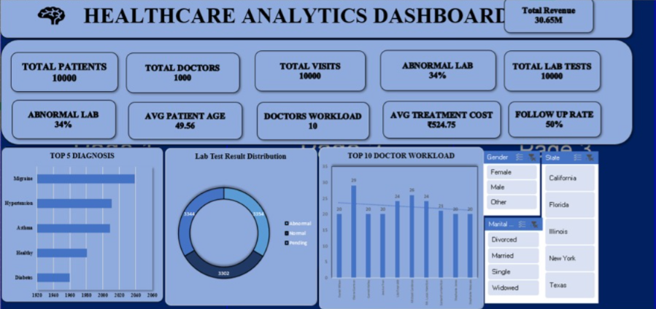
Excel Dashboard - Healthcare Analytics
📊 Interactive Excel Analytics Dashboard
5
6
6

Slide 7
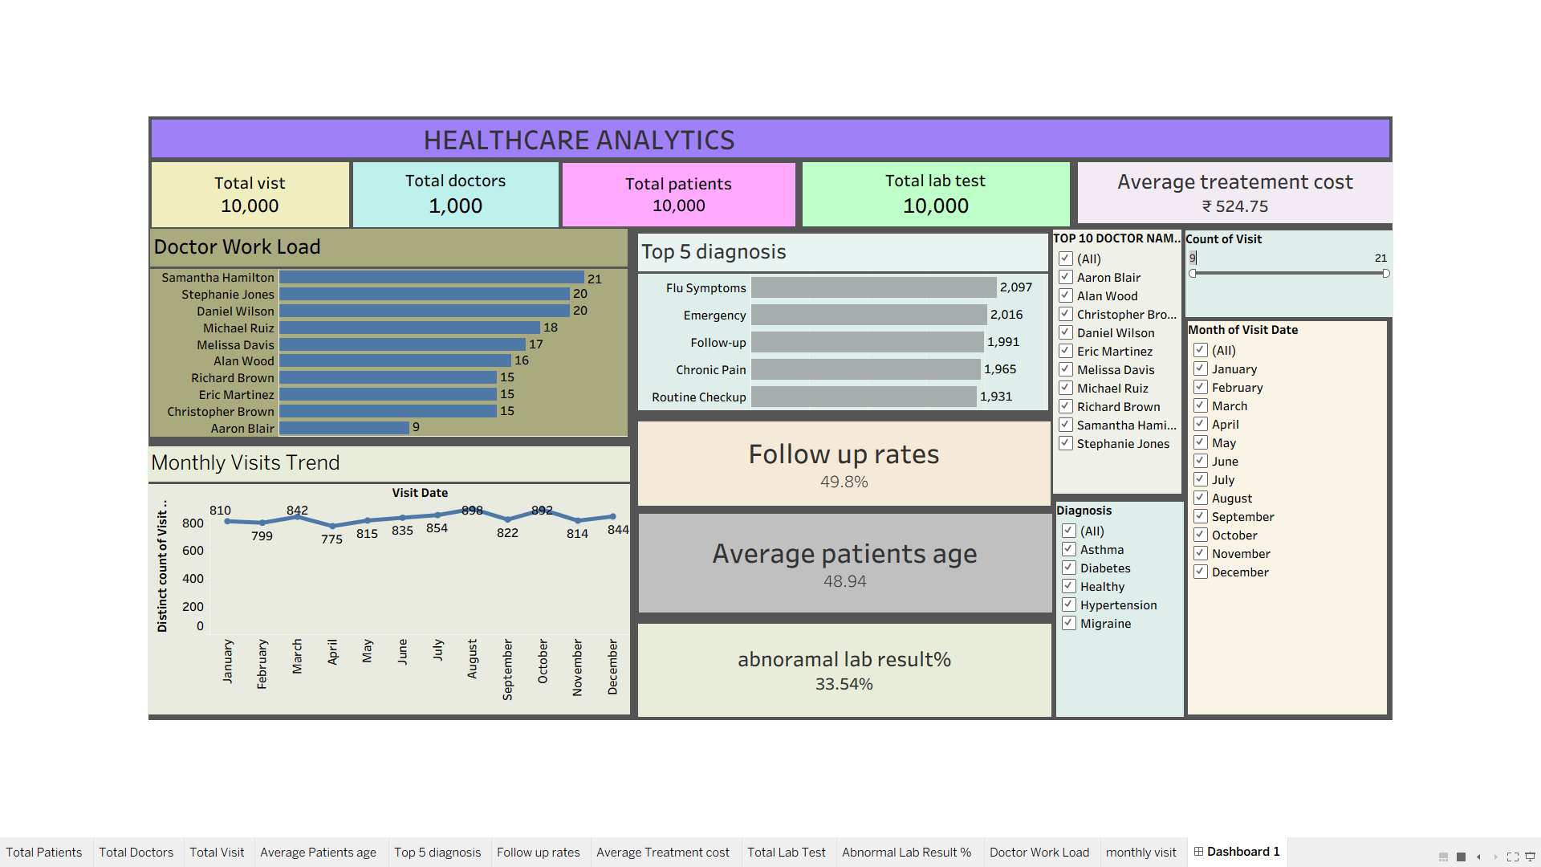
Tableau Dashboard - Healthcare Analytics
📊 Interactive Tableau Analytics Dashboard
6
7
7

Slide 8
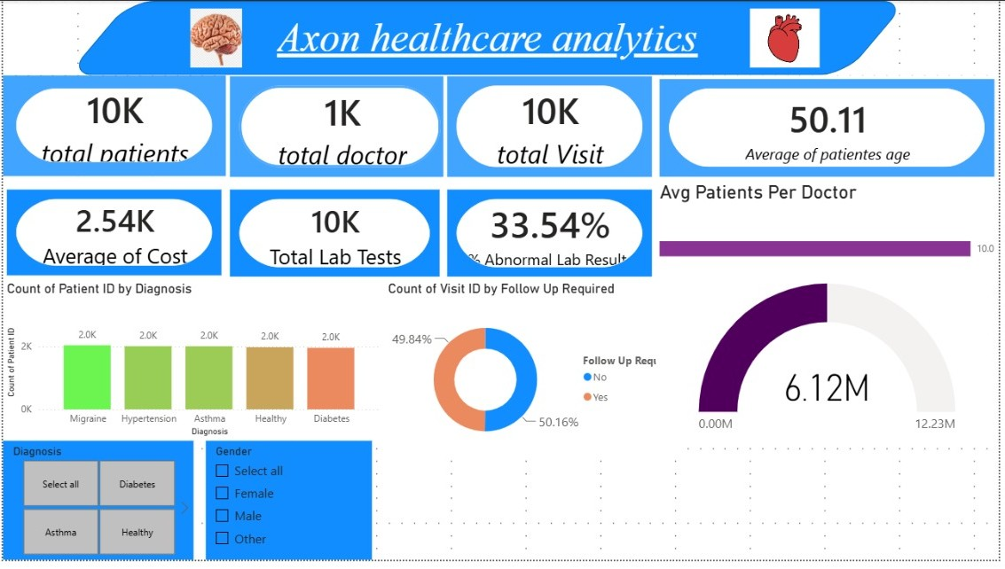
PowerBI Dashboard - Healthcare Analytics
📊 Interactive PowerBI Analytics Dashboard
6
8
8

Slide 9
SQL Implementation & Analysis
▶ Total Patients
SELECT COUNT(DISTINCT PatientID) FROM Patient;
Result: 10,000
▶ Follow-Up Rate
SELECT (COUNT(FollowUp)/COUNT(*)*100) FROM Visit;
Result: 49.84%
▶ Avg Cost
SELECT AVG(Cost) FROM Treatment;
Result: ₹525
▶ Abnormal %
SELECT (COUNT(CASE WHEN Result='Abnormal' THEN 1 END)/COUNT(*)*100) FROM LabResult;
Result: 33.54%
7
9
9

Slide 10
Key Business Insights
📊
Patient Scale
10,000 records provide robust foundation
🔄
Follow-Up Demand
49.84% rate needs efficient scheduling
💰
Cost Efficiency
₹525 avg supports cost-effective care
⚠️
Lab Quality
33.54% abnormal rate requires follow-up
👥
Resource Balance
10 visits/doctor indicates sustainability
8
10
10

Slide 11
Strategic Recommendations
1
Follow-Up Automation
Implement scheduling for 49.84% follow-up visits
2
Real-Time Dashboards
Create live doctor workload visibility
3
Cost Monitoring
Track treatment costs for budget planning
4
Lab Protocols
Develop abnormal result escalation process
5
Data Automation
Enhance database refresh for timely reporting
9
11
11

Slide 12
Project Conclusion
📈 COMPREHENSIVE BI PROJECT ACHIEVEMENT
Successfully developed end-to-end Business Intelligence solution integrating 10,000 patient records. Implemented full pipeline: Excel preparation → MySQL database → SQL analysis → Power BI/Tableau visualization. Solution enables data-driven decision-making for operational improvement and quality monitoring.
✓ VERIFIED ANALYTICS OUTCOMES
✓ Patient Base: 10,000 individuals across comprehensive demographics
✓ Visit Operations: 10,000 visits with 49.84% follow-up requirement
✓ Treatment Activity: 3,325 treatments at ₹525 average cost
✓ Laboratory Quality: 33.54% abnormal rate for disease detection
✓ Resource Efficiency: 1,000 doctors with balanced 10 visits/provider workload
✓ Technology Stack: Excel, MySQL, Power BI, Tableau delivering unified insights
10
12
12

Slide 13
Thank You
Questions & Discussion
11
13
13

